Slide 1
Lab Seminar
IIP LAB
Inpyo-Hong

Slide 2
IIP LAB
Contents
01. Introduction 02. Methods
03. Experiments
04. Conclusion & Review

Slide 3
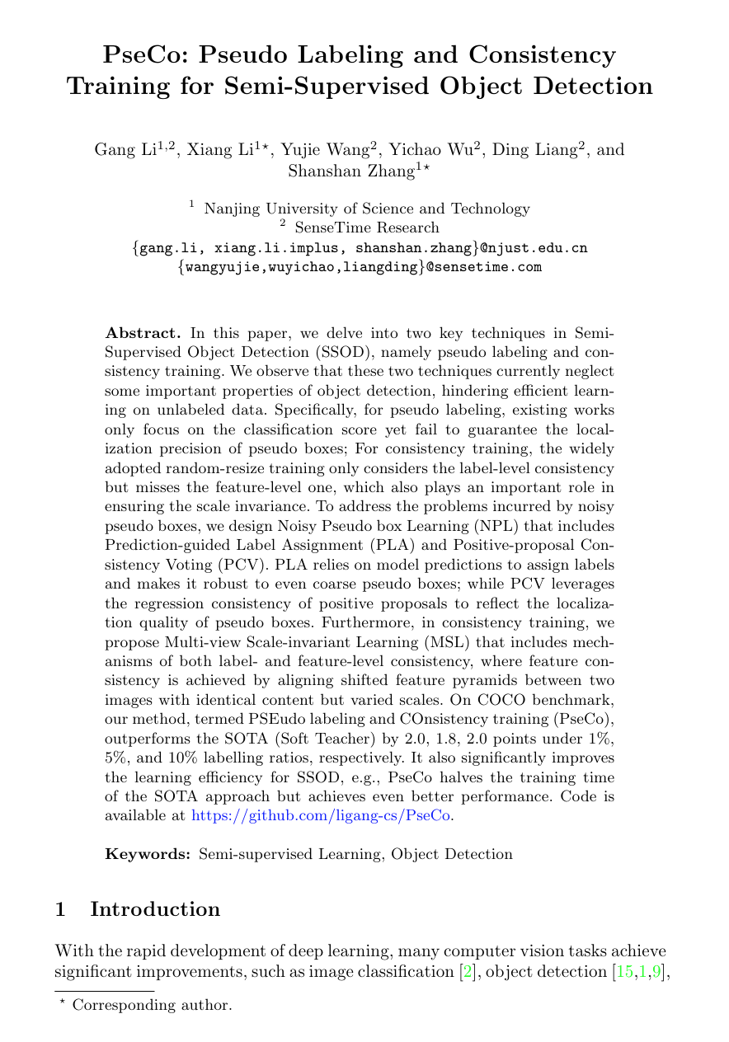
IIP LAB
Paper Information
Title : PseCo: Pseudo Labeling and Consistency Training for Semi-Supervised Object Detection
Author : Gang Li et al.
ECCV 2022
Citation: 1
Keywords: Semi-supervised learning, Object detection

Slide 4
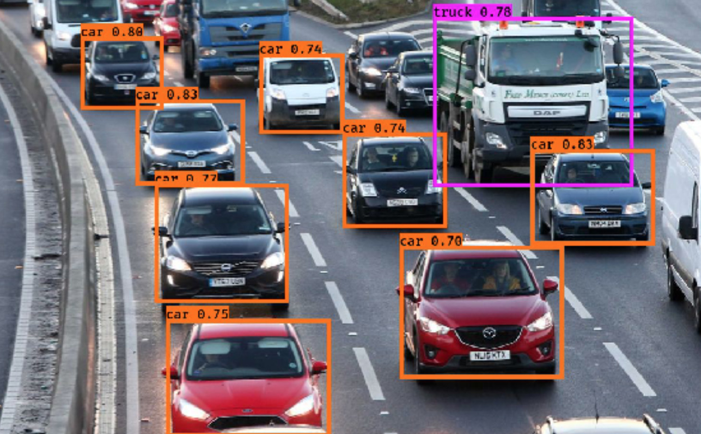
IIP LAB
Introduction
Object Detection
1-Stage Detector (ex. YOLO)
2-Stage Detector (ex. Faster R-CNN)
Bounding Box Regression
(Region Proposal)
Classification

Slide 5
IIP LAB
Introduction
Semi-Supervised learning 소량의 Labeled Data + 다량의 Unlabeled Data로 학습 - 대표적 학습방식
Pseudo Labeling
Consistency Training

Slide 6
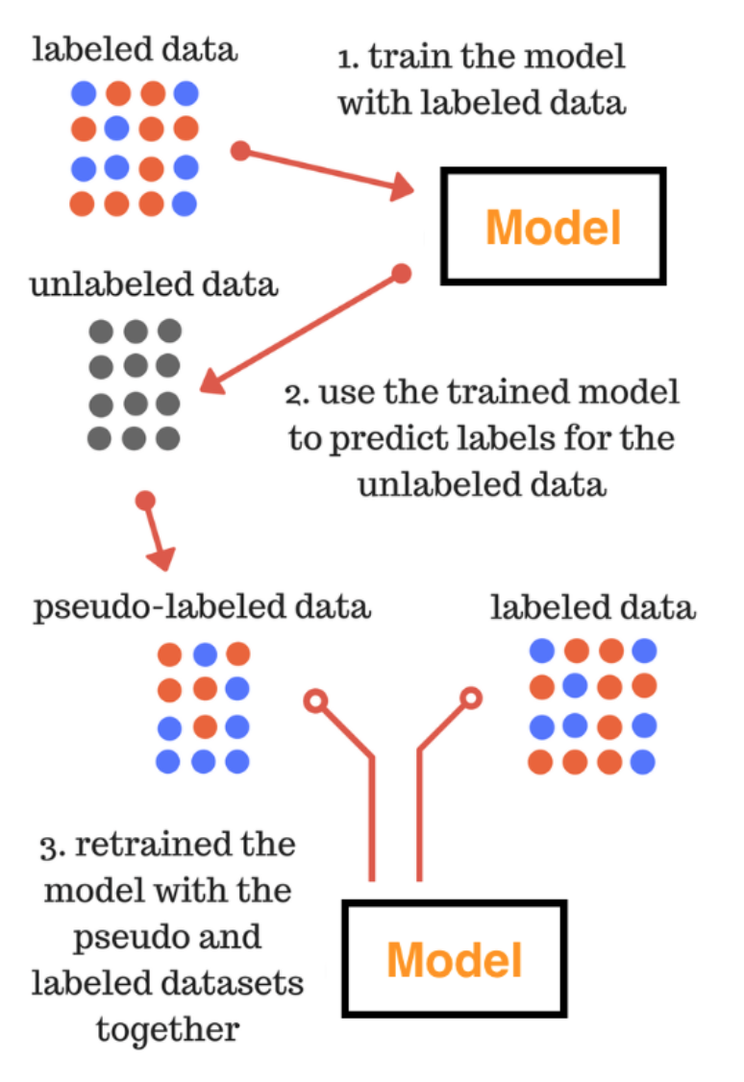
IIP LAB
Introduction
1️⃣
Pseudo Labeling
Labeled data로 모델 지도학습
학습된 모델로 Unlabeled data 예측 ➔ Predicted Label을 GT로 사용 (pseudo-label, GT label)
Pseudo-labeled data + labeled data로 모델 재학습
2️⃣
3️⃣

Slide 7
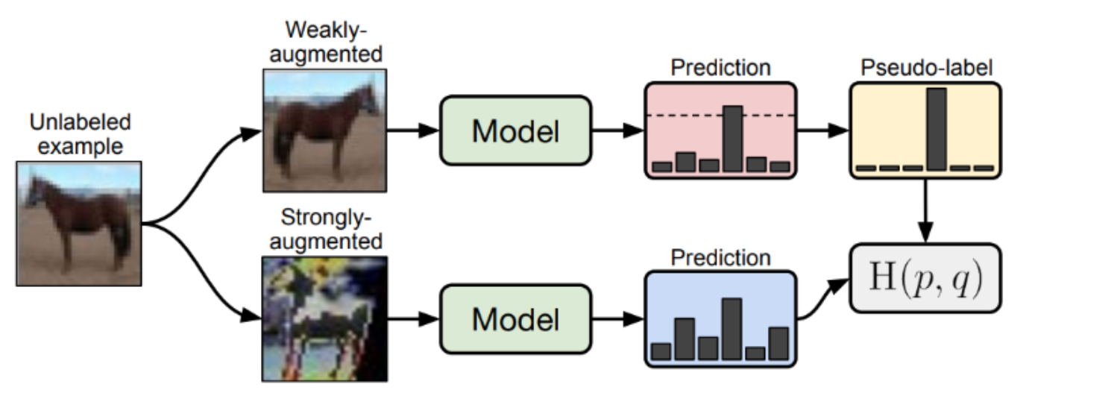
IIP LAB
Introduction
Consistency Training 노이즈X데이터+노이즈O데이터를 동시에 학습 ➔ 모델이 데이터의 작은 변화에 민감하지 않도록 학습하는 방법

Slide 8
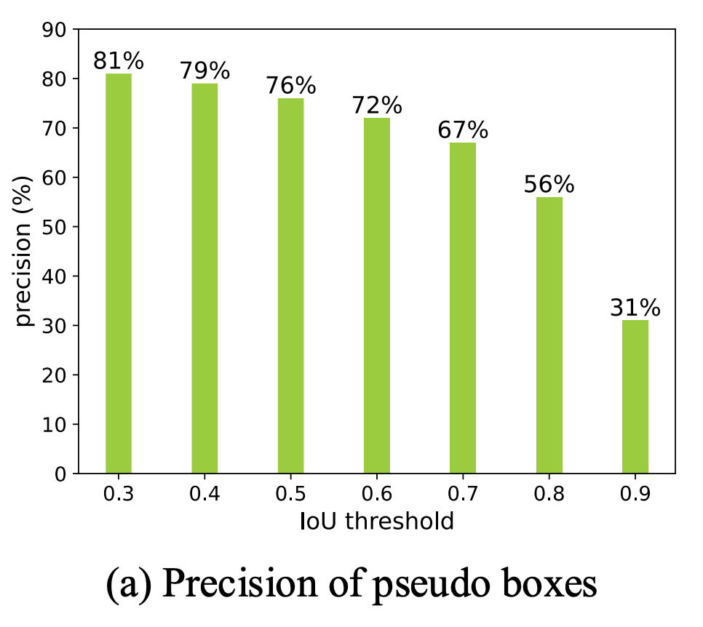
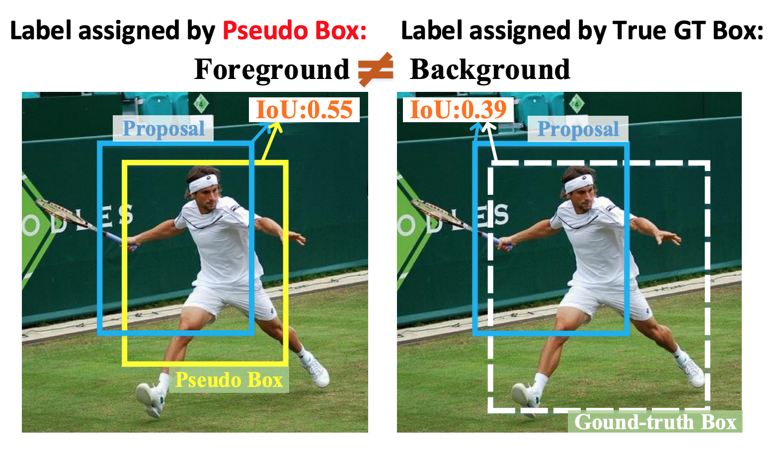
IIP LAB
Introduction
Pseudo Labeling & Consistency Learning의 한계
Pseudo Labeling

Slide 9
IIP LAB
Introduction
Pseudo Labeling & Consistency Learning의 한계
Consistency Learning 1) Bounding-Box 위치정보 반영X 2) Label단계의 정보만 반영하여 학습 ➔ Feature단계정보 반영 weak ➔ 모델의 가중치 일관성 Low

Slide 10
IIP LAB
Methods
Proposed methods 1) Prediction-guided Label Assignment (PLA) ➔ Bounding-Box Quality 개선 2) Positive-proposal Consistency Voting (PCV) ➔ Pseudo Labeling의 한계 개선 3) Multi-view Scale-invariant Learning (MSL) ➔ 모델의 Feature 일관성 개선 ➔ Bounding Box Regression 향상

Slide 11
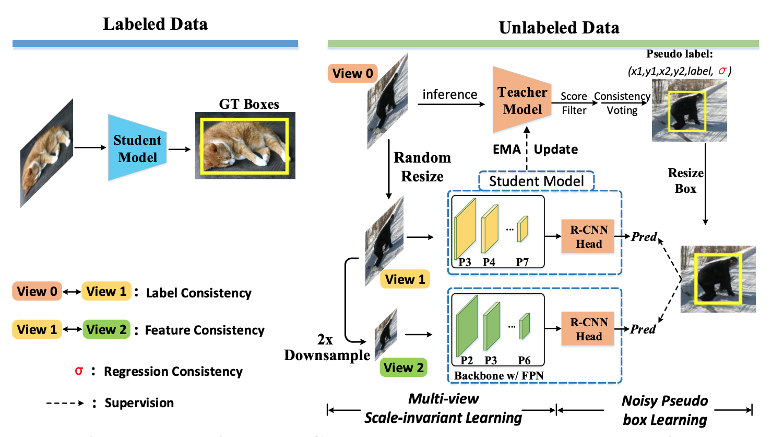
IIP LAB
Methods
Proposed Architecture

Slide 12
IIP LAB
Limit: Box Regression ↓ (Feature 반영X, Box quality 저하)
Methods
Related Work (Soft Teacher Model)
Pseudo Labeling
Detection training

Slide 13
IIP LAB
Methods
Prediction-guided Label Assignment (PLA) 목적: Bounding-Box의 Quality 향상
Student
Model
기존방식: fore-ground / back-ground 단순 판별 ➔ 다량의 back-ground ➔ Box Quality ↓
제안방식: foreground + IoU 반영한 새로운 계산방식 ➔ 높은 퀄리티의 foreground만 선정

Slide 14
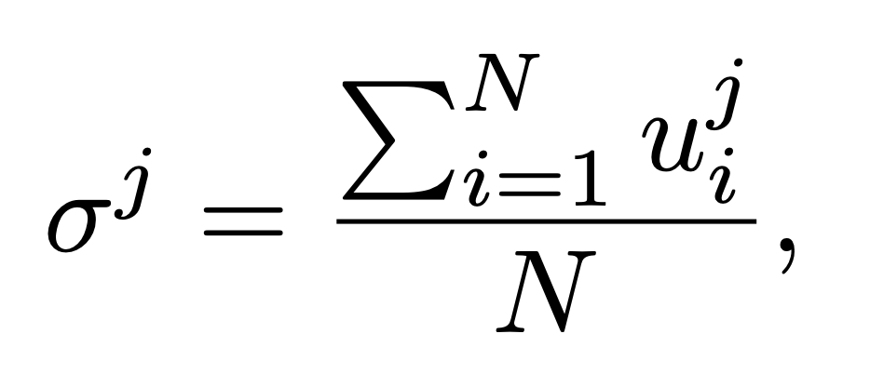
IIP LAB
Methods
Positive-proposal Consistency Voting (PCV)
N: fore-ground(Positive proposal)의 갯수 u = Pseudo label <-> Predict box 간 IoU

Slide 15
IIP LAB
Methods
Positive-proposal Consistency Voting (PCV)
Pseudo Labeling
Classification
➔ Pseudo Labeling 성능 ↑
Box Regression ↑

Slide 16
IIP LAB
Methods
Multi-view Scale-invariant Learning (MSL)
Label Level consistency 반영
Feature Level consistency 반영 (Proposed method)

Slide 17
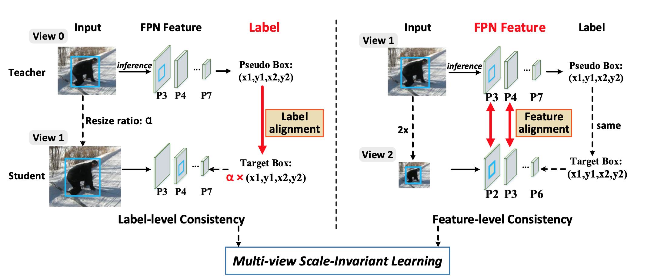
IIP LAB
Methods
Multi-view Scale-invariant Learning (MSL)

Slide 18
IIP LAB
Methods

Slide 19
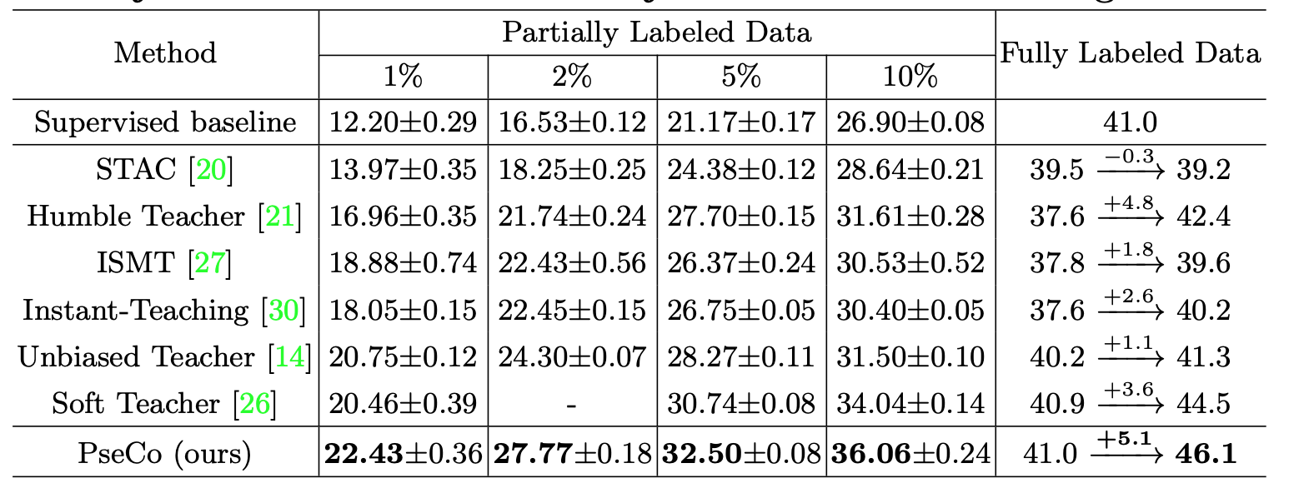
IIP LAB
Experiments

Slide 20
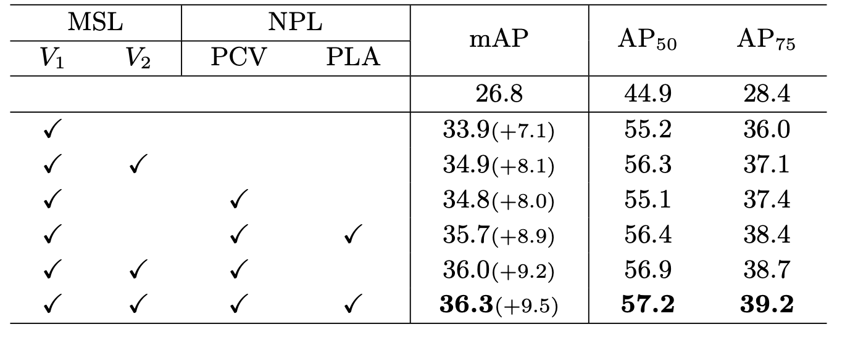
IIP LAB
Experiments

Slide 21
IIP LAB
Experiments

Slide 22
IIP LAB
Conclusion & Review
Conclusion
기존 Semi-supervised Learning의 Bounding-Box Regression 한계 개선
Semi-supervised Learning조건의 Object Detection에서 SOTA달성
Review
Labeled Data와 Unlabeled Data 간 Student Model이 어떻게 연계 되는건지 설명X
2-Stage Detector에서만 SOTA (COCO 1위 mAP: 63, 본 논문 mAP: 46.1)

