Slide 1
IIP Lab Seminar
정기 세미나 발표자료
230510

Slide 2
Disease diagnosis using respiration data

Slide 3
Disease diagnosis using respiration data
ICBHI Challenge database
Pathological data classification task
Learning by converting to one-dimensional value (tensor value)
Learning by converting to 2-dimensional images (spectrogram, Mel-spectrogram, etc.)
Disease multi-classification task
Learning by converting to one-dimensional value (tensor value)
Learning by converting to 2-dimensional images (spectrogram, Mel-spectrogram, etc.)

Slide 4
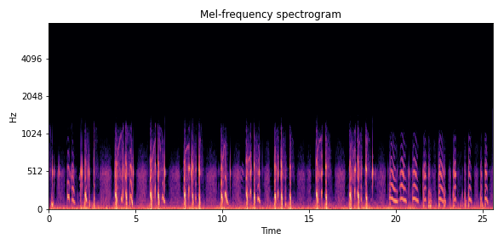
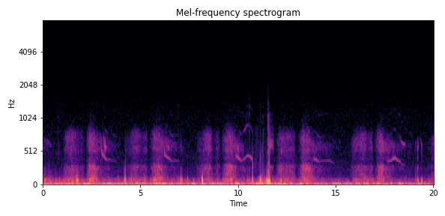
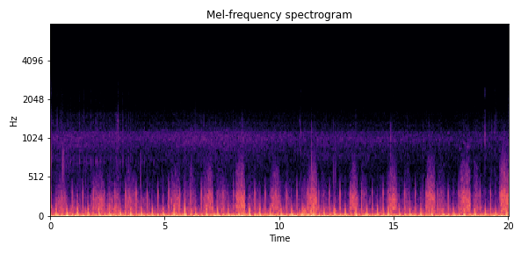
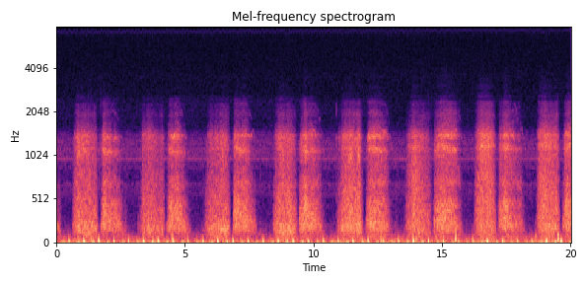
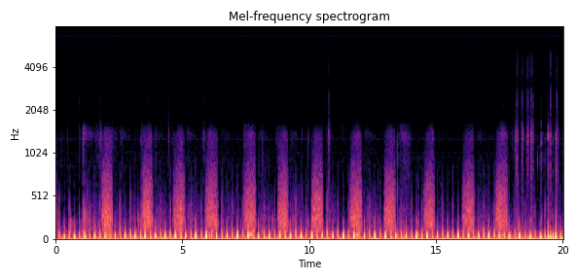
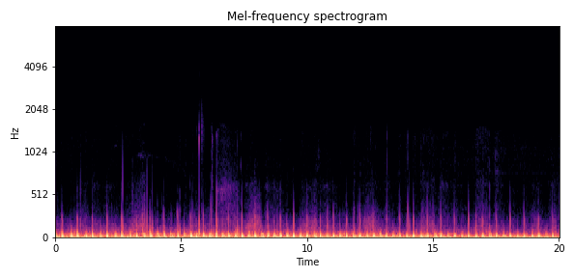
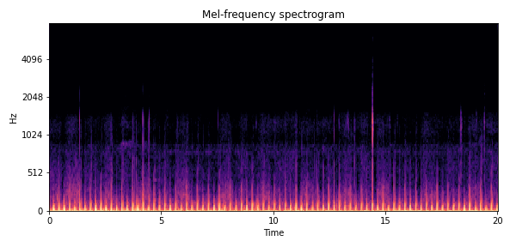
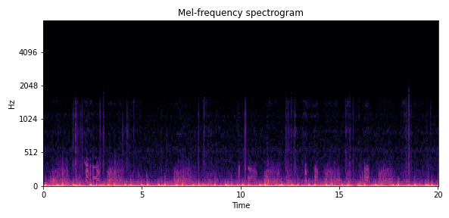
Disease diagnosis using respiration data
Healthy | 35
COPD | 793
Pneumonia | 37
Bronchiectasis | 16
Bronchiolitis | 13
Asthma | 1
LRTI, URTI | 25
total | 945
COPD(만성 폐쇄성 폐질환)
Pneumonia (폐렴)
Healthy(정상)
Bronchiectasis(기관지확장증)
Bronchiolitis (세기관지염)
LRTI(하부 호흡기 감염)
URTI(상부 호흡기 감염)
Asthma(천식)

Slide 5
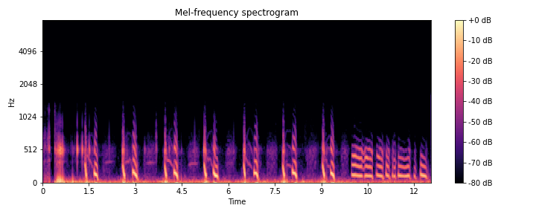
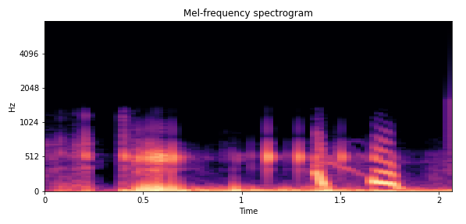
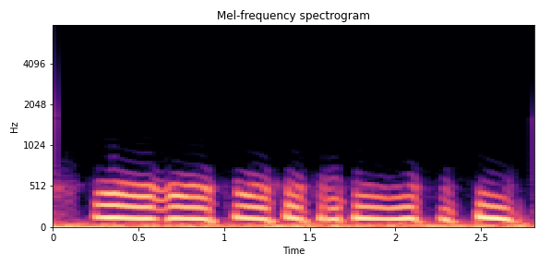
Disease diagnosis using respiration data
ICBHI Challenge database
Crackles(거품소리/ 수포음) = 1 / Wheezes(쌕쌕거림) = 1
COPD(만성 폐쇄성 폐질환)환자
124_1b1_Al_sc_Litt3200
Patient 124
Index:1b1
Chest location: Al (left anterior)
Channel type: sc (single channel)
Recording equipment: Litt3200 (stethoscope)

Slide 6
Disease diagnosis using respiration data
Two-dimensional data
Task | Model | Data | 데이터 형태 | Accuracy
병리학적 데이터 선별 (질병의 유/무) | VGG | Non-segmented | Spectrogram | 97.83%
 |  | Segmented | Spectrogram | 98.99%
 | Resnet | Non-segmented | Spectrogram | 97.28%
 |  | Segmented | Spectrogram | 98.40%
질병 다중 분류 (7 class) | VGG | Non-segmented | Spectrogram | 91.84%
 |  | Segmented | Spectrogram | 95.94%
 | Resnet | Non-segmented | Spectrogram | 90.76%
 |  | Segmented | Spectrogram | 96.52%
호흡음 분류 (3 class) | VGG | Non-segmented |  | -
 |  | Segmented | Spectrogram | -
 | Resnet | Non-segmented | Spectrogram | -
 |  | Segmented | Spectrogram | -

Slide 7
Disease diagnosis using respiration data
One-dimensional data
Task | Model | Data | 데이터 형태 | Accuracy
병리학적 데이터 선별 (질병의 유/무) | TCN | Non-segmented |  | 97.28%
 |  | Segmented | 95.65% | 95.64%
 | Wavenet | Non-segmented | Split to fit the shortest data | 95.65%
 |  | Segmented | 95.65% | 94.57%
질병 다중 분류 (7 class) | TCN | Non-segmented | Signal | -
 |  | Segmented | 95.65% | -
 | Wavenet | Non-segmented | Split to fit the shortest data | 87.03%
 |  | Segmented | 95.65% | 82.57%
호흡음 분류 (3 class) | TCN | Non-segmented |  | -
 |  | Segmented | 95.65% | -
 | Wavenet | Non-segmented | Split to fit the shortest data | -
 |  | Segmented | 95.65% | -

Slide 8
Disease diagnosis using respiration data
Experiment result
2D spectrogram performs better compared to 1D data
Performance improved over previous studies
Additional comparison data types are being selected.

