Slide 1
IIP Lab Seminar
Multi-classification of Respiratory Diseases through Dimension Combinations
230524

Slide 2
ECG user identification

Slide 3
ECG-related research
Reviewer: 1, Recommendation: Accept (minor edits)
Reviewer: 2, Recommendation: Reject (updates required before resubmission)
Related research 2-1 (arrhythmia classification task) Not related to the content of this paper
Need to compare recent papers using short segments
Further experiments are required with the proposed data
(e.g. Heartprint: https://doi.org/10.3390/data7100141) ⇒ Data published in Saudi Arabia in October 2022
No justification for using overlapping signals (using overlap data)
Needs comparison with state-of-the-art methods using multisession data
Notes:
TCN 모델 속도 1s
Wavenet 10ms
Bilstm 10ms
VGG 4s
Resnet 20s
Transformer 18s
TCN 모델 속도 1s
Wavenet 1s
Bilstm 1s
1. Aykanat, M, Kılıç, Ö, Kurt, B, Saryal, S. Classification of lung sounds using convolutional neural networks. J Image Video Process 2017;65.
3. Shi, L, Du, K, Zhang, C, Ma, H, Yan, W. Lung sound recognition algorithm based on VGGish-BiGRU. IEEE Access 2019;7:139438–49.
9. Yuming, Zhu, and Xu Wenlong. "Research on Classification of Respiratory Diseases Based on Multi-features Fusion Cascade Neural Network." 2021 11th International Conference on Information Technology in Medicine and Education

Slide 4
Disease diagnosis using respiration data

Slide 5
Introduction
Research on classification of respiratory data for multiple classification of lung diseases is actively underway.
In previous studies, methods such as spectrogram and gammatongram, which are 2D image conversion methods, are used.
However, the performance for respiratory disease multi-class classification is still poor.
Conduct multi-classification study of respiratory diseases through combination of 1-dimensional and 2-dimensional features
Advantage of fast learning speed of 1D model + Advantage of high accuracy verification of 2D model
Improved model learning speed and accuracy compared to using only the existing 2D converted image

Slide 6
Method
Disease diagnosis using respiration data (ICBHI 2017 Challenge Dataset)
Pathological data classification task (Normal/Abnormal)
Learning by converting to one-dimensional value
Learning by converting to 2-dimensional images (spectrogram)
Learning using a combination of 1D and 2D features
Disease multi-classification task
Learning by converting to one-dimensional value
Learning by converting to 2-dimensional images (spectrogram)
Learning using a combination of 1D and 2D features

Slide 7
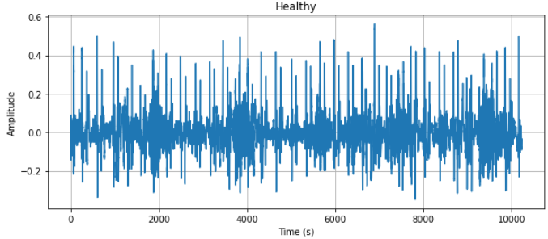
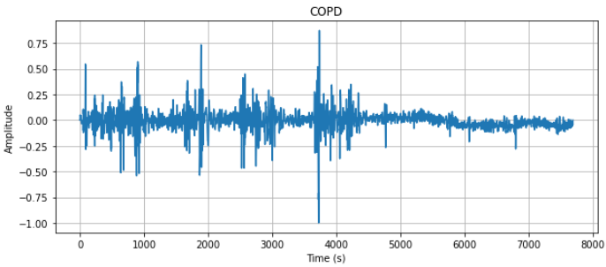
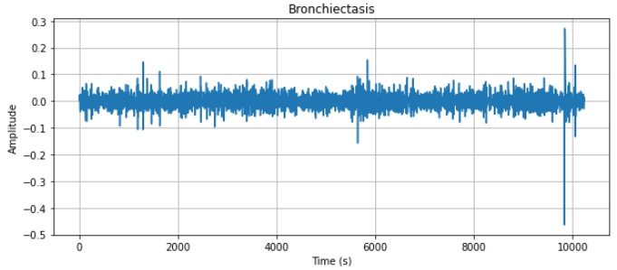
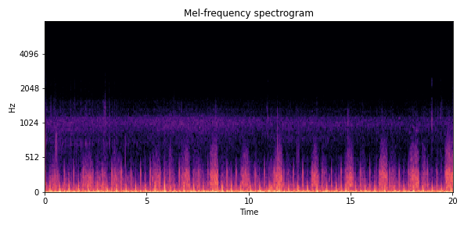
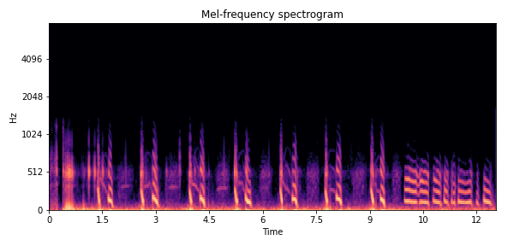
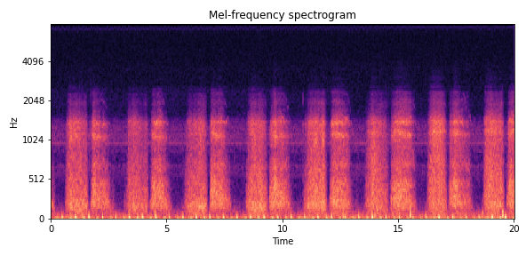
Method
Learning by converting to one-dimensional value
Learning by converting to 2-dimensional images (spectrogram)

Slide 8
Method
Learning using a combination of 1D and 2D features
$$x_{1}$$
$$x_{1}$$
1D array of the signal
$$x_{2}$$
$$x_{2}$$
$$x_{1}$$
$$x_{2}$$
…
$$x_{n−1}$$
$$x_{n}$$
$$x_{2}$$
$$x_{2}$$
…
…
$$x_{n−1}$$
$$x_{n−1}$$
$$x_{n}$$
$$x_{n}$$
$$y_{1}$$
…
Train on time series models
$$y_{1}$$
$$y_{2}$$
$$y_{1}$$
$$y_{2}$$
…
$$y_{n−1}$$
$$y_{n}$$
$$y_{2}$$
$$y_{3}$$
$$y_{3}$$
…
…
$$y_{n−1}$$
$$y_{n−1}$$
$$y_{n}$$
$$y_{n}$$
1D array of pixels

Slide 9
Method
Time series models
TCN(Temporal Convolutional Network)
It is a cnn-based model proposed in 2018 and used for processing time-series data such as natural language and music.
Characteristics of parallel processing and flexible receptive field size
It shows longer effective memory and higher performance than rnn-based LSTM/GRU.
WaveNet
The model proposed in 2016 is used to process voice data.
A model used to generate voice by extracting the shape of the voice waveform and the basic structure of the voice
BiLSTM(Bidirectional LSTM)
A model that was used in previous studies and had high accuracy in multiple disease classification
Bidirectional LSTM model as an RNN-based model

Slide 10
Experiment Result
Normal/abnormal classification (2 class)
Reference | Year | Task | Number of class | Model | Data | Data type | Accuracy
Aykanat et al. [1] | 2017 | Normal/abnormal classification | 2 | CNN, SVM | Self-collected lung sound data | Spectrogram | 86.00%
Gupta et al. [8] | 2021 | Normal/abnormal classification | 2 | AlexNet, GoogLeNet, ResNet-50, Inceptionv3 | Self-collected lung sound data | Gammatongram | 86.00%
Neili et al. [11] | 2022 | Normal/abnormal classification | 3 (Normal, chronic, non-chronic) | ResNet-50, VGG-16 | ICBHI | Gammatongram | 67.97%
Ours | 2023 | Normal/abnormal classification | 2 | TCN | ICBHI | Signal | 97.28%
 |  |  |  | Wavenet |  |  | 95.65%
 |  |  |  | Bi-LSTM |  |  | 86.41%
 |  |  |  | VGG |  | Spectrogram | 97.83%
 |  |  |  | Resnet |  |  | 97.20%
 |  |  |  | Transformer |  |  | 97.82%
 |  |  |  | TCN |  | Signal$+$Spectrogram (1D) | 98.36%
 |  |  |  | Wavenet |  |  | 96.20%
 |  |  |  | Bi-LSTM |  |  | 97.27%
 |  |  |  | TCN |  | Signal$×$Spectrogram (1D) | 97.28%
 |  |  |  | Wavenet |  |  | 96.74%
 |  |  |  | Bi-LSTM |  |  | 96.20%
Notes:
Α Respiratory Sound Database for the Development of Automated Classification
데이터셋
1. Aykanat, M, Kılıç, Ö, Kurt, B, Saryal, S. Classification of lung sounds using convolutional neural networks. J Image Video Process 2017;65.
8. Gupta, S, Agrawal, M, Deepak, D. Gammatonegram based triple classification of lung sounds using deep convolutional neural network with transfer learning. Biom Signal Proc and Con 2021;70:102947.
11. Neili, Zakaria, and Kenneth Sundaraj. "Gammatonegram based Pulmonary Pathologies Classification using Convolutional Neural Networks." 2022 19th International Multi-Conference on Systems, Signals & Devices (SSD). IEEE, 2022.

Slide 11
Experiment Result
Disease classification (7 class)
Reference | Year | Task | Number of class | Model | Data | Data type | Accuracy
Aykanat et al. [1] | 2017 | disease classification | 6 (URTI, Healthy, COPD, Bronchiectasis, Pneumoina, Bronchiolitis) | SVM and CNN | Self-collected lung sound data | Spectrogram | 62.00%
Shi et al. [3] | 2019 | disease classification | 3 (normal, pneumonia, asthma) | VGGish- BiGRU | Self-collected lung sound data | Mel-spectrogram | 87.41%
Yuming et al. [9] | 2021 | disease classification | 6 (URTI, Healthy, COPD, Bronchiectasis, Pneumoina, Bronchiolitis) | LSTM, GRU, BiLSTM | ICBHI | MFCCs | 88.30%
Ours | 2023 | disease classification | 7 (Healthy, COPD, Pneumonia, Bronchiectasis, Bronchiolitis, Asthma, URTI+LRIT) | TCN | ICBHI | Signal | 88.04%
 |  |  |  | Wavenet |  |  | 87.03%
 |  |  |  | Bi-LSTM |  |  | 75.00%
 |  |  |  | VGG |  | Spectrogram | 92.93%
 |  |  |  | Resnet |  |  | 90.76%
 |  |  |  | Transformer |  |  | 89.13%
 |  |  |  | TCN |  | Signal$+$Spectrogram (1D) | 92.934%
 |  |  |  | Wavenet |  |  | 90.22%
 |  |  |  | Bi-LSTM |  |  | 87.50%
 |  |  |  | TCN |  | Signal$×$Spectrogram (1D) | -
 |  |  |  | Wavenet |  |  | -
 |  |  |  | Bi-LSTM |  |  | -
Notes:
TCN 모델 속도 1s
Wavenet 10ms
Bilstm 10ms
VGG 4s
Resnet 20s
Transformer 18s
TCN 모델 속도 1s
Wavenet 1s
Bilstm 1s
1. Aykanat, M, Kılıç, Ö, Kurt, B, Saryal, S. Classification of lung sounds using convolutional neural networks. J Image Video Process 2017;65.
3. Shi, L, Du, K, Zhang, C, Ma, H, Yan, W. Lung sound recognition algorithm based on VGGish-BiGRU. IEEE Access 2019;7:139438–49.
9. Yuming, Zhu, and Xu Wenlong. "Research on Classification of Respiratory Diseases Based on Multi-features Fusion Cascade Neural Network." 2021 11th International Conference on Information Technology in Medicine and Education

Slide 12
Experiment Result
Comparison of experiment results
Normal/abnormal classification
Accuracy
Model training rate (per epoch)
TCN | ICBHI | Signal | 97.28%
Wavenet |  |  | 95.65%
Bi-LSTM |  |  | 86.41%
VGG | ICBHI | Spectrogram | 97.83%
Resnet |  |  | 97.20%
Transformer |  |  | 97.82%
TCN | ICBHI | Signal $$+$$ Spectrogram | 98.36%
Wavenet |  |  | 96.20%
Bi-LSTM |  |  | 97.27%
1D Model+1D Data
2D Model+2D Data
1D Model+(1D Data+2D Data)
TCN | ICBHI | Signal | 1s
Wavenet |  |  | 10ms
Bi-LSTM |  |  | 10ms
VGG | ICBHI | Spectrogram | 4s
Resnet |  |  | 20s
Transformer |  |  | 18s
TCN | ICBHI | Signal $$+$$ Spectrogram | 1s
Wavenet |  |  | 10ms
Bi-LSTM |  |  | 10ms
1D Model+1D Data
2D Model+2D Data
1D Model+(1D Data+2D Data)
Notes:
TCN 모델 속도 1s
Wavenet 10ms
Bilstm 10ms
VGG 4s
Resnet 20s
Transformer 18s
TCN 모델 속도 1s
Wavenet 1s
Bilstm 1s
1. Aykanat, M, Kılıç, Ö, Kurt, B, Saryal, S. Classification of lung sounds using convolutional neural networks. J Image Video Process 2017;65.
3. Shi, L, Du, K, Zhang, C, Ma, H, Yan, W. Lung sound recognition algorithm based on VGGish-BiGRU. IEEE Access 2019;7:139438–49.
9. Yuming, Zhu, and Xu Wenlong. "Research on Classification of Respiratory Diseases Based on Multi-features Fusion Cascade Neural Network." 2021 11th International Conference on Information Technology in Medicine and Education

Slide 13
Experiment Result
Comparison of experiment results
Disease classification
Accuracy
Model training rate (per epoch)
TCN | ICBHI | Signal | 88.04%
Wavenet |  |  | 87.03%
Bi-LSTM |  |  | 75.00%
VGG | ICBHI | Spectrogram | 92.93%
Resnet |  |  | 90.76%
Transformer |  |  | 89.13%
TCN | ICBHI | Signal $$+$$ Spectrogram | 92.934%
Wavenet |  |  | 90.22%
Bi-LSTM |  |  | 87.50%
1D Model+1D Data
2D Model+2D Data
1D Model+(1D Data+2D Data)
TCN | ICBHI | Signal | 1s
Wavenet |  |  | 10ms
Bi-LSTM |  |  | 10ms
VGG | ICBHI | Spectrogram | 4s
Resnet |  |  | 20s
Transformer |  |  | 18s
TCN | ICBHI | Signal $$+$$ Spectrogram | 1s
Wavenet |  |  | 10ms
Bi-LSTM |  |  | 10ms
1D Model+1D Data
2D Model+2D Data
1D Model+(1D Data+2D Data)
Notes:
TCN 모델 속도 1s
Wavenet 10ms
Bilstm 10ms
VGG 4s
Resnet 20s
Transformer 18s
TCN 모델 속도 1s
Wavenet 1s
Bilstm 1s
1. Aykanat, M, Kılıç, Ö, Kurt, B, Saryal, S. Classification of lung sounds using convolutional neural networks. J Image Video Process 2017;65.
3. Shi, L, Du, K, Zhang, C, Ma, H, Yan, W. Lung sound recognition algorithm based on VGGish-BiGRU. IEEE Access 2019;7:139438–49.
9. Yuming, Zhu, and Xu Wenlong. "Research on Classification of Respiratory Diseases Based on Multi-features Fusion Cascade Neural Network." 2021 11th International Conference on Information Technology in Medicine and Education

Slide 14
Conclusion
Improvement of respiratory disease multi-classification accuracy by considering both 1D data features and 2D data features
Speeding up learning using 1D models
Accuracy improvement using 2D data features
12.36% accuracy improvement over previous studies in pathological data classification
4.63% accuracy improvement over existing studies in multi-disease data classification
Notes:
TCN 모델 속도 1s
Wavenet 10ms
Bilstm 10ms
VGG 4s
Resnet 20s
Transformer 18s
TCN 모델 속도 1s
Wavenet 1s
Bilstm 1s
1. Aykanat, M, Kılıç, Ö, Kurt, B, Saryal, S. Classification of lung sounds using convolutional neural networks. J Image Video Process 2017;65.
3. Shi, L, Du, K, Zhang, C, Ma, H, Yan, W. Lung sound recognition algorithm based on VGGish-BiGRU. IEEE Access 2019;7:139438–49.
9. Yuming, Zhu, and Xu Wenlong. "Research on Classification of Respiratory Diseases Based on Multi-features Fusion Cascade Neural Network." 2021 11th International Conference on Information Technology in Medicine and Education

