Slide 1
IIP Lab Seminar
Multi-classification of Respiratory Diseases through Dimension Combinations
230607

Slide 2
Disease diagnosis using respiration data

Slide 3
Method
Disease diagnosis using respiration data (ICBHI 2017 Challenge Dataset)
Pathological data classification task (Normal/Abnormal)
Learning by converting to one-dimensional value
Learning by converting to 2-dimensional images (spectrogram, gammatongram, MFCC)
Learning using a combination of 1D and 2D features
Disease multi-classification task
Learning by converting to one-dimensional value
Learning by converting to 2-dimensional images (spectrogram, gammatongram, MFCC)
Learning using a combination of 1D and 2D features

Slide 4
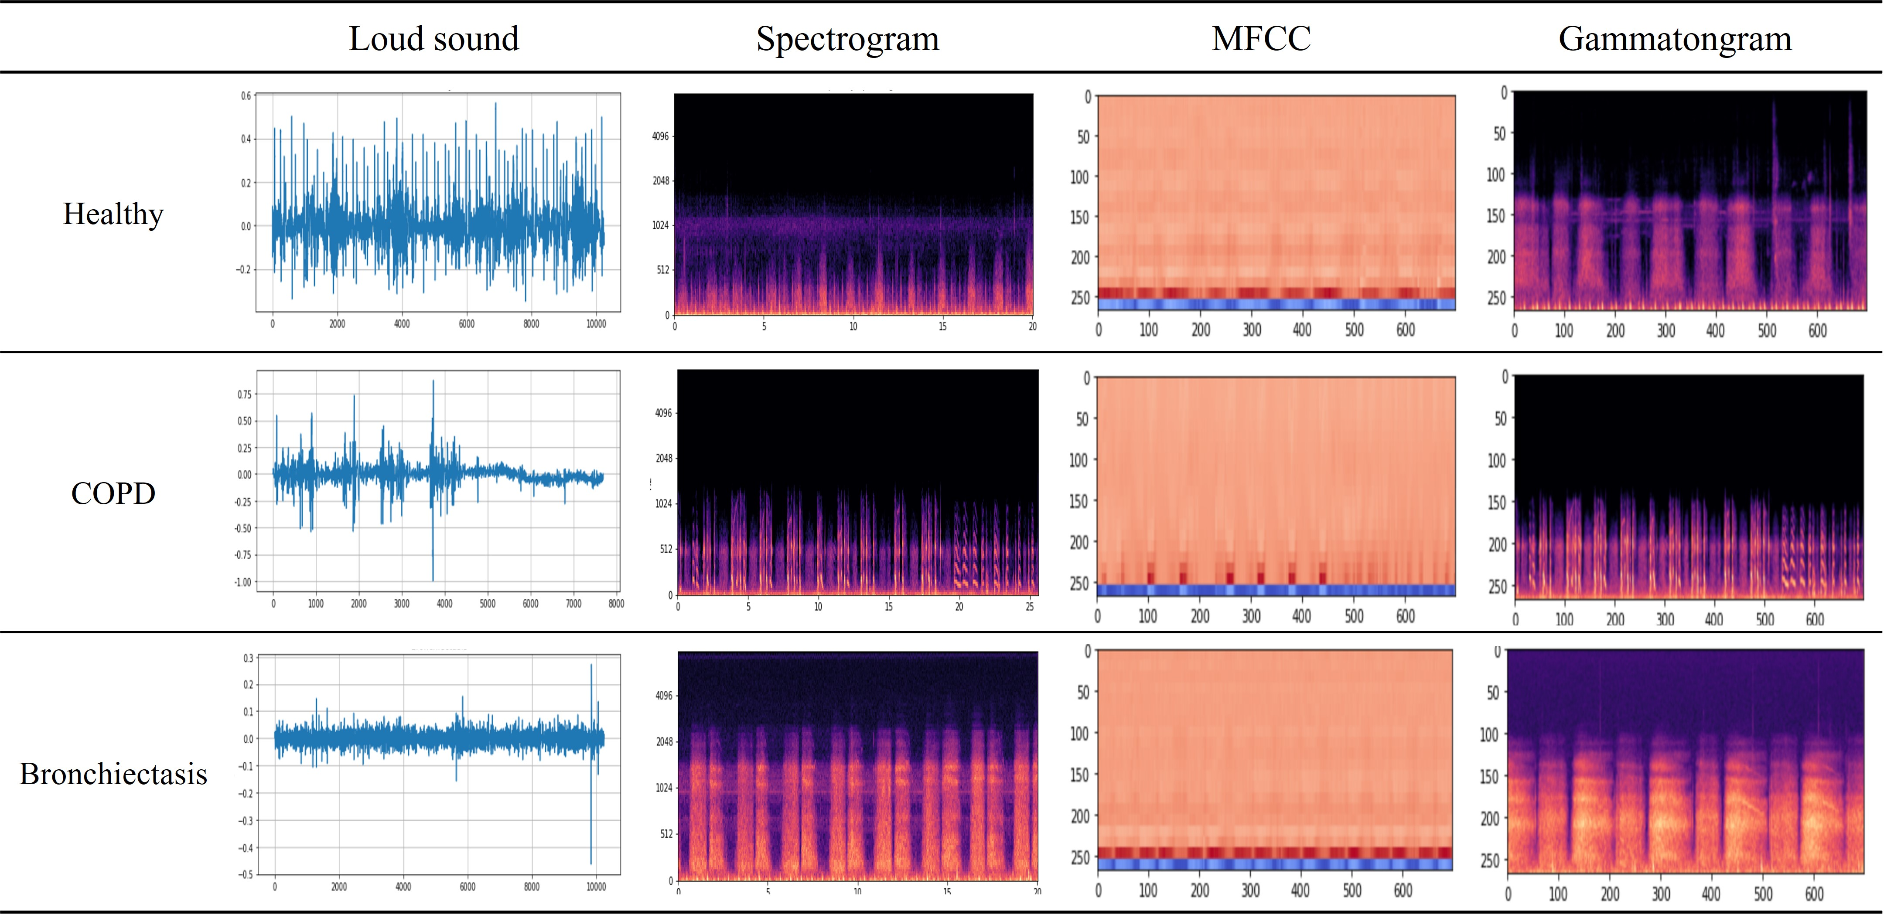
Method
Learning by single data

Slide 5
Method
Learning using a combination of 1D and 2D features

Slide 6
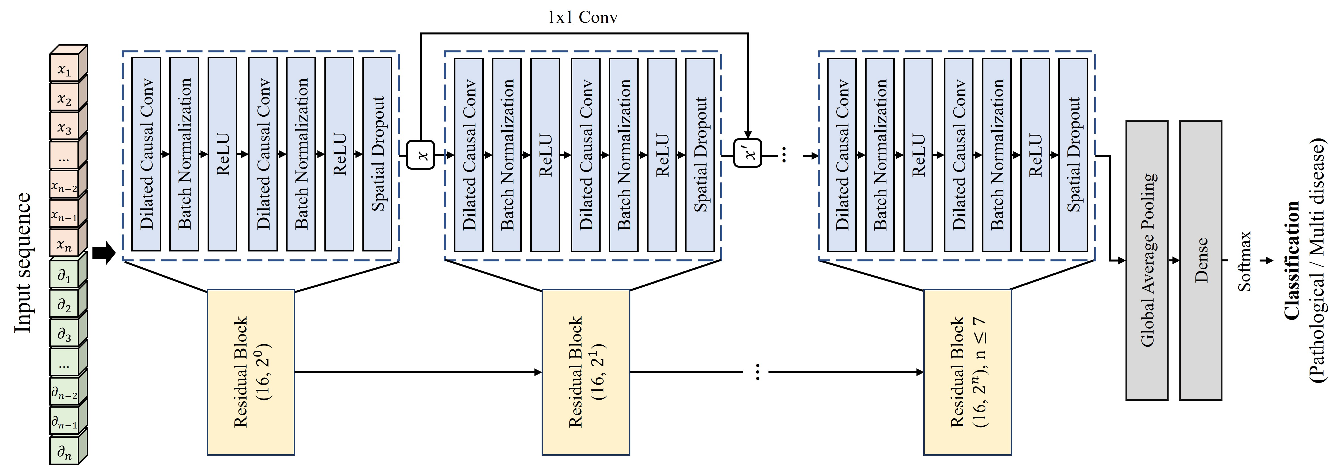
Method
Time series models
TCN(Temporal Convolutional Network)
It is a cnn-based model proposed in 2018 and used for processing time-series data such as natural language and music.
Characteristics of parallel processing and flexible receptive field size
It shows longer effective memory and higher performance than rnn-based LSTM/GRU.

Slide 7
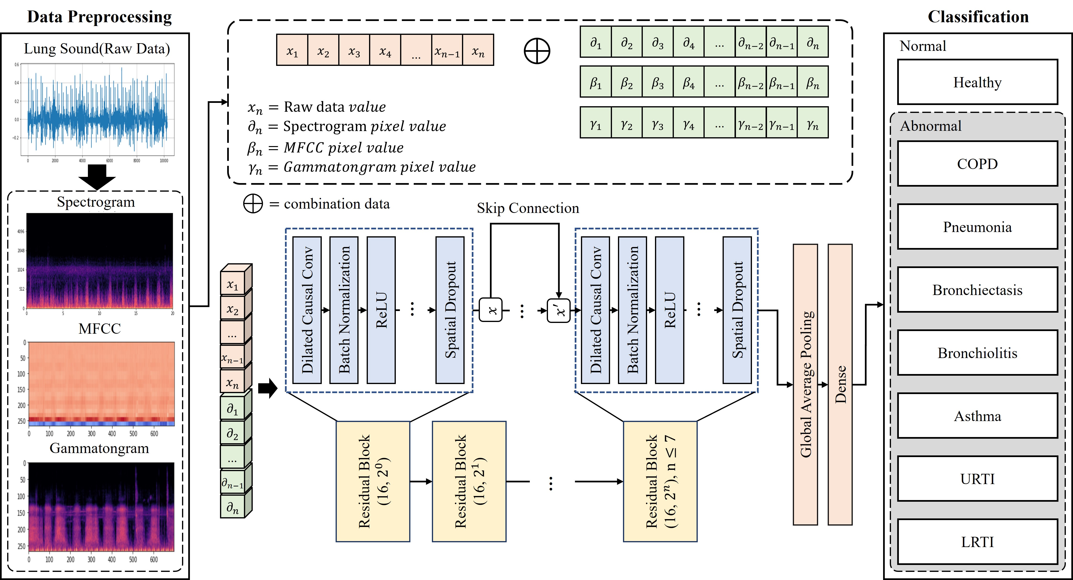
Method
Process

Slide 8
Experiment Result
Comparison of experiment results
Disease classification
Accuracy
Training time(100 epoch)
TCN | ICBHI | Signal $$+$$ MFCC | 88.58%
Wavenet |  |  | 88.04%
Bi-LSTM |  |  | 88.50%
1D Model+(1D Data+MFCC)
TCN | ICBHI | Signal | 88.04%
Wavenet |  |  | 87.03%
Bi-LSTM |  |  | 75.00%
VGG | ICBHI | Spectrogram | 92.93%
Resnet |  |  | 90.76%
Transformer |  |  | 89.13%
TCN | ICBHI | Signal $$+$$ Spectrogram | 92.934%
Wavenet |  |  | 90.22%
Bi-LSTM |  |  | 87.50%
1D Model+1D Data(Vector)
2D Model+2D Data(Spectrogram)
1D Model+(1D Data+Spectrogram)
VGG | ICBHI | Gammatongram | 91.30%
Resnet |  |  | 89.13%
Transformer |  |  | 87.50%
VGG | ICBHI | MFCC | 91.85%
Resnet |  |  | 90.21%
Transformer |  |  | 87.52%
TCN | ICBHI | Signal $$+$$ Gammatongram | 91.30%
Wavenet |  |  | 90.76%
Bi-LSTM |  |  | 87.50%
2D Model+2D Data(Gammatongram)
2D Model+2D Data(MFCC)
1D Model+(1D Data+Gammatongram)
Model | VGG | Resnet | Transformer | TCN | Wavenet | BiLSTM
Training Speed | 350.31s | 260.03s | 280.17s | 89.35s | 199.64s | 99.07s
Notes:
TCN 모델 속도 1s
Wavenet 10ms
Bilstm 10ms
VGG 4s
Resnet 20s
Transformer 18s
TCN 모델 속도 1s
Wavenet 1s
Bilstm 1s
1. Aykanat, M, Kılıç, Ö, Kurt, B, Saryal, S. Classification of lung sounds using convolutional neural networks. J Image Video Process 2017;65.
3. Shi, L, Du, K, Zhang, C, Ma, H, Yan, W. Lung sound recognition algorithm based on VGGish-BiGRU. IEEE Access 2019;7:139438–49.
9. Yuming, Zhu, and Xu Wenlong. "Research on Classification of Respiratory Diseases Based on Multi-features Fusion Cascade Neural Network." 2021 11th International Conference on Information Technology in Medicine and Education

Slide 9
Experiment Result
Comparison of experiment results
Task | Data | Model | Data Type | Auccuracy
Disease classification | ICBHI | TCN | Signal | 88.04%
 |  | Wavenet |  | 87.03%
 |  | Bi-LSTM |  | 75.00%
 |  | VGG | Spectrogram | 92.93%
 |  | Resnet |  | 90.76%
 |  | Transformer |  | 89.13%
 |  | VGG | Gammatongram | 91.30%
 |  | Resnet |  | 89.13%
 |  | Transformer |  | 87.50%
 |  | VGG | MFCC | 91.85%
 |  | Resnet |  | 90.21%
 |  | Transformer |  | 87.52%
 |  | TCN | Signal+Spectrogram | 92.934%
 |  | Wavenet |  | 90.22%
 |  | Bi-LSTM |  | 87.50%
 |  | TCN | Signal+Gammatongram | 91.30%
 |  | Wavenet |  | 90.76%
 |  | Bi-LSTM |  | 87.50%
 |  | TCN | Signal+MFCC | 88.58%
 |  | Wavenet |  | 88.04%
 |  | Bi-LSTM |  | 88.50%
Notes:
TCN 모델 속도 1s
Wavenet 10ms
Bilstm 10ms
VGG 4s
Resnet 20s
Transformer 18s
TCN 모델 속도 1s
Wavenet 1s
Bilstm 1s
1. Aykanat, M, Kılıç, Ö, Kurt, B, Saryal, S. Classification of lung sounds using convolutional neural networks. J Image Video Process 2017;65.
3. Shi, L, Du, K, Zhang, C, Ma, H, Yan, W. Lung sound recognition algorithm based on VGGish-BiGRU. IEEE Access 2019;7:139438–49.
9. Yuming, Zhu, and Xu Wenlong. "Research on Classification of Respiratory Diseases Based on Multi-features Fusion Cascade Neural Network." 2021 11th International Conference on Information Technology in Medicine and Education

Slide 10
Experiment Result
Comparison of experiment results
Accuracy (1D Model)
Notes:
TCN 모델 속도 1s
Wavenet 10ms
Bilstm 10ms
VGG 4s
Resnet 20s
Transformer 18s
TCN 모델 속도 1s
Wavenet 1s
Bilstm 1s
1. Aykanat, M, Kılıç, Ö, Kurt, B, Saryal, S. Classification of lung sounds using convolutional neural networks. J Image Video Process 2017;65.
3. Shi, L, Du, K, Zhang, C, Ma, H, Yan, W. Lung sound recognition algorithm based on VGGish-BiGRU. IEEE Access 2019;7:139438–49.
9. Yuming, Zhu, and Xu Wenlong. "Research on Classification of Respiratory Diseases Based on Multi-features Fusion Cascade Neural Network." 2021 11th International Conference on Information Technology in Medicine and Education

Slide 11
Conclusion
Improvement of respiratory disease multi-classification accuracy by considering both 1D data features and 2D data features
Speeding up learning using 1D models
Accuracy improvement using 2D data features
4.63% accuracy improvement over existing studies in multi-disease data classification
Notes:
TCN 모델 속도 1s
Wavenet 10ms
Bilstm 10ms
VGG 4s
Resnet 20s
Transformer 18s
TCN 모델 속도 1s
Wavenet 1s
Bilstm 1s
1. Aykanat, M, Kılıç, Ö, Kurt, B, Saryal, S. Classification of lung sounds using convolutional neural networks. J Image Video Process 2017;65.
3. Shi, L, Du, K, Zhang, C, Ma, H, Yan, W. Lung sound recognition algorithm based on VGGish-BiGRU. IEEE Access 2019;7:139438–49.
9. Yuming, Zhu, and Xu Wenlong. "Research on Classification of Respiratory Diseases Based on Multi-features Fusion Cascade Neural Network." 2021 11th International Conference on Information Technology in Medicine and Education

