Slide 1
Lab Seminar
Intelligent Information Processing Lab
KiHoon Lee

Slide 2
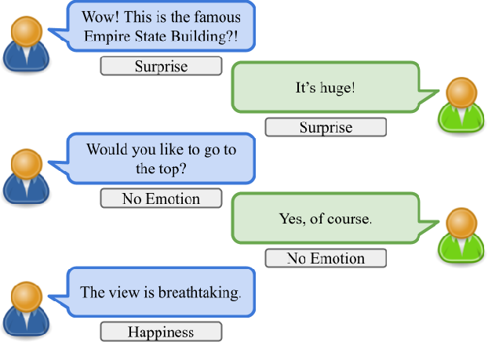
Lab Seminar
Last Seminar
Emotion Recognition in Conversation
Issues with previous research
Language models in the BERT family only attend to the current input sentence, so they do not consider past context.
As a solution, they adopt an approach of inputting both the preceding and current sentences to the language model.
Existing sentiment prediction methods
2

Slide 3
Lab Seminar
Last Seminar
Emotion Recognition in Conversation
Real World
A conversation is not a one-time exchange, but rather a continuous process.
To predict the current emotions, all the utterances from the beginning of the conversation up until the present moment must be taken into account.
real world conversation
3

Slide 4
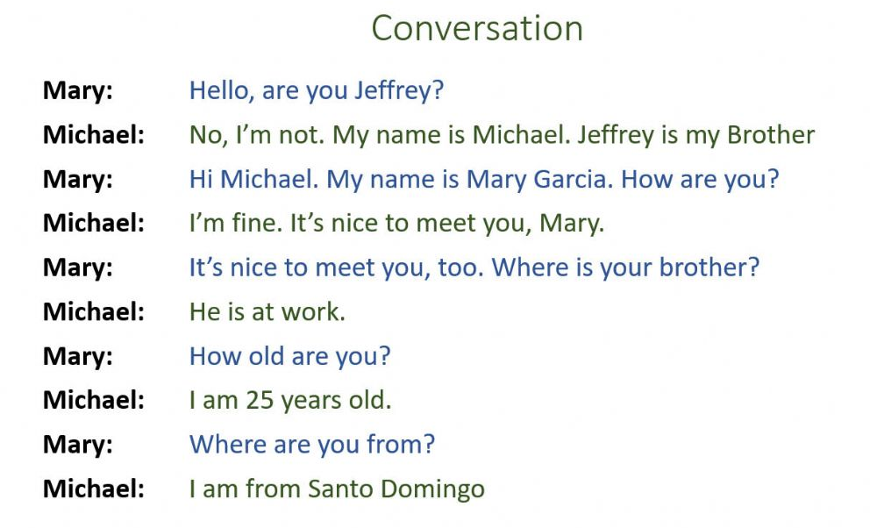
Lab Seminar
Last Seminar
Emotion Recognition in Conversation
Proposed solution
Applying a technique similar to the Long Short-Term Memory (LSTM) method in Transformer-based language models.
A method to accumulate utterances in order during a conversation.
Weight
4

Slide 5
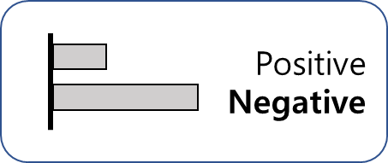
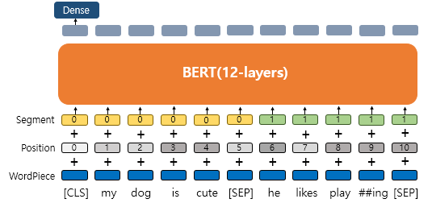
Lab Seminar
Proposal
BERT-based language model
It initializes for each input sentence and then proceeds with training.
The CLS token implicitly holds the information of the input sentence.
5

Slide 6
Lab Seminar
Proposal
Addition of conversation accumulation technique
The CLS vector value of the final layer is used as it is for the next training.
The previous contents are continuously accumulated, and the information up to the previous conversation is used as is, affecting the current sentence.
6

Slide 7
Lab Seminar
Experiment
Model creation
if conversation starts:
proceed as in the previous approach
else if conversation is ongoing:
use the CLS vector value of the final layer up to the previous conversation as is for training.
7

Slide 8
Lab Seminar
Experiment Result
Baseline
Accuracy: 67%(Only text) /
F1-Score: 67%(Only text) /
Baseline
Accuracy: %(Only text)
F1-Score: %(Only text)
8

