Slide 1
Lab Seminar
Intelligent Information Processing Lab
KiHoon Lee

Slide 2
Lab Seminar
Last Seminar
Proposal - Add conversation accumulation technology to BERT series language model
Use the PAST vector value of the last layer as it is in the next training
Previous content continues to accumulate
Uses information up to the previous conversation as it is and affects the current sentence
[CLS]
[${Word}_{0}] …[Word_{i}]$
Input Reset
Embedding Layer
Recycle
$$h_{<PAST>}$$
$$h_{CLS}$$
$$h_{0} … h_i$$
During
Conversation
Pre-trained Language Model
(All layers except embeddings Layer)
Classifier Layer
$$Prediction$$
Back
Propagation
2

Slide 3
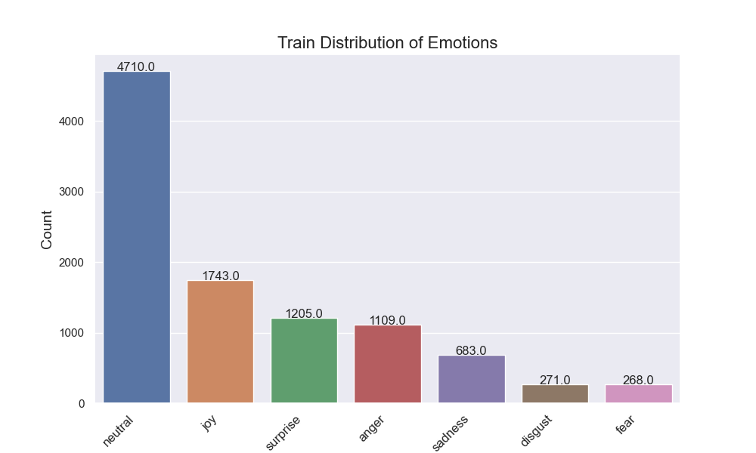
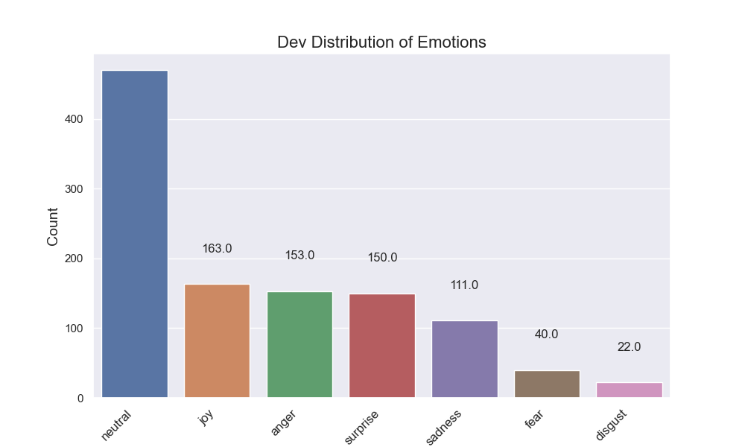
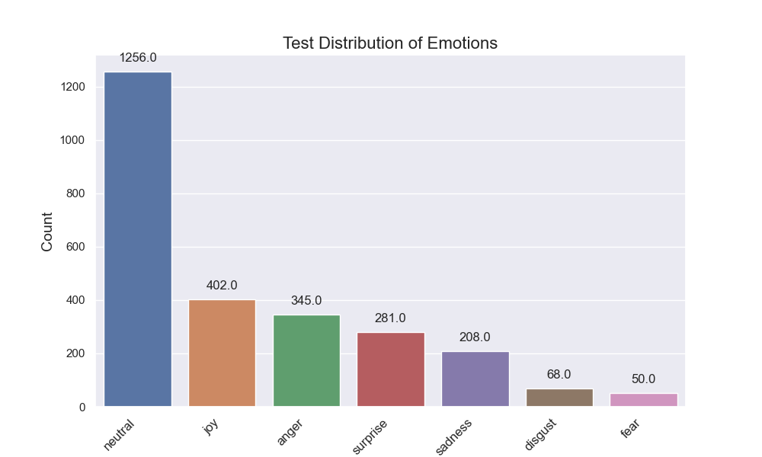
Lab Seminar
Experiment
Data distribution (Total Data Percentage)
Train
neutral 47.1519%
joy 17.4492%
surprise 12.0633%
anger 11.1022%
sadness 6.8375%
disgust 2.7130%
fear 2.6830%
Dev
neutral 42.3805%
joy 14.6979%
anger 13.7962%
surprise 13.5257%
sadness 10.0090%
fear 3.6069%
disgust 1.9838%
Test
neutral 48.1226%
joy 15.4023%
anger 13.2184%
surprise 10.7663%
sadness 7.9693%
disgust 2.6054%
fear 1.9157%
3

Slide 4
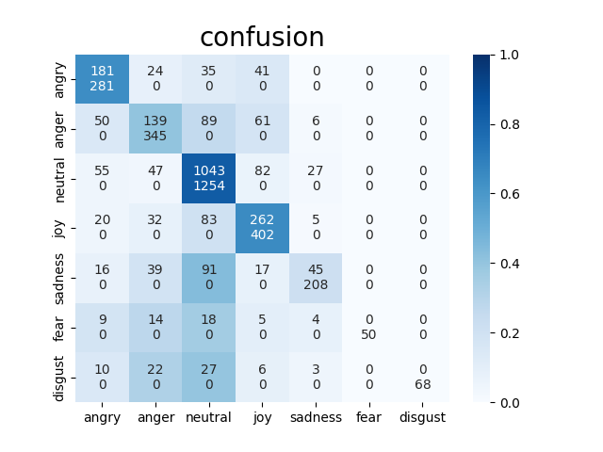
Lab Seminar
Experiment
Baseline
bert-base-uncased
test
weight f1 score : 0.6661986608989413
accuracy : 0.6403374233128835
precision recall f1-score support
0 0.644 0.531 0.582 341
1 0.403 0.438 0.420 317
2 0.832 0.753 0.790 1386
3 0.652 0.553 0.598 474
4 0.216 0.500 0.302 90
5 0.000 0.000 0.000 0
6 0.000 0.000 0.000 0
accuracy 0.640 2608
macro avg 0.392 0.396 0.385 2608
weighted avg 0.701 0.640 0.666 2608
4

Slide 5
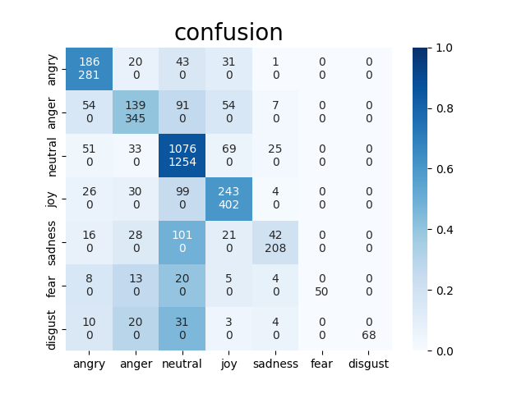
Lab Seminar
Experiment
1. Compare (baseline + input "speaker: speech")
bert-base-uncased
test
weight f1 score : 0.6766611443880576
accuracy : 0.6464723926380368
precision recall f1-score support
0 0.662 0.530 0.589 351
1 0.403 0.491 0.443 283
2 0.858 0.736 0.793 1461
3 0.604 0.570 0.587 426
4 0.202 0.483 0.285 87
5 0.000 0.000 0.000 0
6 0.000 0.000 0.000 0
accuracy 0.646 2608
macro avg 0.390 0.402 0.385 2608
weighted avg 0.719 0.646 0.677 2608
5

Slide 6
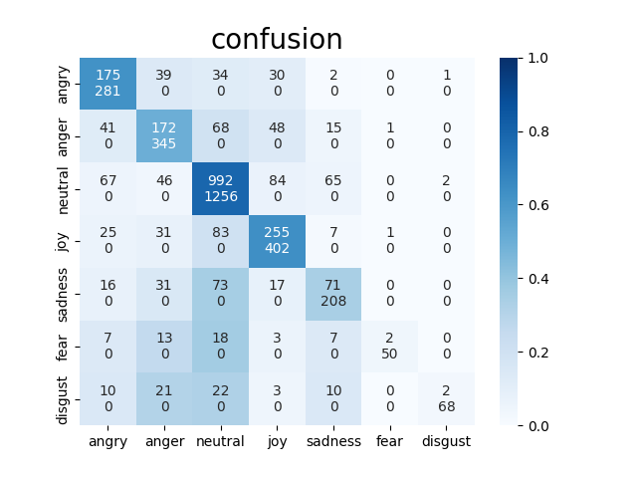
Lab Seminar
Experiment
2. Compare (baseline + add the PAST token method)
bert-base-uncased
test
weight f1 score : 0.6526672497857362
accuracy : 0.6394636015325671
precision recall f1-score support
0 0.623 0.513 0.563 341
1 0.499 0.487 0.493 353
2 0.790 0.769 0.779 1290
3 0.634 0.580 0.606 440
4 0.341 0.401 0.369 177
5 0.040 0.500 0.074 4
6 0.029 0.400 0.055 5
accuracy 0.639 2610
macro avg 0.422 0.521 0.420 2610
weighted avg 0.669 0.639 0.653 2610
6

Slide 7
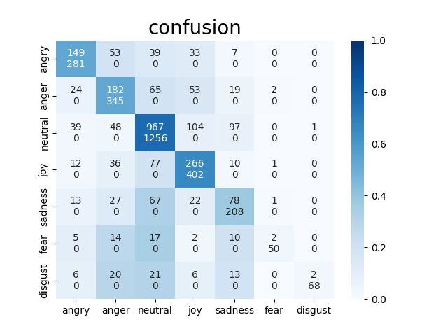
Lab Seminar
Experiment
3. Compare (baseline + add the PAST token method + input "speaker: speech")
bert-base-uncased
test
weight f1 score : 0.6401084506861401
accuracy : 0.6306513409961686
precision recall f1-score support
0 0.530 0.601 0.563 248
1 0.528 0.479 0.502 380
2 0.770 0.772 0.771 1253
3 0.662 0.547 0.599 486
4 0.375 0.333 0.353 234
5 0.040 0.333 0.071 6
6 0.029 0.667 0.056 3
accuracy 0.631 2610
macro avg 0.419 0.533 0.417 2610
weighted avg 0.654 0.631 0.640 2610
7

Slide 8
Lab Seminar
Experiment
실험결과, Baseline 대비 낮은 accuracy와 weighted F1 Score을 얻었으나 Macro F1 score 점수 향상 = (2) PAST 토큰 방안은 불균형한 대화 데이터셋에서 균형있는 예측을 하도록 만듬
lower accuracy and weighted F1 Score were obtained compared to Baseline, but improved Macro F1 score = (2) The PAST token scheme makes balanced predictions in an unbalanced conversation dataset.
$${BERT}_{base}$$ | Accuracy | Weighted f1-score | Macro f1-score
Baseline* | 0.6403 | 0.6690 | 0.390
* + "발화자: 발화문" (1) | 0.6468 (+0.65%) | 0.6767 (+0.77%) | 0.385 (-0.5%)
* + "PAST 토큰" (2) | 0.6395 (-0.08%) | 0.6527 (-1.63%) | 0.420 (+3.00%)
ALL (1+2) | 0.6307 (-0.96%) | 0.6401 (-2.89%) | 0.417 (+2.70%)
8

Slide 9
Lab Seminar
Future Plan
현재 DeBERTaV3, ELECTRA -> PAST 기법과 Baseline 비교 실험 중 전체적인 성능향상이 보이는 모델을 채택하여 4가지 대화 데이터셋 학습 예정 (MELD, IEMOCAP, emoryNLP, DialogRE)
해당 실험으로 논문 초안 작성중
Wav2Vec 사용하여 Audio만 학습 (음성은 MELD, IEMOCAP 만 적용가능)
9

