Slide 1
IIP LAB SEMINAR
IIP LAB
Inpyo-Hong

Slide 2
IIP LAB
Experiment Plan
DeiT모델 Adversarial Attack ➔ 기존 CNN모델과 같이 공격에 취약한지 검증 - 완료
Teacher모델을 통한 DeiT 공격 ➔ Teacher Model 코드 배포X ➔ Teacher Model 직접 구축 후 1번부터 재실험
Knowledge Distillation에서 Output Smoothing의 방어성능 검증 - 예정
DeiT가 ResNet보다 FGSM에 취약한지 실험 (추가실험) - 예정

Slide 3
IIP LAB
Experiments
DeiT모델 Adversarial Attack 위한 Training (Previous experiment)
성공적으로 공격 성공하였으나, Teacher Model 접근불가 (Teacher Model의 Source Code 공개X, 가중치 파일만 제공)
Teacher Model 접근불가 ➔ Teacher Model 공격 불가능
Model | Epoch | Best Epoch | Pretrain | Optimizer | Loss function | Learning rate | Accuracy
DeiT-Tiny | 300 | 44 | True | Adam | Label Smoothing Cross entropy | 0.001 | 0.9009

Slide 4
IIP LAB
Experiments
Fine-tuned
DeiT.pth
(Cifar-10)
Original DeiT
Teacher Model
Pretrained DeiT
RegnetY-160.pth
(ImageNet)
Distillation
Loss
Student Model
DeiT.pth
(ImageNet)
Fine-tuning
Loss
ViT
Author(ImageNet -1K)
User(Cifar-10)

Slide 5
IIP LAB
Experiments # 1-1
Custom DeiT
Teacher Model
RegnetY-160.pth
(ImageNet-1K)
Distillation
Loss
Fine-tuned
Weight.pth
(Cifar-10)
Student Model
Loss
ViT
Cifar-10 Training
Teacher Model | Epoch | Pretrain | Optimizer | Loss function | Learning rate | Accuracy
RegnetY.pth (ImageNet) | 300 | False | Adam | Label Smoothing Cross entropy | 0.001 | 0.22

Slide 6
IIP LAB
Experiments # 1-2
Custom DeiT (Pre-trained X)
Teacher Model
Fine-tuned
RegnetY-160.pth
(Cifar-10)
Distillation
Loss
Fine-tuned
Weight.pth
(Cifar-10)
Student Model
Loss
ViT
Cifar-10 Training

Slide 7
IIP LAB
Experiment #1-2
Custom Teacher 모델 Training (RegNetY-160)
Custom Teacher 활용한 DeiT Training
Model | Epoch | Pretrain | Transform | Optimizer | Learning rate | Accuracy
RegnetY-160 (Custom) | 300 | O | O | Adam | 0.001 | 0.8666
Model | Teacher Model | Epoch | Pretrain | Transform | Optimizer | Learning rate | Accuracy
DeiT | RegNetY-160 (Custom) | 300 | X | O | Adam | 0.001 | 0.5322

Slide 8
IIP LAB
Experiments # 1-3
Custom DeiT (Pre-trained)
Teacher Model
Custom
RegnetY-160.pth
(Cifar-10)
Distillation
Loss
Fine-tuned
Weight.pth
(Cifar-10)
Student Model
Loss
ViT
Cifar-10 Training

Slide 9
IIP LAB
Experiment #1-3
Custom Teacher 모델 Training (RegNetY-160)
Custom Teacher 활용한 DeiT Training
Model | Epoch | Pretrain | Transform | Optimizer | Learning rate | Accuracy
RegnetY-160 (Custom) | 300 | O | O | Adam | 0.001 | 0.8666
Model | Teacher Model | Epoch | Pretrain | Transform | Optimizer | Learning rate | Accuracy
DeiT | RegNetY-160 (Custom) | 300 | O | O | Adam | 0.001 | 0.9399

Slide 10
IIP LAB
Experiment 1
DeiT Fine-tuning 실패했던이유
Teacher Model의 Fine-tuning 후 DeiT Fine-tuning 해야함 ➔ Teacher Model Fine-tuning
DeiT는 사전학습 없이 사용 시 성능이 제대로 나오지 않음 (Transformer 한계) ➔ 사전학습 된 DeiT사용
Experiment 1 결과
Teacher Model : Fine-Tuned RegNetY-106 (Acc: 0.8666)
DeiT Model : Pretrained DeiT (Acc: 0.9399)

Slide 11
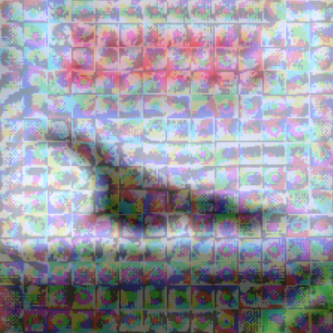
IIP LAB
Experiment 1
DeiT Adversarial attack
Creating adversarial samples: 1,000 (100 examples each class)
정량적 평가
Original Acc : 0.9399 ➔ Adversarial Sample Acc : 0.105 (83.49% 하락) ➔ DeiT모델은 적대적공격에 여전히 취약하며 이를 위한 방어책이 필요함을 제안
정성적 평가
공격성공률은 높으나 사람이 공격을 식별하기 쉬운 이미지 생성(Patch 단위의 공격) ➔ 여전히 CNN 기반 모델보다 ViT기반모델의 공격을 식별하기 쉽다는 공격한계를 제시
<DeiT모델 Attack>

Slide 12
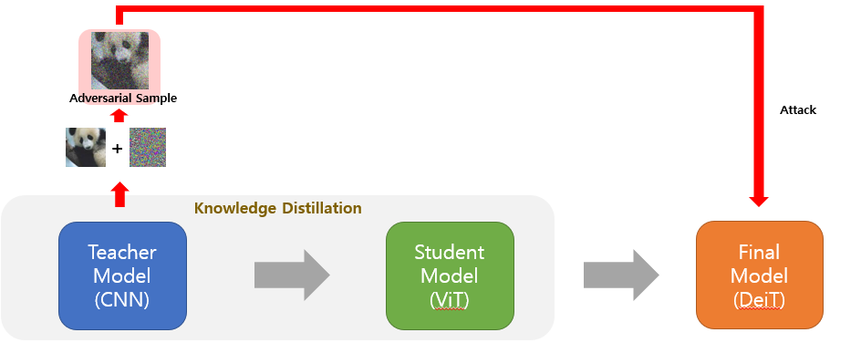
IIP LAB
Experiment 2
Teacher Model 을 통한 Adversarial attack
Teacher Adversarial sample ➔ Teacher Model 삽입 후 검증
Teacher Adversarial sample ➔ DeiT Model 삽입 후 검증

Slide 13
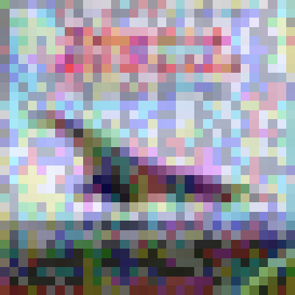
IIP LAB
Experiment 2
Teacher Adversarial attack
Creating adversarial samples: 1,000 (100 examples each class)
정량적 평가
Teacher Acc : 0.8666 ➔ Teacher Sample Acc : 0.092 (77.46% 하락) ➔ 공격성공
DeiT Acc: 0.9399 ➔ Teacher Sample Acc: 0.4750 (46.49% 하락)
정성적 평가
ViT, DeiT 대비 사람이 식별하기 어려운 자연스러운 Perturbation 생성
<Teacher 모델 Attack>
(RegNetY-160)

Slide 14
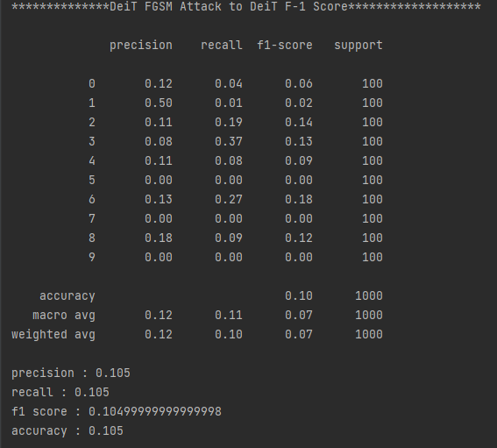
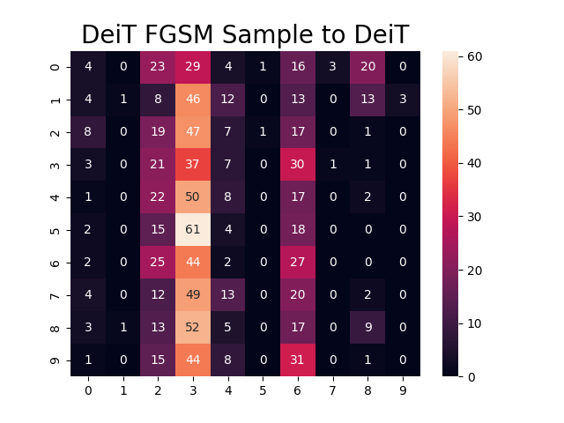
IIP LAB
Experiment 1 (DeiT Attack)
<DeiT 모델 Attack>
Acc: 93.99% ➔ 10.50%

Slide 15
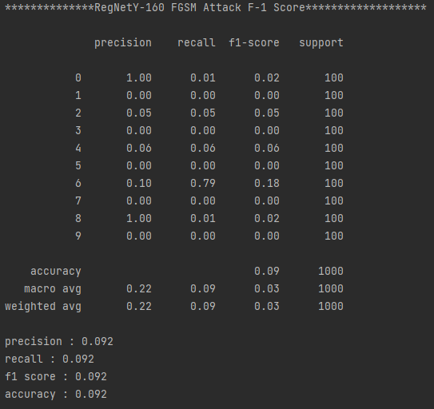
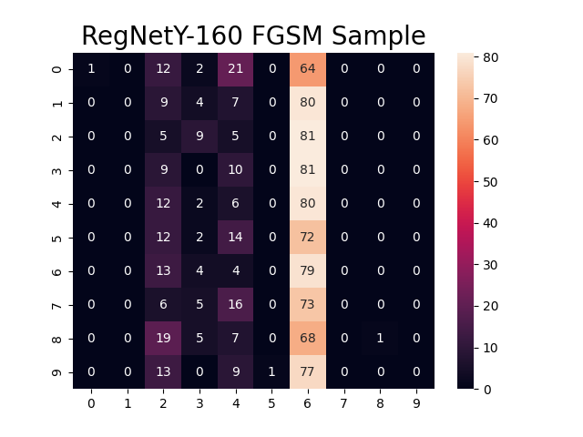
IIP LAB
Experiment 2 (Teacher Attack)
<Teacher 모델 Attack>
Acc: 86.66% ➔ 09.20%

Slide 16
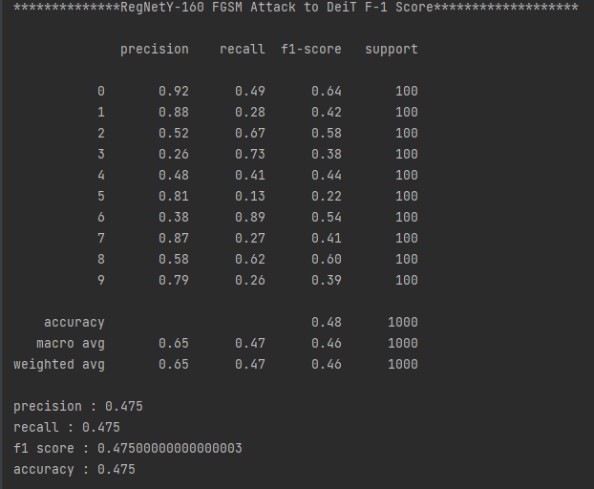
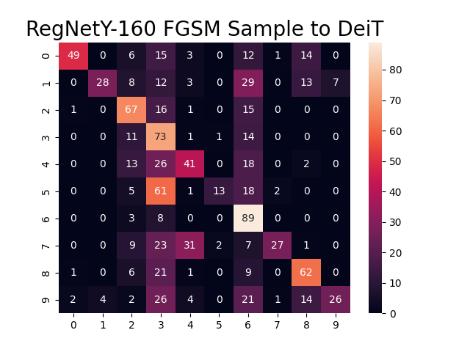
IIP LAB
Experiment 2 (Teacher Sample to DeiT)
<Teacher to DeiT Attack>
Acc: 93.99% ➔ 47.50%

Slide 17
IIP LAB
Current Progress & Future Work
DeiT모델 Adversarial Attack ➔ 기존 CNN모델과 같이 공격에 취약한지 검증 - 완료
Teacher모델을 통한 DeiT 공격 -완료
Knowledge Distillation에서 Output Smoothing의 방어성능 검증 - 예정
DeiT가 ResNet보다 FGSM에 취약한지 실험 (추가실험) - 예정

