Slide 1
IIP LAB SEMINAR
IIP LAB
Inpyo-Hong

Slide 2
IIP LAB
Paper progress
Introduction - Done
Related Work - Done 2-1 Knowledge Distillation and DeiT 2-1-1 DeiT Teacher Model 2-1-2 DeiT Student Model 2-2 Adversarial Attack 2-2-1 FGSM 2-2-2 PGD
Adversarial Attacks - Done 3-1 White Box and Gray Box Attacks 3-1-1 White Box Verification of DeiT 3-1-2 Gray Box Verificaion of DeiT 3-2 Black Box Attack 3-2-1 Black Box Verification of DeiT through Transformer Model Attack 3-2-2 Black Box Verification of DeiT through CNN Model Attack

Slide 3
IIP LAB
Paper progress
Experimental Evaluation and Discussion - Done 4-1 Experimental Evaluation 4-1-1 White Box Attacks of DeiT 4-1-2 Gray Box Attacks of DeiT 4-1-3 Black Box Attacks of DeiT 4-2 Discussion
Conclusion - Done

Slide 4
IIP LAB
Paper Abstract
Current Computer Vision research focuses on model performance
The Emergence of new structure model, But not verified against adversarial attacks
We analyzed the vulnerability of DeiT(ViT based on knowledge distillation)
We verified by dividing it into white box, gray box and black box environments
adversarial attacks through the teacher model(CNN) are fatal in DeiT’s gray box and black box attacks
We suggest that DeiT has adversarial attack vulnerabilities
We expect that knowledge distillation studies with enhanced adversarial robustness will be actively pursued.

Slide 5
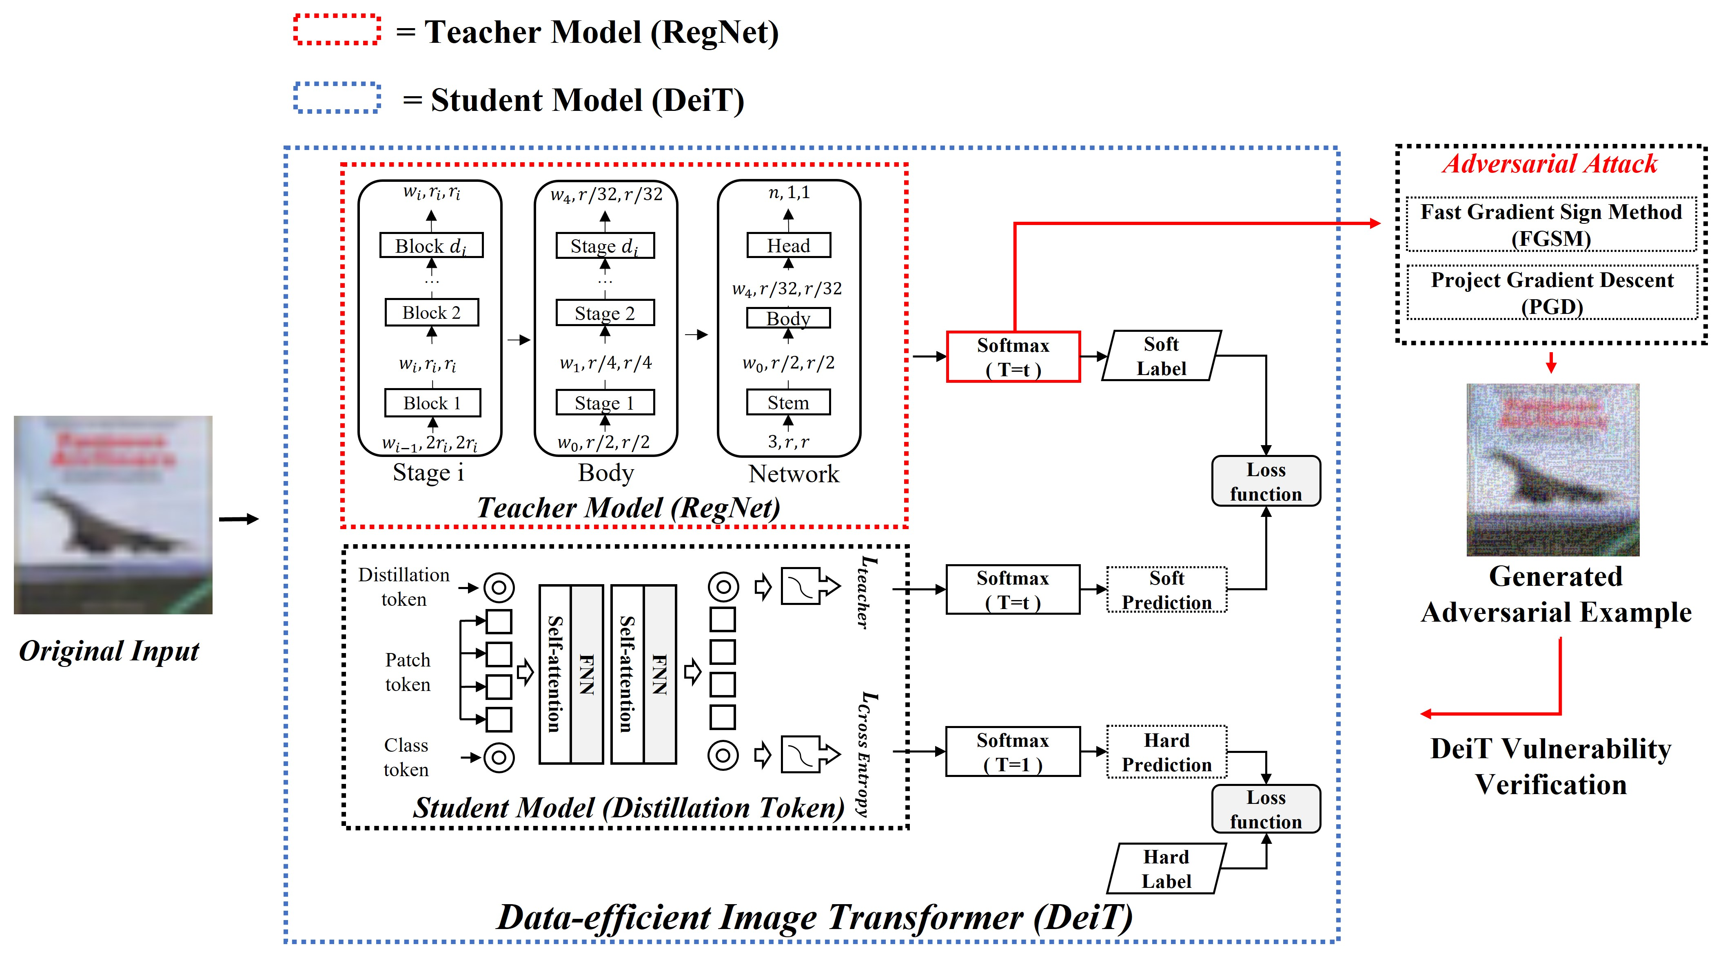
IIP LAB
Paper Figure #1
Teacher Model Vulnerability Verification Overview of DeiT (Gray Box Attack)

Slide 6
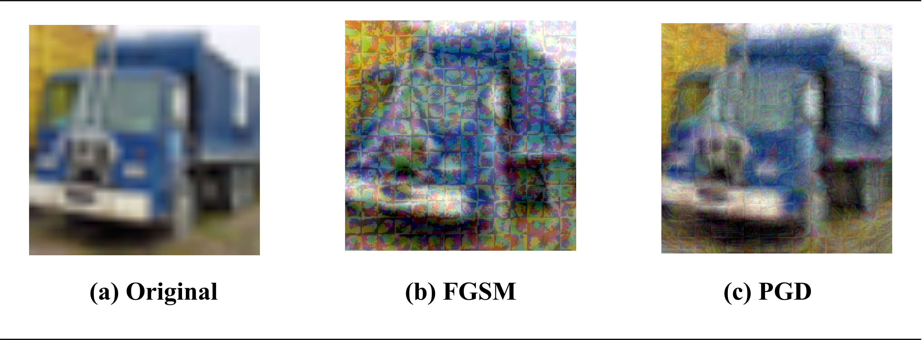
IIP LAB
Paper Figure #2
Adversarial Examples of DeiT Attack(White Box Attack)

Slide 7
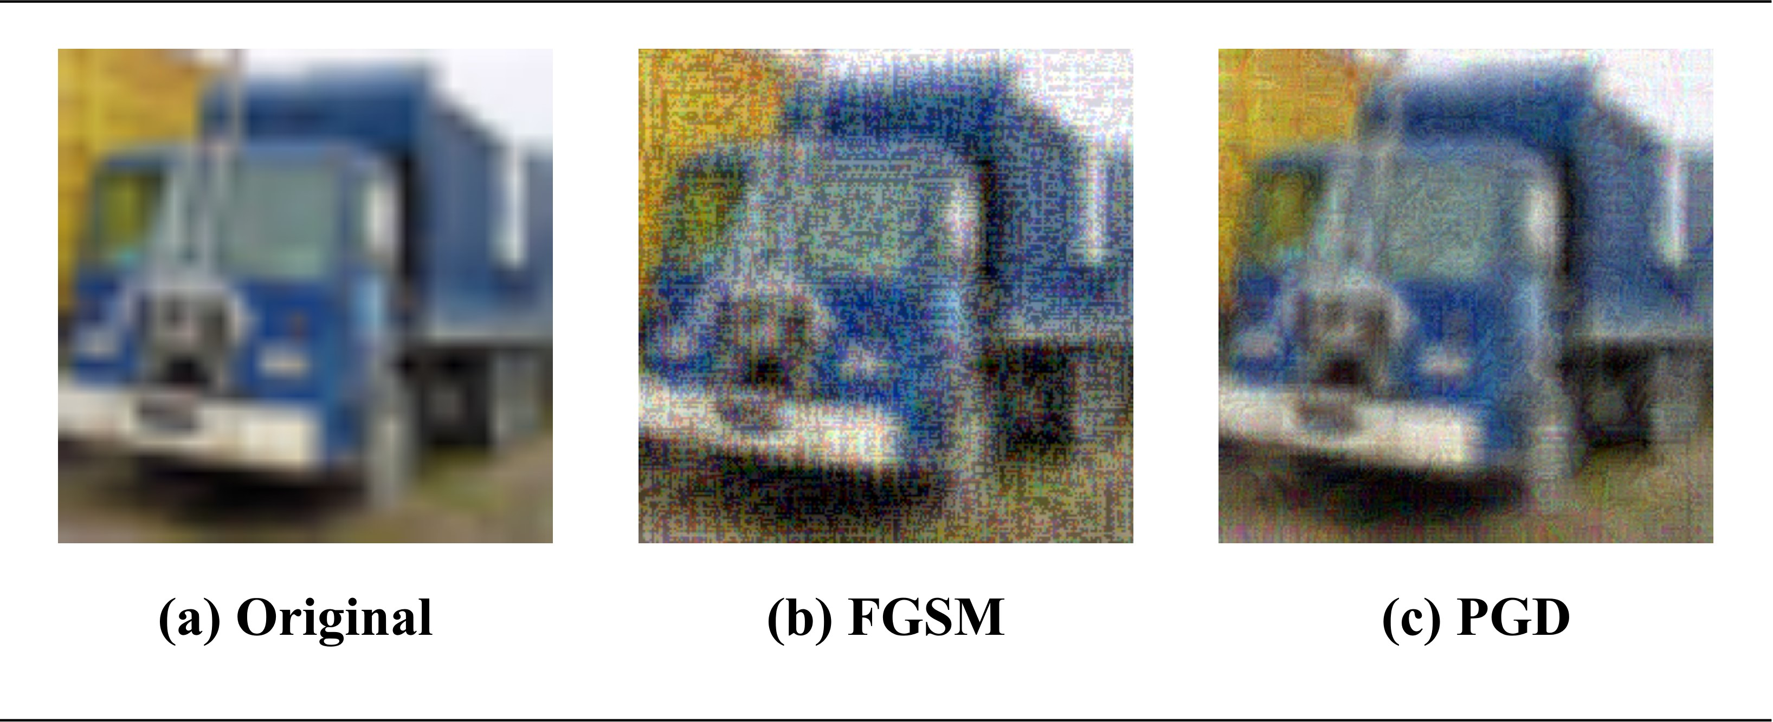
IIP LAB
Paper Figure #3
Adversarial Examples of Teacher Model Attack (Gray Box Attack)

Slide 8
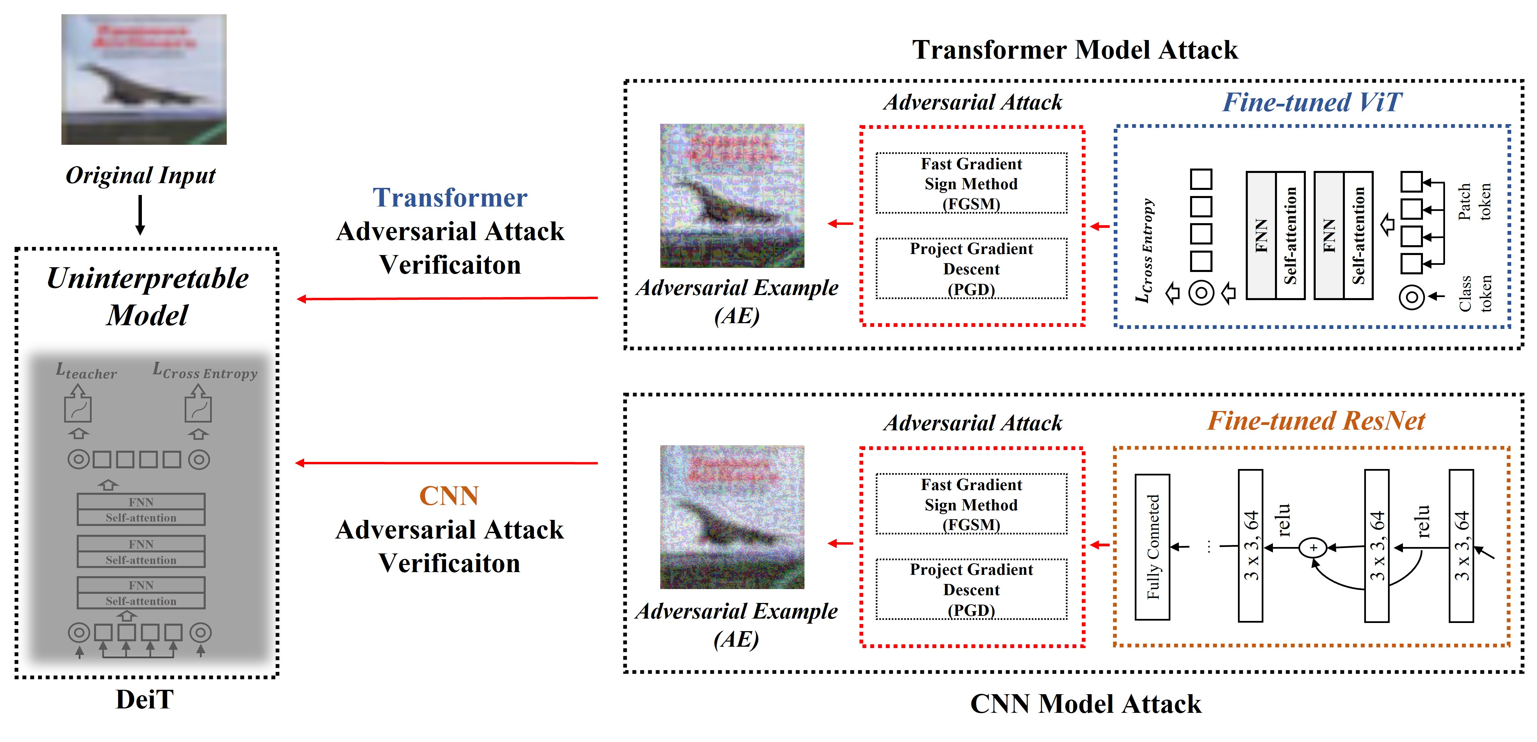
IIP LAB
Paper Figure #4
Black Box Attacks Verification Overview of DeiT

Slide 9
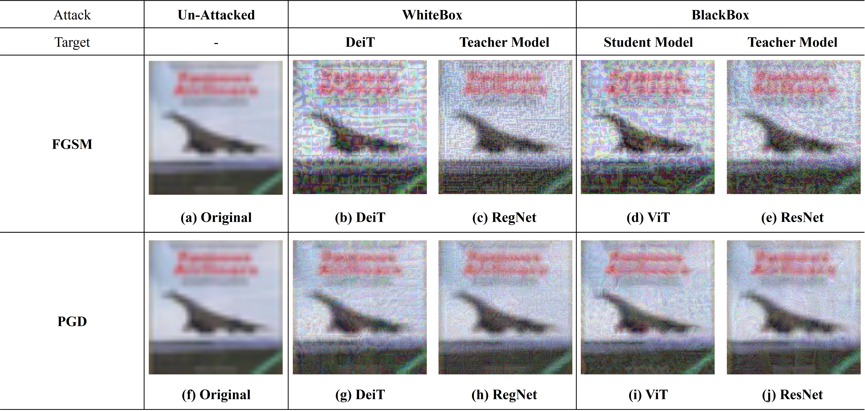
IIP LAB
Paper Figure #5
Generated Adversarial Examples

Slide 10
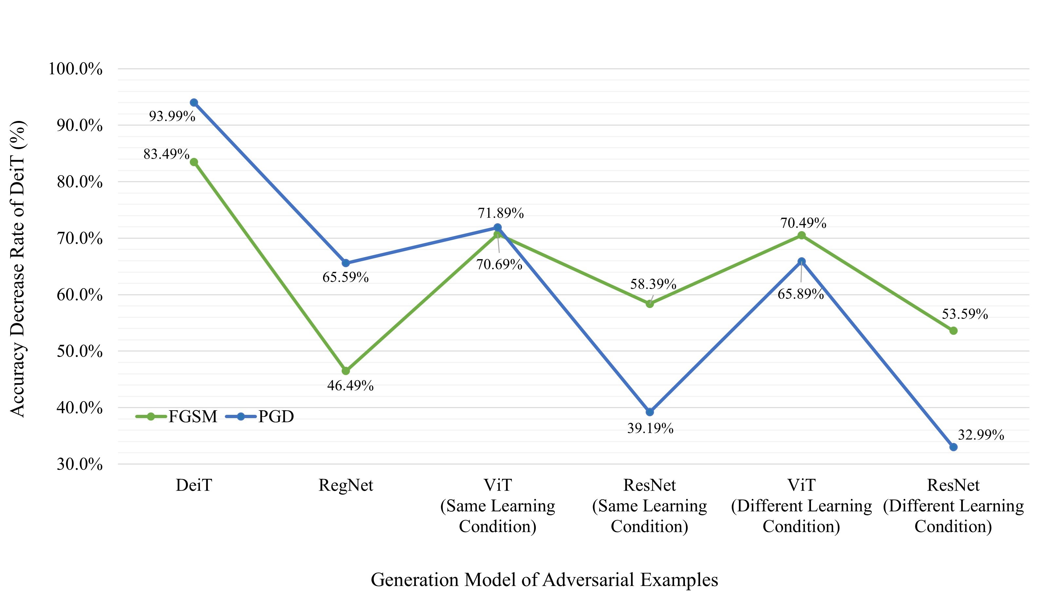
IIP LAB
Paper Figure #6
Experimental result comparison graph

Slide 11
IIP LAB
Paper Table #1
White Box Attacks of DeiT

Slide 12
IIP LAB
Paper Table #2
Gray Box Attacks of DeiT

Slide 13
IIP LAB
Paper Table #3
Black Box Attacks of DeiT (Same Learning Conditions)

Slide 14
IIP LAB
Paper Table #3
Black Box Attacks of DeiT (Different Learning Conditions)

Slide 15
IIP LAB
Task Progress
Draft Paper - Done
Fix Latex Error - In Progress
Paper Translation (Korean->English) – Scheduled
Translated paper Correction - Scheduled

