Slide 1
Master’s Thesis
A Study on Dimensional Feature Data Combinations for Efficient
Epilepsy Prediction
Department: IT Convergence Engineering
(Computer Engineering)
Professor: Chang Choi
Student: Ziyang Gong
Time: 2023.11.15

Slide 2
Contents
Ⅰ. Introduction
A. Motivation and Challenges
B. Main Contribution
C. Organization
Ⅱ. Related Works
A. Epilepsy prediction methods
1. Machine Learning approach
2. Deep Learning approach
B. Deep Learning Network
1. LSTM
2. TCN
3. DenseNet
4. ViT
C. Attention mechanism
1

Slide 3
Contents
Ⅲ. Dimensional Feature Data Combinations for Epilepsy Prediction
A. Data preprocessing
1. Data introduction
2. Data augmentation
3. Short Time Fourier Transform
B. One-dimensional method
C. Multi-dimensional method
D. Dimensional Feature Data Combinations
Ⅳ. Experiment and Result
A. Dataset
B. Experimental Environment
C. Epilepsy Prediction Performance Evaluation
D. Experimental Analysis
Ⅴ. Contribution and Future Work
Reference
2

Slide 4
1. Introduction
3

Slide 5
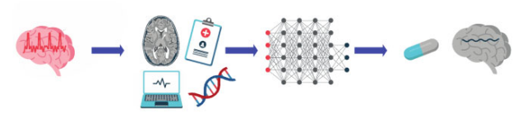
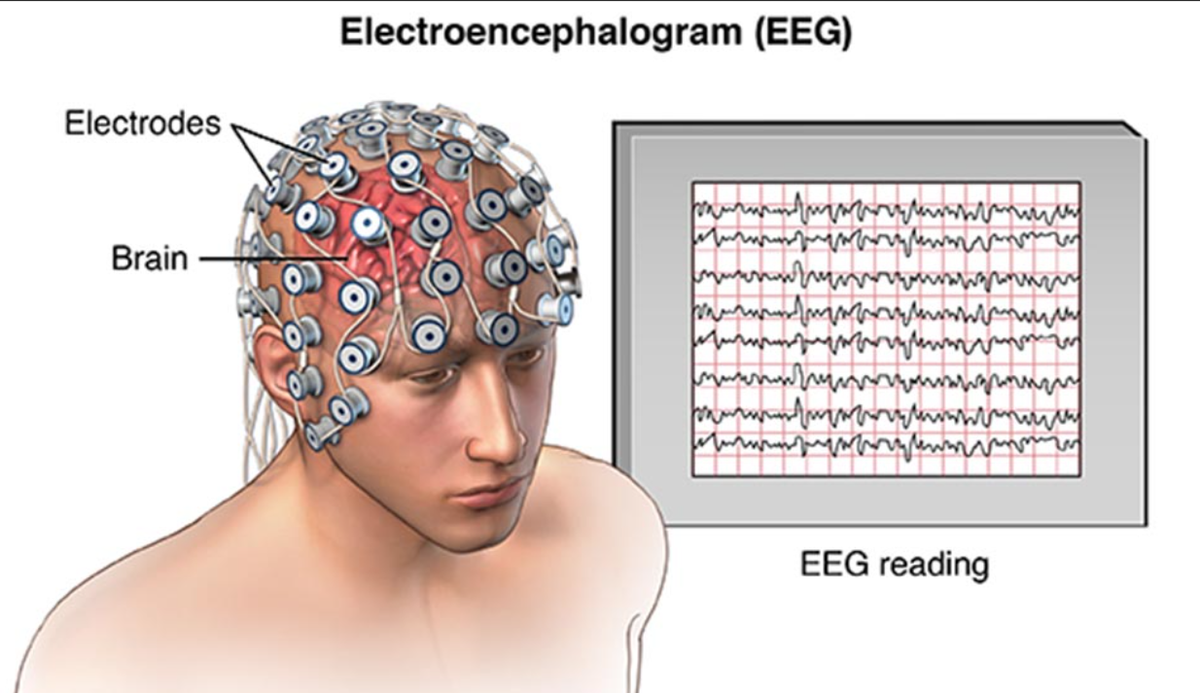
Epilepsy prediction (간질예측)
Significance of epilepsy prediction:
Epilepsy patients account for a large proportion. There are many studies to detect epilepsy, but if epilepsy is predicted in advance, early treatment can be taken, so predicting epilepsy will be more promising.
Challenges :
1. The EEG of epilepsy patients constantly transitions between seizure and non-seizure states.
2. Epilepsy dataset imbalance.
3. It is difficult to achieve high sensitivity and low false prediction rate. lager overlap in the EEG associated with seizure and non-seizure states.
4

Slide 6
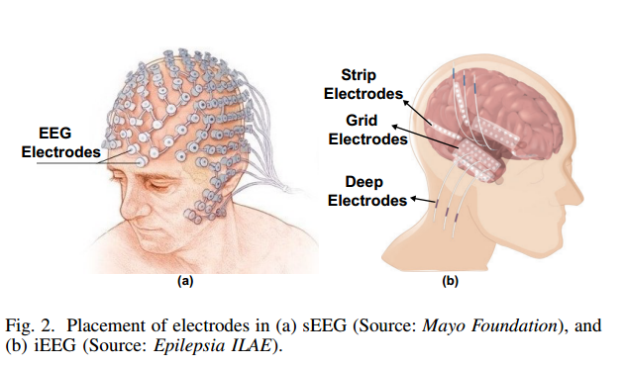


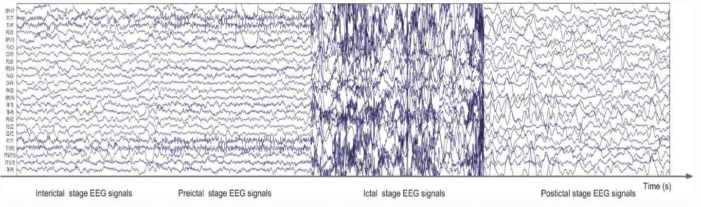
Electroencephalogram (EEG)
There are generally two ways to collect EEG data:
intracranial collection(두개내 채집) iEEG
: Record signal directly, no noise
: short-term implantation into the skull is required, and collection
is difficult
Scalp collection(두피 채취) sEEG
: Convenience, Safety, Extensive
: have noise
5

Slide 7
2. Related Work
6

Slide 8
Related work
Recent AUC and FPR Results on Epilepsy Prediction
Reference | Database | Features | Classifier | 𝑆𝑛 -𝑆𝑝 -AUC-FPR(/h)
Troung et al. 2018 [1] | CHB-MIT | STFT | CNN | 0.9861-NA-NA-0.160
Ozcan et al. 2019 [2] |  | Spectral power, … | 3D CNN | 0.857-NA-NA-0.096
Prathaban et al. 2020 [3] |  | sparse coefficients | 3D OCNN | 0.9925-NA-NA-0.07
Jana et al. 2021 [4] |  | raw data | CNN | 0.978-0.923-NA-0.076
Chen et al. 2021 [5] |  | WPD | GCN | 0.9861-0.989-NA-0.010
Yang et al. 2021 [7] |  | STFT spectral images | RDANet | 0.8925-0.927-0.913-NA
Li et al. 2022 [8] |  | STFT spectrograms | CNN-Transform | 0.935-NA-0.915-0.145
Chang et al. 2023 [9] |  | raw data | MLPs | 0.966-0.867-0.938-0.060
7

Slide 9
3. Dimensional Feature Data Combinations for
Epilepsy Prediction
8

Slide 10
Datasets (public)
CHB-MIT Scalp EEG Dataset (sEEG)
American Epilepsy Society Seizure Prediction Challenge Kaggle (iEEG)
Patient (16) | Age | Gender | Record Time (h) | Duration Of seizures(s) | Number Of Seizures
1 | 11 | F | 40.6 | 499 | 7
2 | 11 | M | 25.3 | 175 | 3
3 | 14 | F | 28.0 | 409 | 7
5 | 7 | F | 39.0 | 563 | 5
6 | 1.5 | F | 66.7 | 147 | 10
7 | 14.5 | F | 68.1 | 328 | 3
8 | 3.5 | M | 20.0 | 924 | 5
9 | 10 | F | 67.8 | 280 | 4
10 | 3 | M | 50.0 | 454 | 7
13 | 3 | F | 33.0 | 547 | 12
14 | 9 | F | 26.0 | 117 | 8
17 | 12 | F | 21.0 | 196 | 3
18 | 18 | F | 36.0 | 323 | 6
20 | 6 | F | 29.0 | 302 | 4
21 | 13 | F | 33.0 | 303 | 4
22 | 9 | F | 31.0 | 207 | 3
Patient (4) | Duration Of preictal(s) | Duration Of interictal (s) | Number Of Seizures
Dog-2 | 3.6 | 87 | 7
Dog-3 | 6.2 | 246 | 12
Dog-4 | 8.7 | 138 | 17
Dog-5 | 2.6 | 77 | 5
seizures with an internal less than 30 min from the previous seizure are considered one seizure.
For patients with more than 1 seizure per 2 h, it is not very meaningful to predict their seizures.
→ we use 16 patients from the CHB-MIT dataset and 4 dogs from the Kaggle dataset
9

Slide 11
Dimensional Feature Data Combinations for Epilepsy Prediction
Data preprocessing
Signal selection
Data augmentation
2D matrix
Model test
Data reading: select 18 channels from 24 channels
  - Channels : [u’FP1-F7’, u’F7-T7’, u’T7-P7’, u’P7-O1’, u’FP1-F3’, u’F3-C3’, u’C3-P3’, u’P3-O1’, u’FP2-F4’, u’F4-C4’, u’C4-P4’, u’P4-O2’, u’FP2-F8’, u’F8-T8’, u’T8-P8-0’, u’P8-O2’, u’FZ-CZ’, u’CZ-PZ’]
Data sampling:
- 30s sampling frequency, 256 sampling points per second
Data cutting:
- preictal: 0.5h before the onset of seizures
- Interictal: 4h before preictal
10

Slide 12
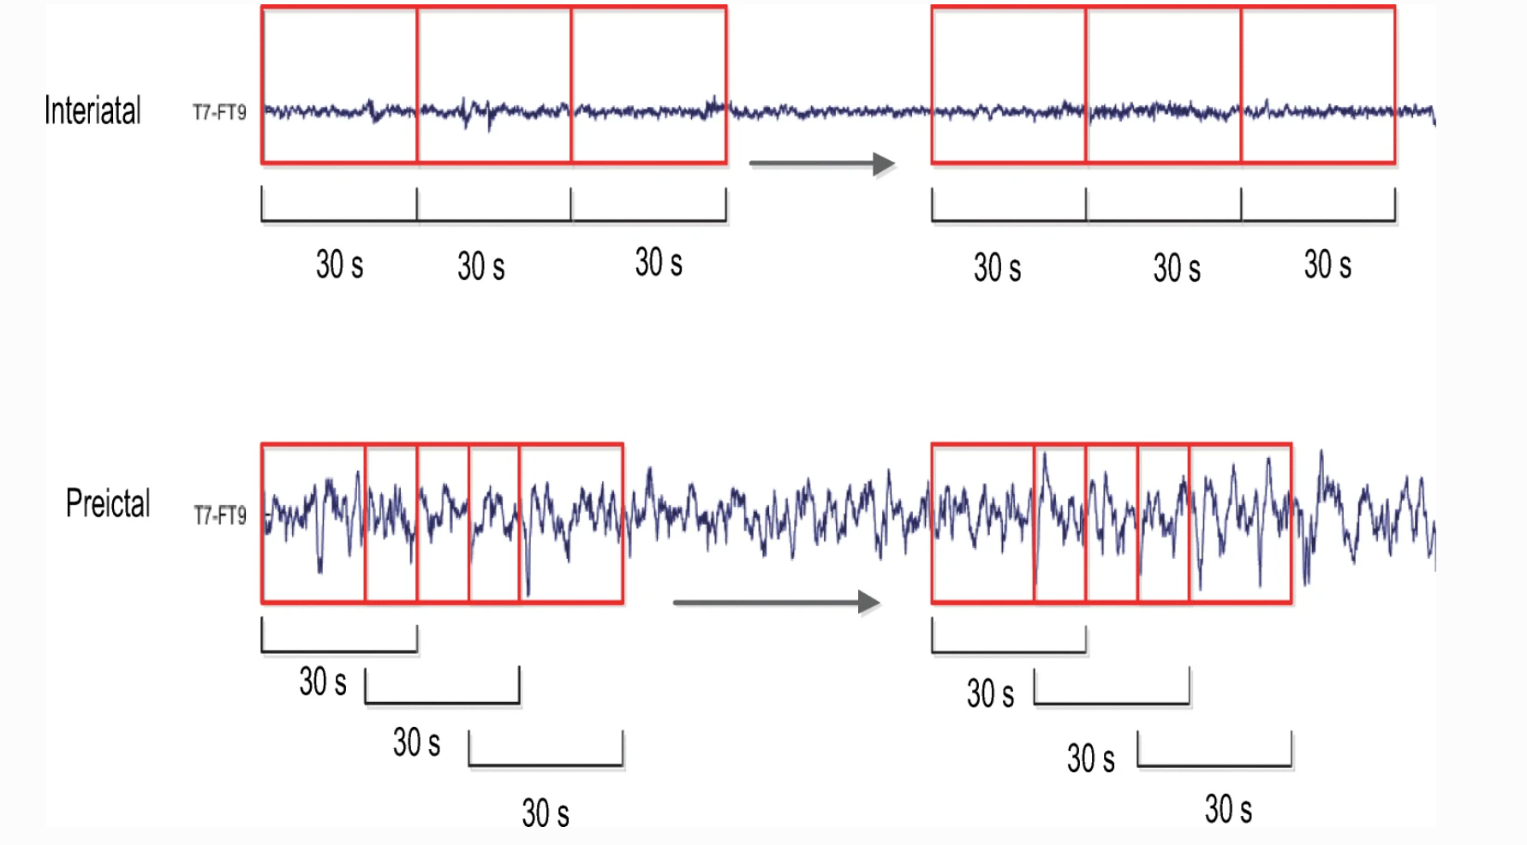
Dimensional Feature Data Combinations for Epilepsy Prediction
Data preprocessing
Signal selection
Data augmentation
2D matrix
Model test
- Use oversampling (30s)
N*18 data
N*18 data
oversampling
11

Slide 13


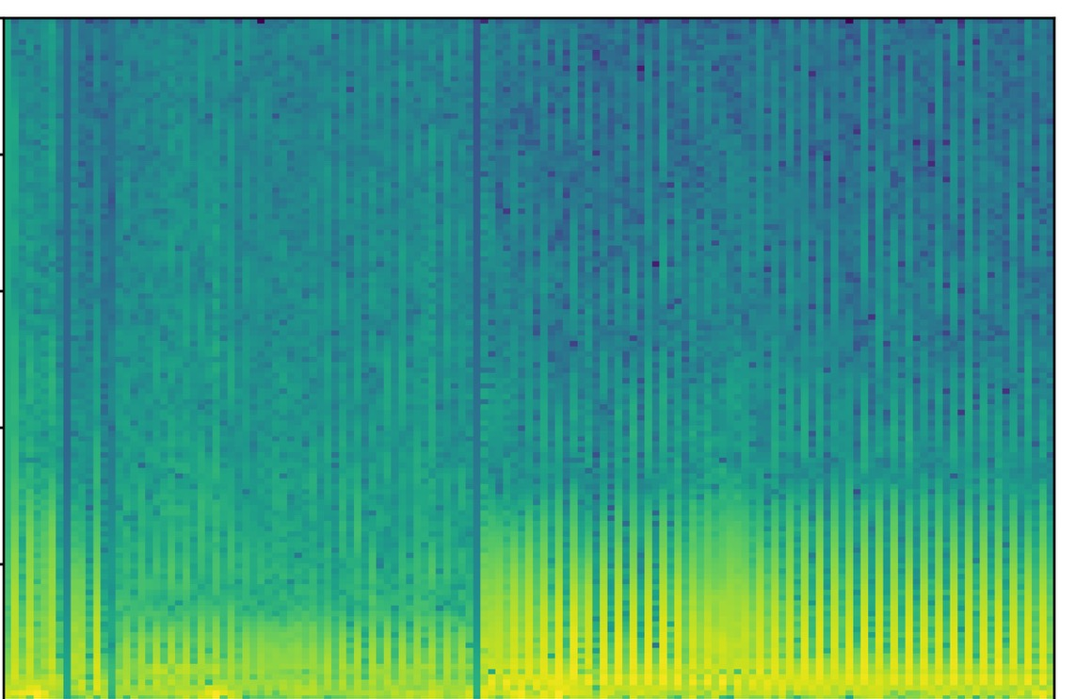
Dimensional Feature Data Combinations for Epilepsy Prediction
Data preprocessing
Signal selection
Data augmentation
2D matrix
Model test
- Short Time Fourier Transform
1 input = 30s
18 channels to 1 channel signal
Use STFT to change to a 2D matrix and remove the noise
- by excluding 47–53 Hz and 97–103 Hz for 50 Hz
and excluding 57–63 Hz and 117–123 Hz for 60 Hz.
12

Slide 14
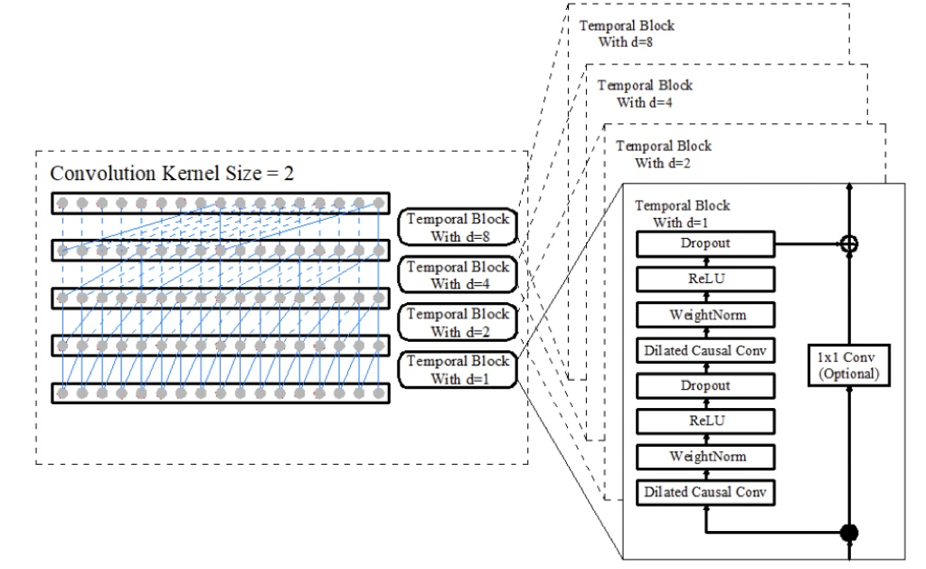
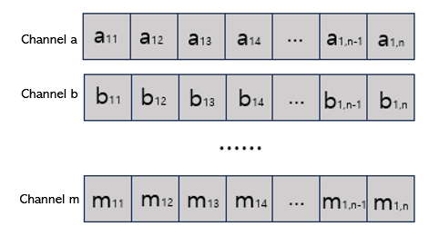

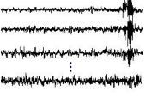




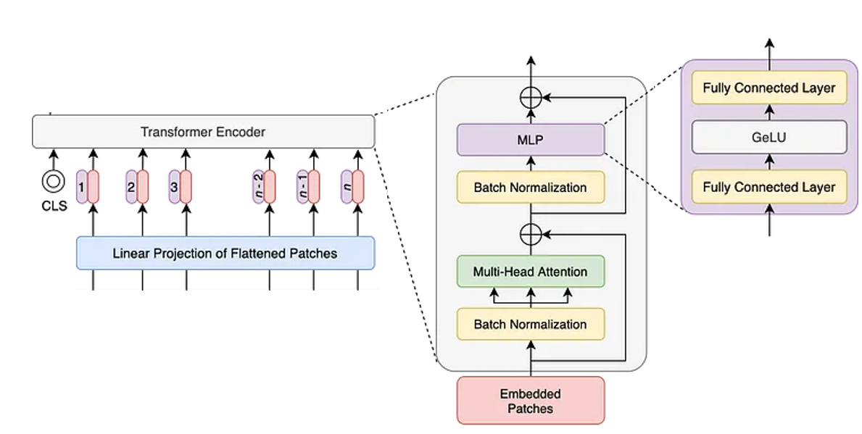
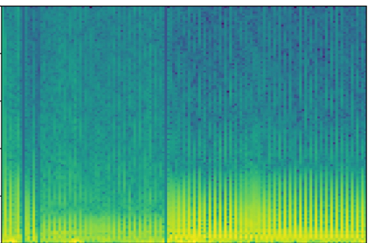


Dimensional Feature Data Combinations for Epilepsy Prediction
Proposed Method
Data Processing Phase
Feature Extraction Phase
TCN model
Feature Selection Phase
Flatten
concatenate
Prediction Phase
Feature
EEG (raw data)
Self attention
preictal
ViT model
STFT
Feature
SoftMax
Feature concatenation
interictal
Linear layer
Flatten
13

Slide 15
4. Experiment Result
14

Slide 16
Experiment Result
Experiment environment
Performance Indicator | Formula
Accuracy | (TP + TN)/(TP + TN + FP + FN)
Sensitivity (Recall) | TP/(TP + FN)
Specificity | TN/(TN + FP)
False Positive Rate (FPR) | FP/(TN + FP)
AUC
K-fold(7): cross-validation splits the data into k folds, using k−1 for training and the remaining one for testing.
Accuracy: the proportion of correctly classified data in the entire data set.
Sensitivity: the proportion of data classified as predictive that are accurately predicted as predictive.
Specificity: proportion of actual intervals predicted in the data classified as intervals.
FPR: the proportion of intervals incorrectly judged as predicted states.
Auc: Area under the ROC curve
15

Slide 17
Experiment Result
1D model Epilepsy Prediction LSTM
1D model Epilepsy Prediction TCN
Patient | Auc | Sens | Spec | Acc | Fpr
1 | 1 | 0.999 | 1 | 1 | 1
2 | 0.982 | 0.27 | 0.99 | 0.946 | 0.381
3 | 0.65 | 0.128 | 0.945 | 0.847 | 0.168
5 | 0.627 | 0.699 | 0.503 | 0.533 | 0.312
6 | 0.503 | 0.518 | 0.499 | 0.502 | 0.232
7 | 0.691 | 0.723 | 0.583 | 0.587 | 0.085
8 | 0.998 | 0.996 | 0.98 | 0.986 | 0.982
9 | 0.705 | 0.617 | 0.989 | 0.686 | 0.14
10 | 0.948 | 0.957 | 0.748 | 0.77 | 0.463
13 | 0.993 | 0.984 | 0.901 | 0.914 | 0.775
14 | 0.632 | 0.42 | 0.892 | 0.734 | 0.513
17 | 0.968 | 0.943 | 0.929 | 0.931 | 0.78
18 | 0.977 | 0.938 | 0.828 | 0.84 | 0.566
20 | 0.926 | 0.998 | 0.874 | 0.887 | 0.663
21 | 0.959 | 0.567 | 0.967 | 0.934 | 0.588
22 | 0.555 | 0.619 | 0.459 | 0.468 | 0.114
Average | 0.819625 | 0.711 | 0.8179375 | 0.7853125 | 0.485125
Patient | Auc | Sens | Spec | Acc | Fpr
1 | 1 | 1 | 0.774 | 0.812 | 0.646
2 | 0.627 | 0.285 | 0.981 | 0.938 | 0.36
3 | 0.973 | 0.956 | 0.851 | 0.864 | 0.628
5 | 0.905 | 0.647 | 0.902 | 0.863 | 0.59
6 | 0.465 | 0.443 | 0.49 | 0.482 | 0.226
7 | 0.846 | 0.899 | 0.641 | 0.648 | 0.119
8 | 0.825 | 0.496 | 0.879 | 0.732 | 0.587
9 | 0.911 | 0.903 | 0.839 | 0.842 | 0.321
10 | 0.979 | 0.516 | 0.992 | 0.943 | 0.653
13 | 0.985 | 0.97 | 0.917 | 0.925 | 0.797
14 | 0.938 | 0.839 | 0.946 | 0.91 | 0.862
17 | 0.961 | 0.439 | 0.962 | 0.894 | 0.519
18 | 0.988 | 0.48 | 0.989 | 0.933 | 0.613
20 | 0.995 | 0.989 | 0.974 | 0.976 | 0.901
21 | 0.901 | 0.927 | 0.701 | 0.719 | 0.355
22 | 0.599 | 0.569 | 0.611 | 0.608 | 0.139
Average | 0.868625 | 0.709875 | 0.8405625 | 0.8180625 | 0.51975
16

Slide 18
Experiment Result
2D model Epilepsy Prediction ViT
2D model Epilepsy Prediction DenseNet
Patient | Auc | Sens | Spec | Acc | Fpr
1 | 1 | 1 | 0.844 | 0.871 | 0.726
2 | 0.357 | 0.061 | 0.998 | 0.94 | 0.112
3 | 0.948 | 0.638 | 0.961 | 0.922 | 0.663
5 | 0.934 | 0.63 | 0.951 | 0.903 | 0.662
6 | 0.644 | 0.308 | 0.826 | 0.737 | 0.286
7 | 0.542 | 0.329 | 0.603 | 0.595 | 0.041
8 | 0.999 | 0.47 | 0.999 | 0.796 | 0.639
9 | 0.799 | 0.76 | 0.726 | 0.728 | 0.188
10 | 0.967 | 0.275 | 0.998 | 0.923 | 0.428
13 | 0.96 | 1 | 0.644 | 0.698 | 0.501
14 | 0.846 | 0.797 | 0.764 | 0.775 | 0.702
17 | 0.911 | 0.356 | 0.935 | 0.86 | 0.399
18 | 0.97 | 0.996 | 0.732 | 0.791 | 0.481
20 | 0.945 | 0.998 | 0.881 | 0.894 | 0.676
21 | 0.944 | 0.935 | 0.851 | 0.858 | 0.523
22 | 0.514 | 0.37 | 0.502 | 0.494 | 0.075
Average | 0.83 | 0.6201875 | 0.8259375 | 0.7990625 | 0.443875
Patient | Auc | Sens | Spec | Acc | Fpr
1 | 1 | 0.994 | 1 | 0.999 | 0.996
2 | 0.809 | 0.386 | 0.996 | 0.958 | 0.531
3 | 0.973 | 0.944 | 0.908 | 0.913 | 0.722
5 | 0.931 | 0.838 | 0.869 | 0.864 | 0.652
6 | 0.668 | 0.426 | 0.793 | 0.73 | 0.35
7 | 0.69 | 0.235 | 0.815 | 0.8 | 0.059
8 | 1 | 0.989 | 0.992 | 0.991 | 0.988
9 | 0.848 | 0.768 | 0.764 | 0.764 | 0.213
10 | 0.963 | 0.732 | 0.978 | 0.953 | 0.762
13 | 1 | 0.996 | 1 | 0.999 | 0.996
14 | 0.93 | 0.559 | 0.981 | 0.84 | 0.7
17 | 0.994 | 0.931 | 0.974 | 0.968 | 0.885
18 | 0.981 | 0.935 | 0.977 | 0.972 | 0.883
20 | 1 | 0.982 | 1 | 0.997 | 0.988
21 | 0.873 | 0.498 | 0.931 | 0.895 | 0.441
22 | 0.582 | 0.458 | 0.594 | 0.587 | 0.11
Average | 0.890125 | 0.7294375 | 0.91075 | 0.889375 | 0.64225
17

Slide 19
Experiment Result
TCN + DenseNet Results on Epilepsy Prediction
TCN + ViT Results on Epilepsy Prediction
Patient | Auc | Sens | Spec | Acc | Fpr
1 | 0.999 | 1 | 0.774 | 0.812 | 0.646
2 | 0.627 | 0.284 | 0.981 | 0.938 | 0.36
3 | 0.973 | 0.956 | 0.851 | 0.864 | 0.628
5 | 0.905 | 0.647 | 0.902 | 0.863 | 0.589
6 | 0.465 | 0.443 | 0.49 | 0.482 | 0.226
7 | 0.846 | 0.899 | 0.641 | 0.648 | 0.119
8 | 0.825 | 0.496 | 0.879 | 0.732 | 0.587
9 | 0.911 | 0.903 | 0.839 | 0.842 | 0.321
10 | 0.979 | 0.516 | 0.992 | 0.943 | 0.653
13 | 0.985 | 0.973 | 0.917 | 0.925 | 0.796
14 | 0.938 | 0.839 | 0.946 | 0.91 | 0.892
17 | 0.961 | 0.439 | 0.962 | 0.894 | 0.519
18 | 0.988 | 0.48 | 0.989 | 0.933 | 0.613
20 | 0.995 | 0.989 | 0.974 | 0.976 | 0.901
21 | 0.901 | 0.927 | 0.7 | 0.719 | 0.355
22 | 0.599 | 0.569 | 0.611 | 0.608 | 0.139
Average | 0.8685625 | 0.71 | 0.8405 | 0.8180625 | 0.5215
Patient | Auc | Sens | Spec | Acc | Fpr
1 | 0.999 | 1.000 | 0.999 | 0.999 | 0.000
2 | 0.991 | 0.829 | 0.99 | 0.978 | 0.023
3 | 0.999 | 0.989 | 0.932 | 0.913 | 0.033
5 | 0.983 | 0.943 | 0.923 | 0.91 | 0.003
6 | 0.861 | 0.873 | 0.91 | 0.851 | 0.153
7 | 0.924 | 0.914 | 0.854 | 0.839 | 0.119
8 | 0.948 | 0.832 | 0.989 | 0.869 | 0.001
9 | 0.799 | 0.874 | 0.946 | 0.859 | 0.068
10 | 0.935 | 0.85 | 0.929 | 0.936 | 0.021
13 | 0.999 | 0.997 | 0.997 | 0.997 | 0.003
14 | 0.979 | 0.84 | 0.96 | 0.969 | 0.004
17 | 0.979 | 0.899 | 0.978 | 0.934 | 0.183
18 | 0.94 | 0.892 | 0.993 | 0.96 | 0.028
20 | 0.992 | 0.983 | 0.969 | 0.979 | 0.002
21 | 0.929 | 0.94 | 0.72 | 0.719 | 0.103
22 | 0.839 | 0.859 | 0.876 | 0.813 | 0.039
Average | 0.944 | 0.907 | 0.935 | 0.908 | 0.048
18

Slide 20
Experiment Result
TCN + ViT Results on Epilepsy Prediction (Kaggle)
dog | Auc | Sens | Spec | Acc | Fpr
2 | 0.905 | 0.809 | 0.89 | 0.93 | 0.059
3 | 0.912 | 0.88 | 0.902 | 0.91 | 0.103
4 | 0.881 | 0.899 | 0.83 | 0.929 | 0.163
5 | 0.892 | 0.94 | 0.953 | 0.958 | 0.107
average | 0.8975 | 0.882 | 0.89375 | 0.93175 | 0.108
Patients consider:
An epileptic seizure less than 30 minutes after the previous epileptic seizure is considered a single epileptic seizure.
Patients with more than one seizure every 2 hours are not considered
  - Experimented on 16 patients from the CHB-MIT dataset
  - Experimented with 4 dogs from Kaggle dataset
19

Slide 21
Experiment Result
1D model Epilepsy Prediction
2D model Epilepsy Prediction
Model | Auc | Sens | Spec | Acc | Fpr
TCN | 0.869 | 0.71 | 0.841 | 0.818 | 0.16
LSTM | 0.82 | 0.711 | 0.818 | 0.785 | 0.204
Model | Auc | Sens | Spec | Acc | Fpr
ViT | 0.83 | 0.62 | 0.826 | 0.799 | 0.174
DenseNet | 0.89 | 0.729 | 0.911 | 0.889 | 0.089
1D+2D model Epilepsy Prediction
Dataset | Model | Auc | Sens | Spec | Acc | Fpr
CHB-MIT | TCN+ViT | 0.944 | 0.907 | 0.935 | 0.908 | 0.048
CHB-MIT | TCN+DenseNet | 0.869 | 0.71 | 0.841 | 0.818 | 0.159
Kaggle | TCN+ViT | 0.8975 | 0.882 | 0.89375 | 0.93175 | 0.24225
20

Slide 22
5. Contribution and Future Work
21

Slide 23
Contribution and Future Work
Contributions
1. This article combines the characteristics of one-dimensional data and two-dimensional data.
  - TCN captures the features of epileptic seizures in time series through convolution operations, and Vision Transformer can capture epilepsy-related features in images by performing self-attention operations on images.
2. Use attention mechanism
  - The experimental results show that the feature can be extracted automatically from EEG signals by deep learning rather than by hand, and the weighted electrode channels can be selected automatically by the attention mechanism.
  - Our experimental results and comparison with previous studies show that this method is effective and reliable.
22

Slide 24
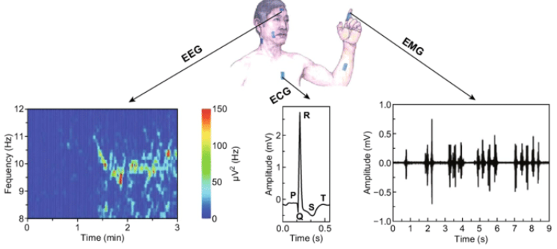
Contribution and Future Work
Feature work
- It is difficult to ensure the stability of predictions with only one data input.
- In the future, we plan to use multiple data fusion models.
For example, combining signals such as electrocardiogram (ECG) and electromyogram (EMG) with electroencephalogram (EEG) recordings could further improve methods of predicting epileptic seizures
23

Slide 25
THANK YOU

