Slide 1
IIP
Plant disease recognition study
2022. 09. 29

Slide 2
Contents
Part.1
Plant
1. Dataset
2. Data Augmentation
3. Result

Slide 3
Current Progress Plant
Description of research progress and results
Dataset
AI Hub
Dataset
PlantVillage Dataset
: 20,639
Kiwi disease Dataset
: 20,000
: 997
: 1,478
: 1,000
: 1,000
: 152
: 2,127
: 1,000
: 1,909
: 952
: 1,771
: 1,676
: 1,404
: 3,209
: 373
: 1,591
Kiwi fruit normal
Kiwi fruit Bacterial soft rot
Kiwi leaf normal
Kiwi leaf Spot
Kiwi leaf Trips
Pepper bell bacteria spot
Pepper bell healthy
Potato early blight
Potato late blight
Potato healthy
Tomato bacterial spot
Tomato early blight
Tomato late blight
Tomato leaf mold
Tomato Septoria leaf spot
Tomato Spider mites
Tomato mosaic virus
Tomato yellowleaf virus
Tomato healthy
Tomato spot
: 2,124
: 1,737
: 2,876
: 7,036
: 5,585
Class
Total
: 26
: 60,639
Citrus disease Dataset
: 20,000
Citrus fruit normal
Citrus fruit CBC
Citrus leaf normal
Citrus leaf CBC
Citrus leaf Panonychus citri
Citrus leaf Toxoptera citricida
: 2,545
: 1,716
: 2,455
: 9,552
: 1,814
: 1,918
: 1,000 images
: Delete

Slide 4
Current Progress Plant
Description of research progress and results
Dataset
Training set : Validation set = 7 : 3
Class : 26 / Total : 60,639
Class : 24 / Total : 60,165
Data Label | train | val | Total
Citrus_Fruit_CBC | 1,372 | 344 | 1,716
Citrus_Fruit_Normal | 2,035 | 510 | 2,545
Citrus_Leaf_aphid | 1,534 | 384 | 1,918
Citrus_Leaf_CBC | 7,642 | 1,910 | 9,552
Citrus_Leaf_Normal | 1,965 | 490 | 2,455
Citrus_Leaf_Redmite | 1,452 | 362 | 1,814
 | 16,000 | 4,000 | 20,000
Kiwi_Fruit_Murm | 1,389 | 348 | 1,737
Kiwi_Fruit_Normal | 1,698 | 426 | 2,124
Kiwi_Leaf_Bug | 4,467 | 1,118 | 5,585
Kiwi_Leaf_Normal | 2,300 | 576 | 2,876
Kiwi_Leaf_Spot | 6,142 | 1536 | 7,678
 | 15,996 | 4,004 | 20,000
Pepper__bell___Bacterial_spot | 800 | 200 | 1,000
Pepper__bell___healthy | 1,182 | 296 | 1,478
Potato___Early_blight | 800 | 200 | 1,000
Potato___healthy | x
Potato___Late_blight | 800 | 200 | 1,000
Tomato__Target_Spot | 1,095 | 309 | 1,404
Tomato__Tomato_mosaic_virus | x
Tomato__Tomato_YellowLeaf__Curl_Virus | 2,578 | 631 | 3,209
Tomato_Bacterial_spot | 1,687 | 440 | 2,127
Tomato_Early_blight | 800 | 200 | 1,000
Tomato_healthy | 1,269 | 322 | 1,591
Tomato_Late_blight | 1,555 | 354 | 1,909
Tomato_Leaf_Mold | 800 | 200 | 1,000
Tomato_Septoria_leaf_spot | 1,432 | 339 | 1,771
Tomato_Spider_mites_Two_spotted_spider_mite | 1,319 | 357 | 1,676
 | 16,117 | 4,048 | 20,165

Slide 5
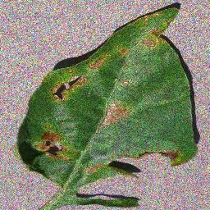
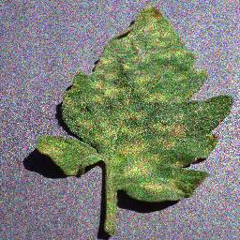
Current Progress Plant
Description of research progress and results
Dataset
Noise type : Impulse, Gaussian, Multiplicative gaussian, Laplacian, Poisson, Uniform
Randomly add noise to image
Pepper bell bacterial spot : + 3 images
Tomato leaf mole : + 48 images
5
/ 26

Slide 6
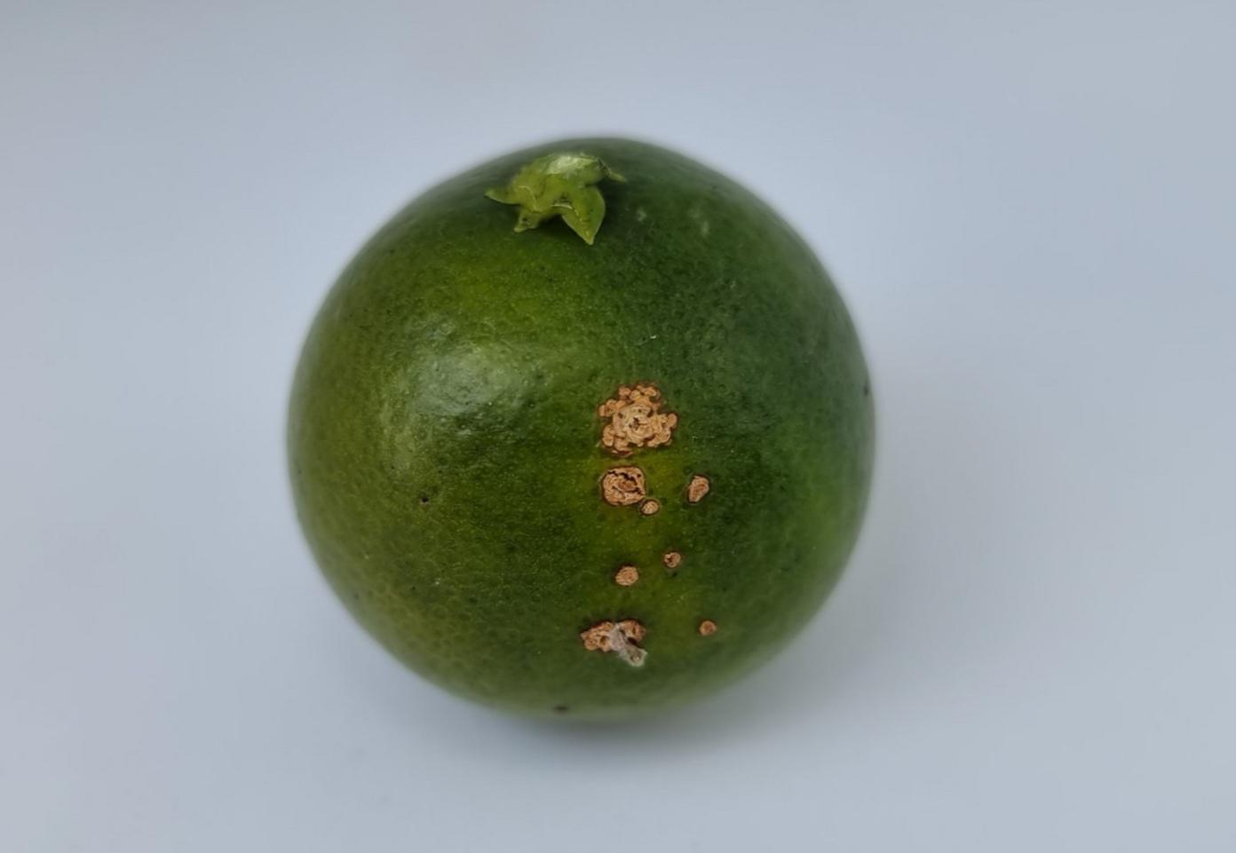
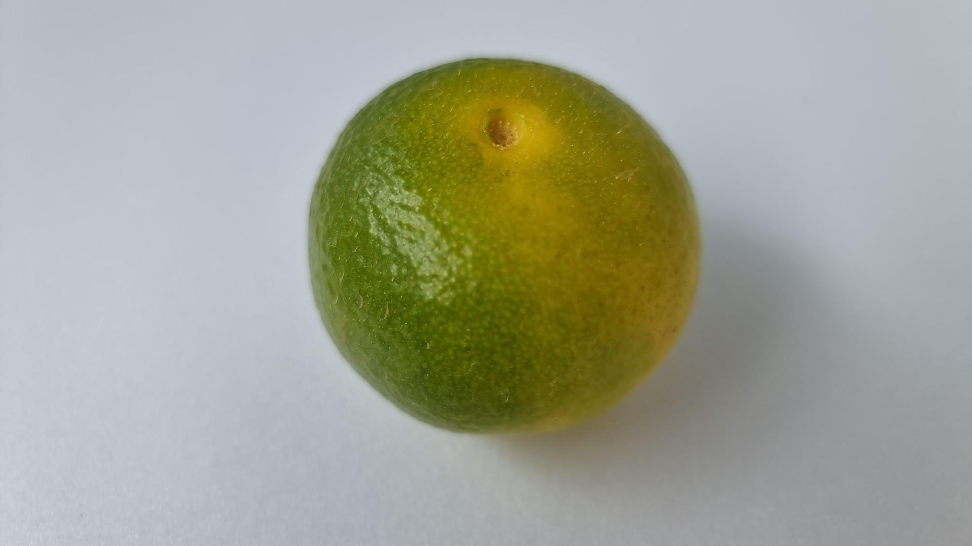
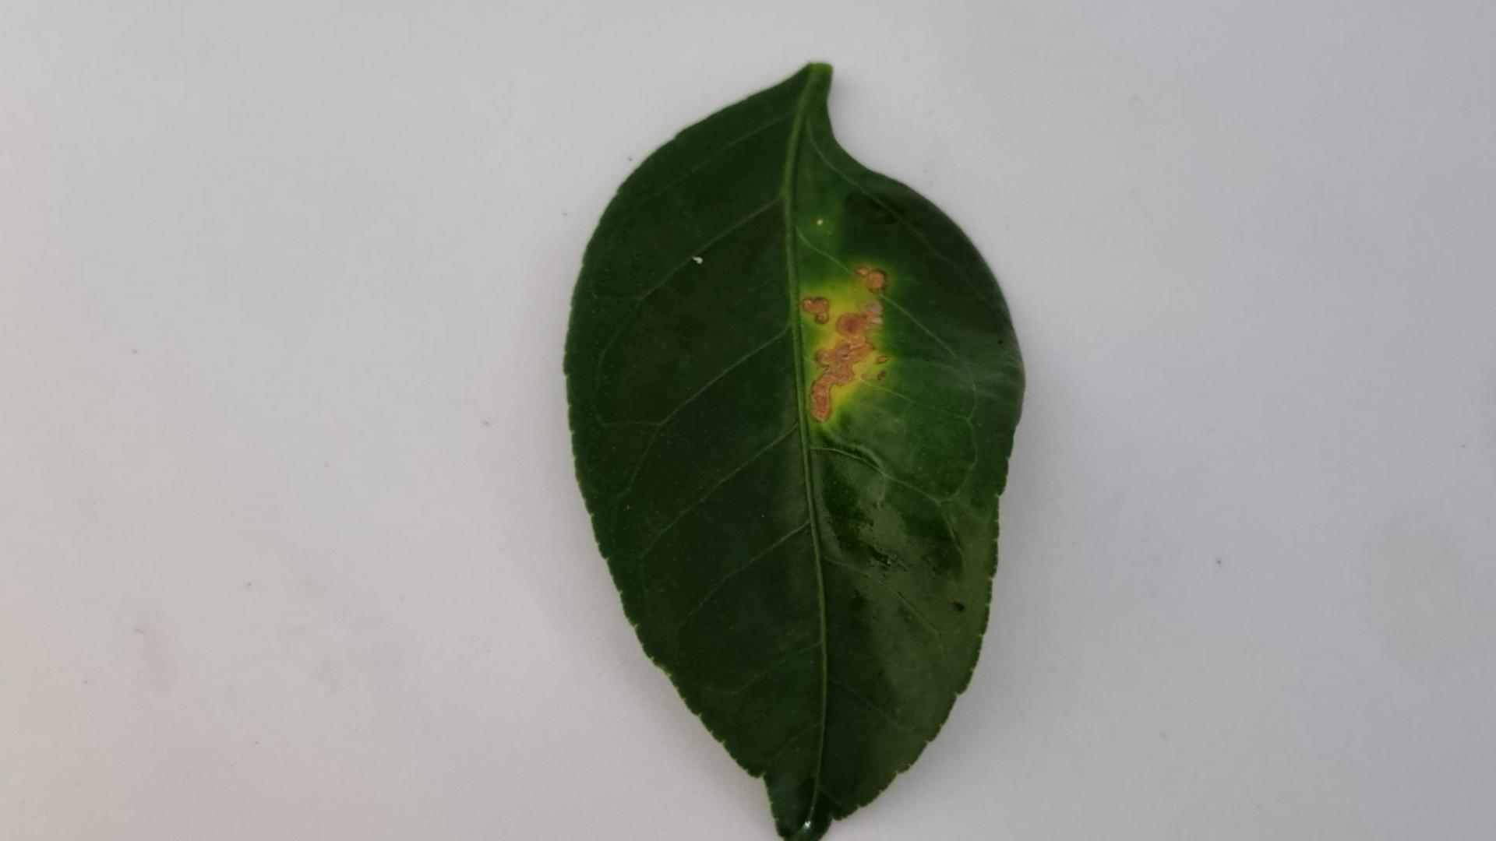
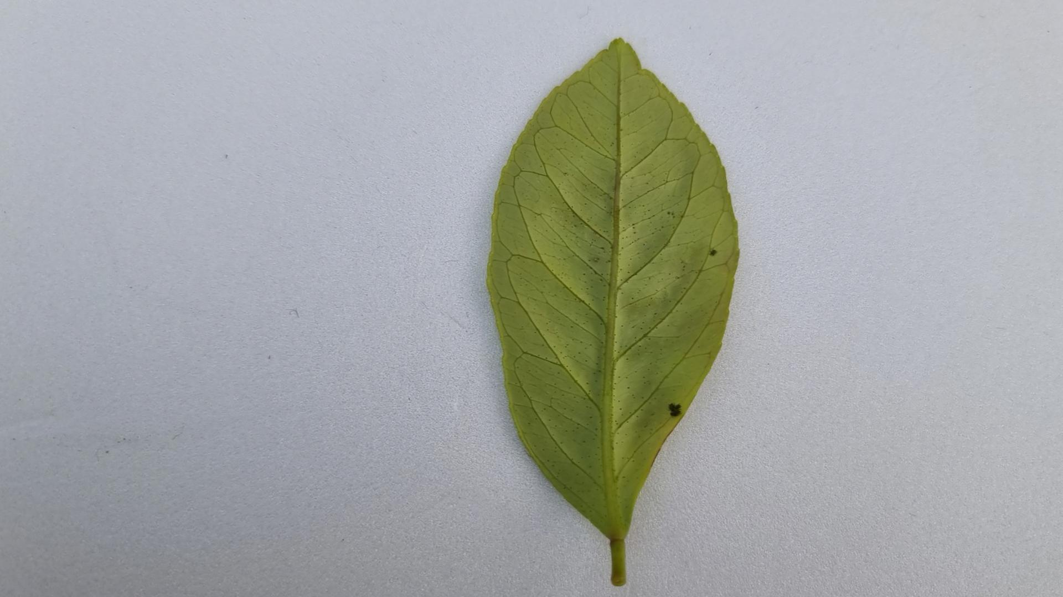
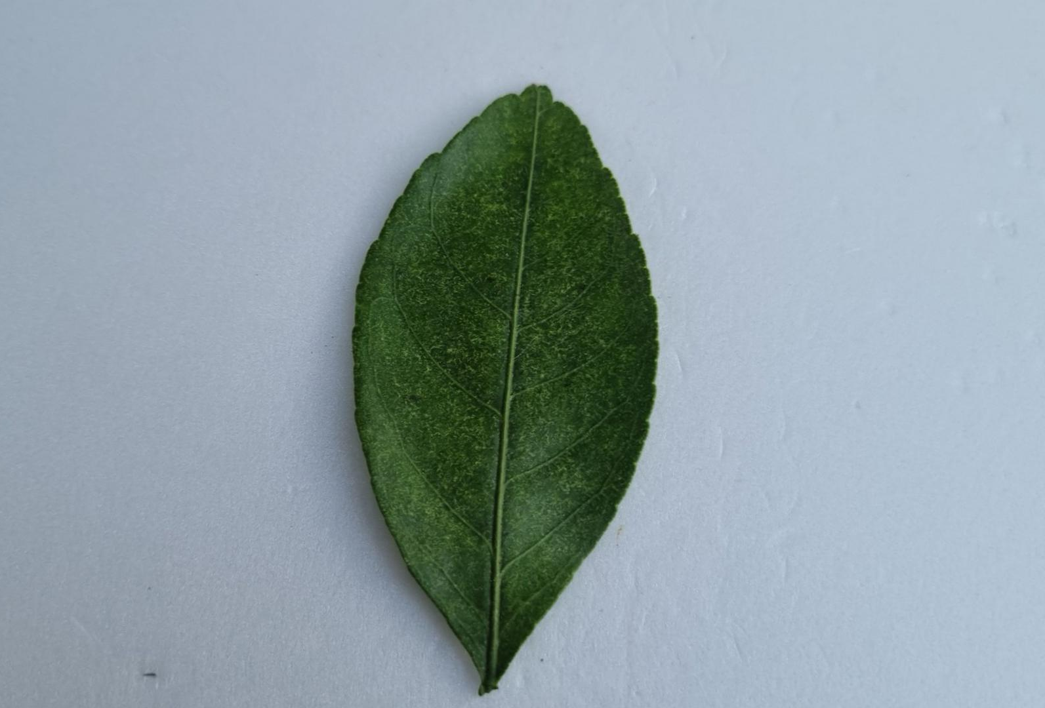
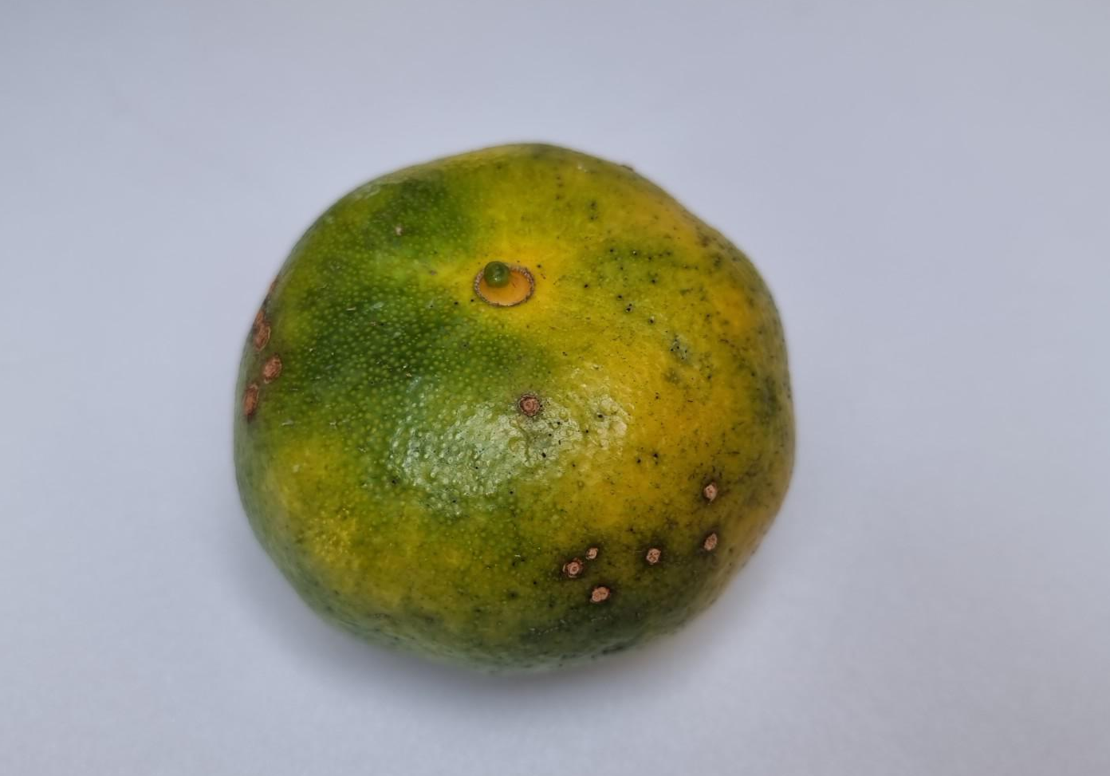
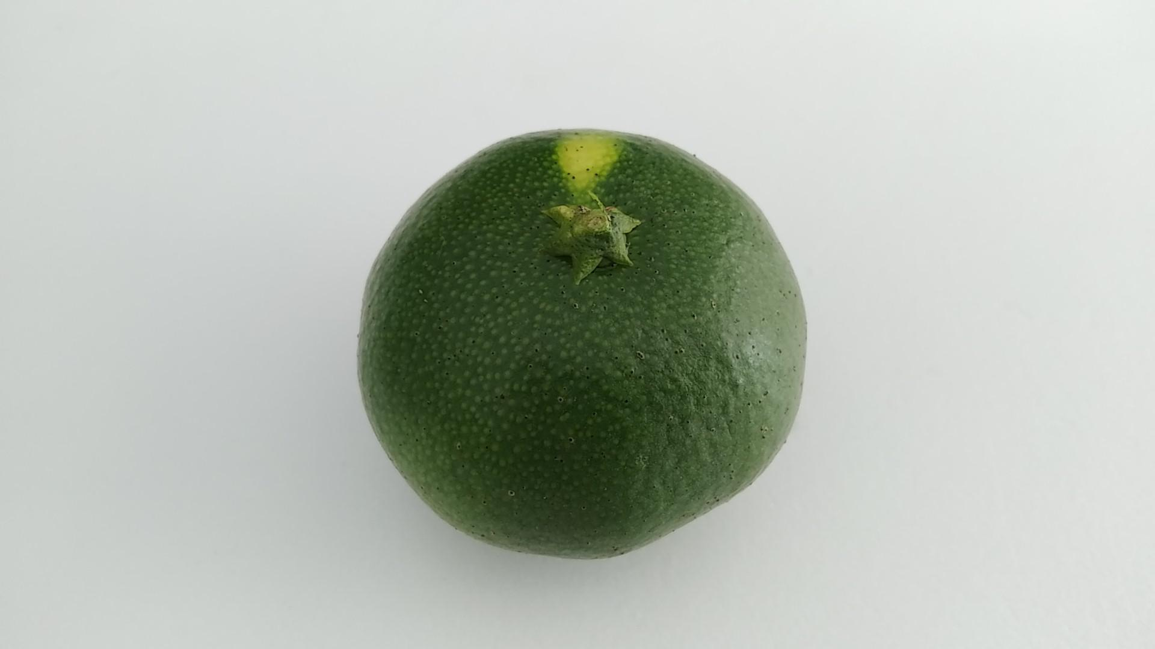
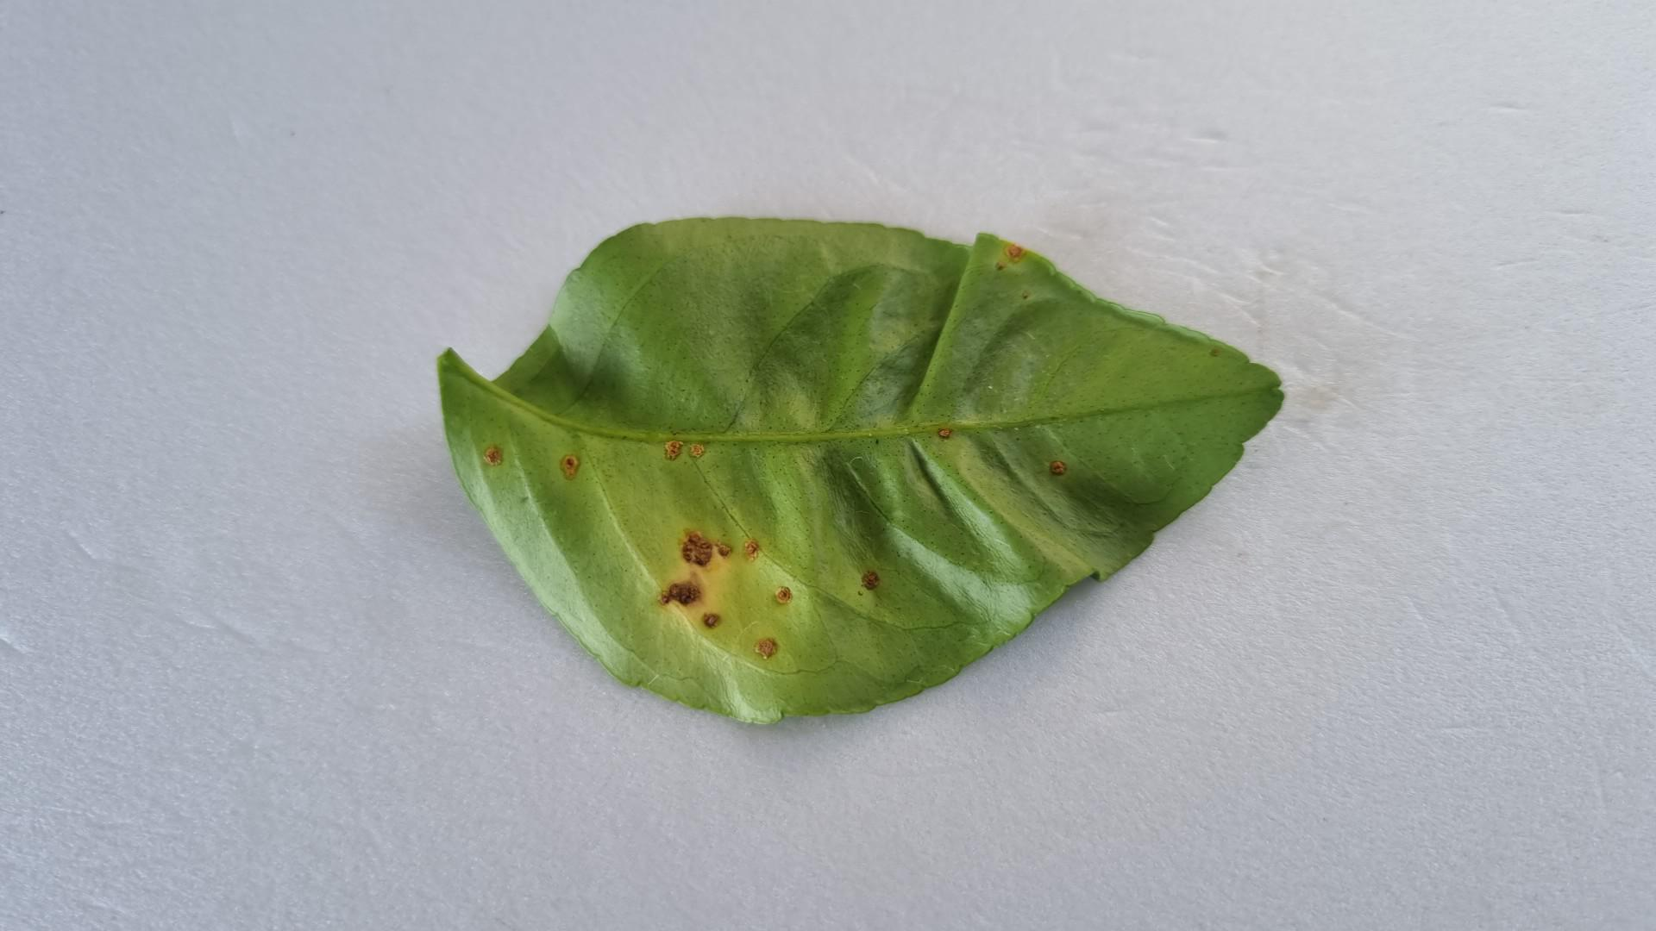
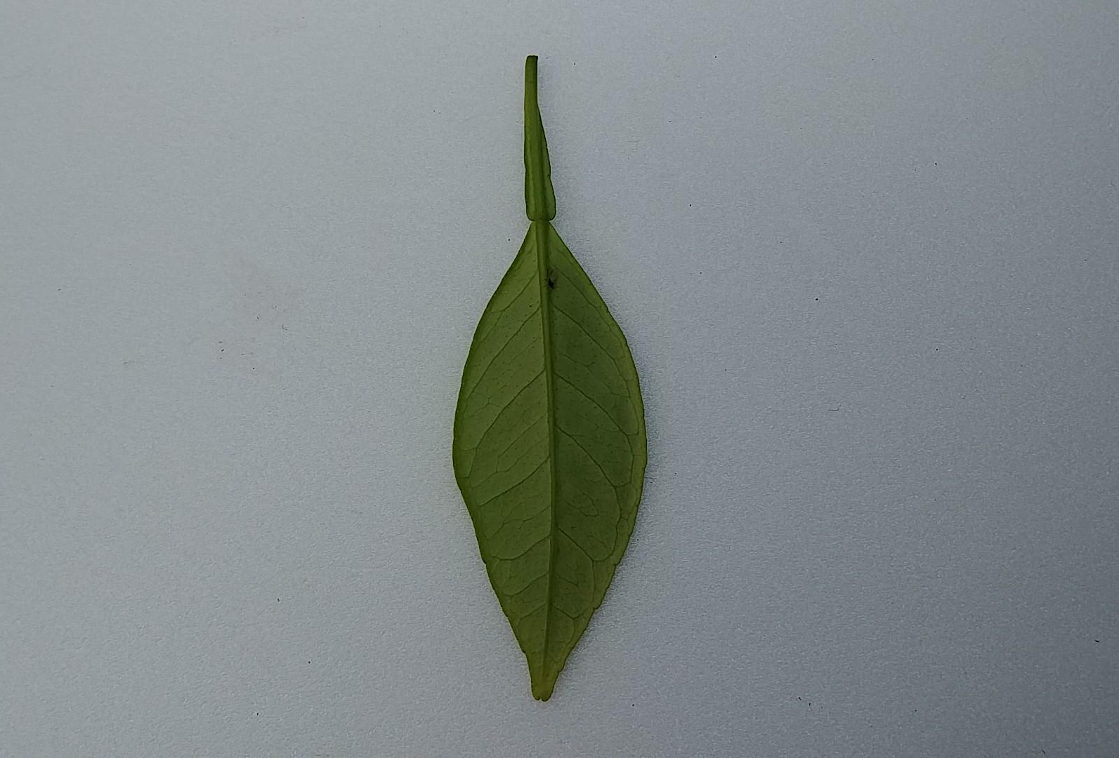
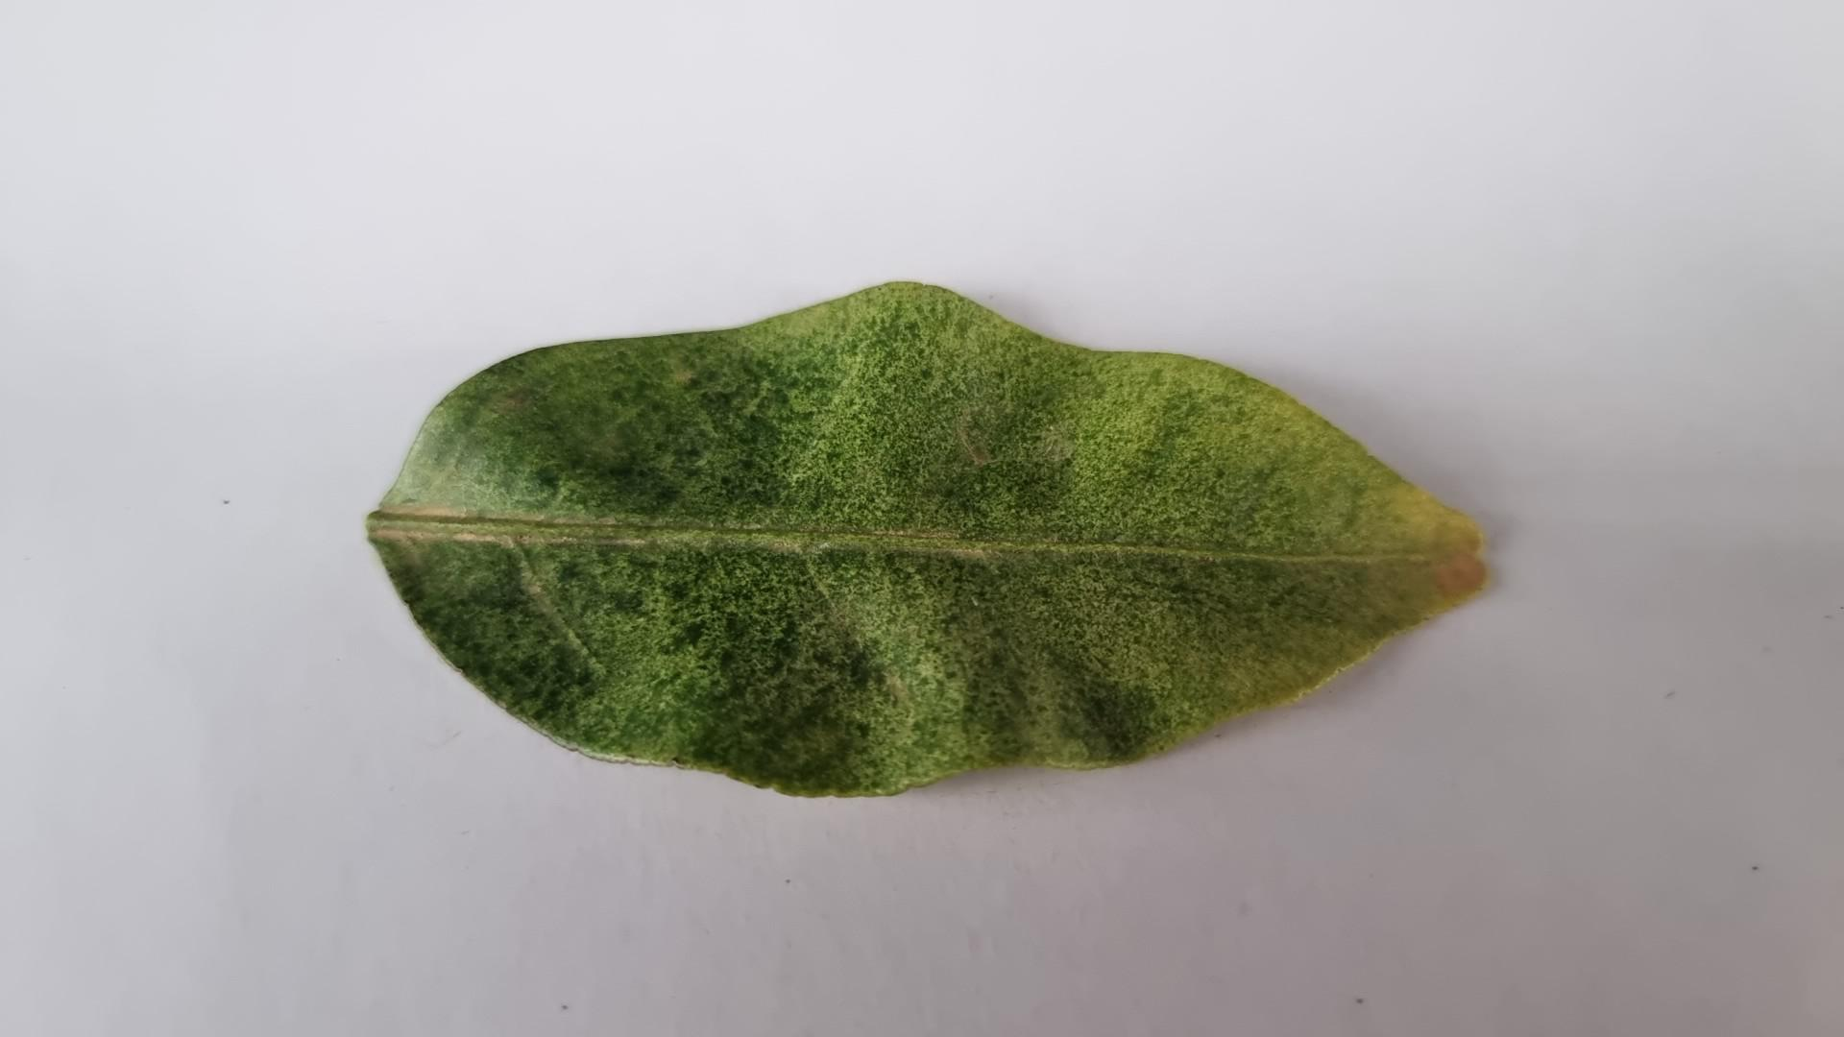
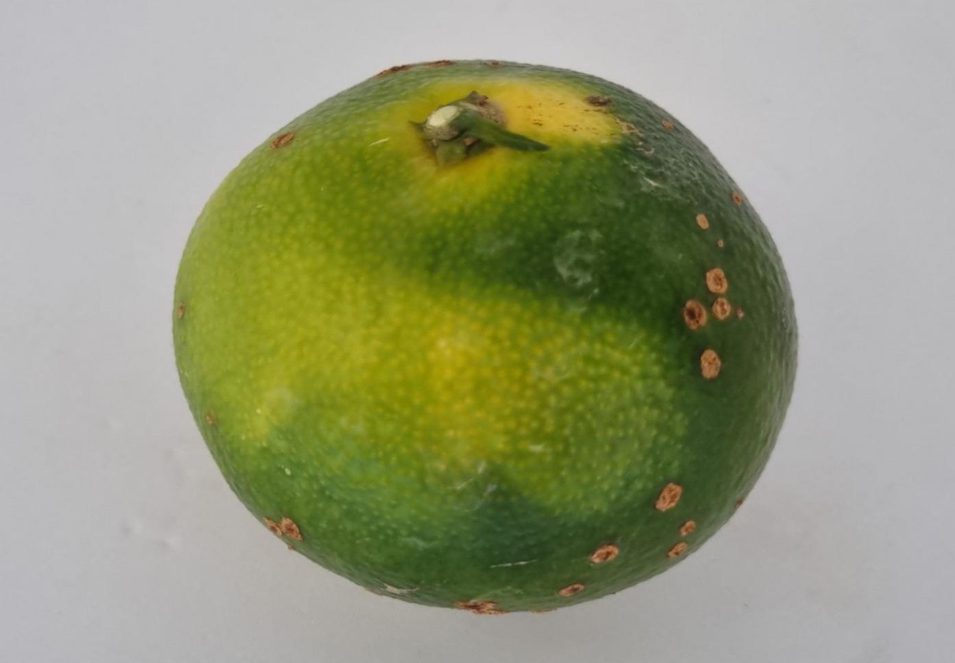
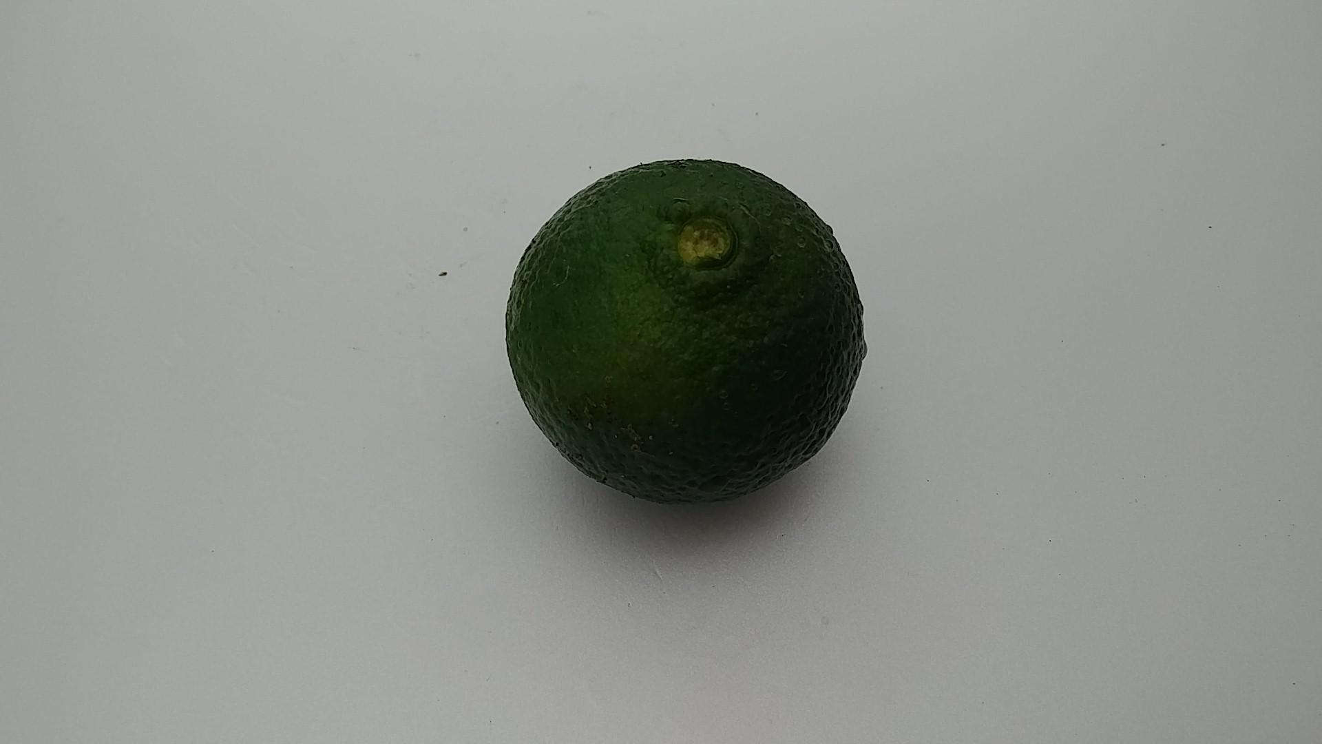
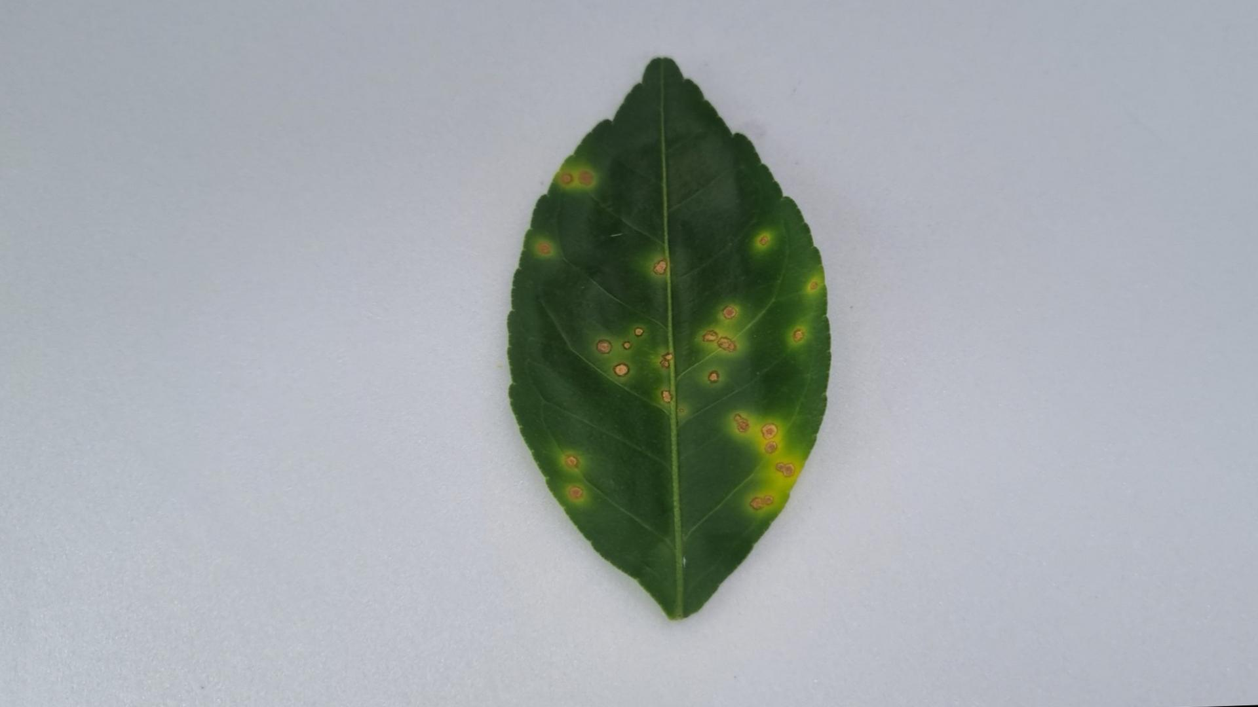
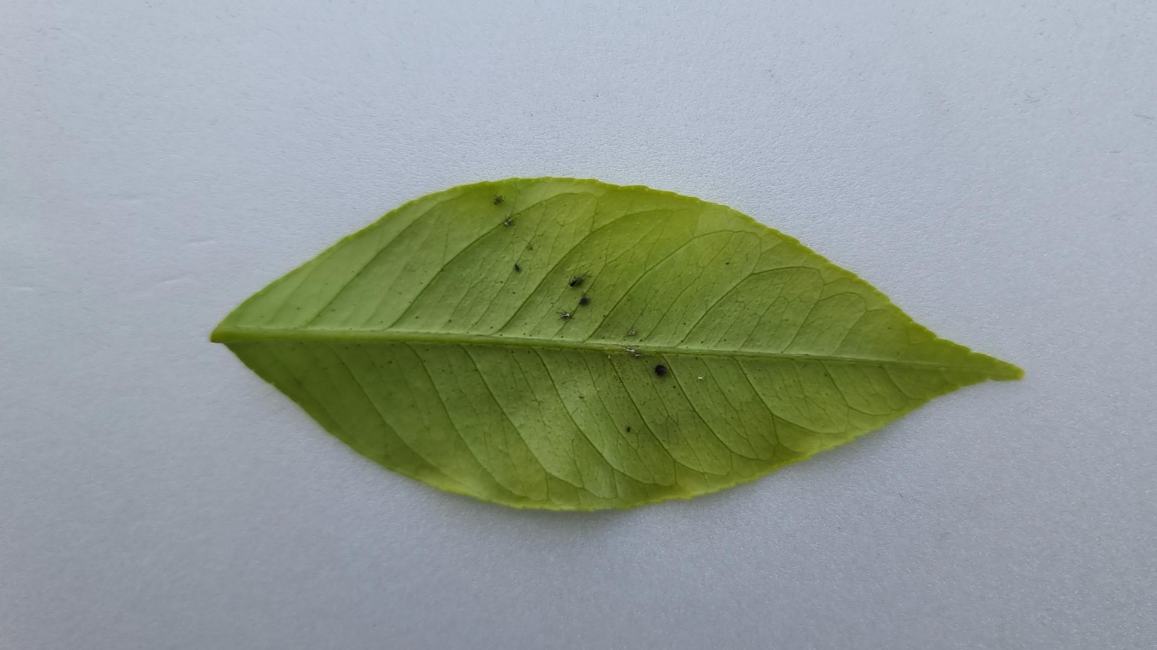
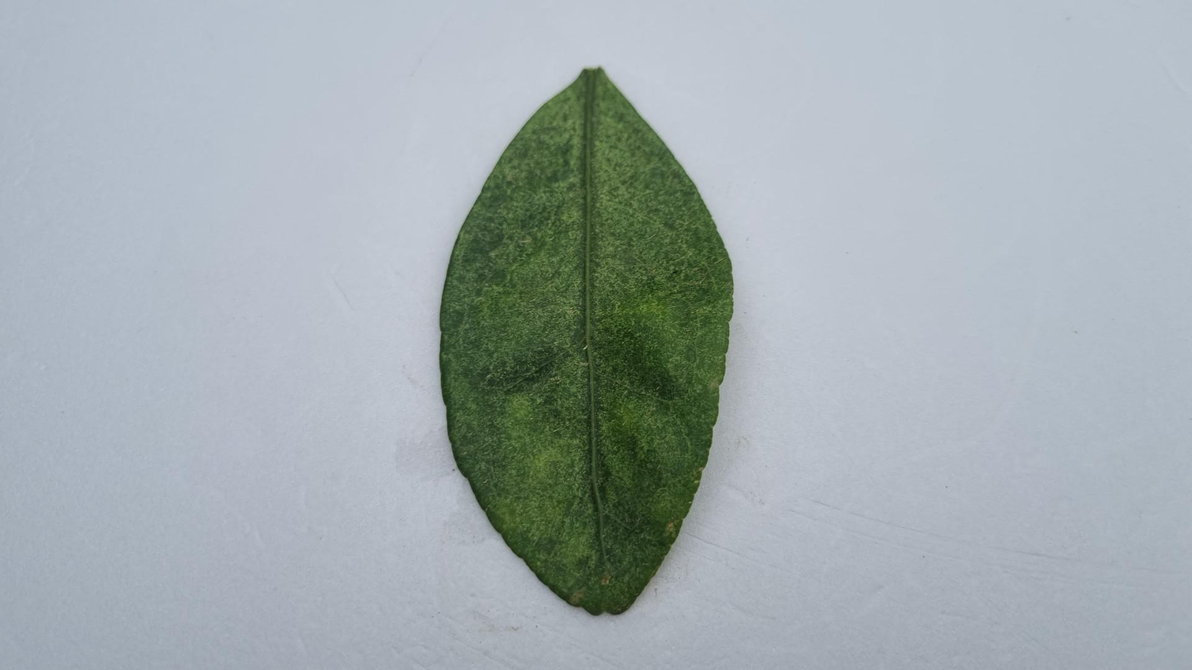
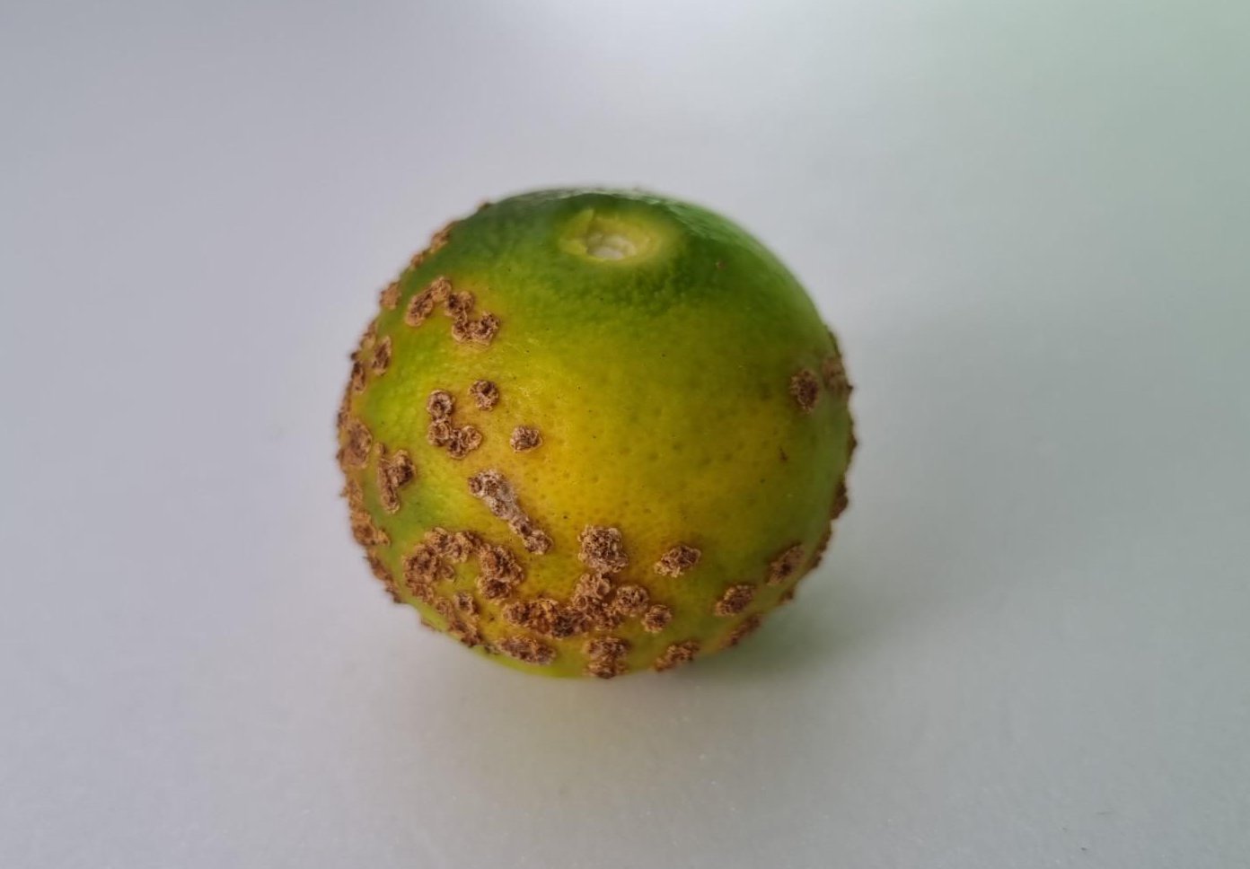
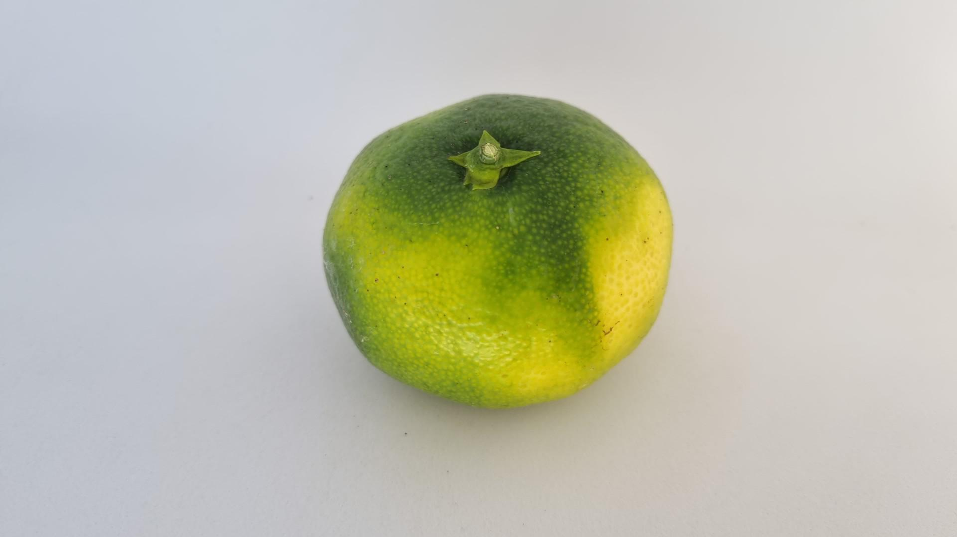
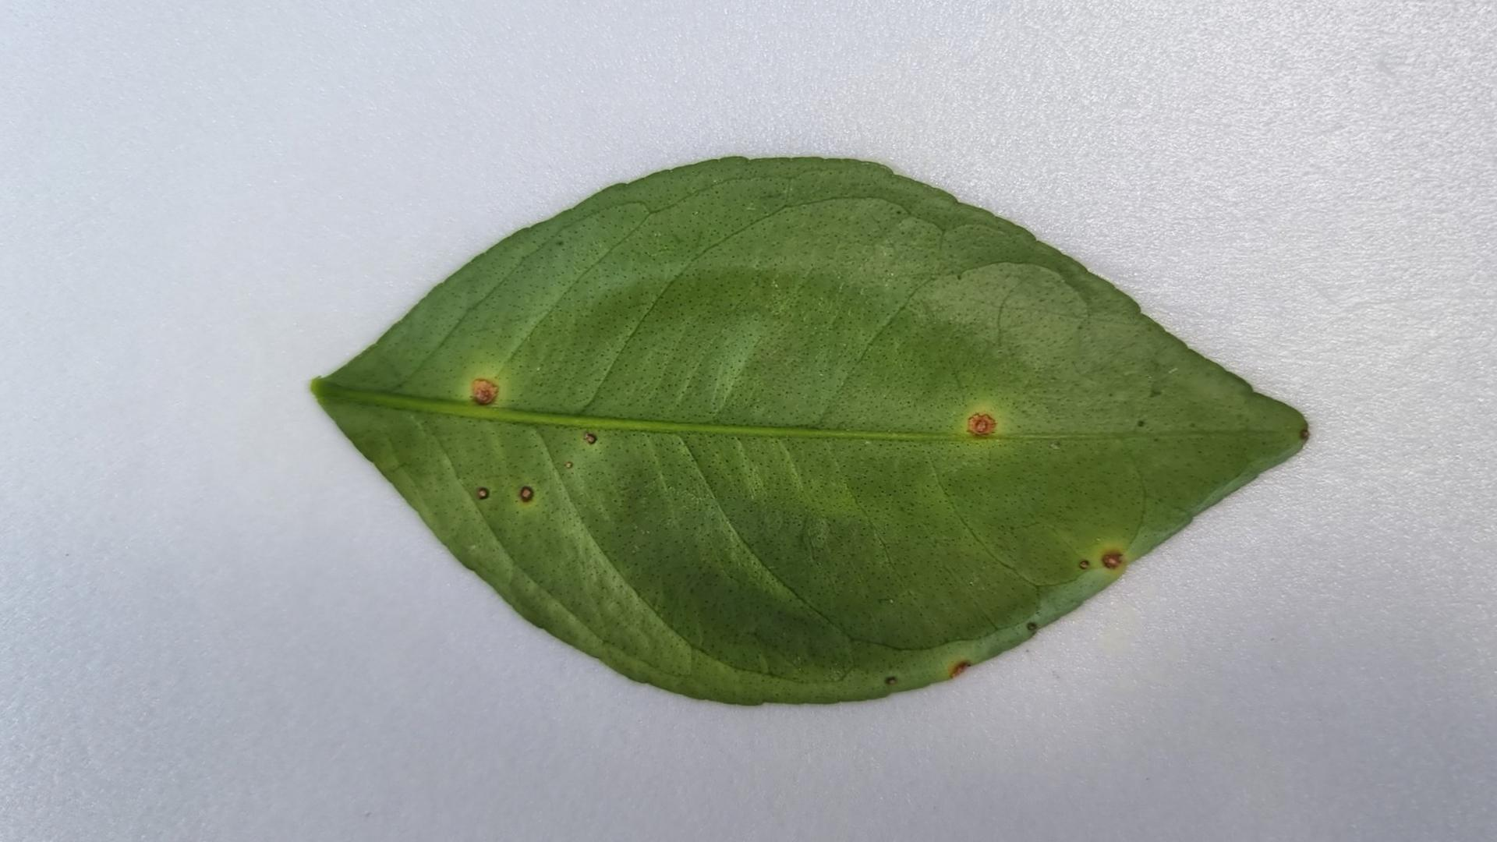
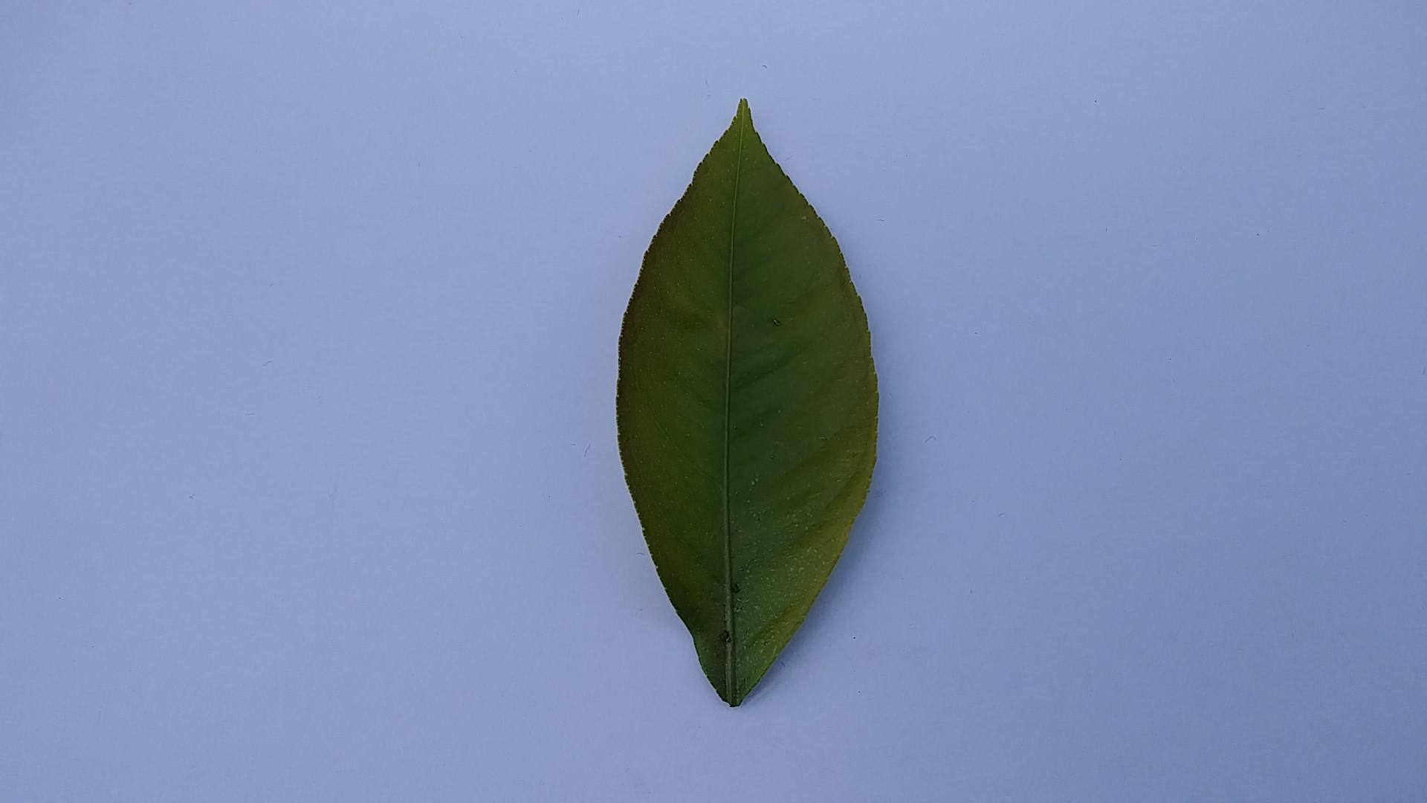
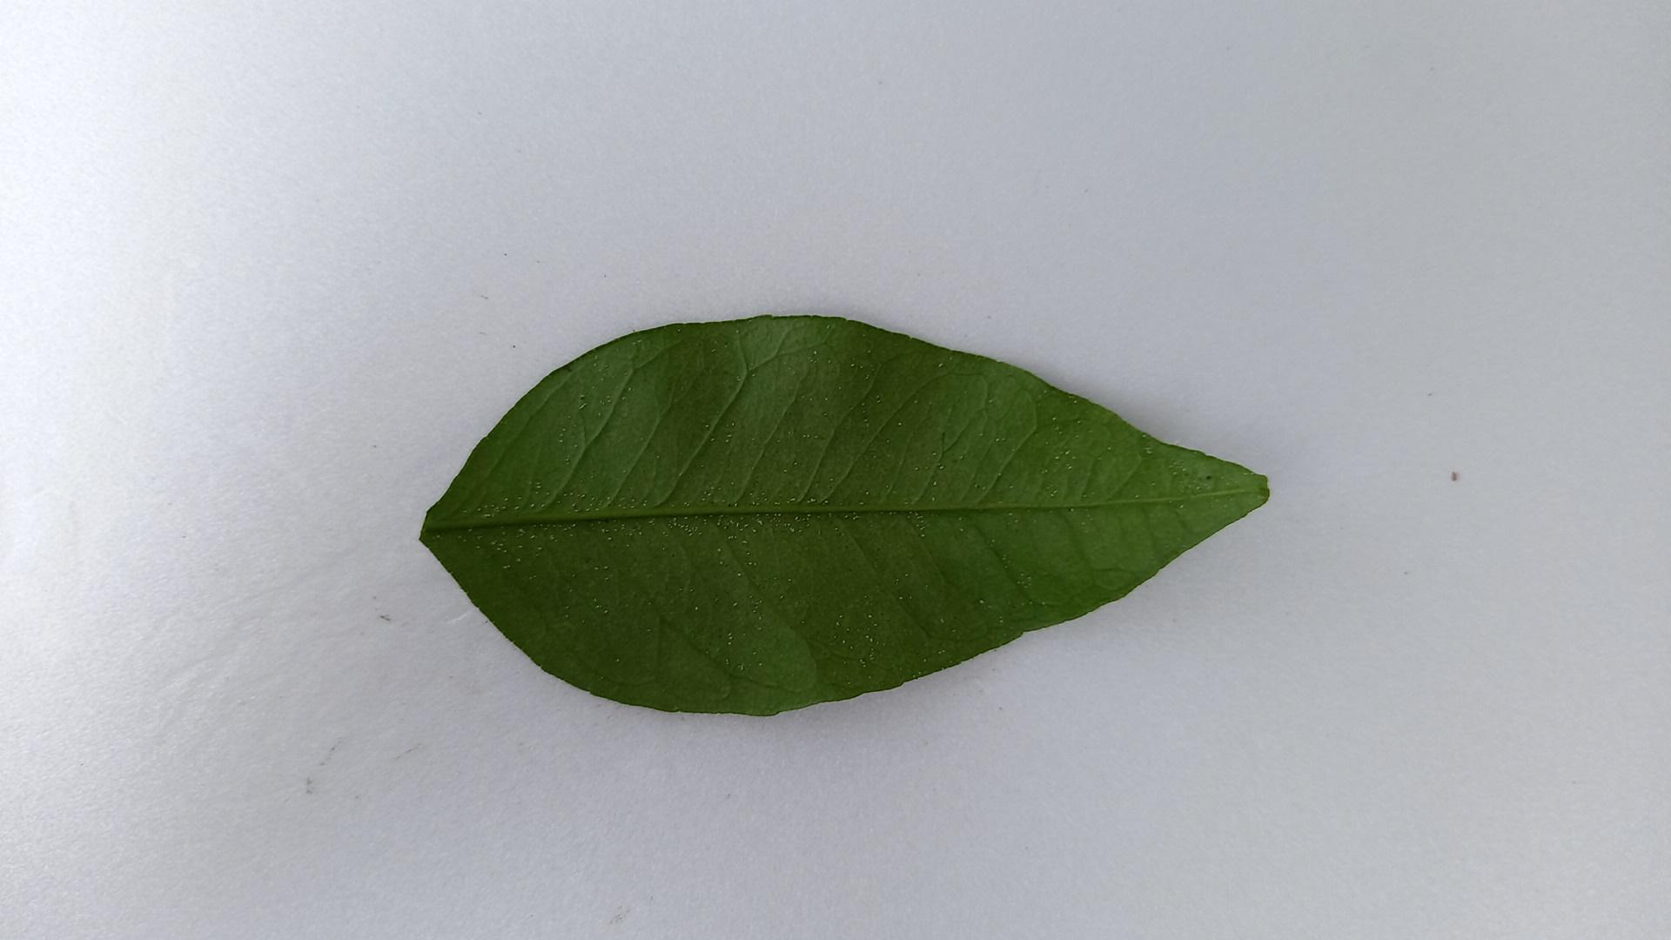
Current Progress Plant
Description of research progress and results
Dataset
Citrus fruit CBC
Citrus fruit healthy
Citrus leaf CBC
Citrus leaf aphid
Citrus leaf red mite

Slide 7
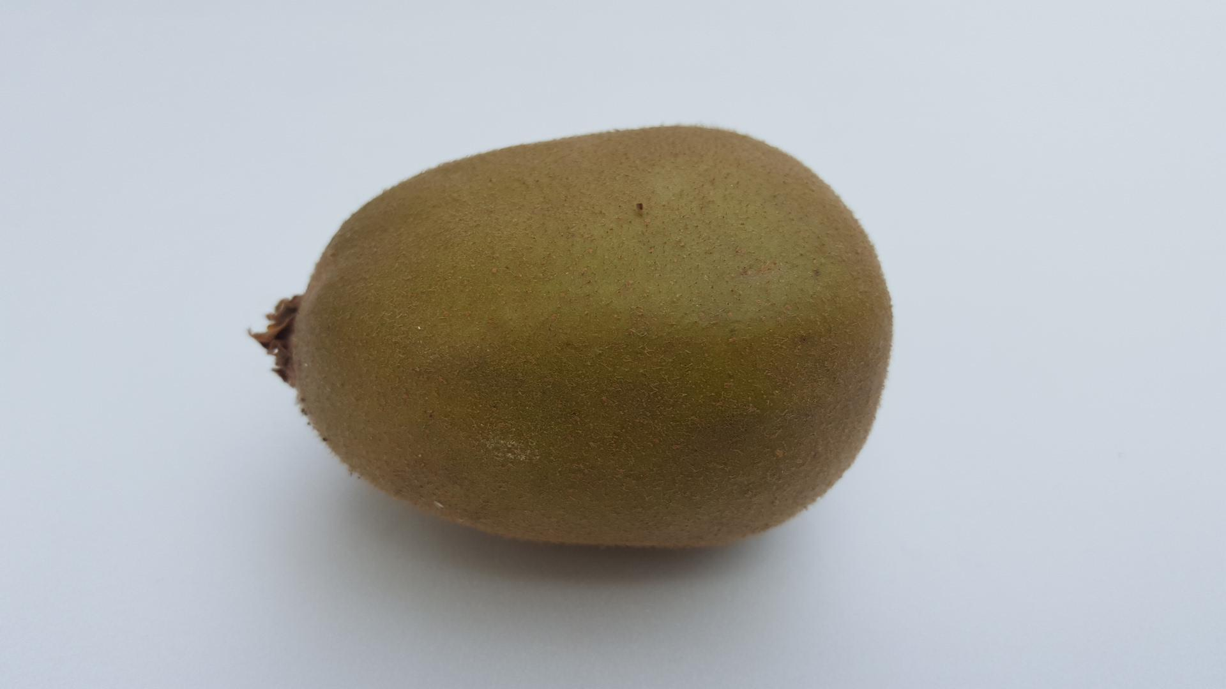
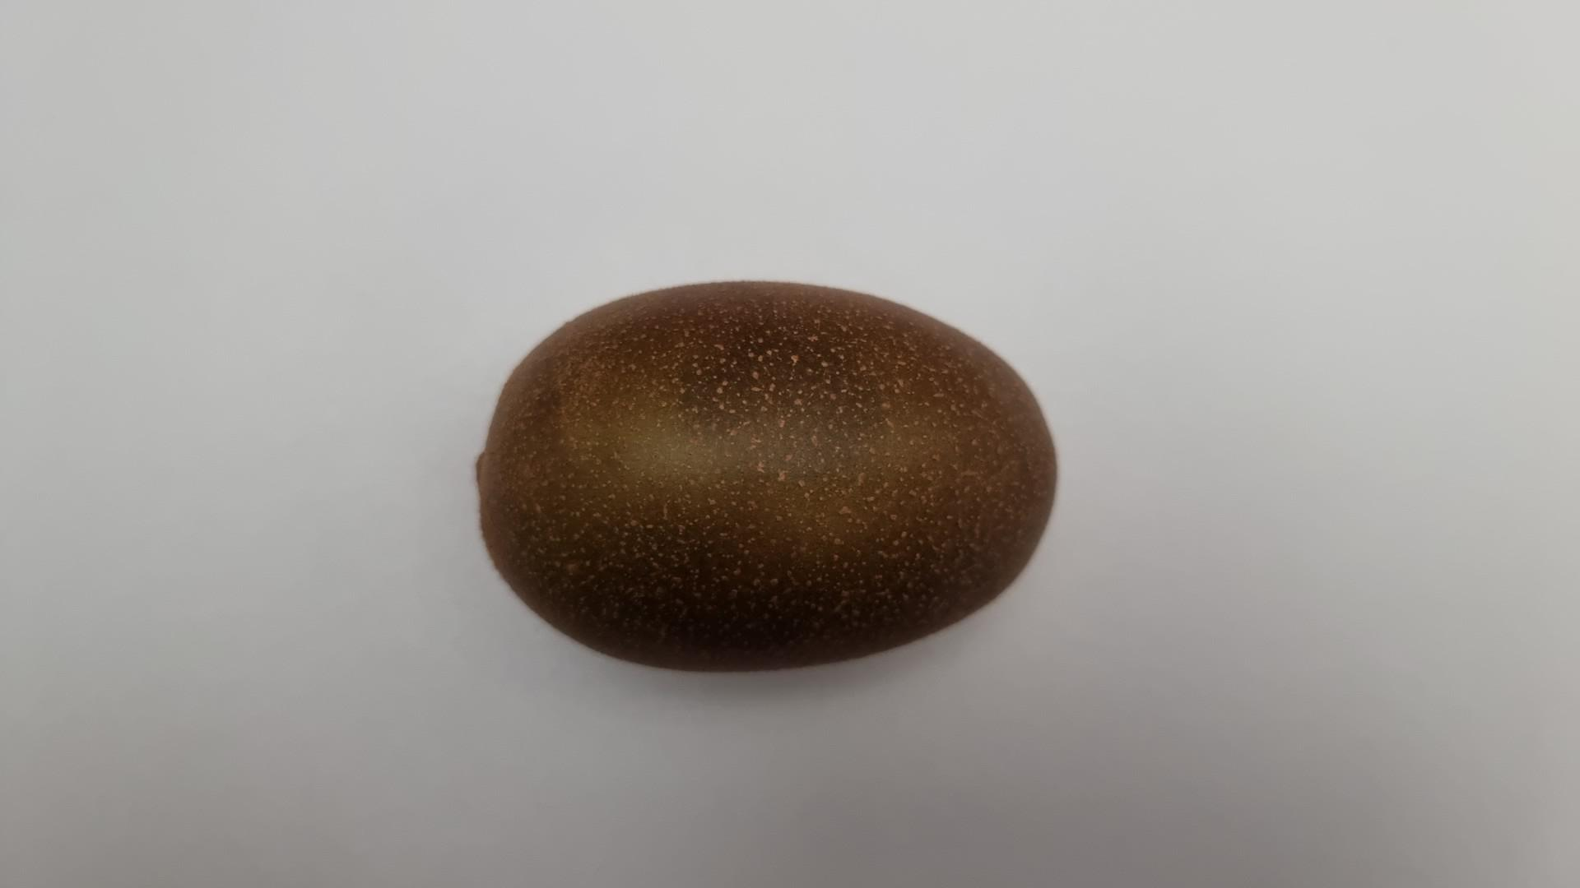
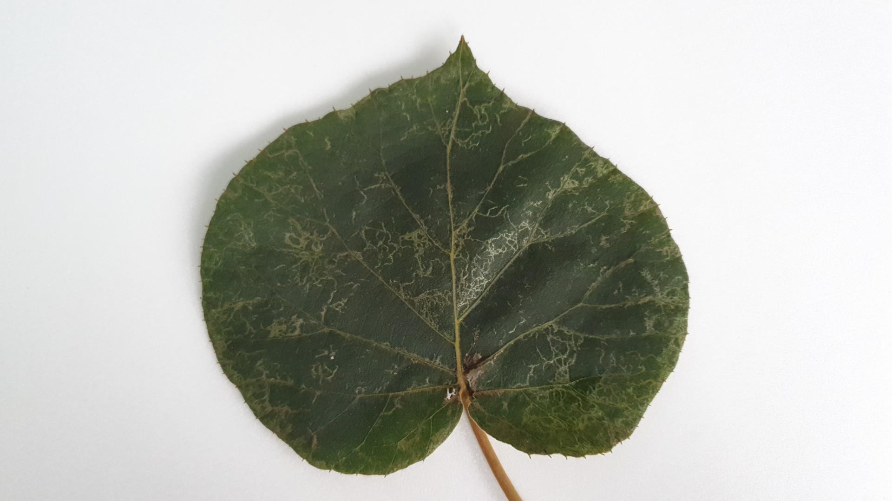
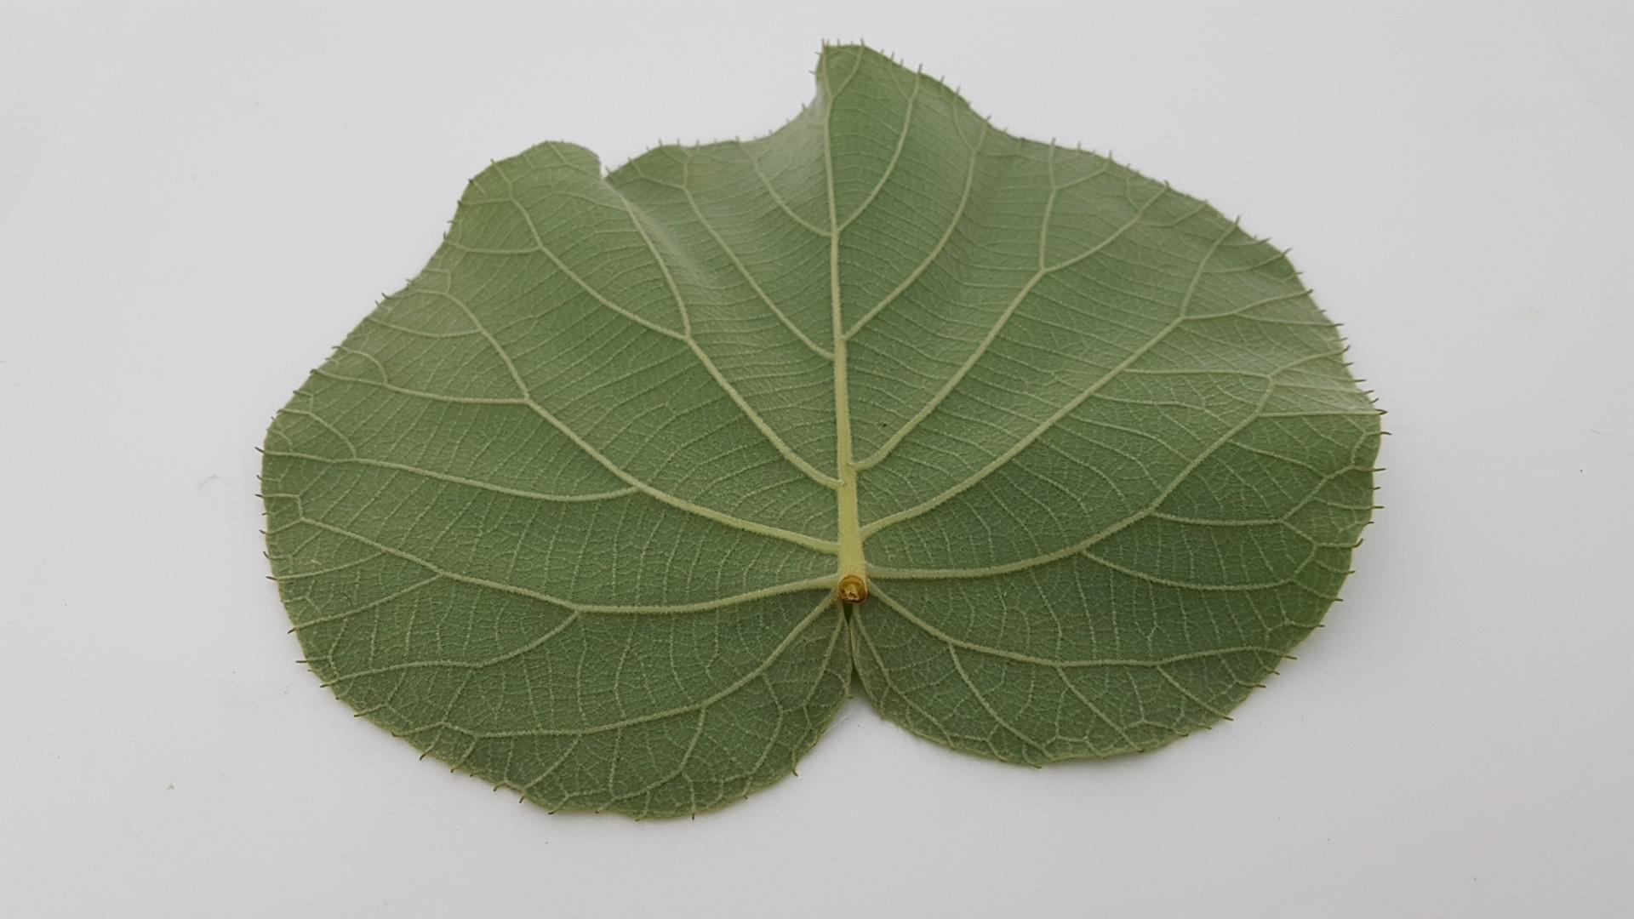
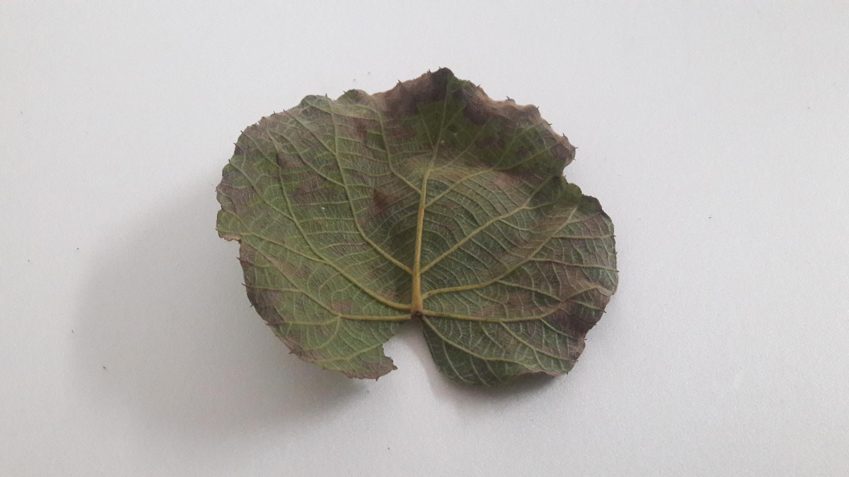
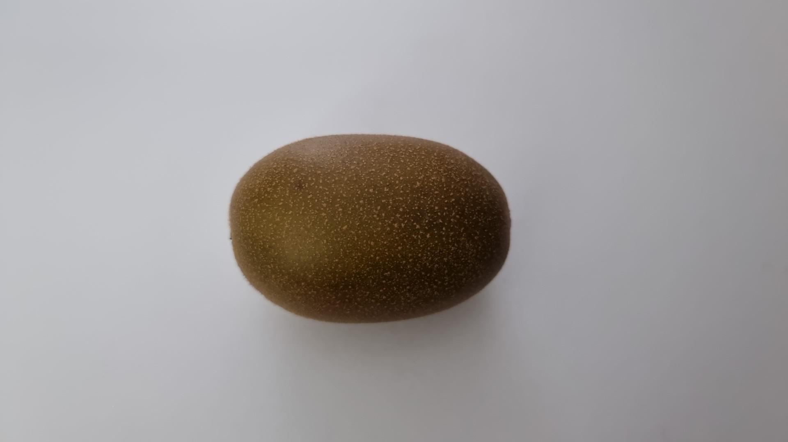
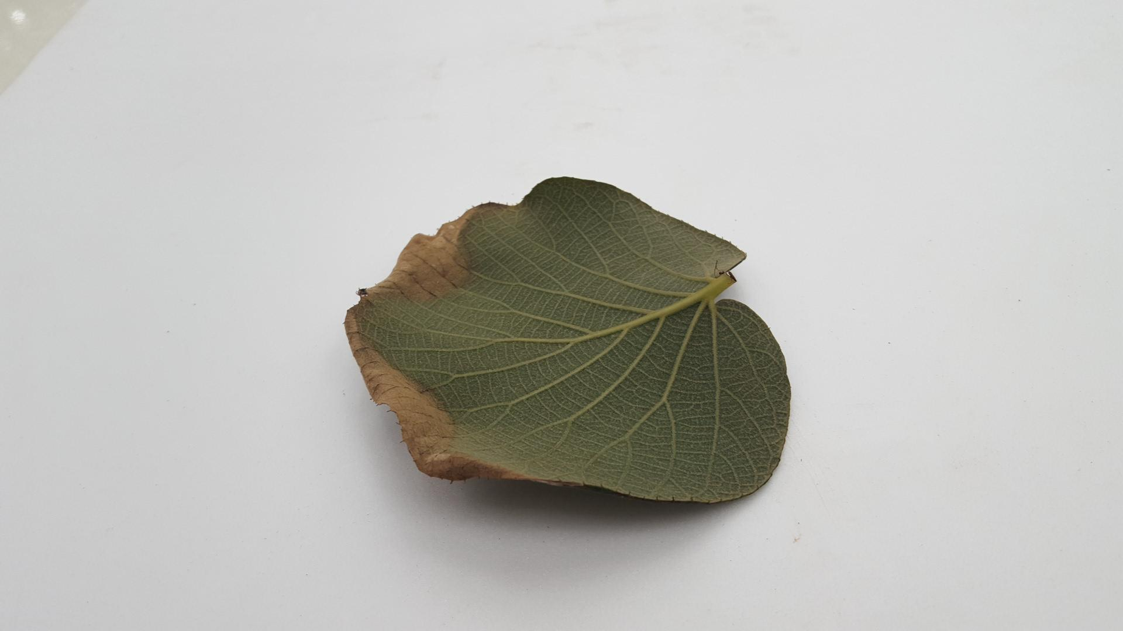
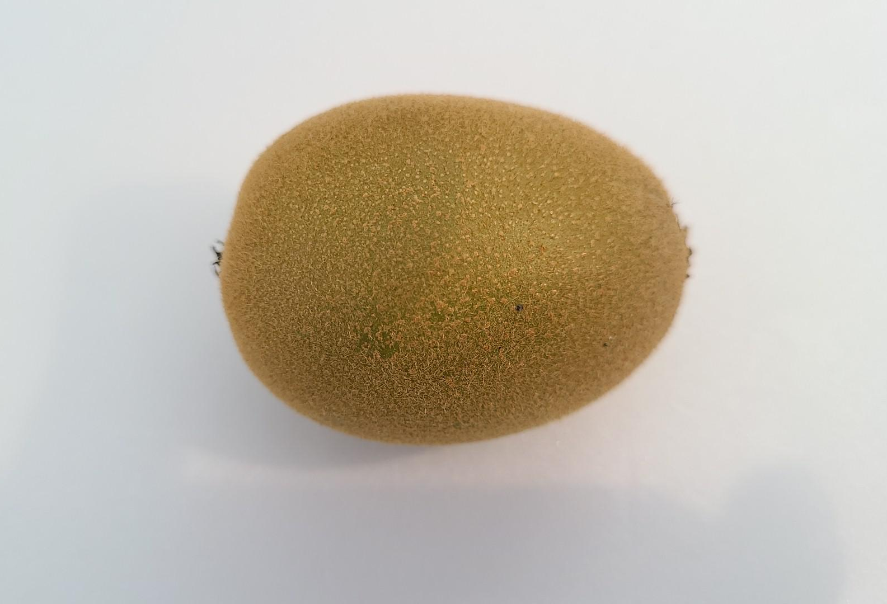
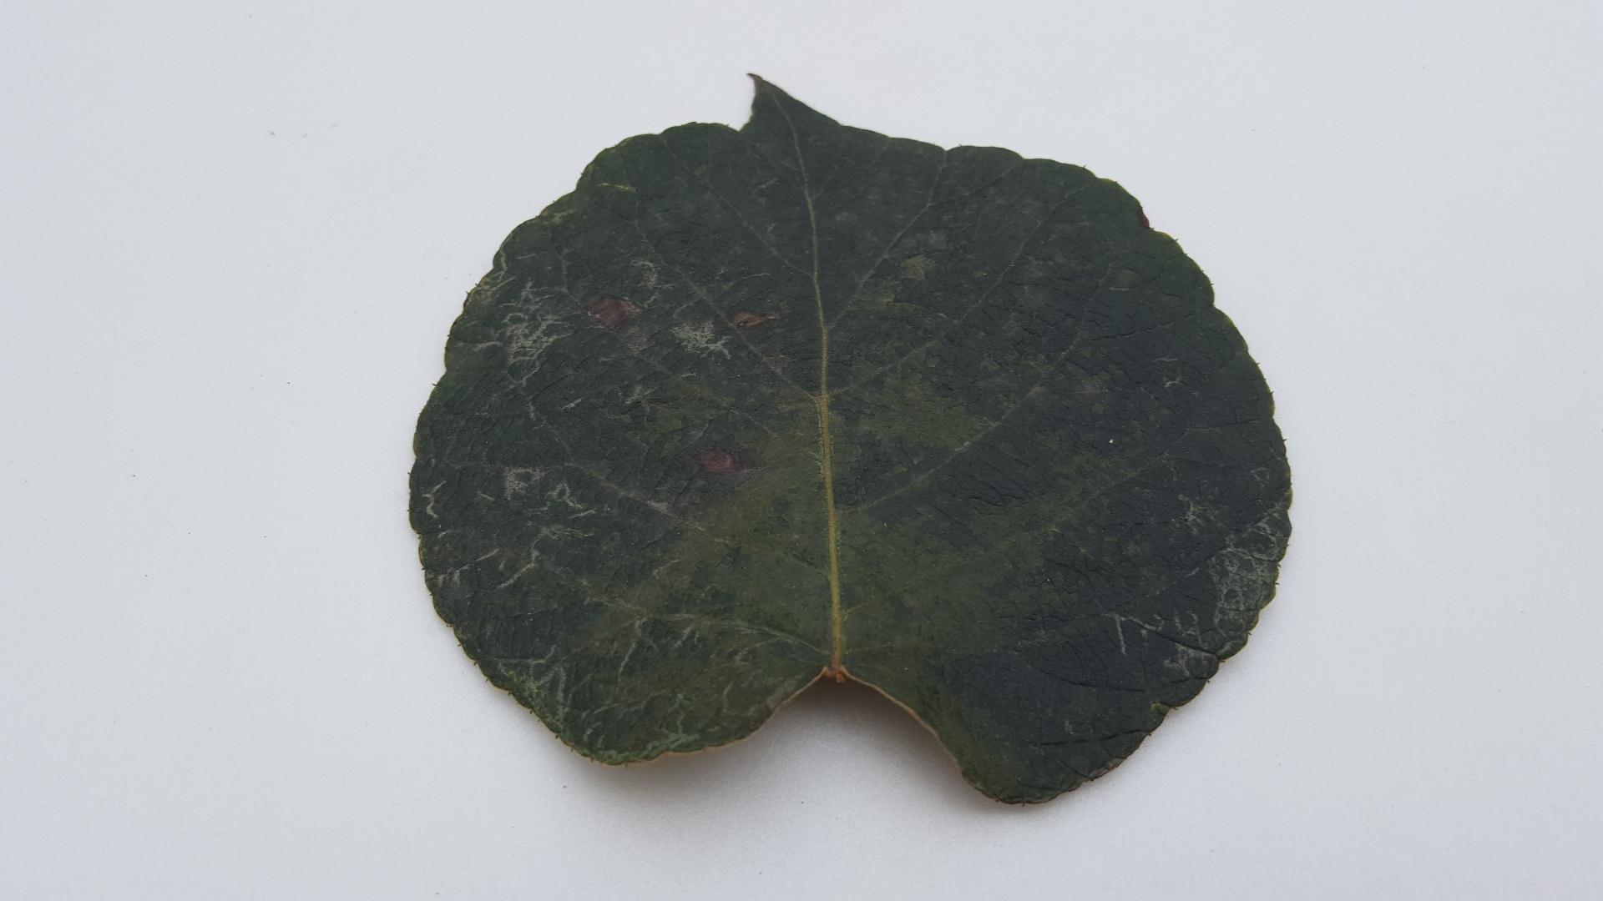
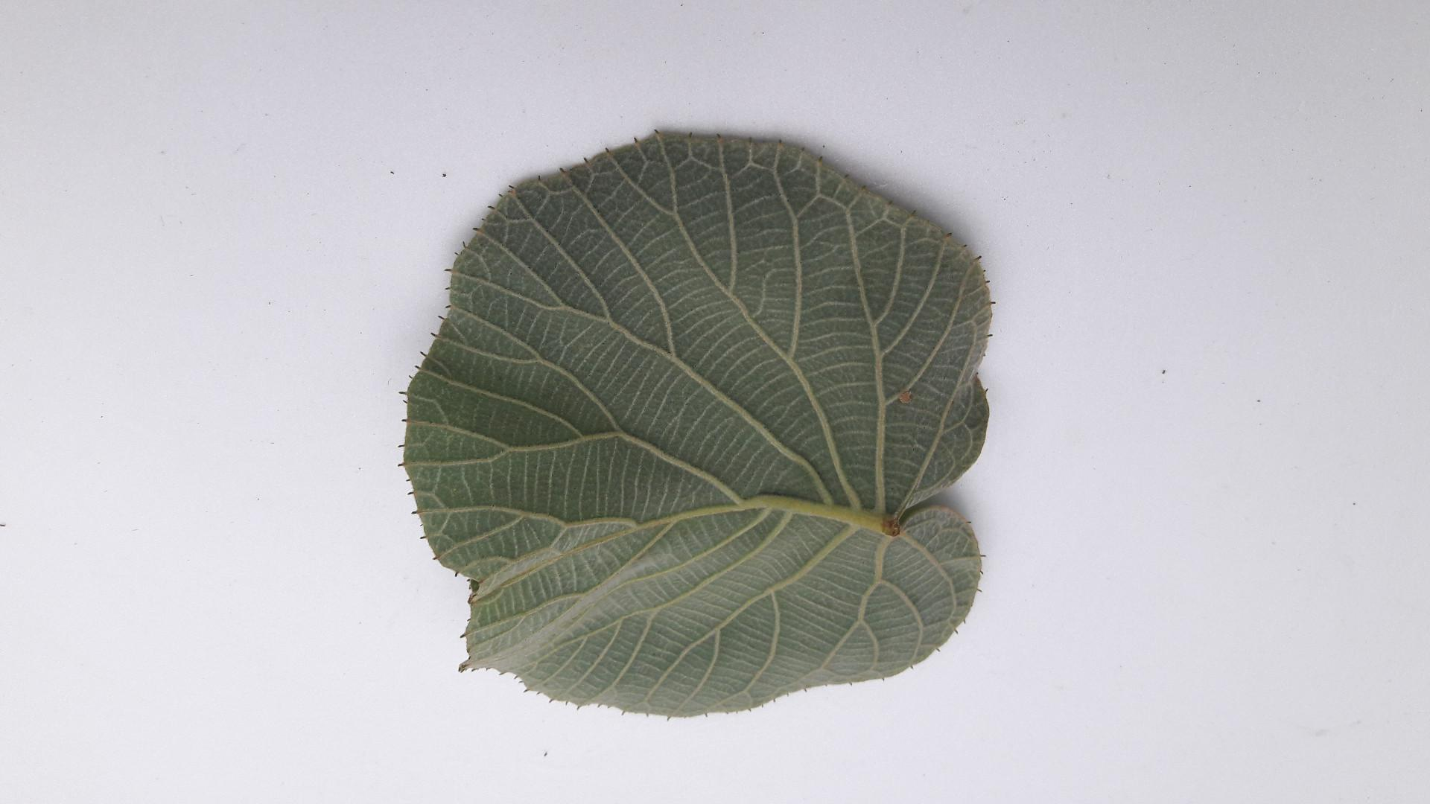
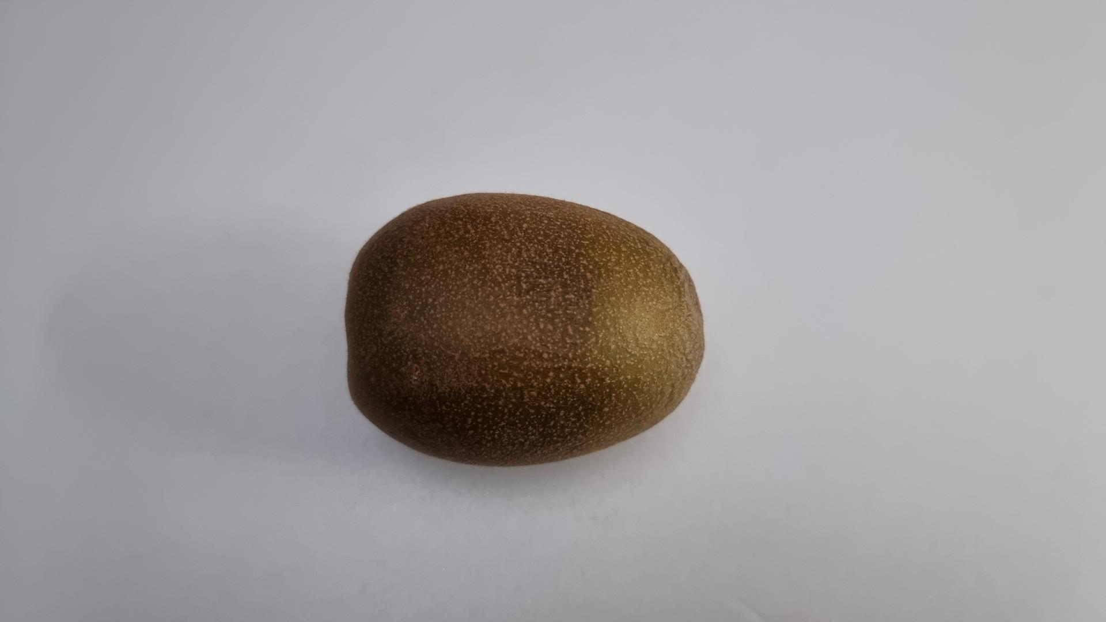
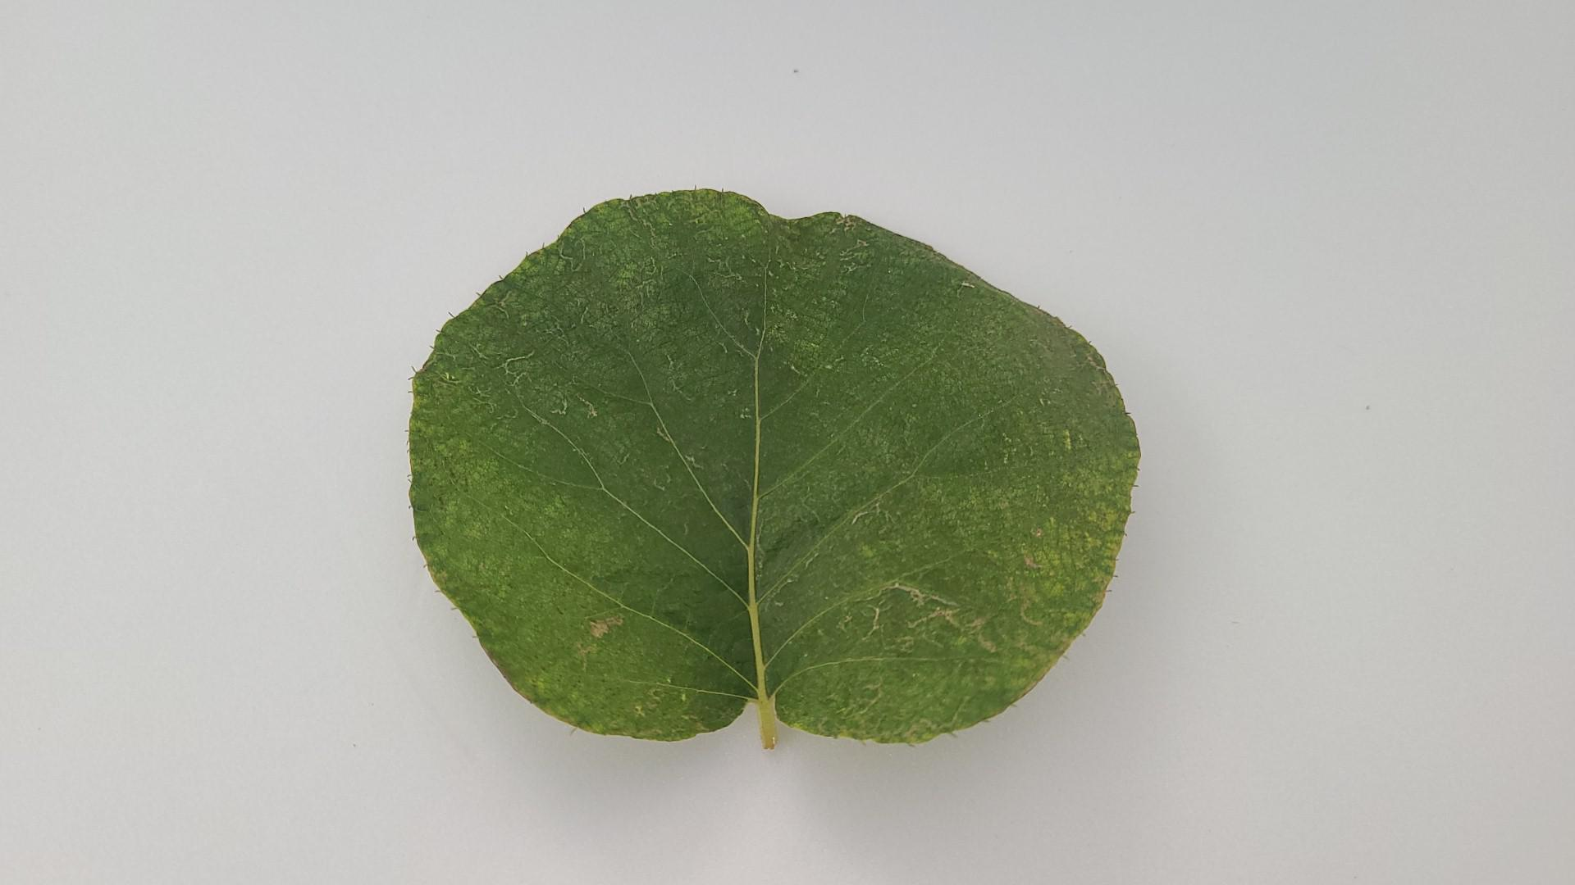
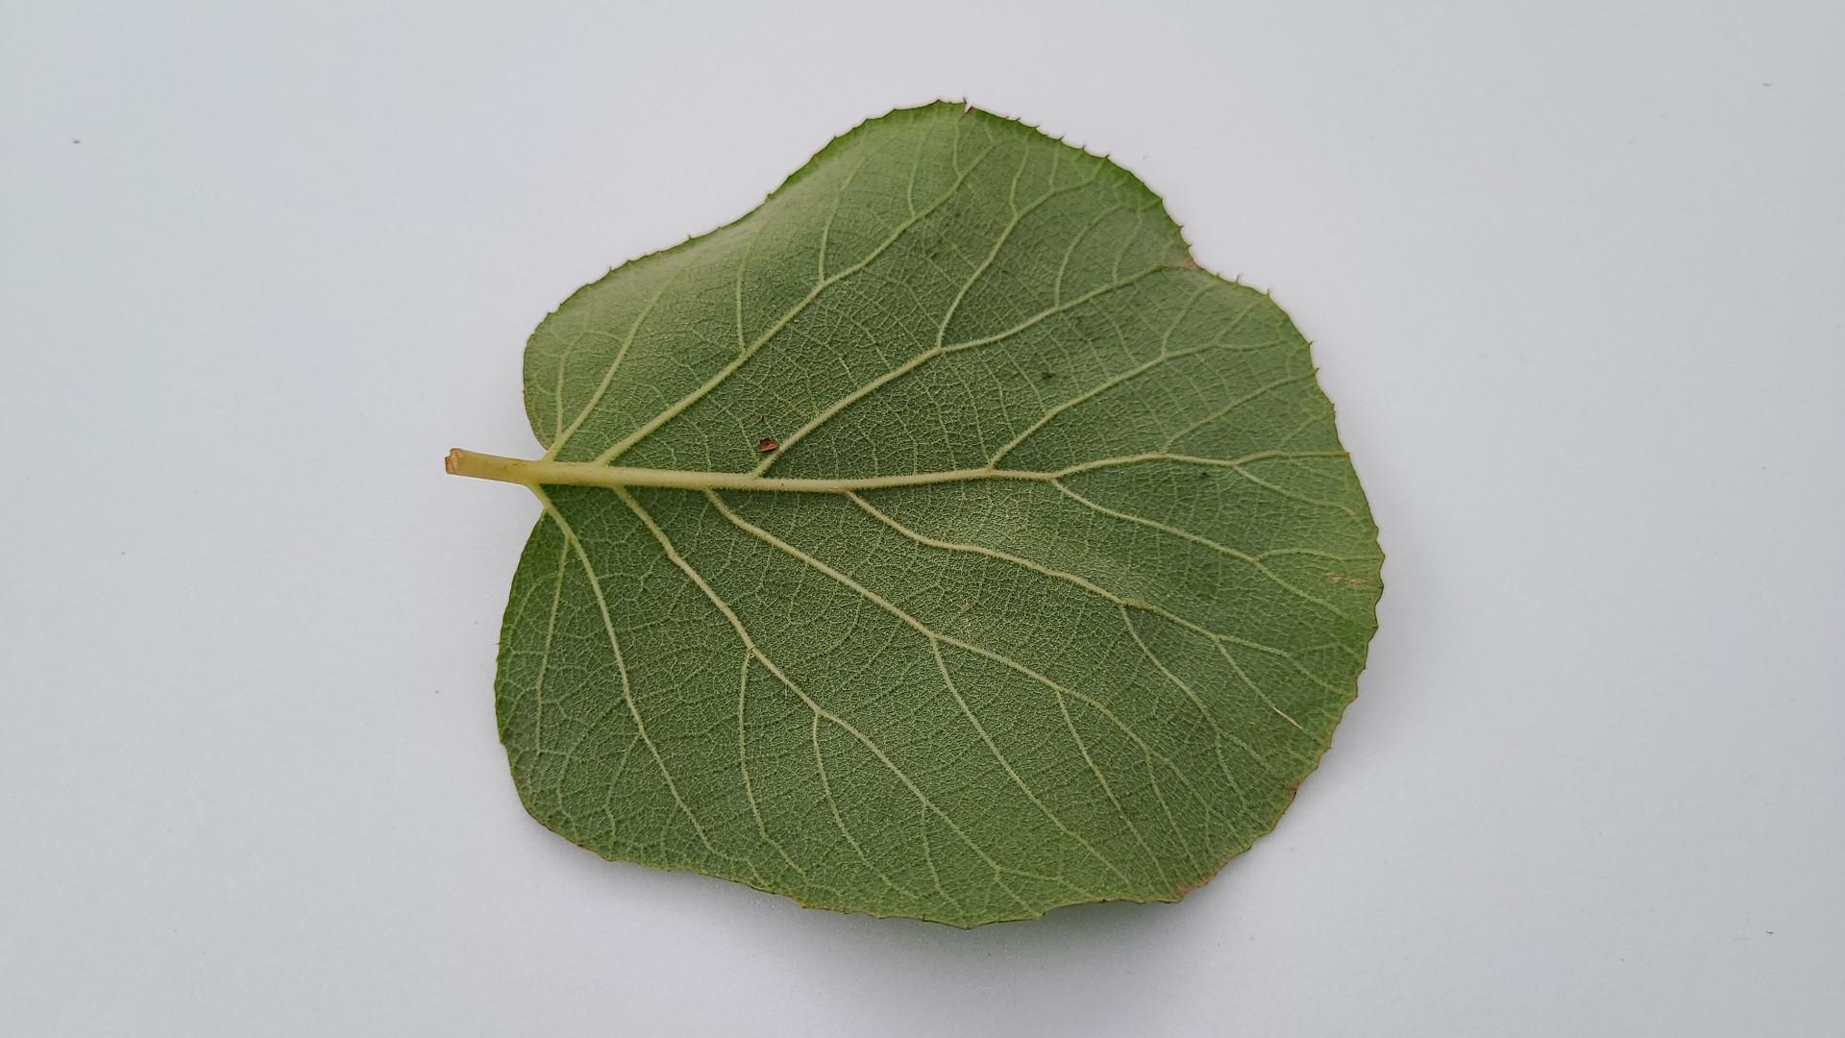
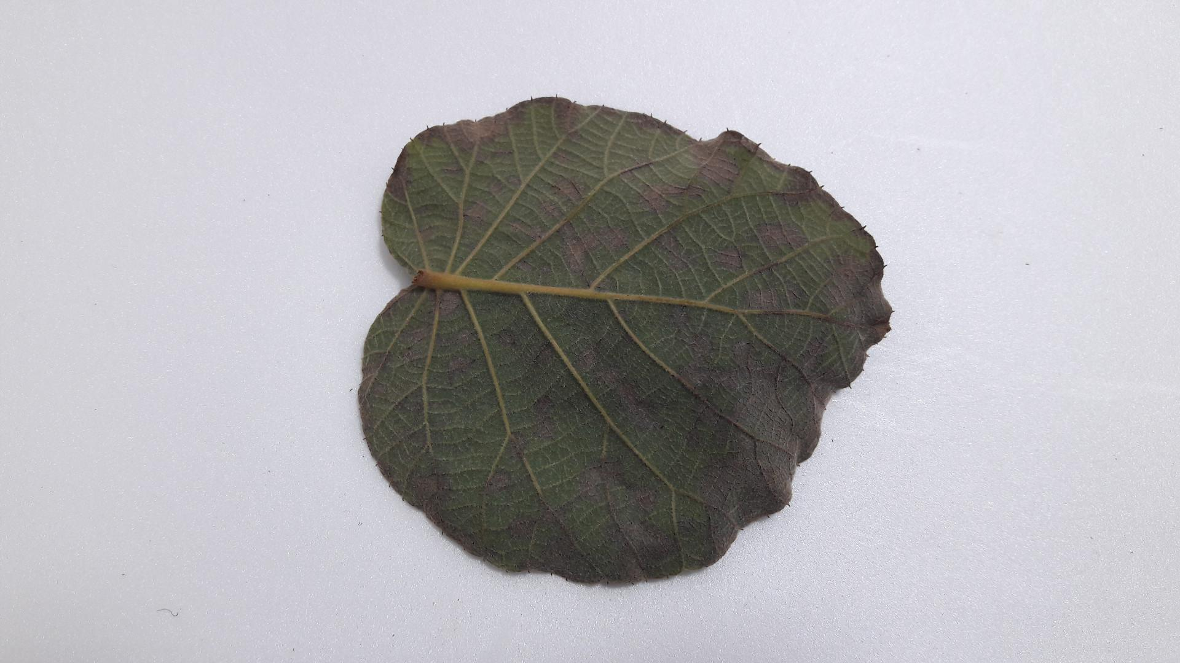
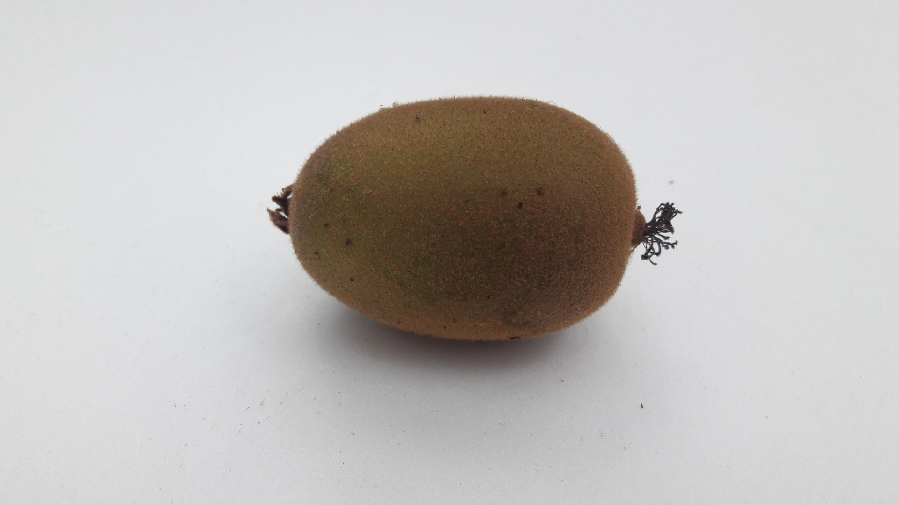
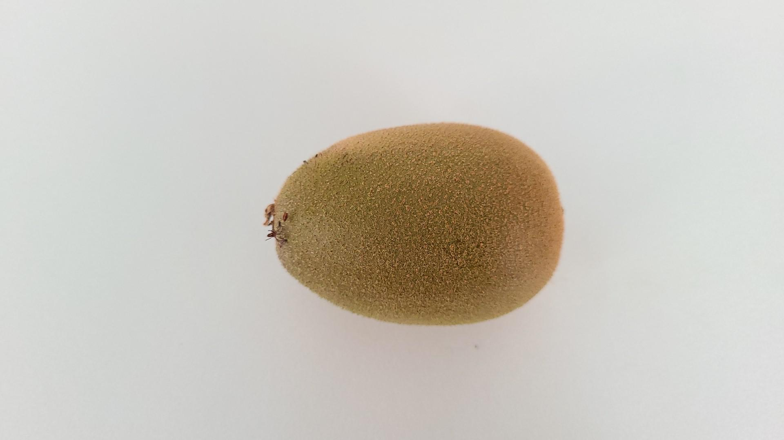
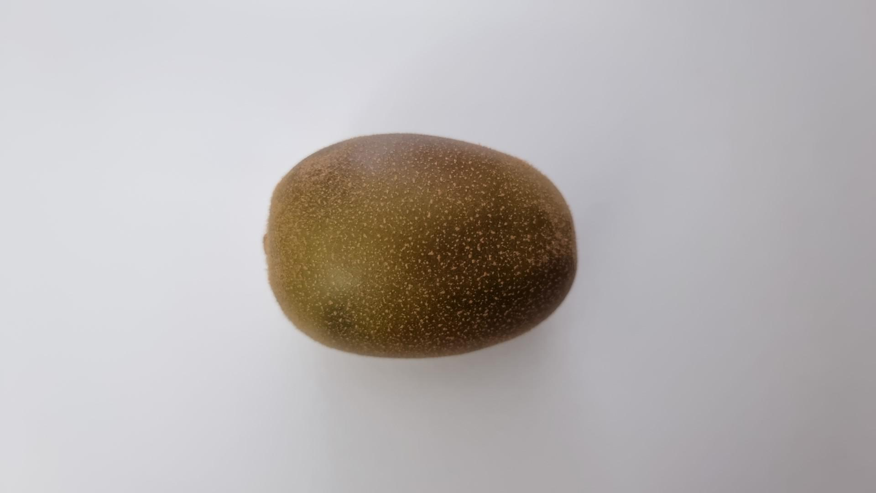
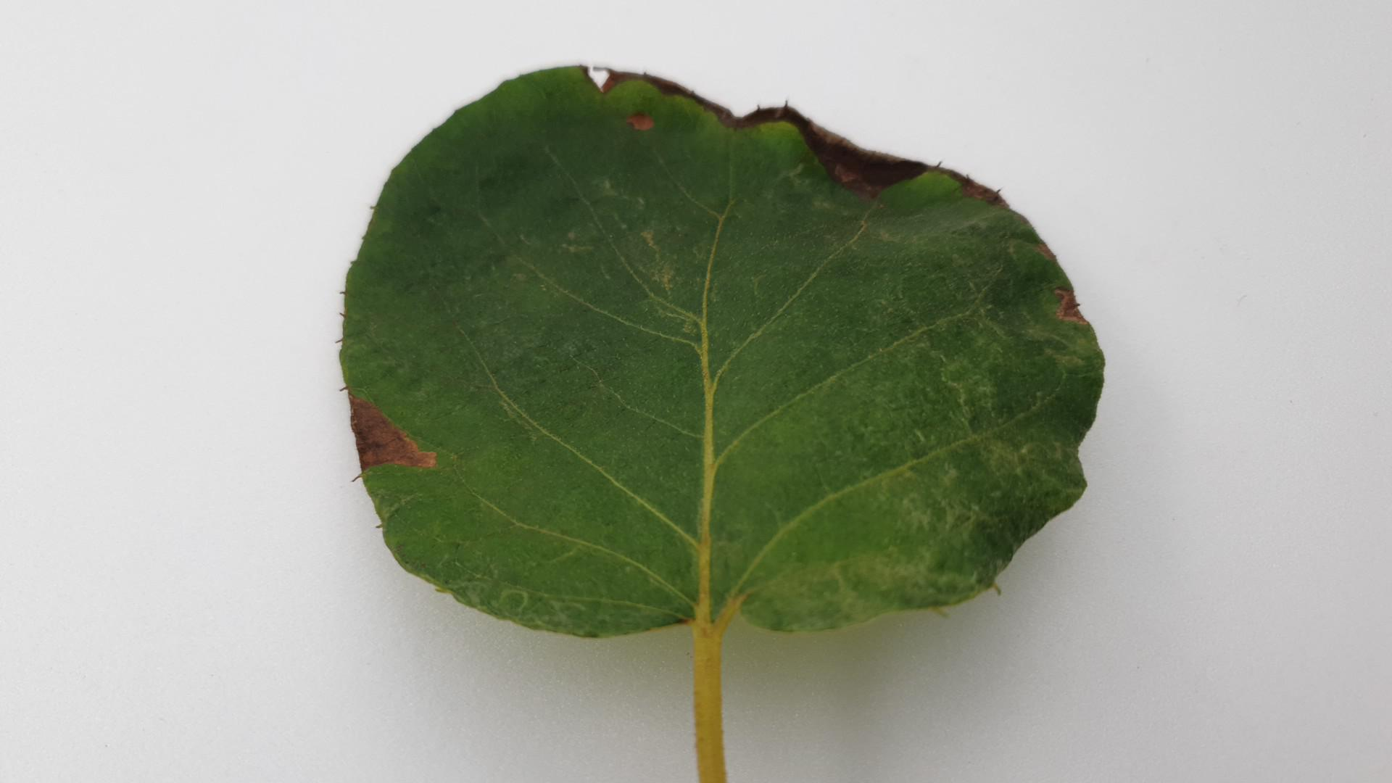
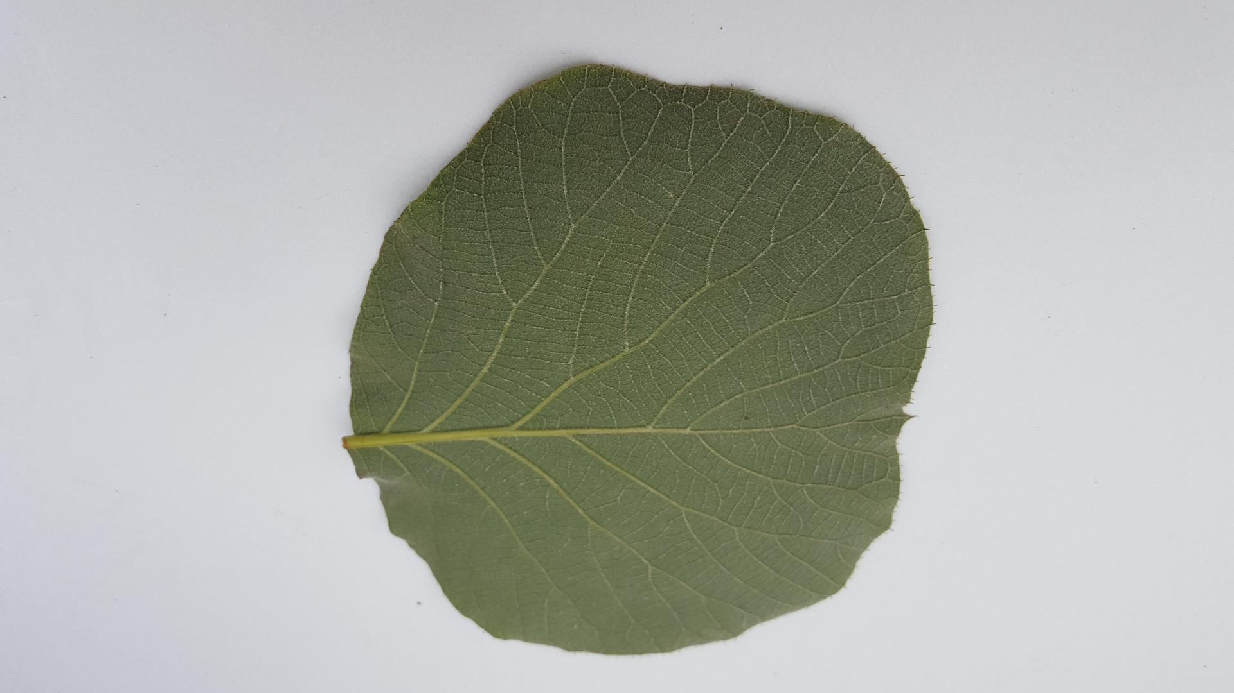
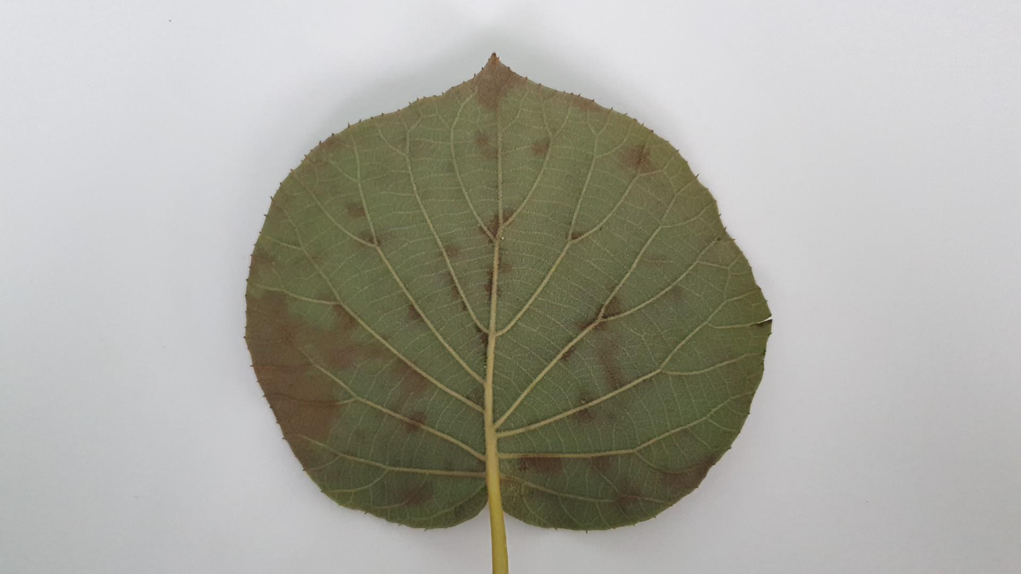
Current Progress Plant
Description of research progress and results
Dataset
Kiwi fruit normal
Kiwi fruit murm
Kiwi leaf bug
Kiwi leaf normal
Kiwi leaf spot

Slide 8
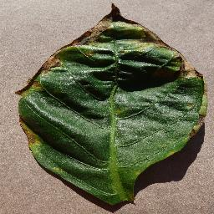
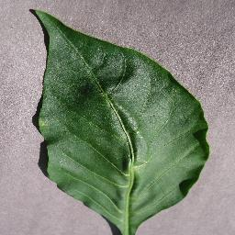
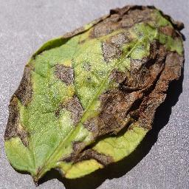
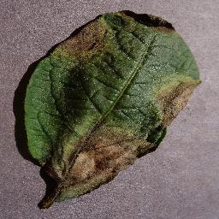
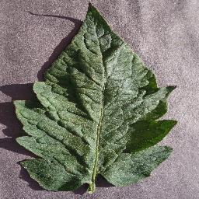
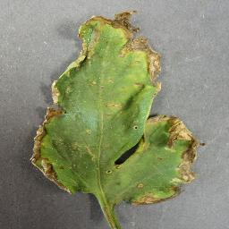
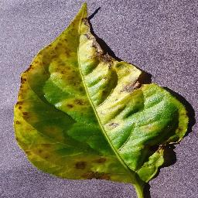
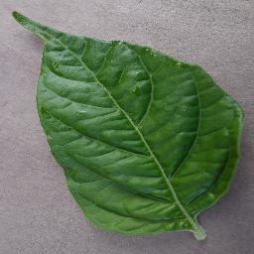
Current Progress Plant
Dataset
Pepper bell bacterial spot
Pepper bell healthy
Potato early blight
Potato late blight
Tomato target spot
Tomato bacterial spot

Slide 9
Tomato late blight
Tomato leaf mold
Tomato yellowleaf curl virus
Tomato septoria leaf spot
Tomato spotted spider mite
Tomato early blight
Tomato healthy

Slide 10
Current Progress Plant
Description of research progress and results
Dataset Augmentation
Data Augmentation Type
10
/ 26

Slide 11
Current Progress Plant
Description of research progress and results
Dataset Augmentation
총 7가지의 data augmentation 방법을 하나 또는 두개를 사용하여 성능을 측정
서로 같은 color distribution을 공유
11
/ 22

Slide 12
Current Progress Plant
Description of research progress and results
Dataset Augmentation
Pepper bell bacterial spot
Original image
Data augmentation images

Slide 13
Current Progress Plant
Description of research progress and results
Dataset Augmentation
Kiwi fruit murm
Original image
Data augmentation images

Slide 14
Current Progress Plant
Description of research progress and results
Experiment
VGGNet
Result
Local
ResNet
DenseNet
EfficientNet
Training set : 48,113
Global
Data transformer
ViT
Validation set : 12,052
DeiT / RegNet
DeiT / VGGNet
DeiT / ResNet
CNN (local)
+
Transformer (Global)
DeiT / EfficietnNet
ConviT

Slide 15
Current Progress Plant
Description of research progress and results
Experiment
Epoch : 300, Batch size : 64, Optimizer : Adam, Loss function : crossentorpyloss
Result
Teacher model : RegNet / Student model : ViT
VGGNet
F1 score : 97.1%
F1 socre : 97.287%
ResNet50
F1 score : 96.4%
DenseNet161
DeiT : hard distillation / soft distillation
EfficientNet
ViT_B_16
ConViT
15
/ 26

Slide 16
Current Progress Plant
Description of research progress and results
Future research
Next
Extract feature map
- 모델이 따라 다르게 나타나는 feature map 추출하기

Slide 17
IIP
감사합니다.
: )

