Slide 1


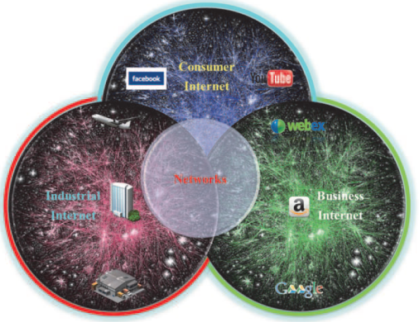

Lab seminar
May 2023
정남규, 추우찬

Slide 2
IIP Lab
Contents
01. Inversion attack for ECG authentication system
02. Electric Usage Prediction
03. Prediction of construction events causes
04. Multimodal News Classification

Slide 3
IIP Lab
02. Electric Usage Prediction

Slide 4
IIP Lab
Korea Heating Corporation
Open Data
Heat supply by time zone by branch office
  지사별 시간대별 열공급량
Heat production information
  열 생산량 정보
Electricity production information
  전기 생산량 정보
Plant Performance DB Statics
  발전소 실적 DB 통계
Weather Observation Information
  기상 관측 정보
Prediction of construction events causes

Slide 5
IIP Lab
Electric Usage Prediction
Competition
Korea Energy Corporation
  2021.05.10 ~ 2021.06.25
Dataset
Buildings number
Date time
Temperature
Wind speed
Humidity
Precipitation
Sunlight
Operation of non-electric cooling facilities
Solar energy
train
  Data from June 1, 2020 to August 24, 2020 for 60 buildings
  Provided every 1 hour
  power consumption (kWh)
test
  Data from August 25, 2020 to August 31, 2020 for 60 buildings
  Provided every 3 hours (In case of precipitation, provided every 6 hours, forecast data)
  power consumption (kWh)
Prediction of construction events causes

Slide 6
IIP Lab
03. Prediction of construction events causes

Slide 7
IIP Lab
Experimental model
Carelessness
Ground subsidence
Simple negligence of the worker
Unstable working posture
Inductor unplaced
Accident
causes
53.83%
31.70%
14.42%
00.03%
00.02%
Transformer
Construct
Rebar
Concrete
Construction
Picking up work
Mask
Materials
construction materials
Prediction of construction events causes

Slide 8
IIP Lab
Knowledge Network
Network connection for causal analysis between nodes
type of construction
-
Main Category A
type of construction
-
Sub Category A
Work Process
Input
Output
Accident object
-
Sub Category A
Accident object
-
Main Category A
type of construction
-
Main Category B
type of construction
-
Sub Category B
Work Process
Accident
cause
Accident object
-
Sub Category B
Accident object
-
Main Category B
type of construction
-
Main Category C
type of construction
-
Sub Category C
Work Process
Accident object
-
Sub Category C
Accident object
-
Main Category C
Prediction of construction events causes

Slide 9
IIP Lab
Experimental model
Frequency of Deaths
FC
Accident
causes
Materials
Construction
materials
Transformer Encoder
Construct
Rebar
Concrete
Construction
Picking up work
Mask
Mask
Mask
Prediction of construction events causes

Slide 10
IIP Lab
Experimental model
Frequency of Deaths
FC
Accident
causes
Materials
Construction
materials
Encoder
Decoder
Construct
Rebar
Concrete
Construction
Picking up work
Prediction of construction events causes

Slide 11
IIP Lab
04. Multimodal News Classification

Slide 12
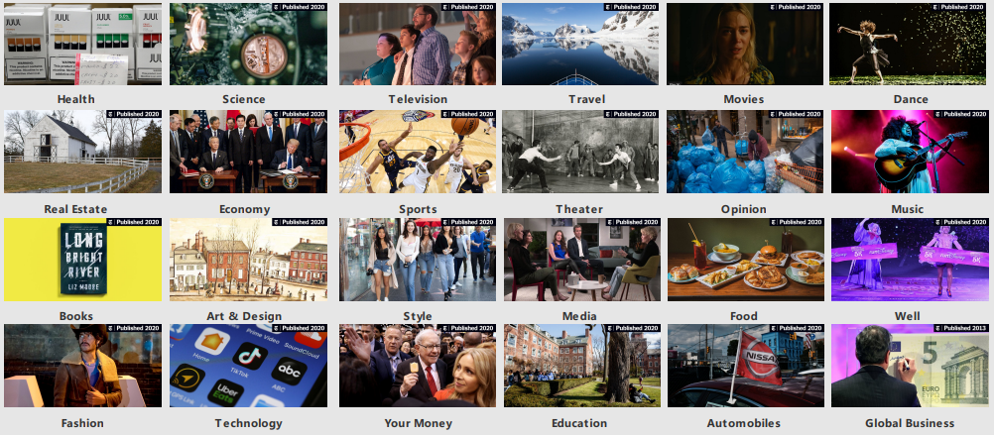
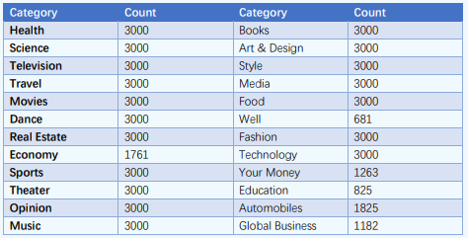
IIP Lab
News Dataset Info.
News includes a variety of media.
Existing natural language processing models are simple-based classification tasks.
  The accuracy of the classification result is poor because it does not consider various media types
To solve a problem, we need to be able to classify news categories by combining different media.
Multimodal News Classification

Slide 13
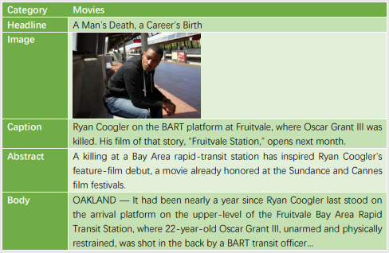
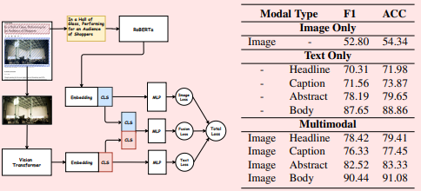
IIP Lab
News Dataset Info.
Data Structure
Base model Result
Multimodal News Classification

Slide 14


IIP Lab
Contribution
Comparison of Multimodal Fusion Techniques for News Category Classification
ViT
features
prediction
Roberta
features
prediction
Early Fusion
  Connect the features of each model and proceed to the input
features
prediction
features
Late Fusion
  Connect the predictions of each model and proceed to the input
prediction
prediction
prediction
Hybrid Fusion
  Connect the predictions & features of each model and proceed to the input
features
Fusion prediction
prediction
features
Multimodal News Classification

Slide 15
IIP Lab
Contents
01. Land Compensation Prediction
02. Fetal Arrhythmia Detection
03. Battery SOH Estimation

Slide 16
IIP Lab
01. Land Compensation Prediction

Slide 17
IIP Lab
Dataset
P_COMPAY | PL_PAY | RATIO | JIMOK | GEO_HL | GEO_FORM | ROAD_SIDE | CALS_YEAR | CLASS | SPFC1_MAIN | LAND_USE_MAIN | CTY_CD
74000.0 | 12000 | 0.3416499 | 5 | 3 | 7 | 8 | 2012 | 2 | 6 | 7 | 46170
63666.7 | 23000 | 0.2613977 | 5 | 3 | 7 | 8 | 2015 | 2 | 4 | 7 | 46150
185000.0 | 59000 | 0.2613977 | 2 | 2 | 4 | 12 | 2015 | 1 | 4 | 6 | 46150
5550.0 | 920 | 0.2369574 | 5 | 4 | 7 | 12 | 2012 | 2 | 8 | 7 | 46130
185000.0 | 59000 | 0.2613977 | 2 | 2 | 4 | 12 | 2015 | 1 | 4 | 6 | 46150
211666.7 | 55000 | 0.2613977 | 1 | 2 | 4 | 12 | 2015 | 1 | 4 | 5 | 46150
222666.7 | 70000 | 0.2613977 | 1 | 2 | 4 | 8 | 2015 | 1 | 4 | 5 | 46150
242333.3 | 70000 | 0.2613977 | 1 | 2 | 4 | 8 | 2015 | 1 | 4 | 2 | 46150
89000.0 | 32000 | 0.2405012 | 1 | 3 | 7 | 10 | 2018 | 1 | 6 | 5 | 42130
…
Land compensation data collected from 2012 to 2018
32851 data including 12 columns
Land Compensation Prediction

Slide 18
IIP Lab
Column | Mean | Type
P_COMPANY | Corporate arithmetic valuation (법인 산술 평가액) | Numeric
PL_PAY | Comparative Standard Land Price Official Land price (비교표준지 공시지가) | Numeric
RATIO | Average land price change rate for 3 years including base year (기준 년도 포함 3개년의 지가변동률 평균) | Numeric
JIMOK | Primary land use (지목) | Factor
GEO_HL | Land highs and lows (지형 고저) | Factor
GEO_FORM | Land Shape (지형 형상) | Factor
ROAD_SIDE | Road adjacency rate (도로 접면) | Factor
CALS_YEAR | Year (기준 년도) | Factor
CLASS | Land classification (대지 구분) | Factor
SPFC1_MAIN | Use area (용도지역) | Factor
LAND_USE_MAIN | Land use situation (토지이용상황) | Factor
CTY_CD | City/County/District Code (시/군/구 코드) | Factor
Dataset
Consists of 3 numeric data and 9 factor data
We need deep learning-based model that utilizes both types of data for performing predictions
Land Compensation Prediction

Slide 19
IIP Lab
Model Structure
Numeric
Numeric
…
Factor
…
+
Factor
Land Compensation Prediction

Slide 20
IIP Lab
Result
Verification of predictive model performance
 | RMSE | MAPE
XGBoost | 19903.55 | 19.5608
Our Method | 14504.70 | 19.5460
※ In the "Korea Institute of Civil Engineering and Building Technology" land compensation prediction model
Land Compensation Prediction

