Slide 1
Lab seminar
Intelligent Information Processing Lab
Namgyu Jung, Woochan Choo

Slide 2
Contents
Prediction of construction events causes
Multimodal News Classification
Development of an AI-based fast diagnostic model for State of Health (SOH) of Lithium-ion batteries

Slide 3
Last week’s plan
Experiment environment change
Evaluation metrics change
Evaluation metrics reflecting the priority of the accident cause list
Knowledge network
Change the number of dummy accident data generated through knowledge networks
Change the structure of the knowledge network
Change the order of connections between nodes
Changed method of generating dummy incident data
Random probability correction and data generation criteria change

Slide 4
Knowledge Network
Network connection for causal analysis between nodes
type of construction - Main Category A
type of construction - Sub Category A
Work Process
Accident object - Sub Category A
Accident object - Main Category A
type of construction - Main Category B
type of construction - Sub Category B
Work Process
Accident cause
Accident object - Sub Category B
Accident object - Main Category B
type of construction - Main Category C
type of construction - Sub Category C
Work Process
Accident object - Sub Category C
Accident object - Main Category C

Slide 5
Experiment
Evaluation Metrics
Hit@5 : Predict 5 possible accident causes
Environment
epochs : 300
Learning rate : 0.0001
embed size : 256
Hidden size : 512

Slide 6
Experimental model
Carelessness
Ground subsidence
Simple negligence of the worker
Unstable working posture
Inductor unplaced
Accident causes
53.83%
31.70%
14.42%
00.03%
00.02%
Transformer
Construct
Rebar Concrete Construction
Picking up work
Mask
Materials
construction materials

Slide 7
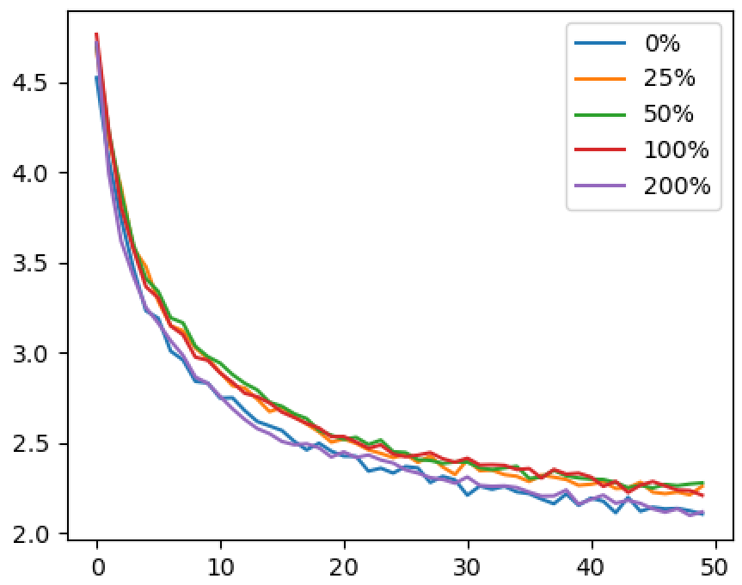
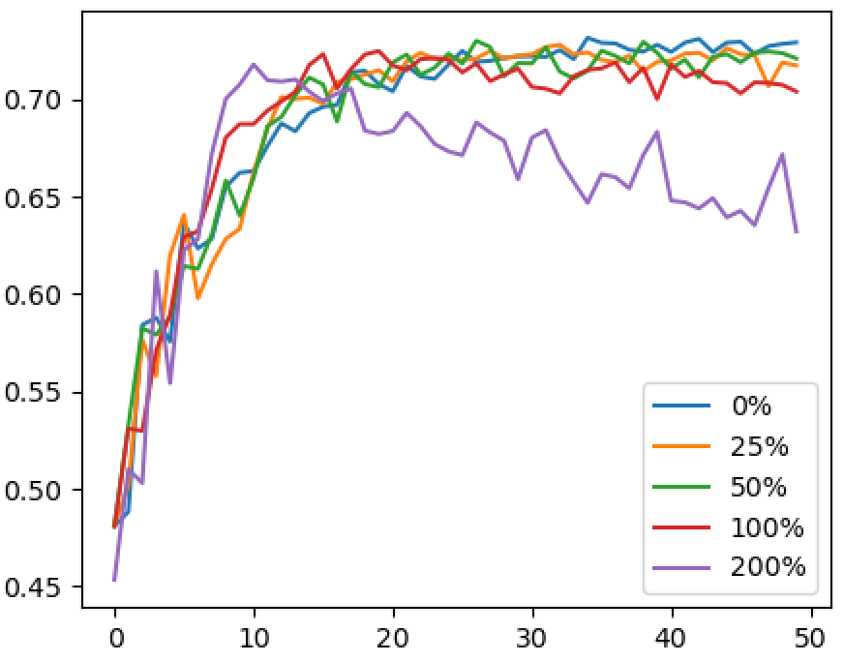
Experiment
 |  | test
Real |  | 0.735
Real + Dummy | 25% | 0.728
 | 50% | 0.730
 | 100% | 0.725
 | 200% | 0.718

Slide 8
Last week’s plan
Experiment environment change
Evaluation metrics change
Evaluation metrics reflecting the priority of the accident cause list
Knowledge network
Change the structure of the knowledge network
Change the order of connections between nodes
Changed method of generating dummy incident data
Random probability correction and data generation criteria change

Slide 9
Contents
Prediction of construction events causes
Multimodal News Classification
Development of an AI-based fast diagnostic model for State of Health (SOH) of Lithium-ion batteries

Slide 10
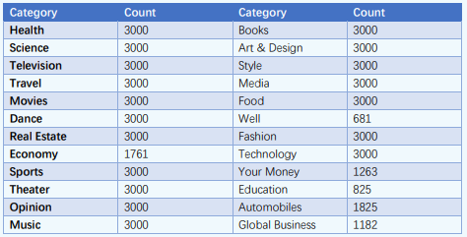
News Dataset Info.
News includes a variety of media.
Existing natural language processing models are simple-based classification tasks.
The accuracy of the classification result is poor because it does not consider various media types
To solve a problem, we need to be able to classify news categories by combining different media.

Slide 11
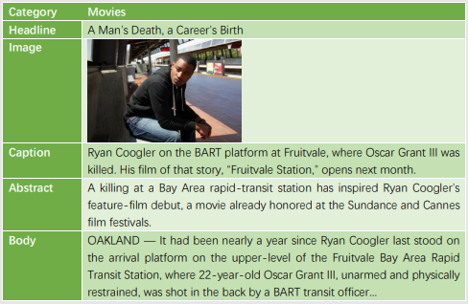
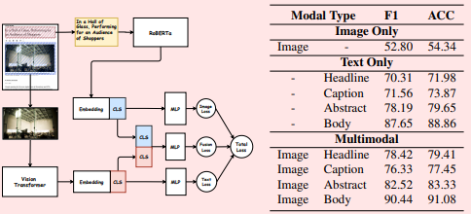
News Dataset Info.
Data Structure
Base model Result

Slide 12
Contents
Prediction of construction events causes
Multimodal News Classification
Development of an AI-based fast diagnostic model for State of Health (SOH) of Lithium-ion batteries

Slide 13
Using Data
Charging: charging to 4.2V with a current of 8A
Discharge: Discharge to 2.5V with a current of 8A
Cycles: Collecting a total of 1000 cycles of data

Slide 14
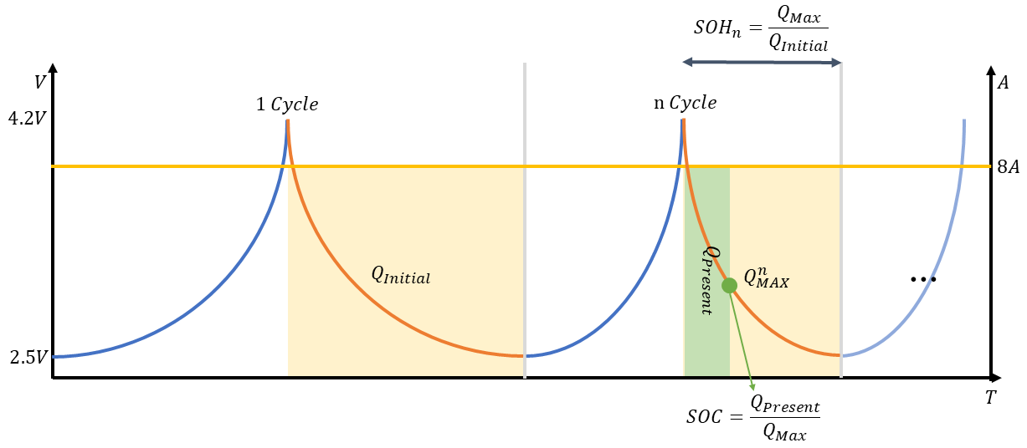
Construction of training data
- Method of data selection
$Q_{Initial}$ : Select the total discharge capacity at 1 cycle as the existing maximum capacity
$Q_{Max}$ : Select the total discharge capacity for each cycle as the maximum capacity
$Q_{Present}$ : Discharge capacity up to the current point
$$SOC=\frac{Q_{Present}}{Q_{Max}}$$
$$SOH=\frac{Q_{Max}}{Q_{Initial}}$$

Slide 15
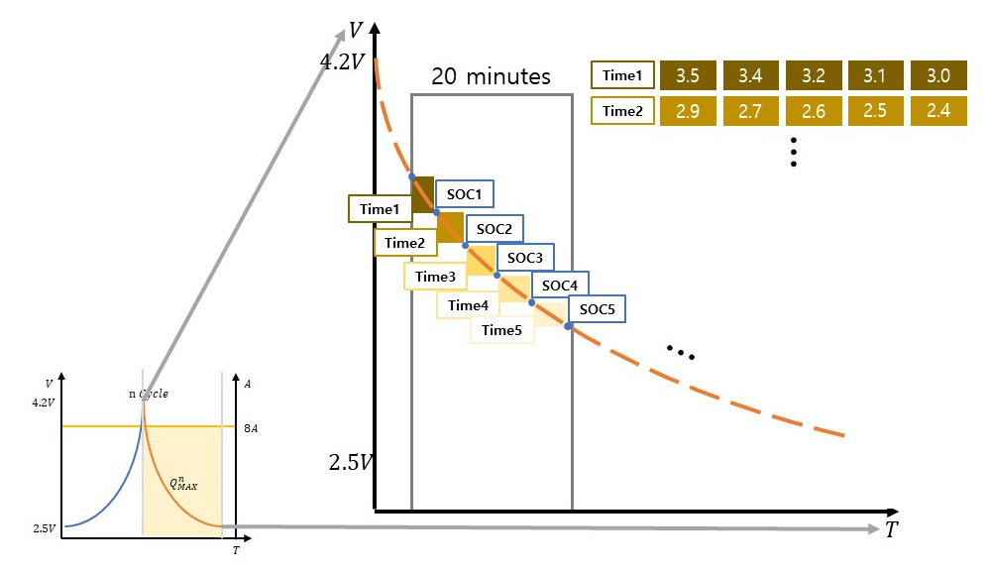
Construction of training data
- Data construction method
The voltage variation is divided by Time and a section suitable for SOC estimation is searched, and accurate SOC estimation is possible through this
The appropriate learning data length of the time series prediction model can be constructed using SOC estimation according to the input time interval, making SOH prediction comfortable
$Time$: Data for intervals grouped by time of total discharge V change
$SOC$: SOC status of the battery corresponding to each discharge time

Slide 16
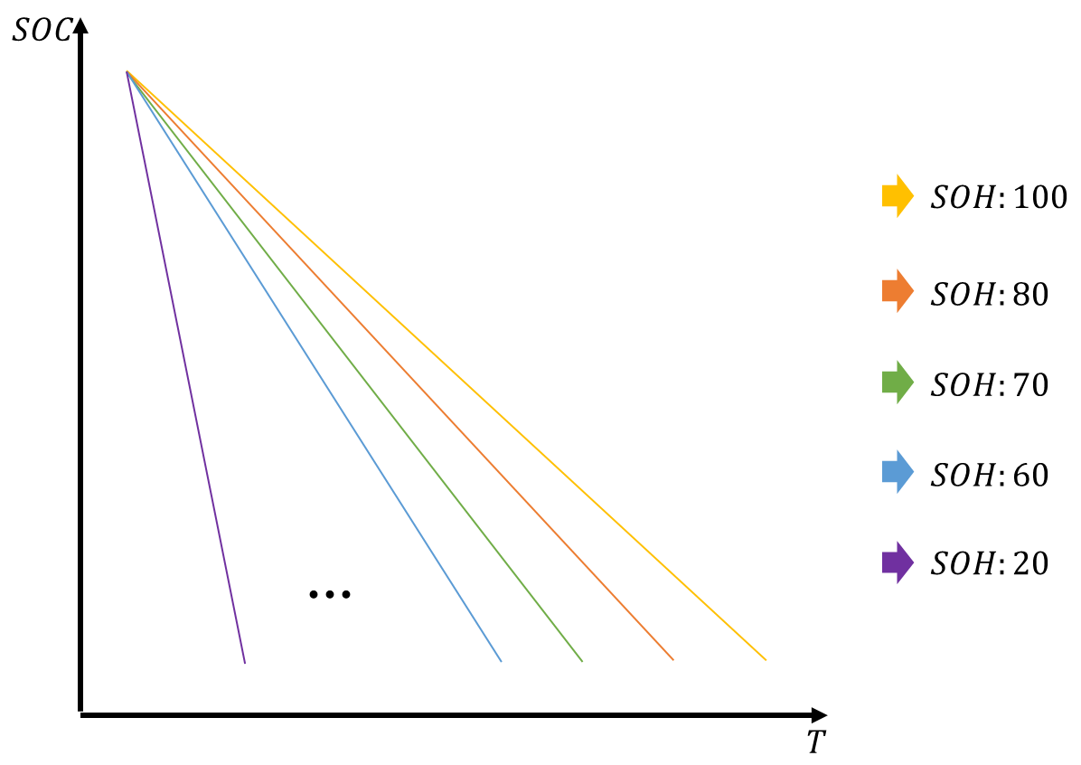
Construction of training data
- Data construction method
Under a fixed discharge quantity, SOC decreases linearly during discharge.
At this point, the maximum discharge amount of the battery decreases with SOH, which leads to a larger decrease in SOC.
Effective estimation of SOH can be achieved by using the linear graph that represents the decrease in SOC

Slide 17
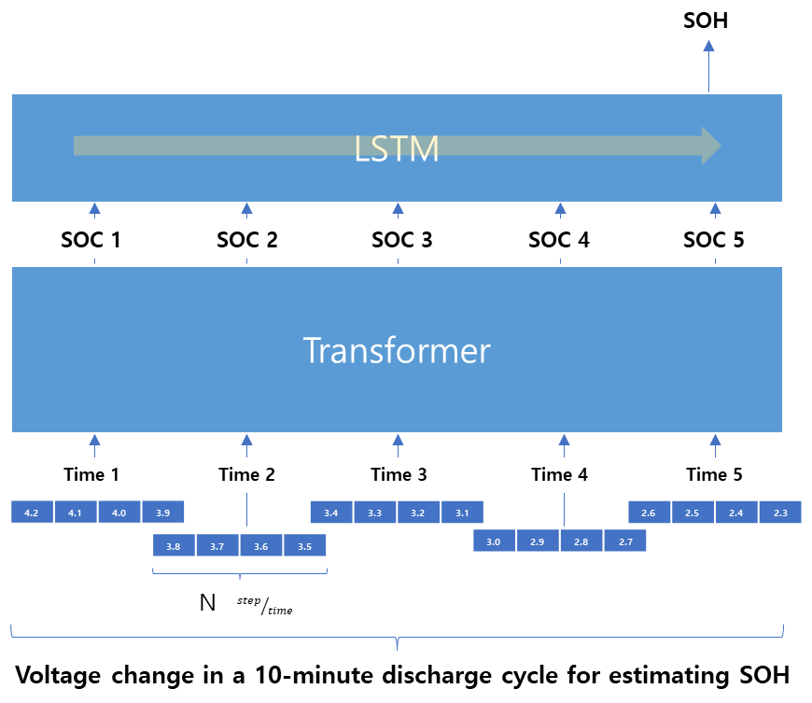
Method
- SOH estimation model structure
We propose a hierarchical artificial intelligence model consisting of Transformer steps for SOC estimation and LSTM steps for SOH estimation
Transformer explores SOC differences between voltage intervals and finds effective voltage intervals for $Q_{Max}$ estimation of the cycle
Using LSTM, the change in SOC and its correlation SOH were learned by exploiting the fact that the decrease curve of SOC varies depending on the SOH

Slide 18
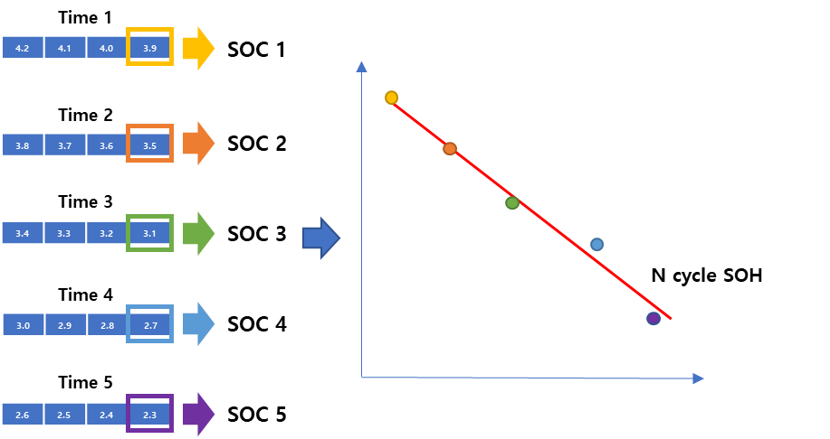
Method
- SOH estimation model structure
The linear graph of SOC can be inferred from the estimated SOC distribution
Finally, it is possible to estimate the SOH according to the slope of the SOC linear graph

