Slide 1
Lab Seminar
IIP LAB
Inpyo-Hong

Slide 2
IIP LAB
Previous Research & Goal of research
DeiT
Knowledge Distillation
Verified Vulnerability of DeiT 1. Fatal CNN attack (locality)
2. Fatal Transformer attack (globality)
CNN
Transformer
Goal of research Create a knowledge distillation model robust to both locality and globality

Slide 3
IIP LAB
Related Work # Defense Techniques
Adversarial Training
A base-line defense technique that can defend against adversarial attacks
Adversarial patterns are learned by retraining the generated adversarial examples.
Limitations: Re-training takes a long time, and the amount of learning increases.

Slide 4
IIP LAB
Related Work # Defense Techniques
SHIELD Neural Network
Model that breaks the fundamental assumption of the attack that the NN model remains constant.
Defend against adversarial attacks by modifying and retraining only the last layer of the NN
Le, Thai, Noseong Park, and Dongwon Lee. "SHIELD: Defending textual neural networks against multiple black-box adversarial attacks with stochastic multi-expert patcher." Proceedings of the 60th Annual Meeting of the Association for Computational Linguistics (Volume 1: Long Papers). 2022.

Slide 5
IIP LAB
Related Work # Defense of Knowledge distillation
The teacher model’s adversarial training is also effective for the student model
verified that the defense performance was effective when using knowledge distillation only with the adversarial training of the teacher model
Limitations: Both the teacher model and the student model were tested as CNN models. ➔ It is necessary to verify whether effective defense is possible in knowledge distillation between CNN and transformer model.
Goldblum, Micah, et al. "Adversarially robust distillation." Proceedings of the AAAI Conference on Artificial Intelligence. Vol. 34. No. 04. 2020.

Slide 6
IIP LAB
Experiment Methods
Create teacher model of shield NN (CNN)
Objective: Build a DeiT teacher model that is robust to locality
Create student model of shield NN (Transformer)
Objective: Build a DeiT teacher model that is robust to globality
Build a DeiT that merges ① and ②
Objective: Build a DeiT that is robust to locality and globality

Slide 7
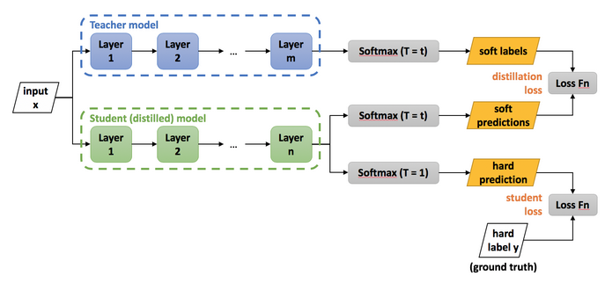
IIP LAB
Experiment Methods
NN Layer ➔ Change to SHIELD NN Layer
Averaging ➔ Final Output
NN Layer ➔ Change to SHIELD NN Layer

