Slide 1
Lab Seminar
Intelligent Information Processing Lab
2023. 05. 24
SaeBom Lee

Slide 2
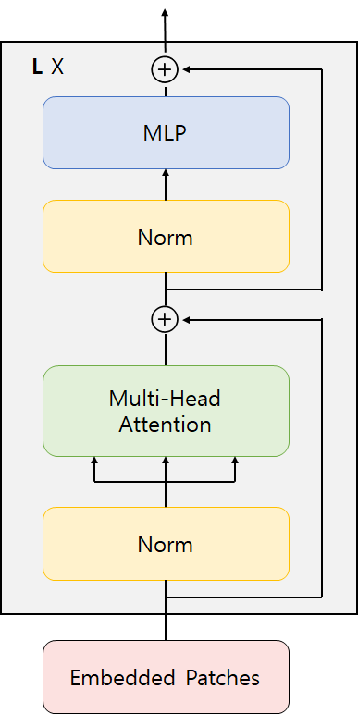
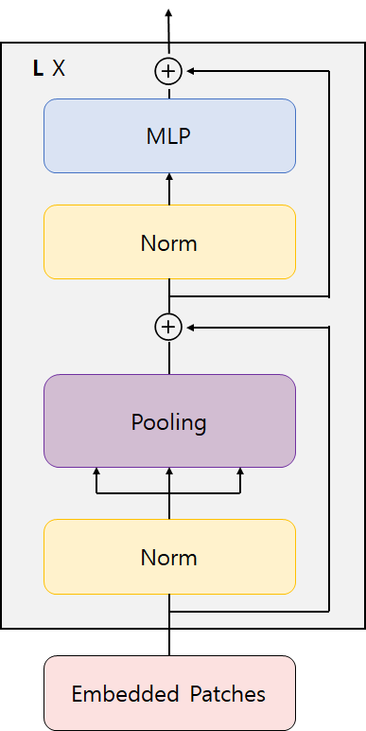
IIP Lab
연구 아이디어
My Research Idea : Multimodal experiment using Pooling without attention in Transformer Encoder
Transformer Encoder
...
Existing: Attention-based transformer
CLS Token
Changed: Pooling based transformer

Slide 3
IIP Lab
연구 아이디어
Related work
Metaformer (2022)
: Performing only the token mixing by replacing the transformer's attention module with a pooling operator with a very simple structure.
* MACs(Multiply-ACcumulate) : FMA 연산이 몇 번 실행되었는지 카운트 (FMA = $a∗x+b$)
Yu, Weihao, et al. "Metaformer is actually what you need for vision." Proceedings of the IEEE/CVF conference on computer vision and pattern recognition. 2022.

Slide 4
IIP Lab
연구 아이디어
Network Architecture
loss
loss
Transformer

Slide 5
IIP Lab
연구 아이디어
Network Architecture
Modality Specific : Using three transformers
Transformer
Modality Agnostic : Using one transformers

Slide 6
IIP Lab
연구 아이디어
Pretraining dataset : Howto100M
Downstream Tasks
136 million video clips with captions from 1.2 M Youtube videos
23,000 activities in domains such as cooking, crafts, personal care, gardening or fitness
Composition: video + audio + text
Video action recognition : Kinetics-400 → 400 classes, 234,584 videos, Each clip lasts about 10 seconds
Audio event recognition : ESC50 → 50 classes, 2,000 audio clips, 5 second recorded environment audio
Image classification : ImageNet-1000k → 1,000 classes, 1.2M

Slide 7
Thank you

