Slide 1
Recent Research IIP lab

Slide 2
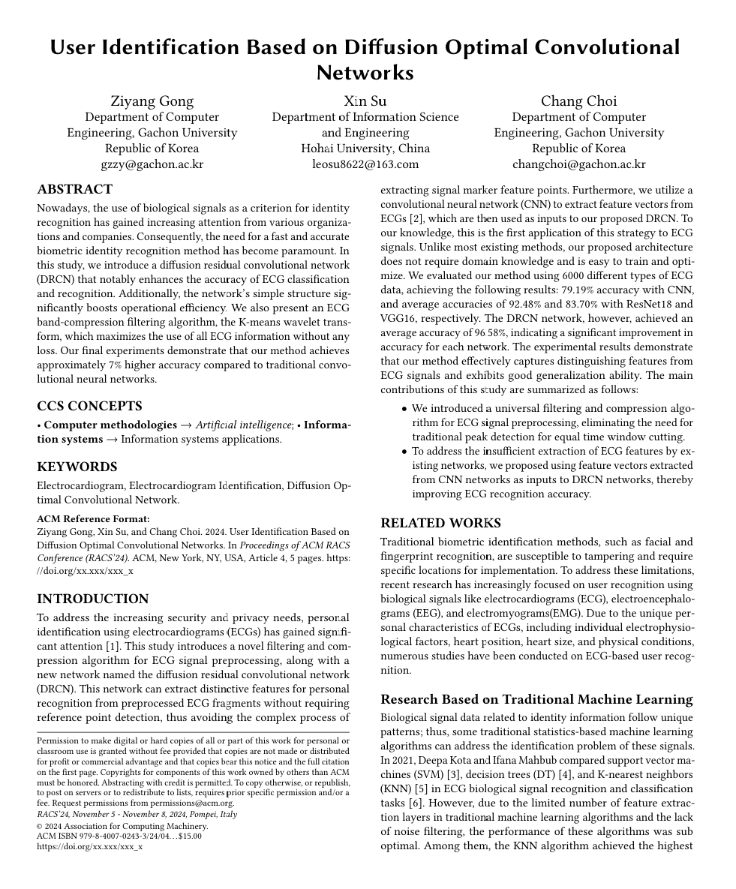
ACM 2024 paper
IIP recent research
Abstract:
Introduces a diffusion residual convolutional network (DRCN) for improving the accuracy and efficiency of ECG-based biometric identity recognition. The DRCN, combined with a K-means wavelet transform for ECG band-compression filtering, enhances ECG classification accuracy by approximately 7% compared to traditional convolutional neural networks.
Journal: ACM RACS 2024
Conference Date: November 5-8
Status: Submitted
1. Paper progress
1

Slide 3
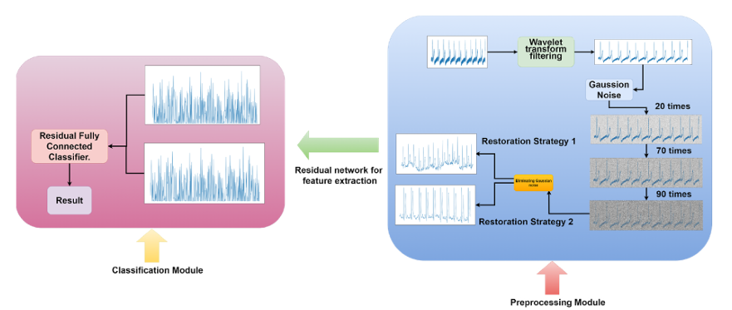
Method
IIP recent research
Figure1. The automated identification system for electrocardiogram (ECG) identity information consists of two modules: the preprocessing module (located on the right side of Fig. 2) and the classification module (also located on the right side of Fig. 2). The preprocessing module is responsible for applying wavelet transform filtering to the raw ECG data to remove noise. The denoised ECG data is then fed into a diffusion generative network, which performs 100 iterations of adding Gaussian noise and applies two noise removal strategies to generate two different sets of new ECG data. The classification module is responsible for identifying and classifying the generated new data from the preprocessing module along with the original ECG data. This module utilizes a residual network for convolutional classification. The residual network extracts features from each ECG data, forming feature maps, and outputs the final result through fully connected layers.
1. Paper progress
2

Slide 4
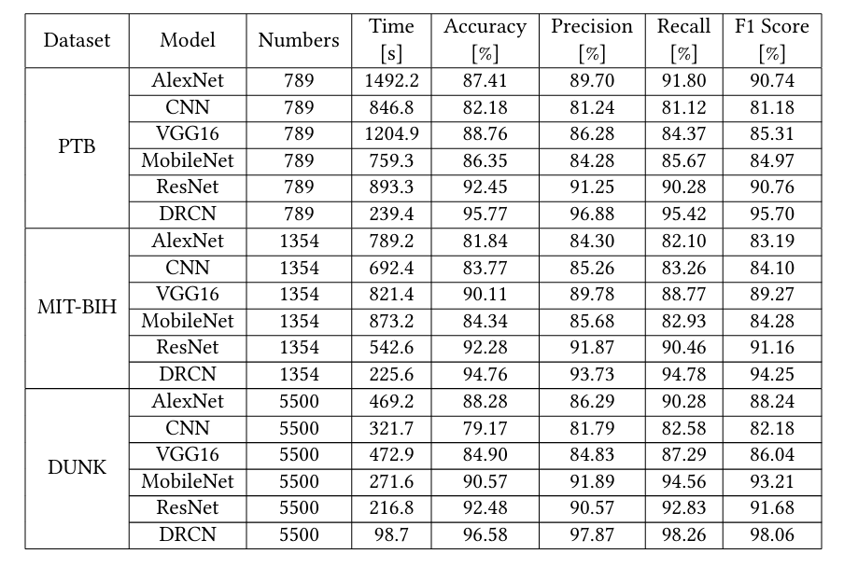
Conclusion
IIP recent research
Table1. The test set accuracy of Alexnet, CNN, VGG16, MobileNet, ResNet, and DRCN
Table2. We compared the average recognition rates of six network models and their proximity to the evaluation criteria.
1. Paper progress
3

Slide 5
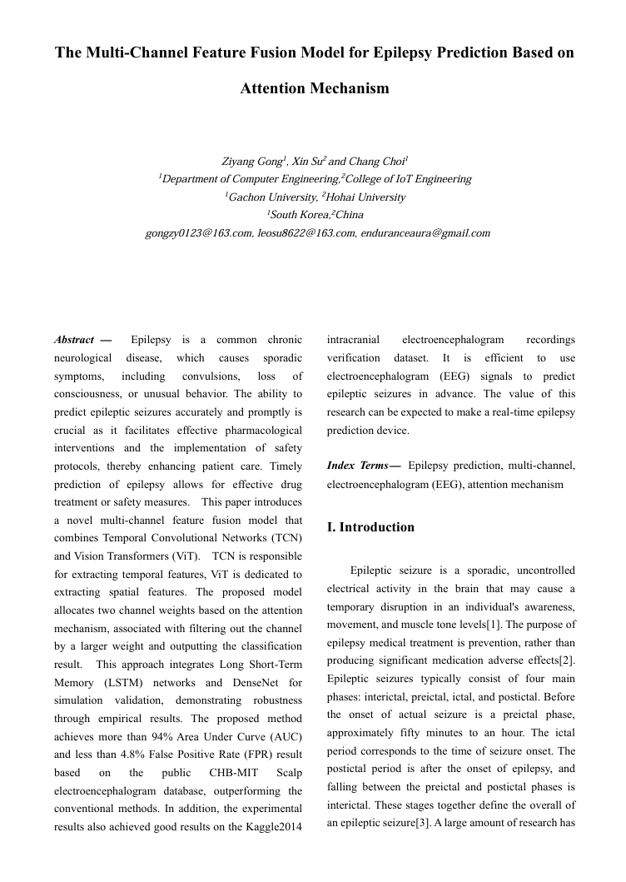
Journal paper
IIP recent research
Abstract:
Developed a model combining Temporal Convolutional Networks (TCN) and Vision Transformers (ViT) to accurately predict epileptic seizures. The model achieves over 94% AUC and less than 4.8% false positive rate, supporting the development of real-time epilepsy prediction devices.
Journal: Journal of Internet Technology (JIT) or ?
Status: Revising - September 1
1. Paper progress
4

Slide 6
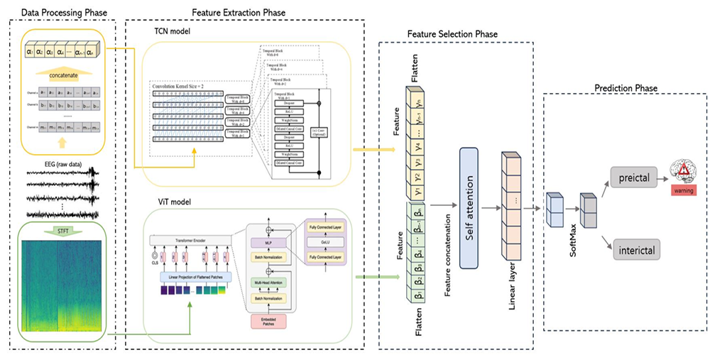
Method
IIP recent research
Figure2. The Multi-Channel Feature Fusion Model for Epilepsy Prediction Based on Attention Mechanism model approach.
1. Paper progress
5

Slide 7
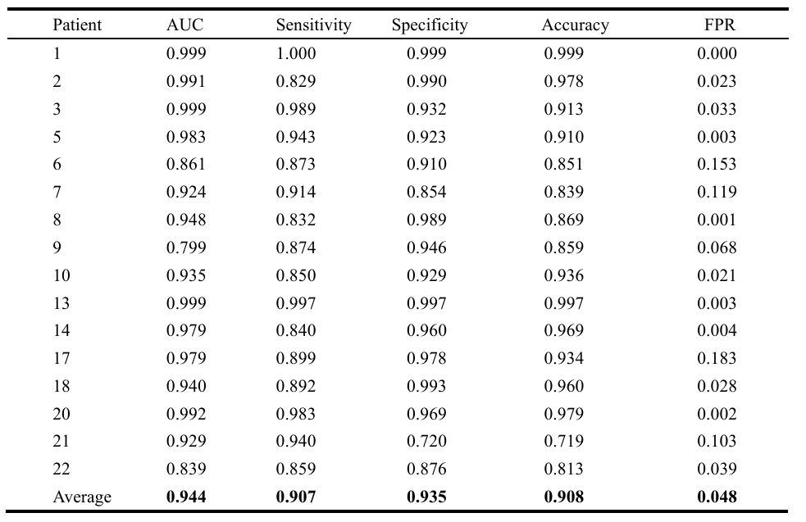
Conclusion
IIP recent research
Table3. Predicted performance for each patient with proposed model.
Table4. Performance for each dog in the Kaggle dataset.
1. Paper progress
6

Slide 8
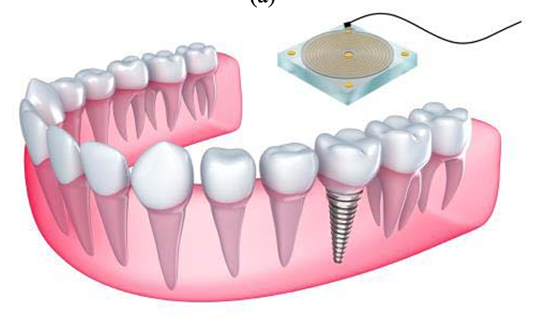
Project with China
IIP recent research
Research on signal processing and positioning of flexible tags for implantable dentures
Project Purpose:
This project aims to enhance elderly health management technology in the context of aging populations through China-Korea collaboration, focusing on developing electronic tags for dentures. The research plan includes designing RFID tags, developing 3D printing technology, enabling multi-scenario indoor positioning, and conducting system validation and performance evaluation.
2. Project progress
7

Slide 9
Main contents
IIP recent research
Research on signal processing and positioning of flexible tags for implantable dentures
STEP 1
Structure and parameter design of RFID（Radio Frequency Identification）tag for implantable dentures
KOREA side
Using AI such as online real-time learning:
To identify various signal interference characteristics and improve system performance.
Quickly generate positioning prediction results, which helps to quickly identify patients carrying tags.
STEP 2
Flexible label and denture production method based on micro 3D printing
STEP 3
Tag reflection signal processing and positioning method based on RFID
STEP 4
Experimental verification and performance evaluation of the denture implant label positioning system
2. Project progress
[1] Truong, Nhan Duy, et al. "Convolutional neural networks for seizure prediction using intracranial and scalp electroencephalogram." Neural Networks 105 (2018): 104-111.Cited by 365
8

Slide 10
Current progress
IIP recent research
Continue to prepare proposal
Application time for China:
2024.10
Application time for Korea:
Maybe 2024.11.24 public
2. Project progress
9

Slide 11
THANKS
Department: IT Convergence Engineering
(Computer Engineering)
gzzy@gachon.ac.kr
Ziyang Gong
2024.08.21

