Slide 1
의치 임플란트식 RFID 태그 신호 처리 및 위치 추적 메커니즘
Project with China

Slide 2
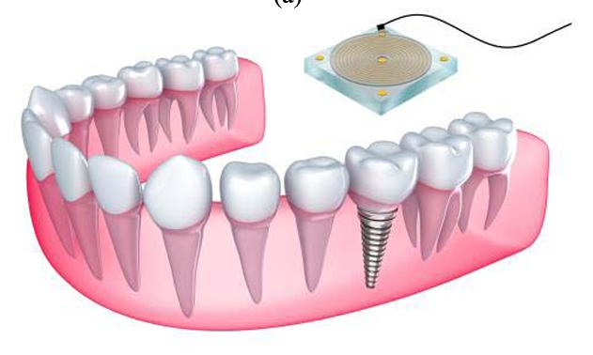
Basic content of the project
Project idea
의치 임플란트식 RFID 태그 신호 처리 및 위치 추적 메커니즘(RFID = Tag + Reader)
Project Purpose:
의치 임플란트식 RFID 태그 신호 처리와 위치 추적 메커니즘은 RFID 기술을 사용하여 의치 임플란트의 위치를 파악하고 데이터를 처리하는 방법을 말합니다. 이 메커니즘은 주로 RFID 리더기와 태그 간의 무선 신호를 통해 데이터를 주고받고, 태그의 위치를 추적하는 데 사용됩니다. 신호 처리 기술과 AI 알고리즘을 결합하여 더 정확하고 효율적인 위치 추적을 가능하게 할 수 있습니다.
(Denture Implant-type RFID tag signal processing and location tracking mechanisms refer to methods of locating denture implants and processing data using RFID technology. This mechanism is mainly used to send and receive data via wireless signals between RFID readers and tags, and to track the location of tags. By combining signal processing technology and AI algorithms, more accurate and efficient location tracking can be possible.)
1

Slide 3
How to combine AI technology
Project idea
Improve the received signal positioning accuracy and de-noise signal
Methods:
1. Using AI algorithms to correct and optimize localization algorithms can improve accuracy, especially in complex environments.
2. Feature extraction and optimization using neural networks. AI algorithms can also be used for noise reduction and filtering to enhance the clarity and reliability of signals.
3. Data Fusion and Multi-Sensor Fusion. Fusion of signal data from multiple readers improves positioning accuracy.
2

Slide 4
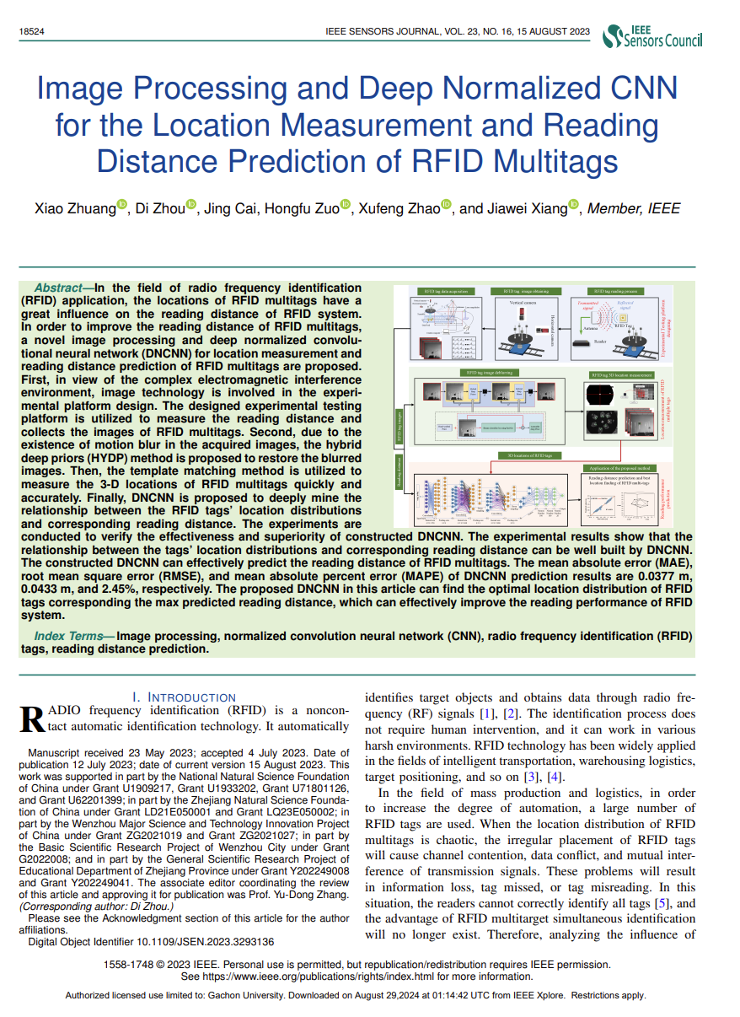
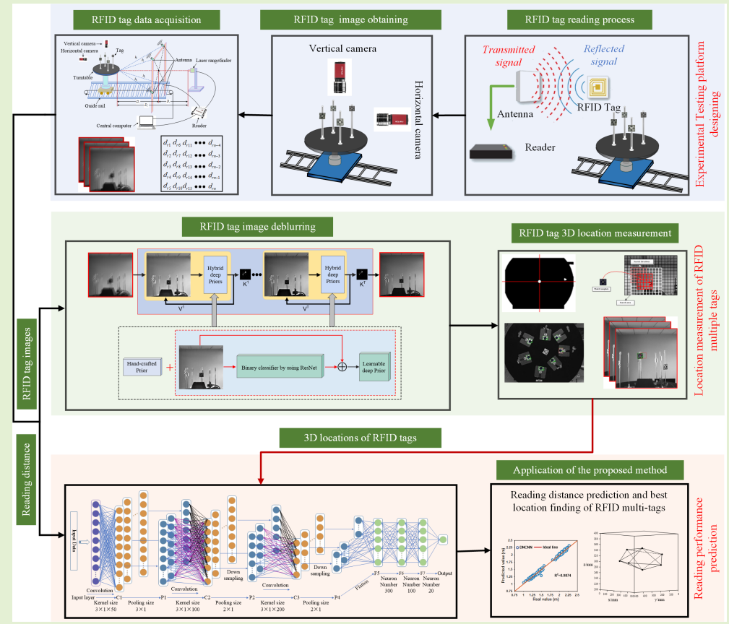
How to combine AI technology
Project idea
Improve the received signal positioning accuracy and de-noise signal
Topic: Using a CNN based on image processing and deep normalization to read the location distance of multiple RFID tags
Different: in this project, we only have one tag, in the teeth.
Journal: IEEE Sensors, 2023, IF: 4.3
3

Slide 5
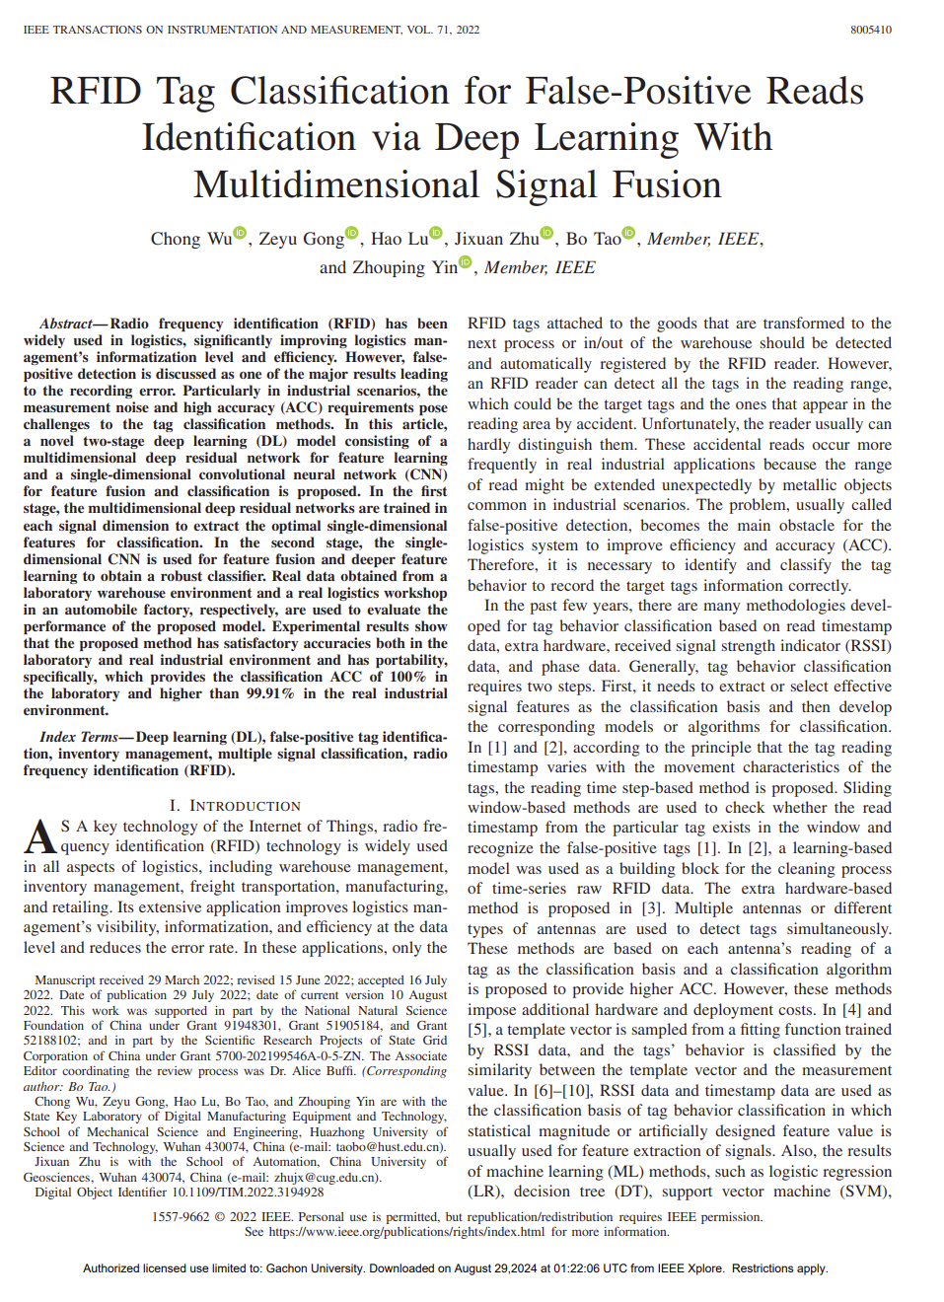
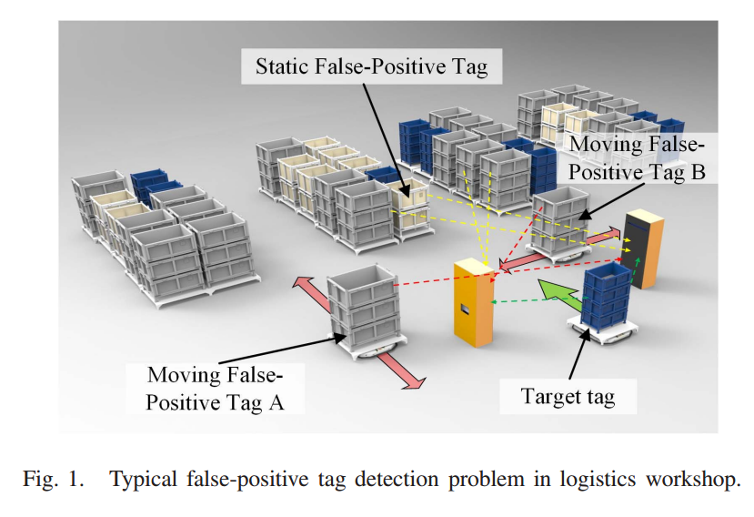
How to combine AI technology
Project idea
Improve the received signal positioning accuracy and de-noise signal
Topic: Classify RFID tag False-Positives by using feature fusion learning of different signal data.
Journal: IEEE Transactions on Instrumentation and Measurement, 2022, IF: 5.6
4

Slide 6
THANKS

