Slide 1
Lab Seminar
Intelligent Information Processing Lab
2023.05.17.
Myeonghoe Lee

Slide 2
Review
Sound event detection : my individual subject
Mission : Test event detection on video.
Image captioning : collaborative subject
The level of steps you just started.

Slide 3
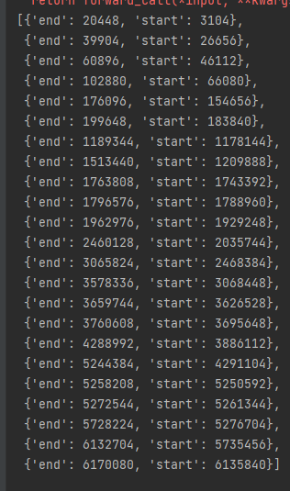
Sound event detection test
6-minute video test
23 Events Occurred
Less than 1s to 30s : various event intervals
More than 10s : 6

Slide 4
Sound event detection test
Goals : Improvements in content search technology
1. MFCC compare
2. Compare via video frame
Tells event interval and fine the label value
Giving label values and finding event intervals
Notes:
이벤트 구간을 알려주고 라벨 값을 찾는 것
라벨 값을 알려주고 이벤트 구간을 찾는 것

Slide 5
Sound event detection test
6 classification, 5.5H / Feature extraction classification using MFCC
Video classification : ViViT use / Audio classification : Extracting MFCC Features
Vgg-sound dataset
300 classification / 550+H → Loss during preprocessing / Remaining data : 380H

Slide 6
Image captioning - Topic, Dataset
Topic
"Judgement analysis through different background on similar objects.”
Dataset
Sports image dataset
Dataset of 14,506 images according to 22 sports genres
Sports Gameplay image dataset
100,000 gameplay images dataset of 175 video games according to 10 sports genres

Slide 7
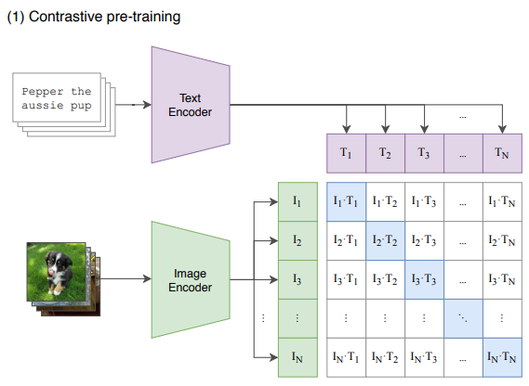
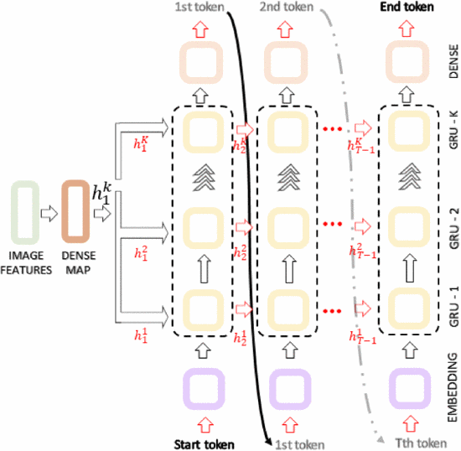
Image captioning – Encoder, Decoder
[Image Encoder]
-Self Attention, Clip
[Text Decoder]
Dual-CNN, multi-layer GRU

Slide 8
Monthly plan
May : Dataset collection, Research relevant data,
June : Data pre-processing, A model test
July, August : Performance Improvements
September : Writing paper

