Slide 1
Signal Analysis and Classification
Ziyang Gong
2023.05.17
gongzy0123@163.com

Slide 2
contents
Purpose
Dataset
Related work
Plan Structure
Contribution

Slide 3
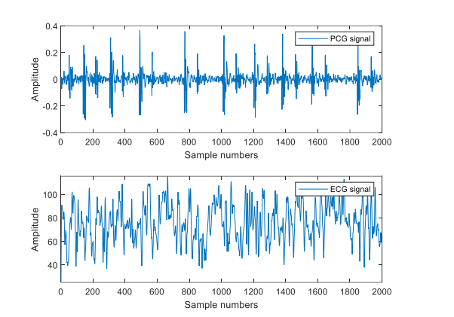
Purpose
Use ECG and PCG(phonocardiogram, 심음도) two Simultaneous signals.
Use the deep learning-oriented hybrid fusion method to do user authentication.
Improve the performance indicators of classification and improves the classification effect.

Slide 4
Dataset
1. ECG: three ECG leads
RA ( right arm ), RL( right leg) , LA ( left arm)
2. PCG: on the left side of the heart, between the fourth and sixth ribs(늑골).
3. Simultaneous signals from the same subject

Slide 5
Dataset: EPHNOGRAM: A Simultaneous Electrocardiogram and Phonocardiogram Database
Signal | Number | Age & Gender | Conditions | Num Channels | Record Duration (min)
A Simultaneous Electrocardiogram (ECG) and Phonocardiogram (PCG) Database | 24 healthy adults include 69 records | between 23 and 29 (average: 25.4 ± 1.9 years) | resting | 2 & 5 | 30min *61
 |  |  | walking
 | 69 records | Male | running |  | 0.5min *8
 |  |  | biking conditions
“So has enough length, can be split into a large data set”

Slide 6
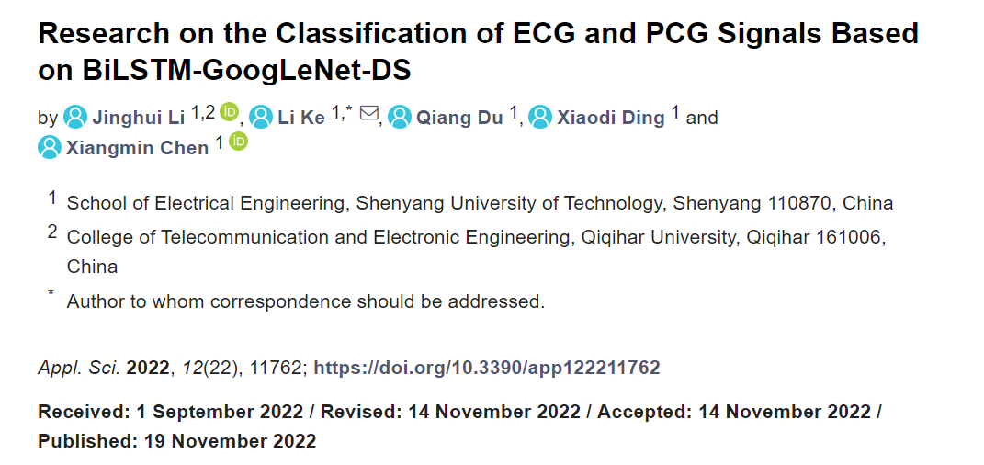
Related work
Contributions:
For judging cardiac disease
The classification method of ECG and PCG signals is better than the classification methods of single-modal signals.
Information fusion of ECG and PCG signals improves the performance indicators of classification and improves the classification effect.
The model proposed in this paper

Slide 7
Related work
Paper：Li J, Ke L, Du Q, et al. Research on the Classification of ECG and PCG Signals Based on BiLSTM-GoogLeNet-DS[J]. Applied Sciences, 2022, 12(22): 11762.
Get some inspirations:
Try to use this method for user identification authentication.
The specificity value has place to improve.
Try to make some modifications, such as using other models.

Slide 8
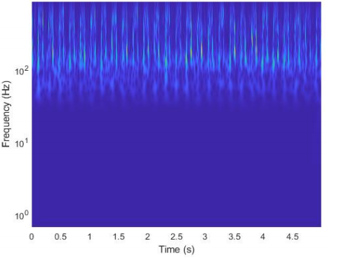
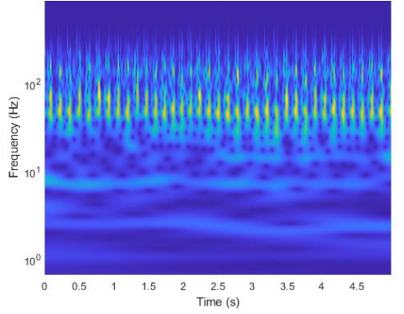
Plan Structure
SS1/SS2 interval time series
BiLSTM Network
Signal fusion input
RR interval time series
Pre-processing
STFT
Spectrogram image and split
Resnet Network
Feature Fusion
User Identification
Pre-processing
STFT
Spectrogram image and split
Resnet Network
A total of three channel results are used and finally merged.
2. Choose Resnet to handle image input currently.

Slide 9
Contribution:
Next to do:
Data preprocessing
Continue to find suitable dataset
Future to do:
Classification model | Acc | Sen | Spe | Pre | F1
PCG-BiLSTM
ECG-BiLSTM
PCG-ECG-BiLSTM
PCG-ResNet
ECG-ResNet
BiLSTM-ResNet

