Slide 1
Signal Analysis and Classification
Ziyang Gong
2023.05.31
gongzy0123@163.com

Slide 2
contents
1. Abandon ECG User Authentication
2. Predicting seizures（간질예측） from EEG signals
1

Slide 3
Why abandon ECG user authentication
Hard to find innovations:
Current accuracy values are high (ML & DL)
It is difficult to have breakthroughs in innovative methods
2. My research：
My progress is difficult, too much time wasted.
Want to consider other topics about signaling research
1

Slide 4
EEG Predicting epileptic seizures （간질 발작을 예측하다）
2

Slide 5
Purpose
Significance of epilepsy prediction:
Epilepsy patients account for a large proportion. There are many studies to detect epilepsy, but if epilepsy is predicted in advance, early treatment can be taken, so predicting epilepsy will be more promising.
Challenges :
1.The EEG of epilepsy patients constantly transitions between seizure and non-seizure states
2. Epilepsy dataset imbalance
3. It is difficult to achieve high sensitivity and low false prediction rate : lager overlap in the EEG associated with seizure and non-seizure states.
3

Slide 6
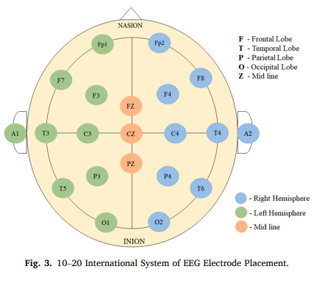
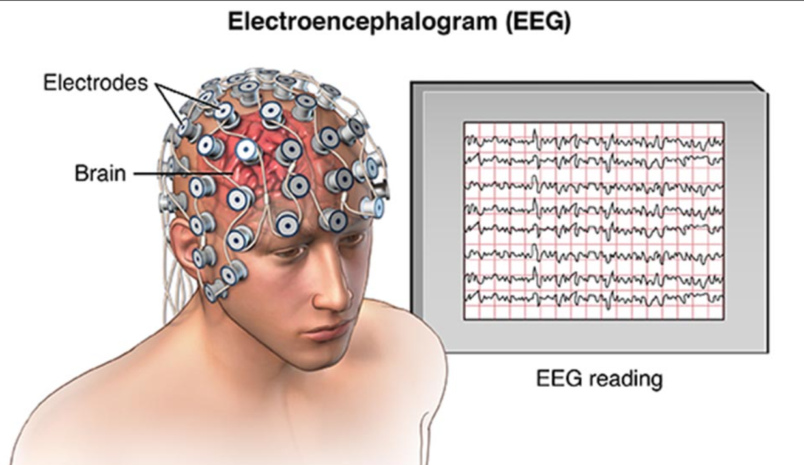
EEG
There are generally two ways to collect EEG data:
intracranial collection(두개내 채집) iEEG
: Record signal directly, no noise
: short-term implantation into the skull is required, and collection
is difficult
Scalp collection(두피 채취) sEEG
: Convenience, Safety, Extensive
: have noise
4

Slide 7
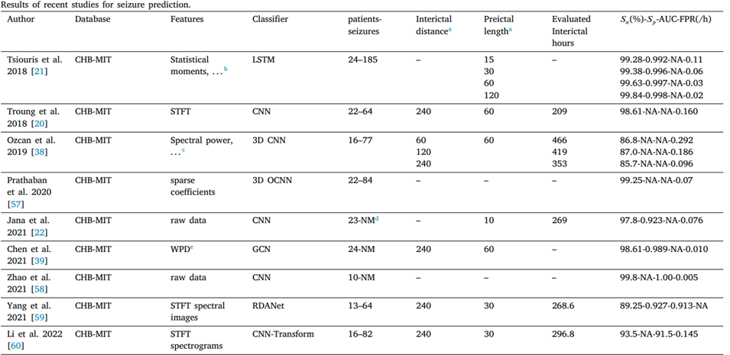
Related work
Recent AUC and FPR Results on Epilepsy Prediction
where 𝑛 is the number of true seizure predictions, 𝑁 is the total number
of seizures.
[4]Li, Chang, et al. "Spatio-temporal MLP network for seizure prediction using EEG signals." Measurement 206 (2023): 112278.
5

Slide 8
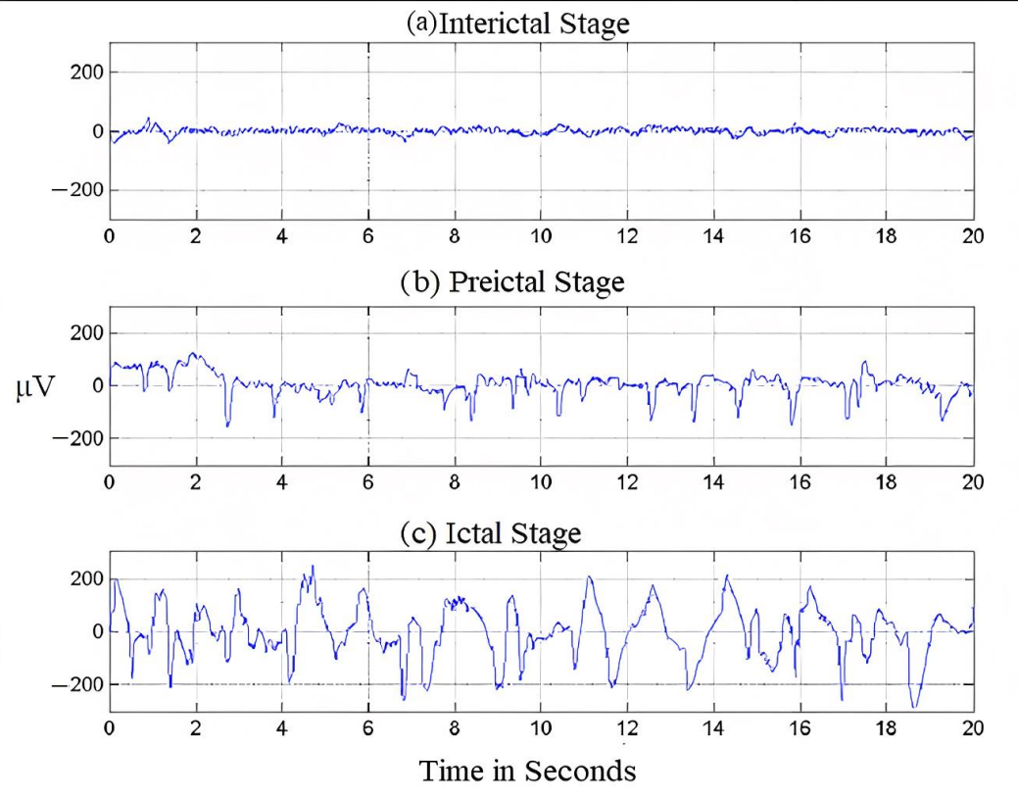
Seizure introduction
The waveforms in different stages：
SIH: Seizure interictal horizon (간질 간기 범위）
SPH: Seizure prediction horizon（간질예측발작범위）
SOP: Seizure occurrence period（간질 발작기）
About predictions:
Only need Interictal, Preictal stage
For clinical:
SPH should be long
6

Slide 9
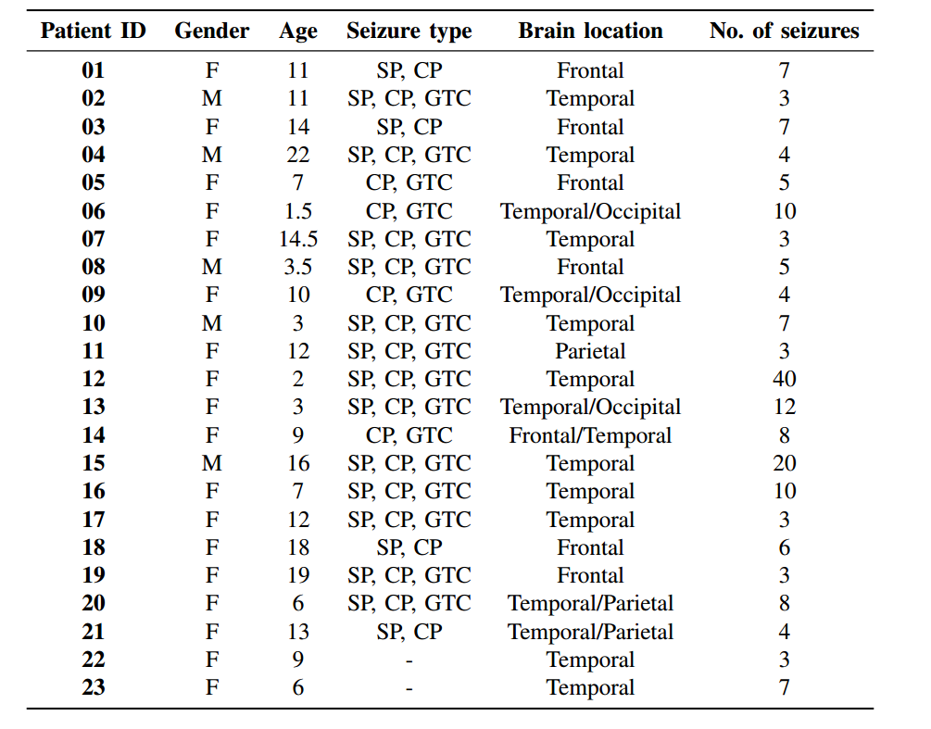
CHB-MIT Scalp EEG Database (sEEG)
CHB-MIT dataset ：
Select a common channel for all patients
→ Usually choose 18 channels
Several well-known databases :
[2] Zhang Y, Guo Y, Yang P, et al. Epilepsy seizure prediction on EEG using common spatial pattern and convolutional neural network[J]. IEEE Journal of Biomedical and Health Informatics, 2019, 24(2): 465-474. IF: 7.021
23
198
983
[1] Truong, Nhan Duy, et al. "Convolutional neural networks for seizure prediction using intracranial and scalp electroencephalogram." Neural Networks 105 (2018): 104-111.Cited by 365
7

Slide 10
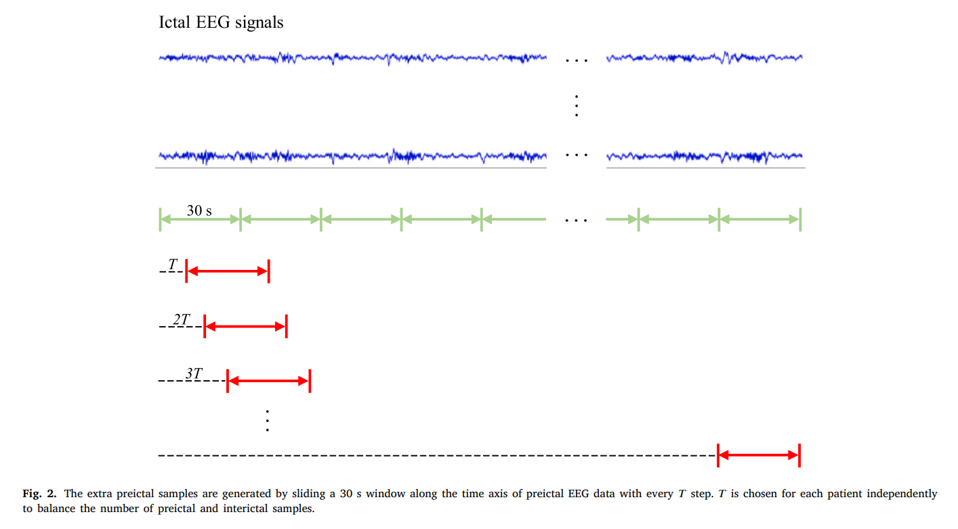
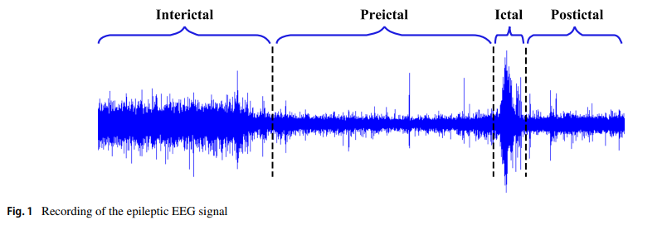
Data imbalance
Data augmentation
Why data augmentation ?
For example, in the Freiburg Hospital dataset, the interictal-to-preictal ratio per patient ranges from 9.5:1 to 15.9:1.
Why not use GNN？
Using GNN to generate signals, because of the large number of channels, there will be a lack of channel correlation
8

Slide 11
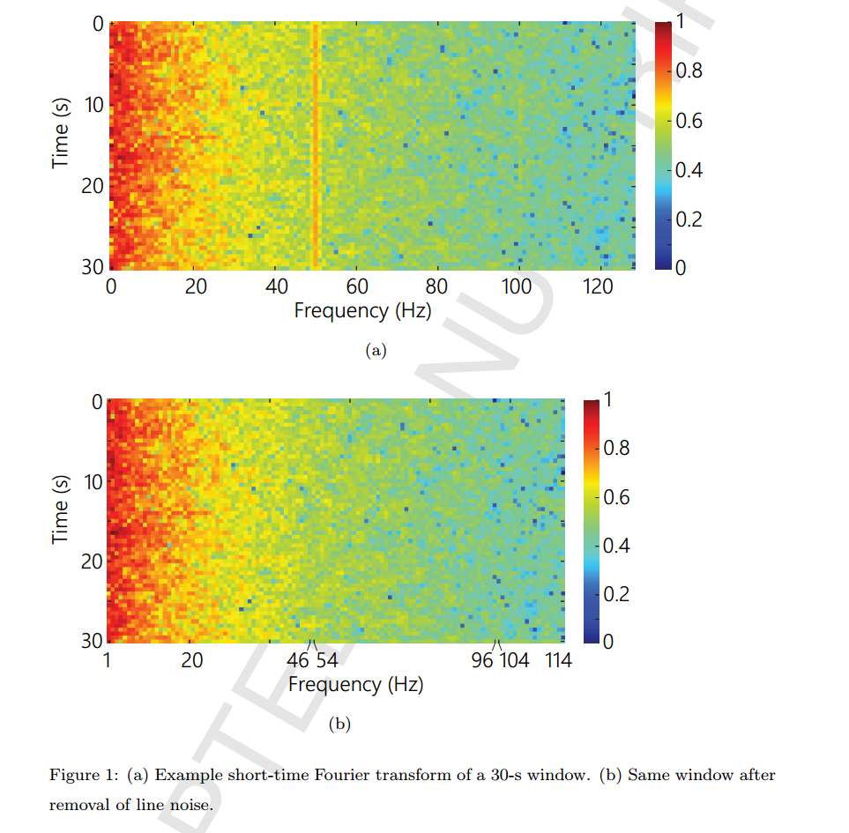
1D signal to 2D matrix (STFT)
Transform raw data into suitable input for CNN
use an EEG window length of 30 s
Remove Power Line Noise:
by excluding 47–53 Hz and 97–103 Hz for 50 Hz
and excluding 57–63 Hz and 117–123 Hz for 60 Hz.
[1] Truong, Nhan Duy, et al. "Convolutional neural networks for seizure prediction using intracranial and scalp electroencephalogram." Neural Networks 105 (2018): 104-111.Cited by 365
9

Slide 12
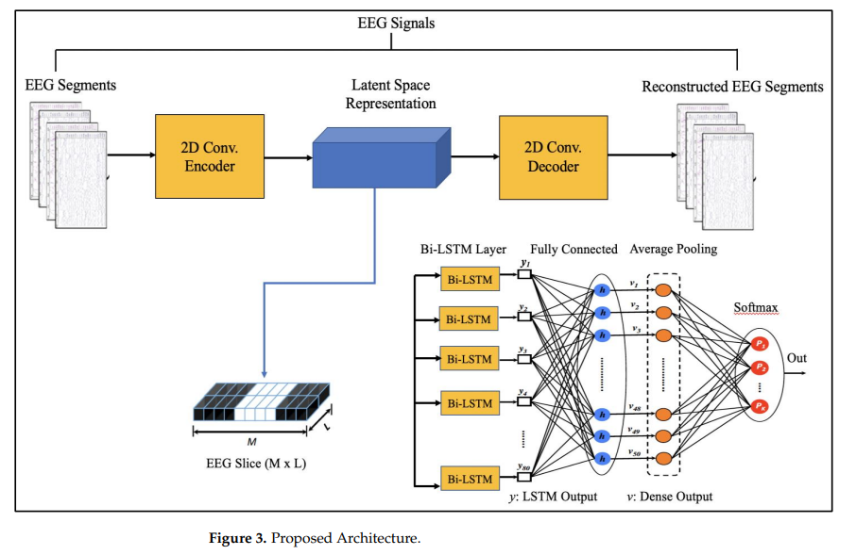
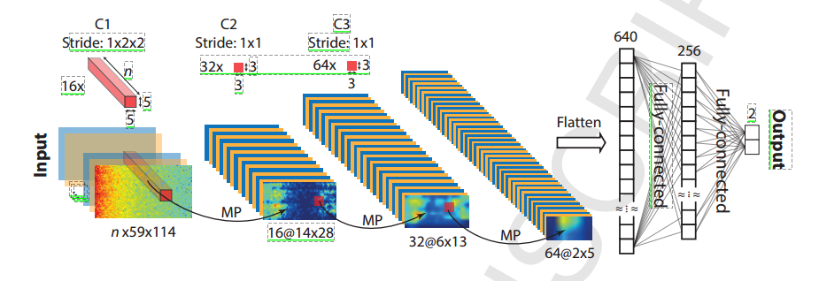
Model
[1] Truong, Nhan Duy, et al. "Convolutional neural networks for seizure prediction using intracranial and scalp electroencephalogram." Neural Networks 105 (2018): 104-111.Cited by 365
[3] Mir W A, Anjum M, Shahab S. Deep-EEG: an optimized and robust framework and method for EEG-based diagnosis of epileptic seizure[J]. Diagnostics, 2023, 13(4): 773.
10

Slide 13
Alarm setting
If an alarm occurs at any point within 30 min before seizure onset, it is considered a successful prediction
For a correct prediction, a seizure onset must be after the SPH and within the SOP.
11

Slide 14
Contribution
My research process:
a. Convert 1D signal to 2D matrix
STFT ; remove the noise line
b. to make data balance
oversampling
c. Model selection, stacking method
CNN+Lstm/BiLSTM
12

Slide 15
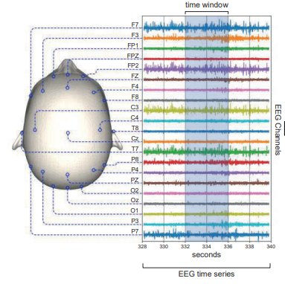
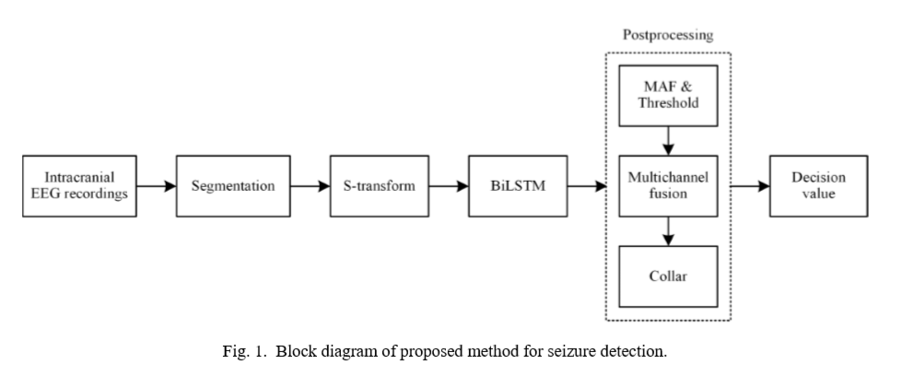
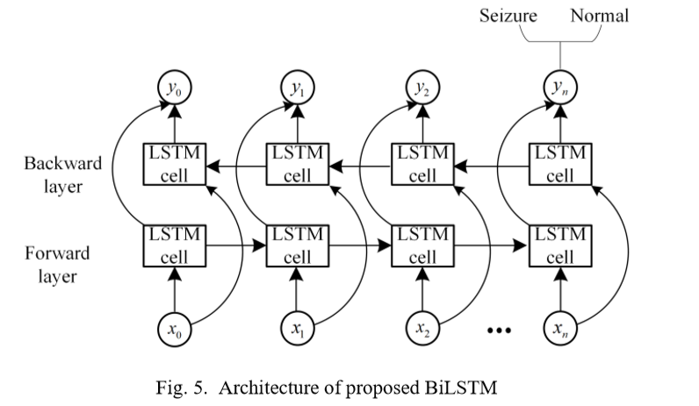
Contribution
2. Use two models for stacking:
12

Slide 16
THANKS
1

