Slide 1
EEG Predicting epileptic seizures （간질 발작을 예측하다）
Ziyang Gong
2023.6.14

Slide 2
Purpose
Significance of epilepsy prediction:
Epilepsy patients account for a large proportion. There are many studies to detect epilepsy, but if epilepsy is predicted in advance, early treatment can be taken(발작 예측은 조기 치료 예방으로 이어질 수 있습니다), so predicting epilepsy will be more promising.
Challenges :
1.The EEG of epilepsy patients constantly transitions between seizure and non-seizure states
2. Epilepsy dataset imbalance
3. Have many channels
4. It is difficult to achieve high sensitivity and low false prediction rate : lager overlap in the EEG associated with seizure and non-seizure states.
1

Slide 3
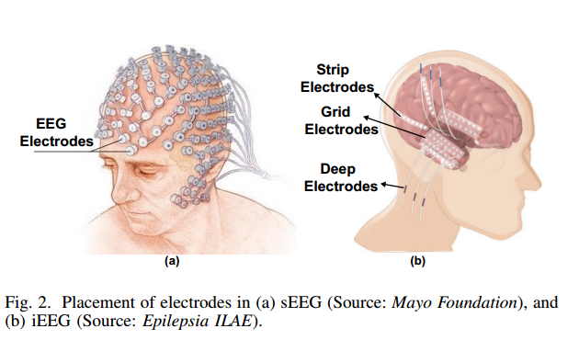
EEG
There are generally two ways to collect EEG data:
intracranial collection(두개내 채집) iEEG
: Record signal directly, no noise
: short-term implantation into the skull is required, and collection
is difficult
Scalp collection(두피 채취) sEEG
: Convenience, Safety, Extensive
: have noise
2

Slide 4
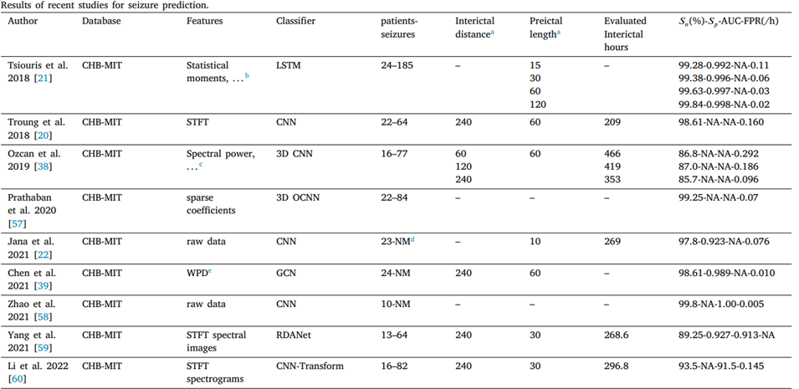
Related work
Recent AUC and FPR Results on Epilepsy Prediction
where 𝑛 is the number of true seizure predictions, 𝑁 is the total number
of seizures.
[4]Li, Chang, et al. "Spatio-temporal MLP network for seizure prediction using EEG signals." Measurement 206 (2023): 112278.
3

Slide 5
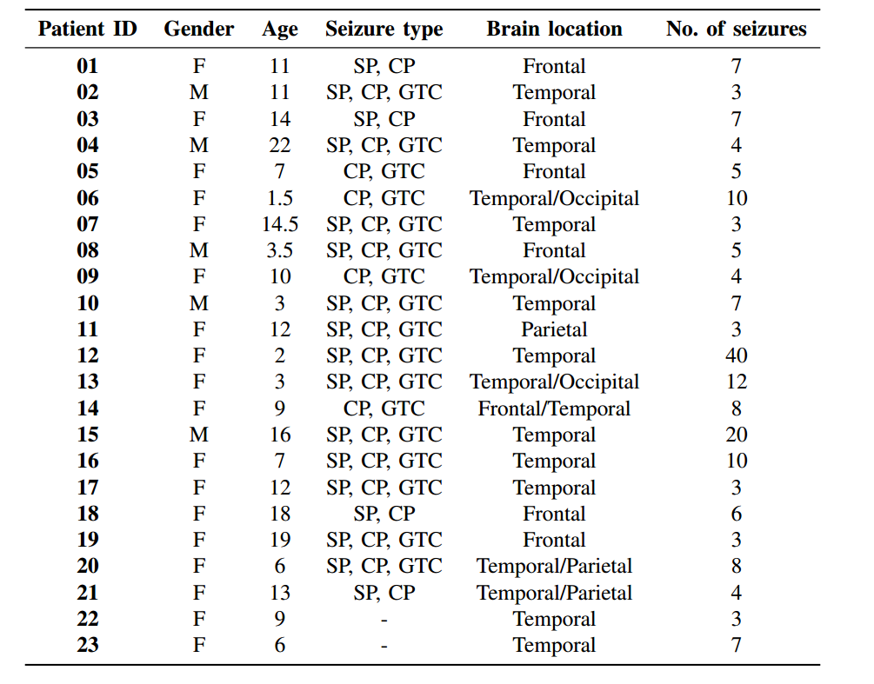
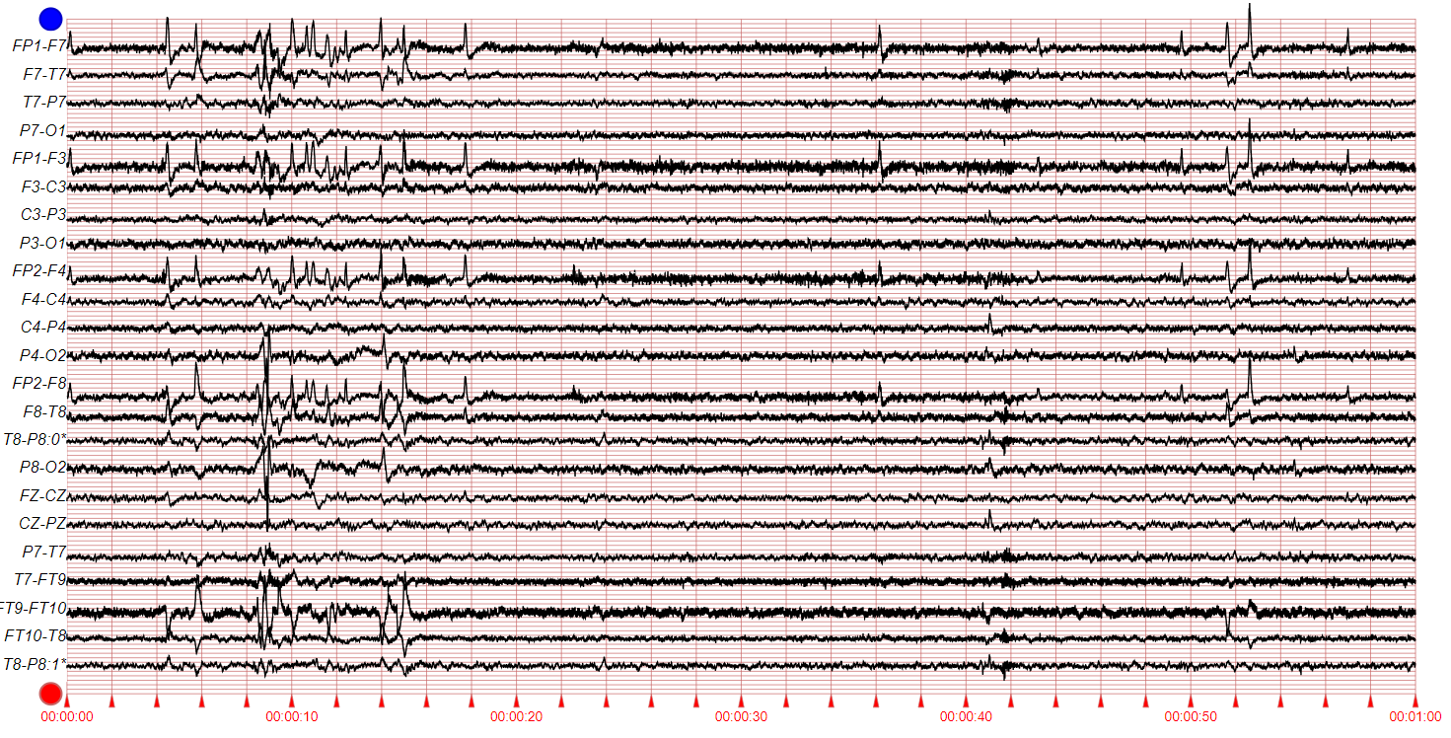
CHB-MIT Scalp EEG Database (sEEG)
CHB-MIT dataset ：
[2] Zhang Y, Guo Y, Yang P, et al. Epilepsy seizure prediction on EEG using common spatial pattern and convolutional neural network[J]. IEEE Journal of Biomedical and Health Informatics, 2019, 24(2): 465-474. IF: 7.021
23 Channel (24 or 26 in a few cases)
[1] Truong, Nhan Duy, et al. "Convolutional neural networks for seizure prediction using intracranial and scalp electroencephalogram." Neural Networks 105 (2018): 104-111.Cited by 365
4

Slide 6
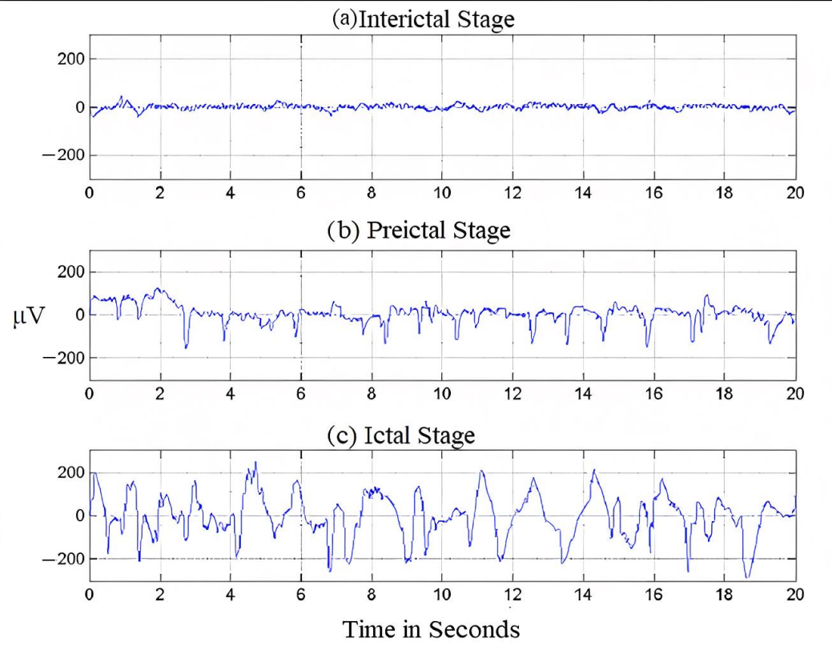
Seizure introduction
The waveforms in different stages：
SIH: Seizure interictal horizon (간질 간기 범위）
SPH: Seizure prediction horizon（간질예측발작범위）
SOP: Seizure occurrence period（간질 발작기）
Usually: Interictal : 4h preictal : 0.5h
About predictions:
Only need Interictal, Preictal stage
For clinical:
SPH should be long
5

Slide 7
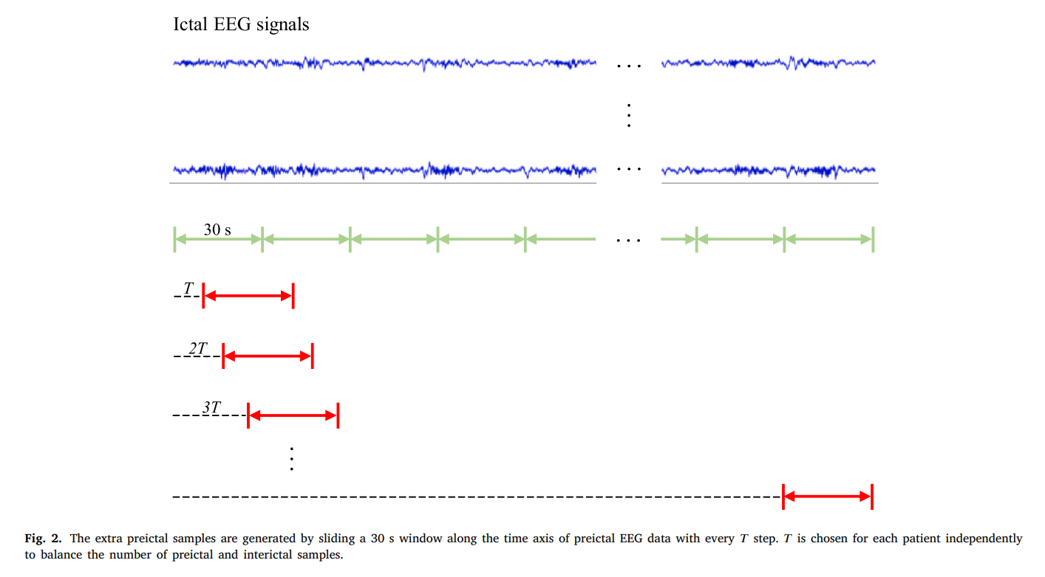
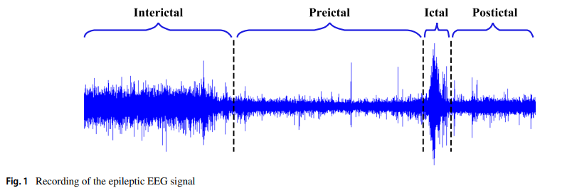
Data imbalance
Data augmentation
Interictal : 4h preictal : 0.5h
Method:
Why data augmentation ?
For example, in the Freiburg Hospital dataset, the interictal-to-preictal ratio per patient ranges from 9.5:1 to 15.9:1.
Why not use GNN？
Using GNN to generate signals, because of the large number of channels, there will be a lack of channel correlation
6

Slide 8
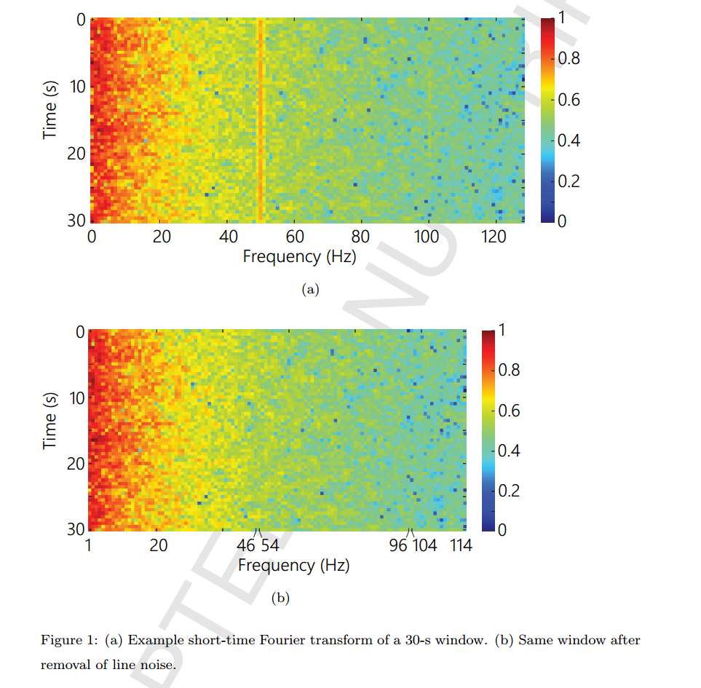
1D signal to 2D matrix
Method1: Short-time Fourier transform(STFT) done
Method2: Stockwell transform (ST)
Transform raw data into suitable input for CNN
use an EEG window length of 4 s
Remove Power Line Noise:
by excluding 47–53 Hz and 97–103 Hz for 50 Hz
and excluding 57–63 Hz and 117–123 Hz for 60 Hz.
[1] Truong, Nhan Duy, et al. "Convolutional neural networks for seizure prediction using intracranial and scalp electroencephalogram." Neural Networks 105 (2018): 104-111.Cited by 365
7

Slide 9
Alarm setting
If an alarm occurs at any point within 30 min before seizure onset, it is considered a successful prediction
For a correct prediction, a seizure onset must be after the SPH and within the SOP.
8

Slide 10
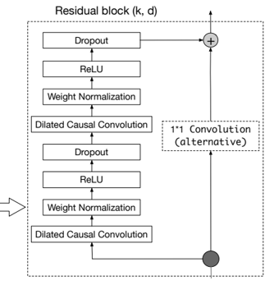
Method
Method Ⅰ(1D signal + ID TCN model)
1
0
output
input
…
TCN(Temporal Convolutional Network)
9

Slide 11
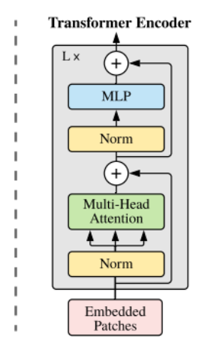
Method
Method Ⅱ (2D matrix + 2D ViT model)
Classification
MLP
Head
Transformer Encoder
STFT
ST
…
ViT(Vision Transformer)
10

Slide 12
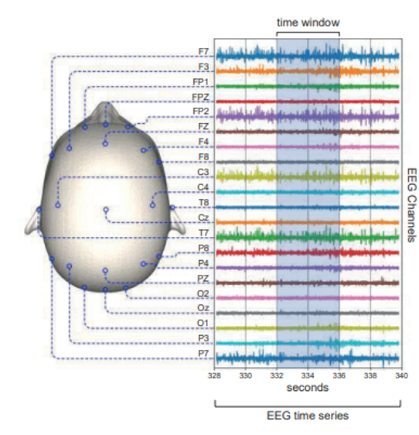
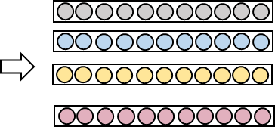
Method
Method Ⅲ (1D Signal 2D Metrix + ID TCN model)
1D Signal
…
TCN model
TCN Classification
…
Output
feature extraction to 1D
ViT model
Feature
2D Metrix
11

Slide 13
Next:
Use ST method convert 1D signal to 2D matrix.
Take methodⅠⅡⅢ result and compare.
12

Slide 14
THANKS

