Slide 1
EEG Predicting epileptic seizures （간질 발작을 예측하다）
Ziyang Gong
2023.7.11

Slide 2
Purpose
Significance of epilepsy prediction:
Epilepsy patients account for a large proportion. There are many studies to detect epilepsy, but if epilepsy is predicted in advance, early treatment can be taken(발작 예측은 조기 치료 예방으로 이어질 수 있습니다), so predicting epilepsy will be more promising.
Challenges :
1.The EEG of epilepsy patients constantly transitions between seizure and non-seizure states
2. Epilepsy dataset imbalance
3. Have many channels
4. It is difficult to achieve high sensitivity and low false prediction rate : lager overlap in the EEG associated with seizure and non-seizure states.
1

Slide 3
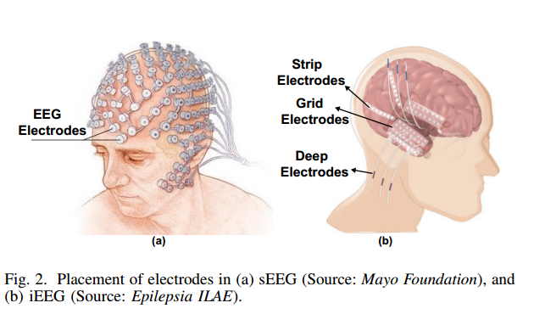
EEG
There are generally two ways to collect EEG data:
intracranial collection(두개내 채집) iEEG
: Record signal directly, no noise
: short-term implantation into the skull is required, and collection
is difficult
Scalp collection(두피 채취) sEEG
: Convenience, Safety, Extensive
: have noise
2

Slide 4
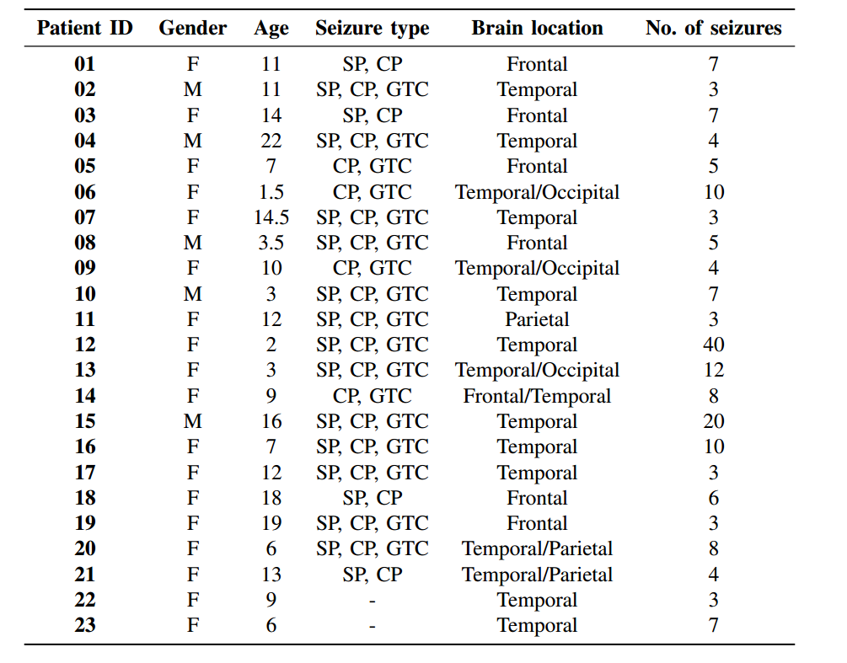
CHB-MIT Scalp EEG Database (sEEG)
CHB-MIT dataset ：
23 Channel (24 or 26 in a few cases)
[2] Zhang Y, Guo Y, Yang P, et al. Epilepsy seizure prediction on EEG using common spatial pattern and convolutional neural network[J]. IEEE Journal of Biomedical and Health Informatics, 2019, 24(2): 465-474. IF: 7.021
[2] Qi N, Piao Y, Yu P, et al. Predicting epileptic seizures based on EEG signals using spatial depth features of a 3D-2D hybrid CNN[J]. Medical & Biological Engineering & Computing, 2023: 1-12. IF: 3.200
[1] Truong, Nhan Duy, et al. "Convolutional neural networks for seizure prediction using intracranial and scalp electroencephalogram." Neural Networks 105 (2018): 104-111.Cited by 365
3

Slide 5
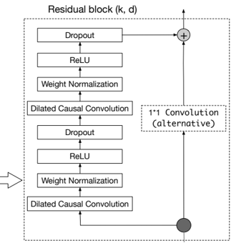
Method
Method Ⅰ(1D signal + ID TCN model)
1
0
output
input
…
TCN(Temporal Convolutional Network)
4

Slide 6
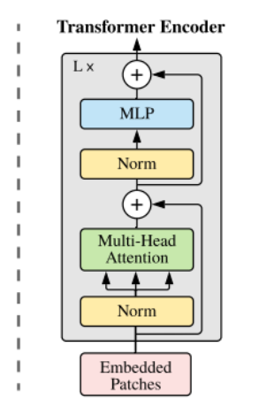
Method
Method Ⅱ (2D matrix + 2D ViT model)
Classification
MLP
Head
Transformer Encoder
STFT
ST
…
ViT(Vision Transformer)
5

Slide 7
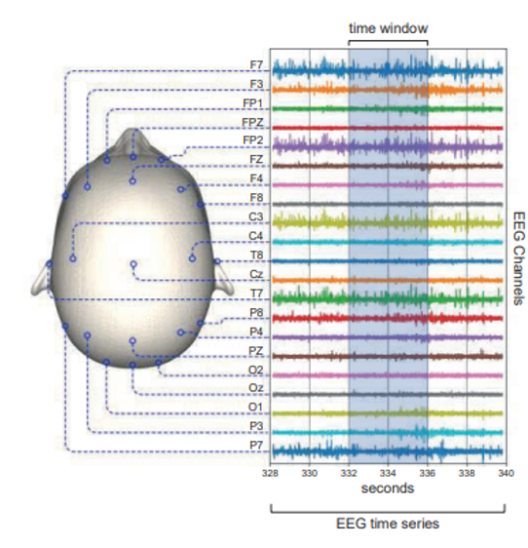
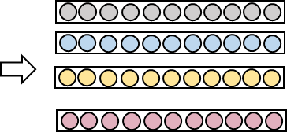
Method
Method Ⅲ (1D Signal 2D Metrix + ID TCN model)
1D Signal
…
TCN model
TCN Classification
…
Output
feature extraction to 1D
ViT model
Feature
2D Metrix
6

Slide 8
Process (Method Ⅱ ) 2D matrix + 2D model
data preprocessing
data augmentation
short-time Fourier
Vit model result
Data reading: select 18 channels from 24 channels
channels : [u'FP1-F7', u'F7-T7', u'T7-P7', u'P7-O1', u'FP1-F3', u'F3-C3', u'C3-P3', u'P3-O1’, u'FP2-F4’, u'F4-C4', u'C4-P4', u'P4-O2', u'FP2-F8', u'F8-T8', u'T8-P8-0', u'P8-O2', u'FZ-CZ’, u'CZ-PZ’]
2. Data sampling:
30 minutes sampling frequency, 256 sampling points per second
3. Data cutting:
preictal: 0.5 hours before the onset of seizures
interictal: 4 hours before preictal
7

Slide 9
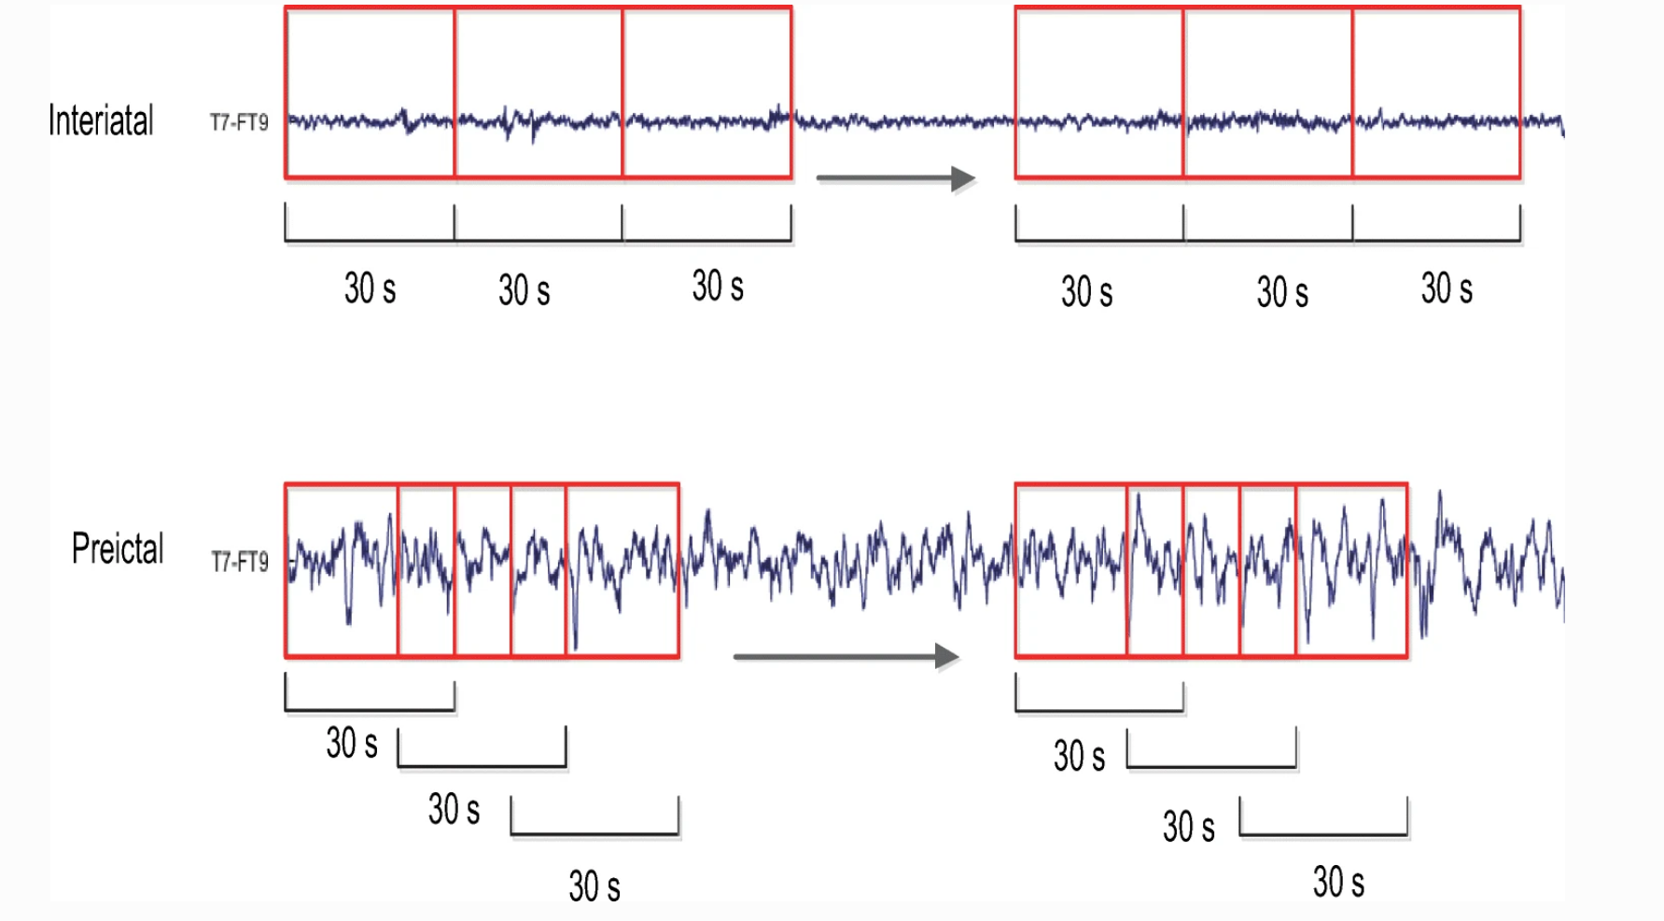
Process (Method Ⅱ )
data preprocessing
data augmentation
short-time Fourier
Vit model result
Use oversampling
2. Use downsampling
4 h
Interiatal
N*18 data
10N*18 data
30s
30s
30s
30s
30s
30s
downsampling
Preiatal
0.5 h
N*18 data
30s
30s
30s
30s
30s
30s
N*18 data
oversampling
Preiatal
N*18 data
30s
30s
30s
30s
30s
30s
8

Slide 10
Process (Method Ⅱ )
data preprocessing
data augmentation
short-time Fourier
Vit model result
Noise line
by excluding 47–53 Hz and 97–103 Hz for 50 Hz and excluding 57–63 Hz and 117–123 Hz for 60 Hz.
9

Slide 11
Process (Method Ⅱ )
data preprocessing
data augmentation
short-time Fourier
Vit model result
Model : ViT
epoch = 50
batch size = 32
train : val : test = 3 : 2 : 1
Patient 1 auc: 0.914371 sens: 0.866949 spec: 0.791077 acc: 0.804047 f1: 0.602001 fpr: 0.208923
Patient 2 auc: 0.926361 sens: 0.616949 spec: 0.991931 acc: 0.968973 f1: 0.708861 fpr: 0.008069
……
→ overfitting
10

Slide 12
Next
Method Ⅱ (2D matrix + 2D ViT model)
Try to use downsampling method for data augmentation.
ViT model modification.
11

Slide 13
THANKS

