Slide 1
Attention All You Need
By: Ashish Vaswani
Presented By: Abdul Hai Karimi

Slide 2
TABLE OF CONTENTS
How Transformers comes into the picture?
Vanila Encoder Decoder architecture.
Attention mechanism-based Encoder Decoder.
Transformer Encoder Architecture.
Transformers Decoder Architecture.

Slide 3
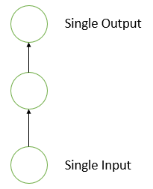
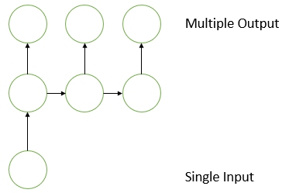
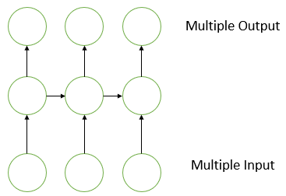
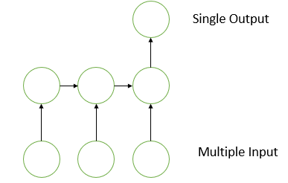
How Transformers Comes into the picture?
There are five types of problems in literature.
One-To-One problem.
One-To-Many problem
Many-To-One problem
Many-To-Many (Seq2Seq) Problem
Synchronies Seq2Seq
Asynchronies Seq2Seq
One-To-One
One-To-Many
Many-To-Many
Many-To-One

Slide 4
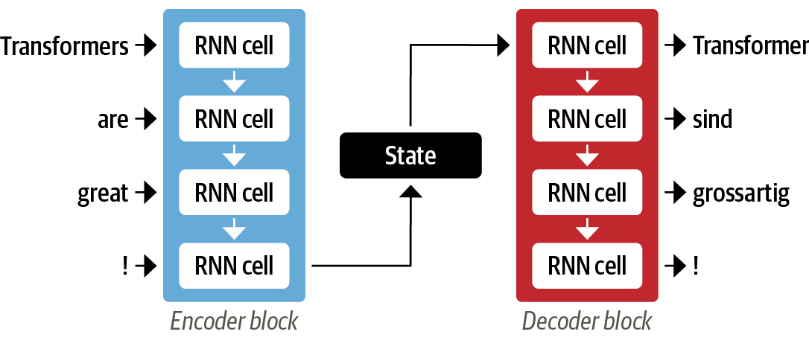
Vanila Encoder Decoder architecture
Paper: SEQUENCE TO SEQUENCE LEARNING WITH NEURAL NETWORKS – by “Ilya Sutskever” in 2014

Slide 5
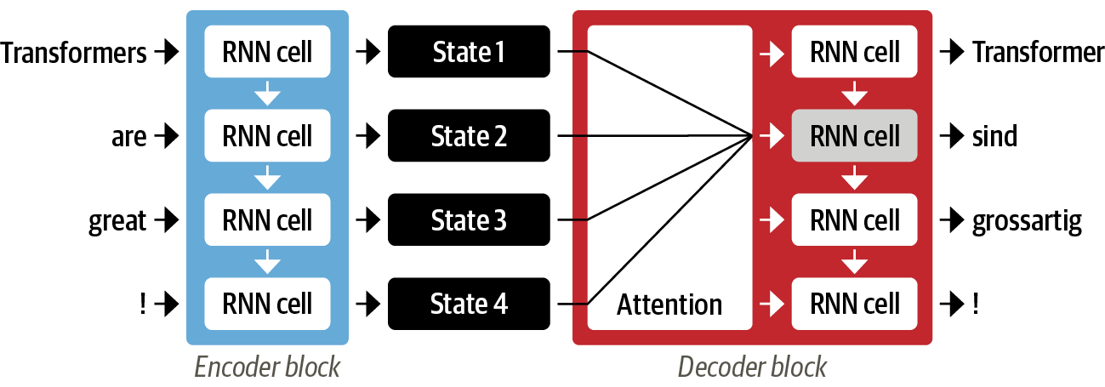
Attention Mechanism Based Encoder Decoder architecture
Paper: NEURAL MACHINE TRANSLATION BY JOINTLY LEARNING TO ALIGN AND TRANSLATE– By “Bahdanau” in 2015.

Slide 6
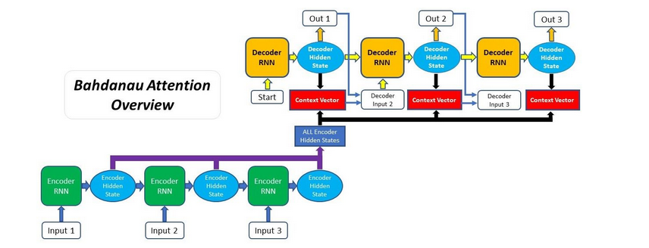
Bahdanau Attention Overview
Additive attention

Slide 7
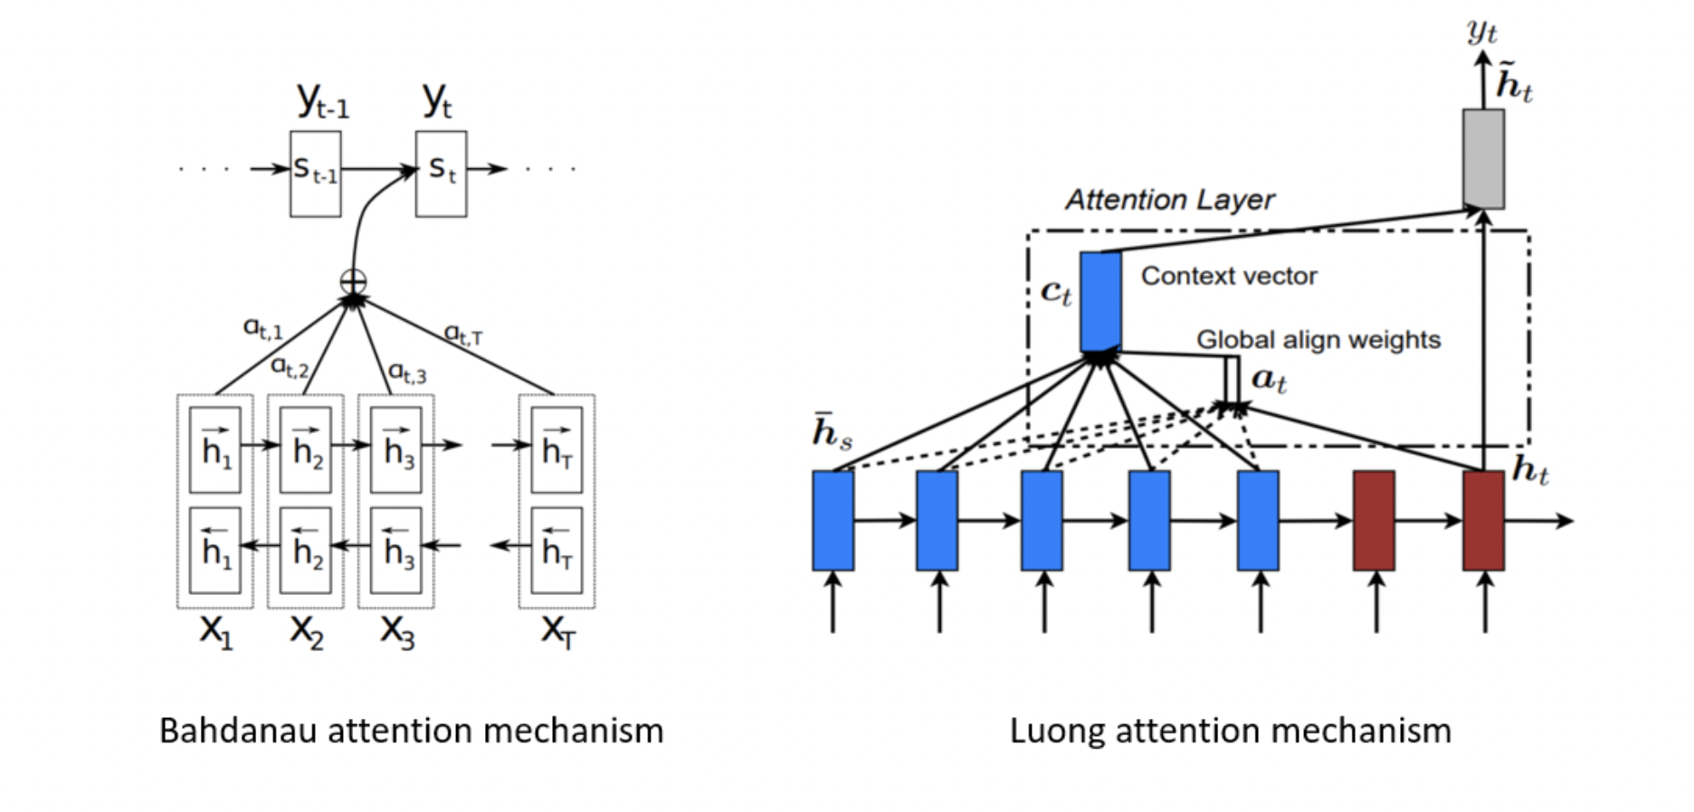
Luong Attention
Paper: EFFECTIVE APPROACHES TO ATTENTION-BASED NEURAL MACHINE TRANSLATION – by “Thang Luong” in 2016
Multiplicative attention

Slide 8
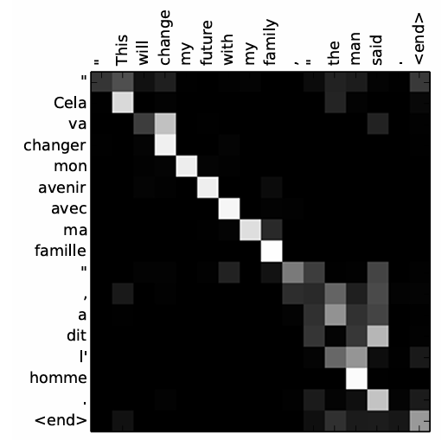
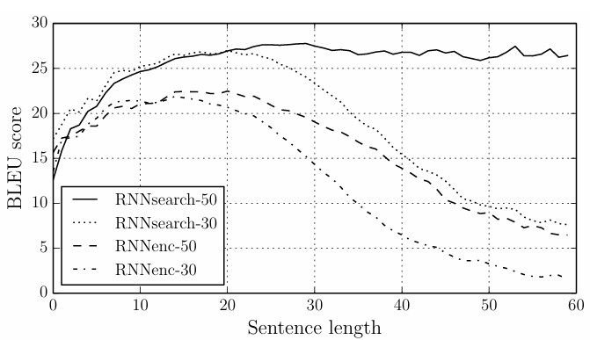
Results Of Attention Based Encoder Decoder

Slide 9
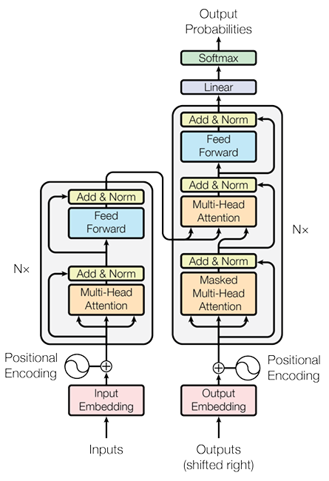
Attention Is All You Need
Paper: Attention Is All You Need – By Google Brain in 2017.

Slide 10
Transformers Architecture
ENCODER
DECODER
ENCODER
DECODER
ENCODER
DECODER
ENCODER
DECODER
ENCODER
DECODER
ENCODER
DECODER
ENCODER
DECODER

Slide 11
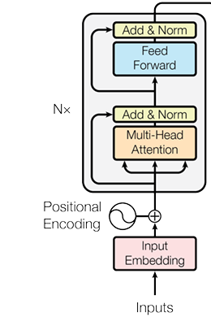
Transformers Encoder Block Input’s
Embedding
Positional Encoding

Slide 12
Embedding & Positional Encoding
Encoder’s Input
Embedding: Sematic Vector Representation of a word.
Positional Encoding: A way to encode the words position.
Embedding
Positional Encoding

Slide 13
How Positional Encoding works?
New Embedded Vector
for First Word
Positional Encoding
0
1
0
1
0
1
0
1
Embedding Vector
2
3
4
3
2
8
1
5
2
4
4
4
2
9
1
6
New Vector

Slide 14
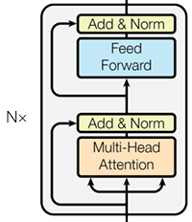
Transformers Encoder Block
ENCODER
Feed Forward NN
Self Attention

Slide 15
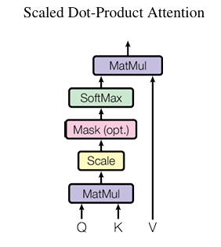
How Self Attention Works?
Self attention is way to extract contextual vector representation of a word.
K
WQ
WV
WK
Q
.
.
1
2
Money
3
4
Bank
V
Money V
Bank V
Money
3
x
+
1
x
x
Money
1
2
Bank V
Money V
3
4
Bank
Bank
4
x
+
2
x

Slide 16
How Multi-Head Self Attention Works?
Multi-Head self attention mechanism is a self attention with multiple heads, and it extract contextual information from different aspects.

Slide 17
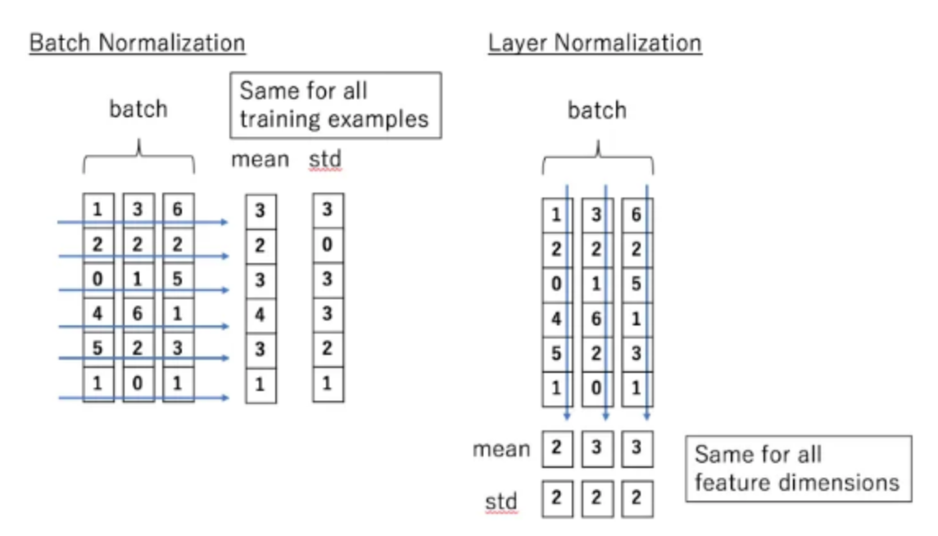
Batch Normalization Vs Layer Normalization

Slide 18
Feed Forward Neural Network & Skin Connection
A feed Forward Neural Network with input layer of 512 units, hidden layer of 2048 and output layer of 512 units.
Skip Connection is used to mitigate the vanishing gradient problem, better information flow, and combining low-level and high-level features.

Slide 19
Transformers Decoder Block
Masked Mult-Head Attention
Cross Attention
DECODER
Feed Forward Neural Network

Slide 20
Transformers Decoder Block Input’s
Shifted Right: Adding an extra token in the start of the words <SOS>
Shifted Right
Embedding: Vector Representation of the target language Words same as encoder block
Embedding
Positional Encoding
Positional Encoding: A way to encode the words position in the embedded vector same as encoder block.

Slide 21
Transformers Decoder Block Masked Multi Head Attention
K
WQ
WV
Q
WK
.
3
1
6
.
How
4
7
2
Are
V
4
3
1
You
3
1
6
0
-∞
-∞
3
-∞
-∞
3
0
0
How
+
4
7
x
Are
-∞
Softmax
0
4
7
2
0
0
4
7
-∞
You
4
3
1
0
0
0
4
3
1
4
3
1

Slide 22
Transformers Decoder Block Cross Attention
Cross attention is same as the self attention mechanism as we have in the encoder block but in cross attention the key and values will be feed from the encoder, while the query will be passed from masked multi head attention

Slide 23
Transformers Decoder Block Feed Froward, Add & Layer Normalization
Feed Froward Neural: The Input to this network will be of size (None ,None , 512) with hidden units of 2048 and units will be same as the input which is 512 as in “Attention All You Need” Paper
Add: also know as Skip Connection which combine high level and low level features.
Norm: Is a layer normalization layer which normalizes the feature vectors sample wise not the bases of batches.

Slide 24
Transformers Decoder Block Output
Linear: A Feed Forward Neural network with 512 input units and len(V) output units.
Softmax: is an activation function which gives as probabilities.

Slide 25
Transformer Taring Vs Inference
Transformers are non-autoregressive at training time, but autoregressive at inference time.
Forward
Forward
<Sos>
How
are
You
<End>

Slide 26
Thanks!!

