Slide 1
IIP Lab Seminar 2023.07.11
A summary of my MS degree
Hacı İsmail Aslan

Slide 2
Early days & First SCIE publication
I have been working on Graph Neural Networks for last 2 years
My first conference publication was «Prediction of Number of Suicidal People Based on KNN» for ICEIC in February, 2022.
It was a basic paper, applying KNN along with other traditional ML techniques to regress the population that is tendent to suicide.
Later, I only worked on Graph-related machine learning tasks.
My first SCIE paper was published by Mathematical Biosciences and Engineering (AIMS Press) in August 2022.

Slide 3
Classification of vertices on social networks by multiple approaches (first SCIE paper)
GCN & GAT versus Harmonic Functions
Graph Convolutional Network
Graph Attention Network
$$h_{i}=σ\left(\sum_{j∈V\left(i\right)}{W^{T}}h_{j}\right)$$
$$=\frac{ exp\left(LeakyReLU\left(a\left[W^{T} | h_{i} | W^{T}h_{j}\right]\right)\right)}{\sum_{k∈V\left(i\right)}^{n}{exp\left(LeakyReLU\left(a\left[W^{T} | h_{i} | W^{T}h_{k}\right]\right)\right)}}$$
$$α_{ij}$$
Harmonic Functions
$${h^{′}}_{i}=σ\left(\sum_{j∈V\left(i\right)}^{n}{α_{ij}W^{T}h_{j}}\right)$$
$$h\left(V_{i}\right)=\frac{1}{d_{i}}\sum_{\left(V_{i},V_{j}\right)∈V}{h\left(V_{j}\right)}$$

Slide 4
Datasets
 | Karate | Email | Cora | Pubmed
No. Nodes | 34 | 1.005 | 2.708 | 19.717
No. Edges | 78 | 25.571 | 5.429 | 44.338
No. Clusters | 2 | 42 | 7 | 3
No. Training Nodes | 2 | 804 | 2.166 | 5.000
Average Clustering Coefficient | 0.57 | 0.4 | 0.24 | 0.06
Average Degree | 4.59 | 25.44 | 3.9 | 4.5

Slide 5
Classification of vertices on social networks by multiple approaches
 | GCN | GAT | Harmonic
Karate | 100% | 100% | 100%
Email | 72.1 ± 0.52% | 67.95 ± 0.47% | 70.7 ± 0.68%
Cora | 81.45 ± 0.3% | 83.05 ± 0.29% | 86.35 ± 0.23%
Pubmed | 80.39 ± 0.26% | 80.73 ± 0.24% | 82.35 ± 0.07%
GCN & GAT need to improve on supervised learning settings
When it comes to less homogeneous graphs, GCN is still better

Slide 6
GNN for ECG Biometric Authentication(Submitted to ESWA, Minor Revision)
Important Metrics in Authentication
Proposed Environment for Biometric Authentication
Data Handling
VisGIN: Visibility Graph Isomorphism Network for ECG Biometric Authentication

Slide 7
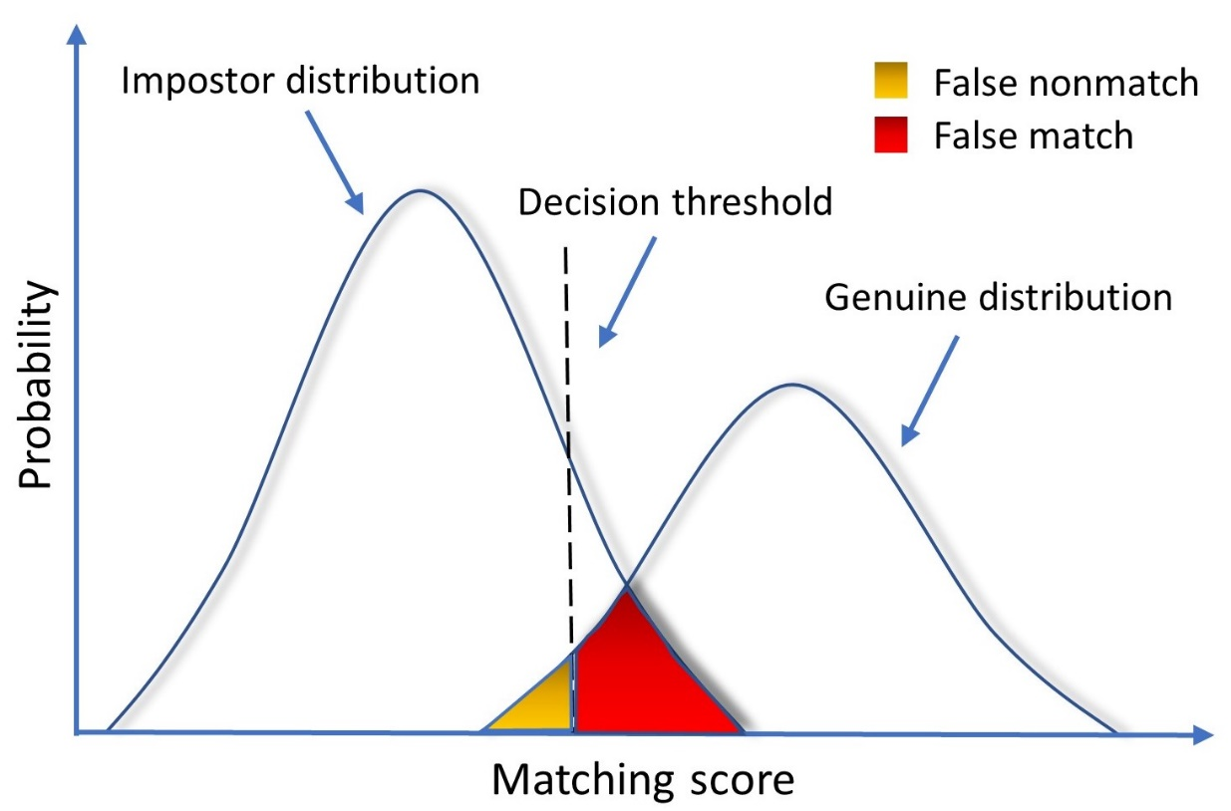
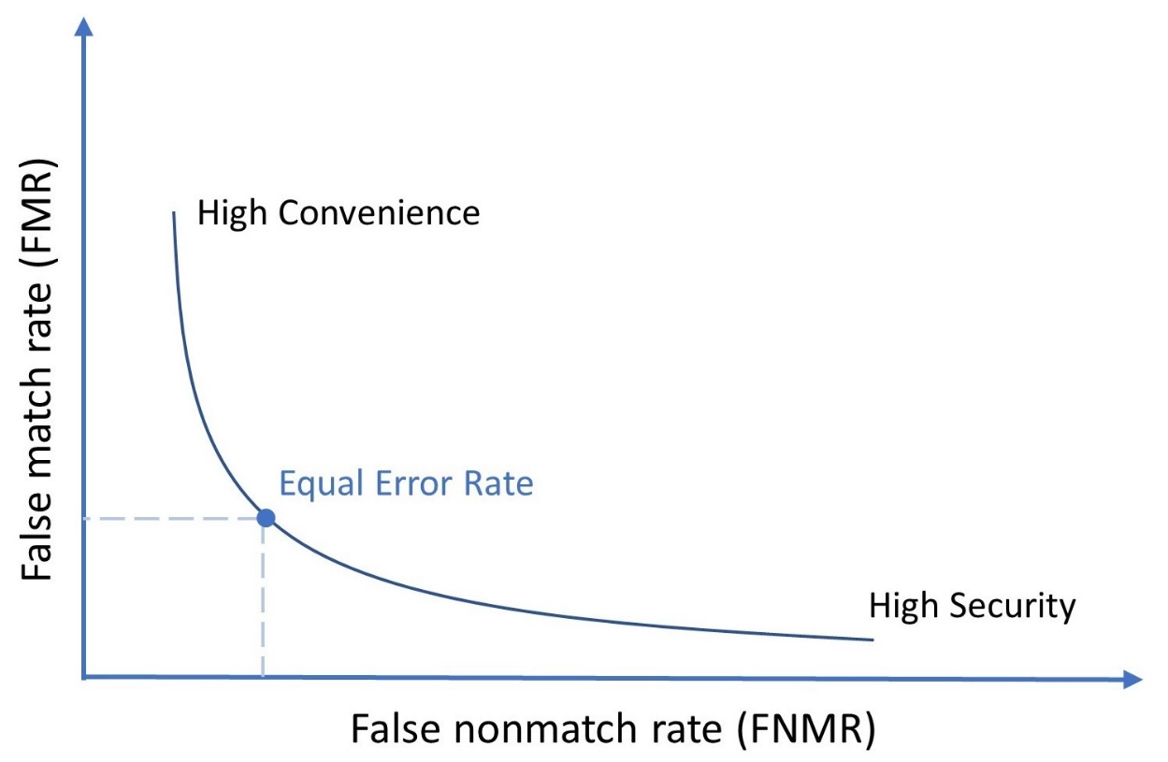
Important Metrics in Authentication

Slide 8
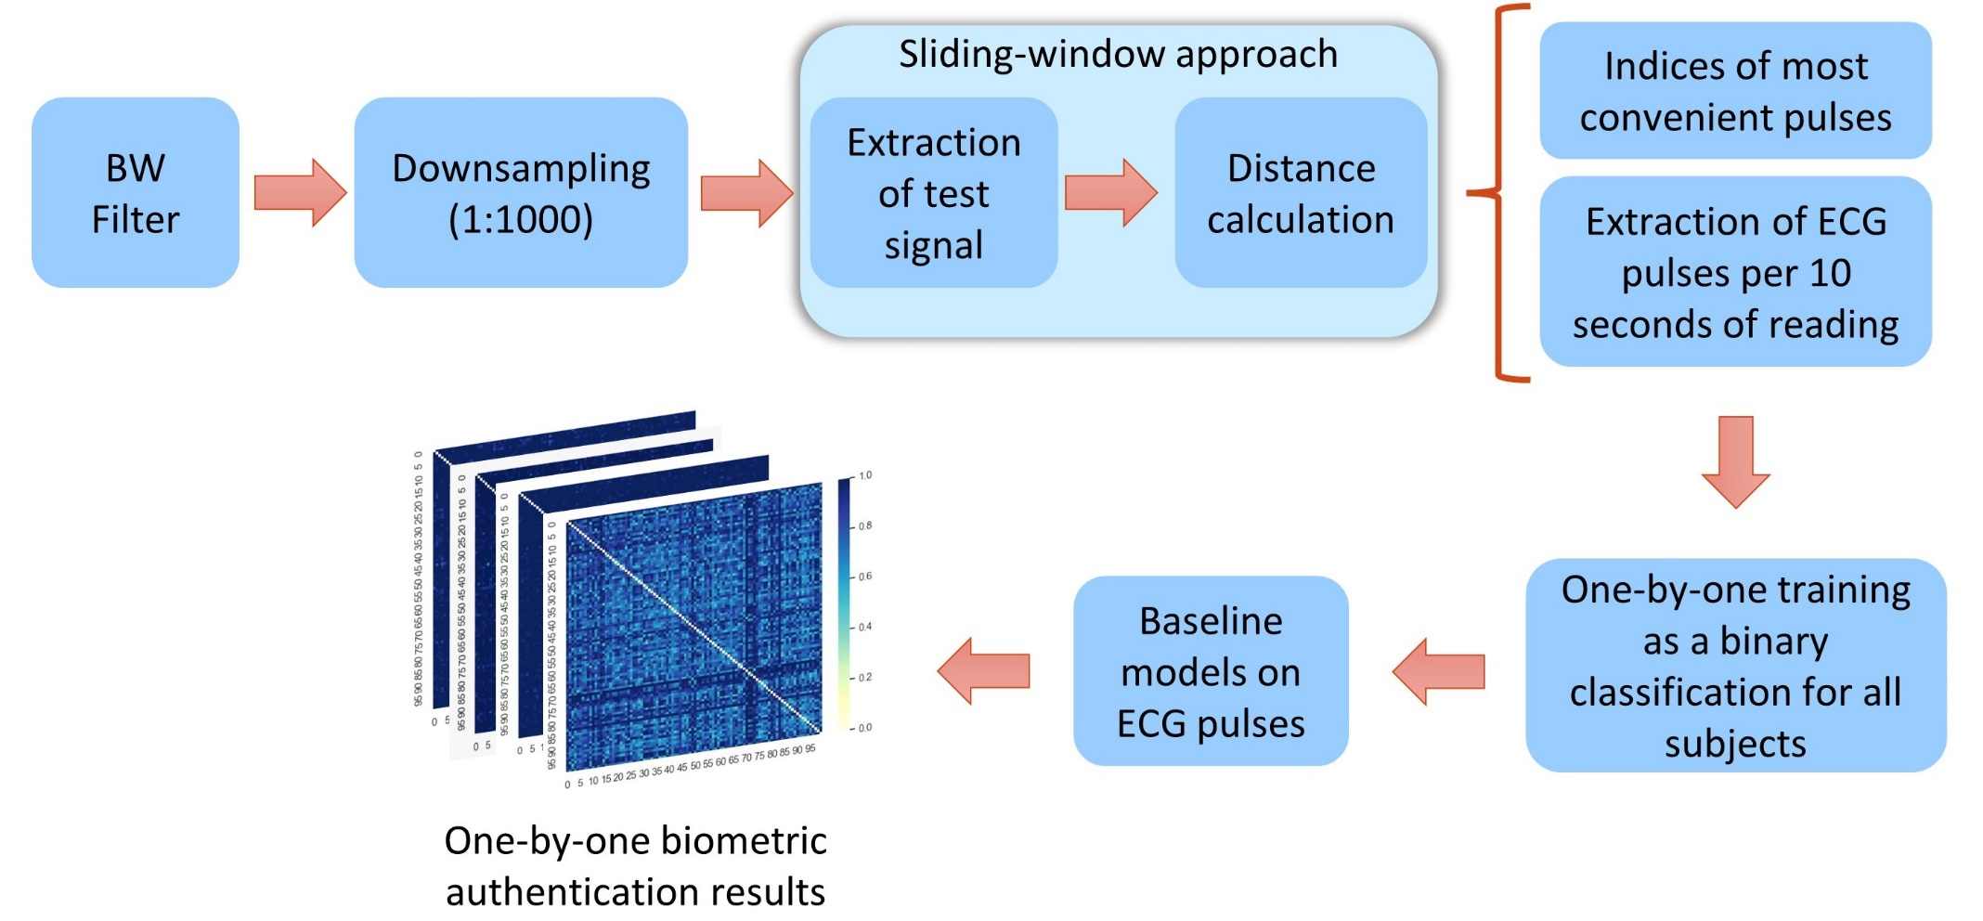
Proposed Environment for Biometric Authentication

Slide 9
Data Handling
Which strategy to extract pulses?

Slide 10
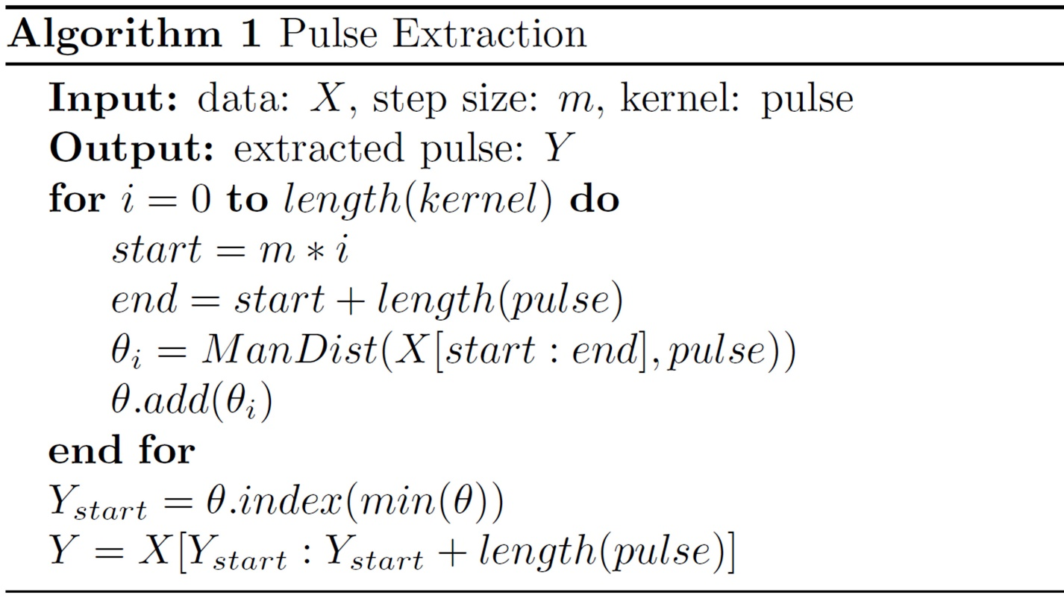
Data Handling (Cont.)
starting index of the windowed ECG sample
last index of the windowed ECG sample
similarity/distance
append all similarity scores in a list
find the minimum distance/maximum similarity and get the index of it in the list
fetch the most similar pulse from the start index
kernel
Extracted Pulse

Slide 11
Data Handling (Cont.)
Why not to use R-peak finders?
Because all R-peak finders make our application bound to the accuracy of the R-peak finder algorithm. In other words, R-peak finder algorithms cannot detect R peaks with %100 accuracy.
Hamilton
Engelse and Zeelenberg
Pan and Tompkins
Stationary Wavelet Transform
Two Moving Average
Matcher Filter
WQRS
All these methods are available in py-ecg-detectors package.
However, our application doesn’t need to detect R-peak index for pulse extraction

Slide 12
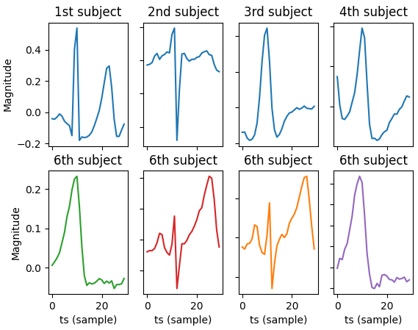
Data Handling (Cont.)
Extracted pulses after Pan-Tompkins
To check why it is not needed to get R points with R-peak finders, I simulated Pan-Tompkins algorithm.
R-peaks with Pan-Tompkins and windowed 30 samples around R-peak (10 samples before R-peak and 20 samples after R-peak)
Note that all these samples below belongs to 6th subject. However, pan-tompkins did not work out well on these.

Slide 13
VisGIN: Visibility Graph Isomorphism Network for ECG Biometric Authentication
Graph Isomorphism
A
G
A
H
Two graphs $G$ and $H$ are considered isomorphic $G≅H$ if there exists a structure-preserving bijection $f: N_{G}→N_{H}$, where the vertex function $f$ preserves adjacency.
B
H
G
B
$$\text{≅}$$
C
I
C
J
D
J
I
D

Slide 14
VisGIN: Visibility Graph Isomorphism Network for ECG Biometric Authentication
Graph Isomorphism Network
$$h_{i}=MLP\left(\left(1+ϵ\right)⋅x_{i}+\sum_{j∈𝒩_{𝒾}}^{N}{h_{i}^{0}}\right)$$
GIN Convolution
Graph-level representation
$$h_{G} = \sum_{i=0}^{N}{h_{i}^{0}} \left| \right| … \left| \right| \sum_{i=0}^{N}{h_{i}^{k}}$$
Commonly used operators include mean ($h_{G}=\sum_{i=0}^{N}{h_{i}/N}$), sum ($h_{G}=\sum_{i=0}^{N}{h_{i}}$), and max ($h_{G}=max_{i=0}^{N}\left(h_{i}\right)$).

Slide 15
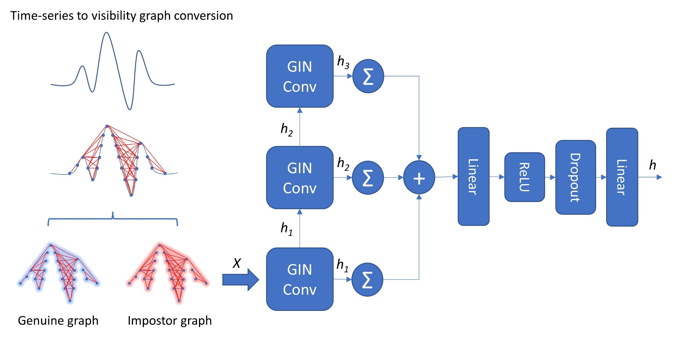
VisGIN: Visibility Graph Isomorphism Network for ECG Biometric Authentication

Slide 16
GNN for ECG Biometric Authentication
Model | Not Applied (%) | Applied (%)
LSTM | 92.98 ± 10.1% | 94.78 ± 8.2%
MLP | 97.15 ± 4.1% | 98.68 ± 2.8%
TCN | 97.29 ± 4.6% | 98.23 ± 3.6%
mWDN | 98.88 ± 2.4% | 99.03 ± 2.2%
XCM | 99.08 ± 2.2% | 99.04 ± 2.2%
FCN | 99.23 ± 1.9% | 99.26 ± 1.9%
LSTM-FCN | 99.24 ± 1.9% | 99.24 ± 1.9%
MLSTM-FCN | 99.27 ± 1.9% | 99.25 ± 1.9%
InceptionTime | 99.36 ± 1.8% | 99.30 ± 1.9%
VisGIN (Proposed) | 99.54 ± 1.5% | 99.55 ± 1.5%
Effects of baseline correction (wander removal)

Slide 17
GNN for ECG Biometric Authentication
 | $$ℳ =1$$ |  |  | $$ℳ =2$$ |  |  | $$ℳ =3$$
Model | ACC $\left(↑\right)$ | FNMR $(↓)$ | FMR $(↓)$ | ACC $(↑)$ | FNMR $(↓)$ | FMR $(↓)$ | ACC $(↑)$ | FNMR ($↓)$ | FMR ($↓)$
LSTM | 92.98 ± 10.1 | 7.28 | 6.75 | 95.0 ± 7.1 | 4.99 | 4.99 | 95.66 ± 6.0 | 4.42 | 4.26
MLP | 97.15 ± 4.1 | 2.81 | 2.89 | 97.86 ± 2.7 | 2.12 | 2.16 | 98.04 ± 2.3 | 1.89 | 2.0
TCN | 97.29 ± 4.6 | 2.79 | 2.61 | 98.4 ± 2.4 | 1.66 | 1.53 | 98.48 ± 2.2 | 1.53 | 1.52
mWDN | 98.88 ± 2.4 | 1.11 | 1.12 | 98.92 ± 1.8 | 1.11 | 1.05 | 98.94 ± 1.5 | 1.06 | 1.05
XCM | 99.08 ± 2.2 | 0.97 | 0.86 | 99.32 ± 1.3 | 0.69 | 0.65 | 99.36 ± 1.1 | 0.66 | 0.61
FCN | 99.23 ± 1.9 | 0.79 | 0.74 | 99.66 ± 0.9 | 0.35 | 0.33 | 99.72 ± 0.7 | 0.28 | 0.29
LSTM-FCN | 99.24 ± 1.9 | 0.79 | 0.73 | 99.67 ± 0.9 | 0.34 | 0.32 | 99.71 ± 0.7 | 0.28 | 0.30
MLSTM-FCN | 99.27 ± 1.9 | 0.73 | 0.74 | 99.63 ± 0.9 | 0.38 | 0.35 | 99.69 ± 0.7 | 0.30 | 0.31
InceptionTime | 99.36 ± 1.8 | 0.59 | 0.69 | 99.44 ± 1.2 | 0.54 | 0.57 | 99.49 ± 0.9 | 0.52 | 0.51
VisGIN | 99.54 ± 1.5 | 0.5 | 0.42 | 99.67 ± 0.9 | 0.34 | 0.31 | 99.76 ± 0.7 | 0.24 | 0.25

Slide 18
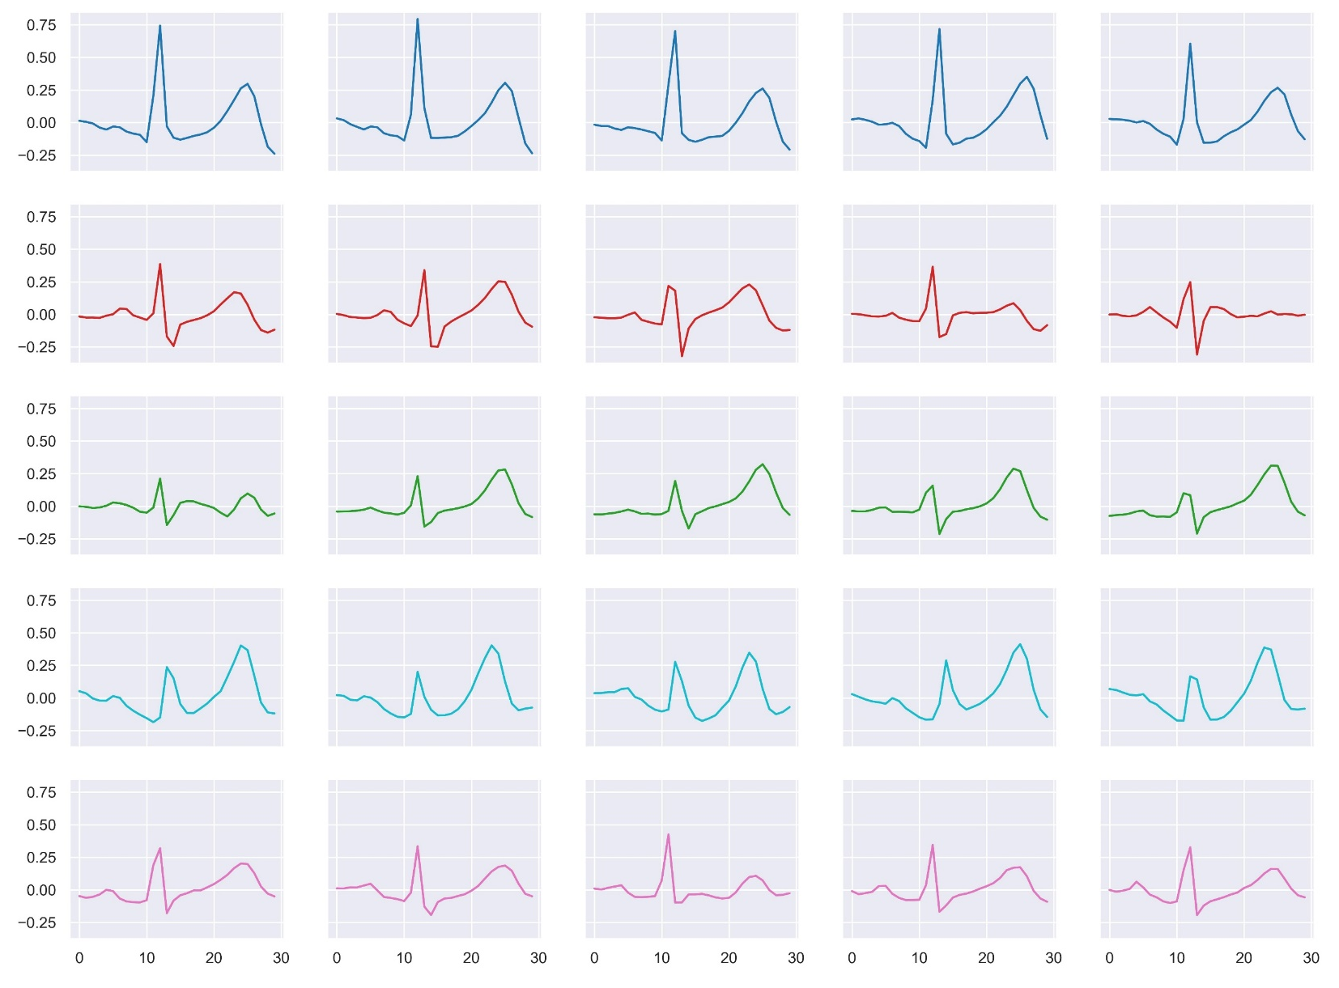
GNN for ECG Biometric Authentication
ECG pulse signals of a selection of individuals. X-axis and y-axis denote sample numbers and magnitudes (mV), respectively.

Slide 19
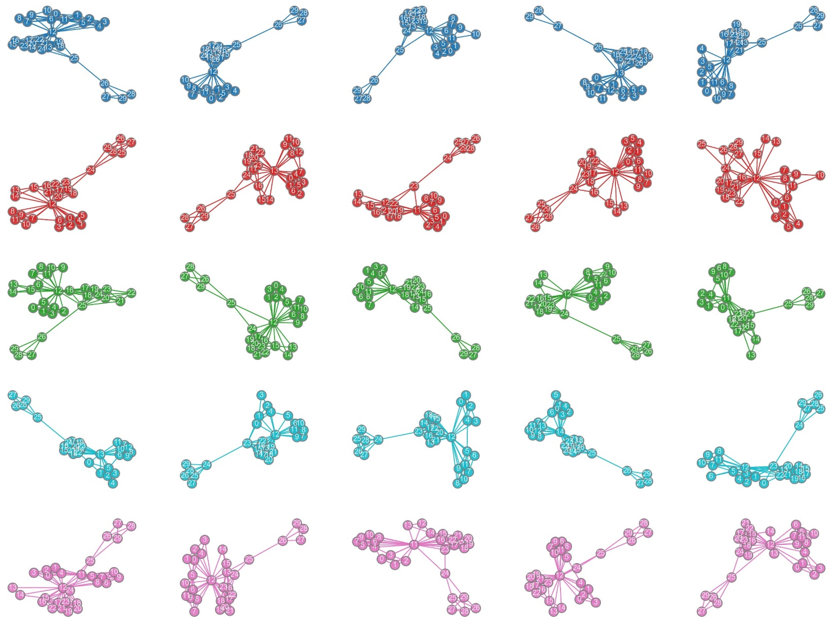
GNN for ECG Biometric Authentication
Corresponding visibility graphs of the signals in the previous slide.

Slide 20
Other Research
We have published a short paper at ICLR 2023 with Taimoor Khan about performance evaulation of ConvNextTiny model for fire detection.
It will be indexed at DBLP when proceedings are announced.
For a while, we have tried to compete in OGB-LSC 2022: A Large-Scale Challenge for ML on Graphs with Namgyu and Kihoon.
However, the memory and GPU requirements were massive and we decided not to continue with it.

Slide 21
Future Plan
I would like to pursue a career that involves graphs, for sure.
I am looking for PhD options for the next year, but I may also take an industry job as well.
The future seems fuzzy a bit, but I hope to come up with a final decision soon.
Apart from job-related things, I would like to submit a paper to LoG 2023 conference, after submitting my revisions for the ESWA paper.
If LoG paper fails, or not prepared on time due to poor results, I will still continue that research for an SCIE submission.

Slide 22
Thanks for listening
You will be missed for sure. Your questions are now welcomed!
발표 경청해 주셔서 감사합니다

