Slide 1
WHO AM I
Exploring My Path And Passion

Slide 2
INTRODUCTION
Identity:
Given Name: Abdul Hai
Surname: Karimi
Hometown:
Afghanistan
Role/Status:
A Research assistant at Islamia College Peshawar.

Slide 3
MY EDUCATIONAL BACKGROUND
Schooling:
Bachelor Of Science:
From: Islamia College Peshawar
Duration: 2019 – 2023
High School & College:
From: Khoshal Khan High School
Duration: 2006 – 2018

Slide 4
WORK EXPERIENCE
Research Assistant, Islamia College Peshawar:
Duration: 2021 – 2023, one and half years
Responsibilities:
Assisted in Conducting research Projects.
Guiding new Research Students.
Achievements:
Contributed with MS and PHD student in multiple research projects namely:
Leukocytes detection and classification
Abandoned Object Detection and Classification

Slide 5
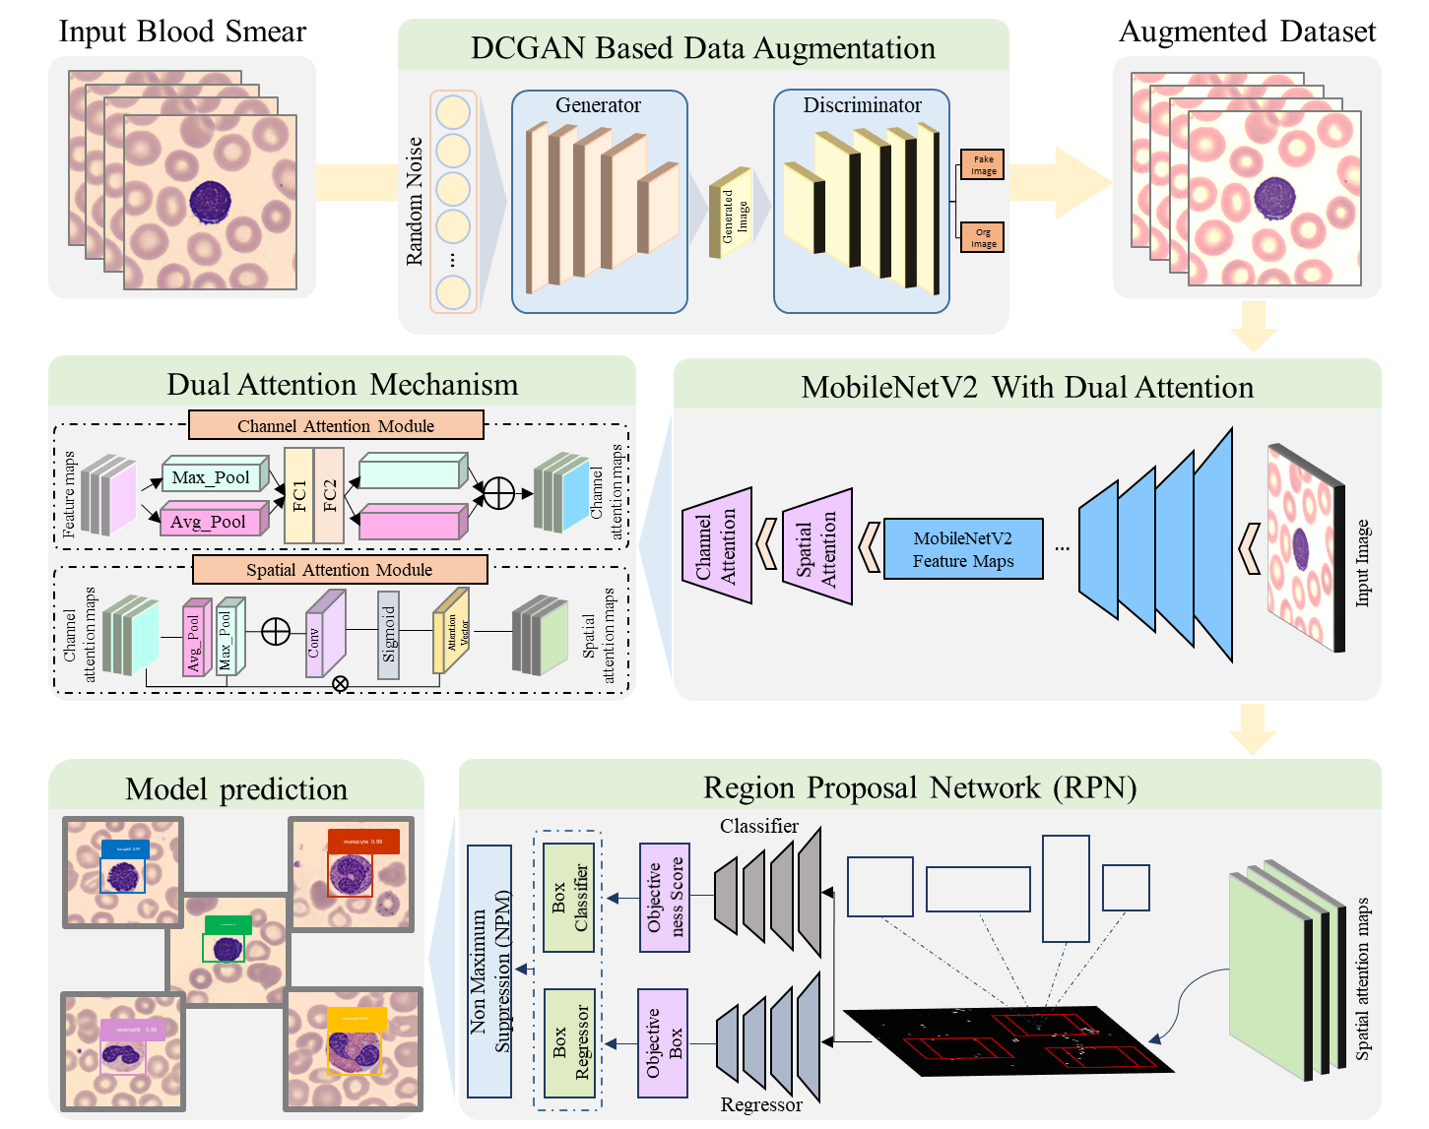
WORK EXPERIENCE
Leukocytes detection and classification

Slide 6
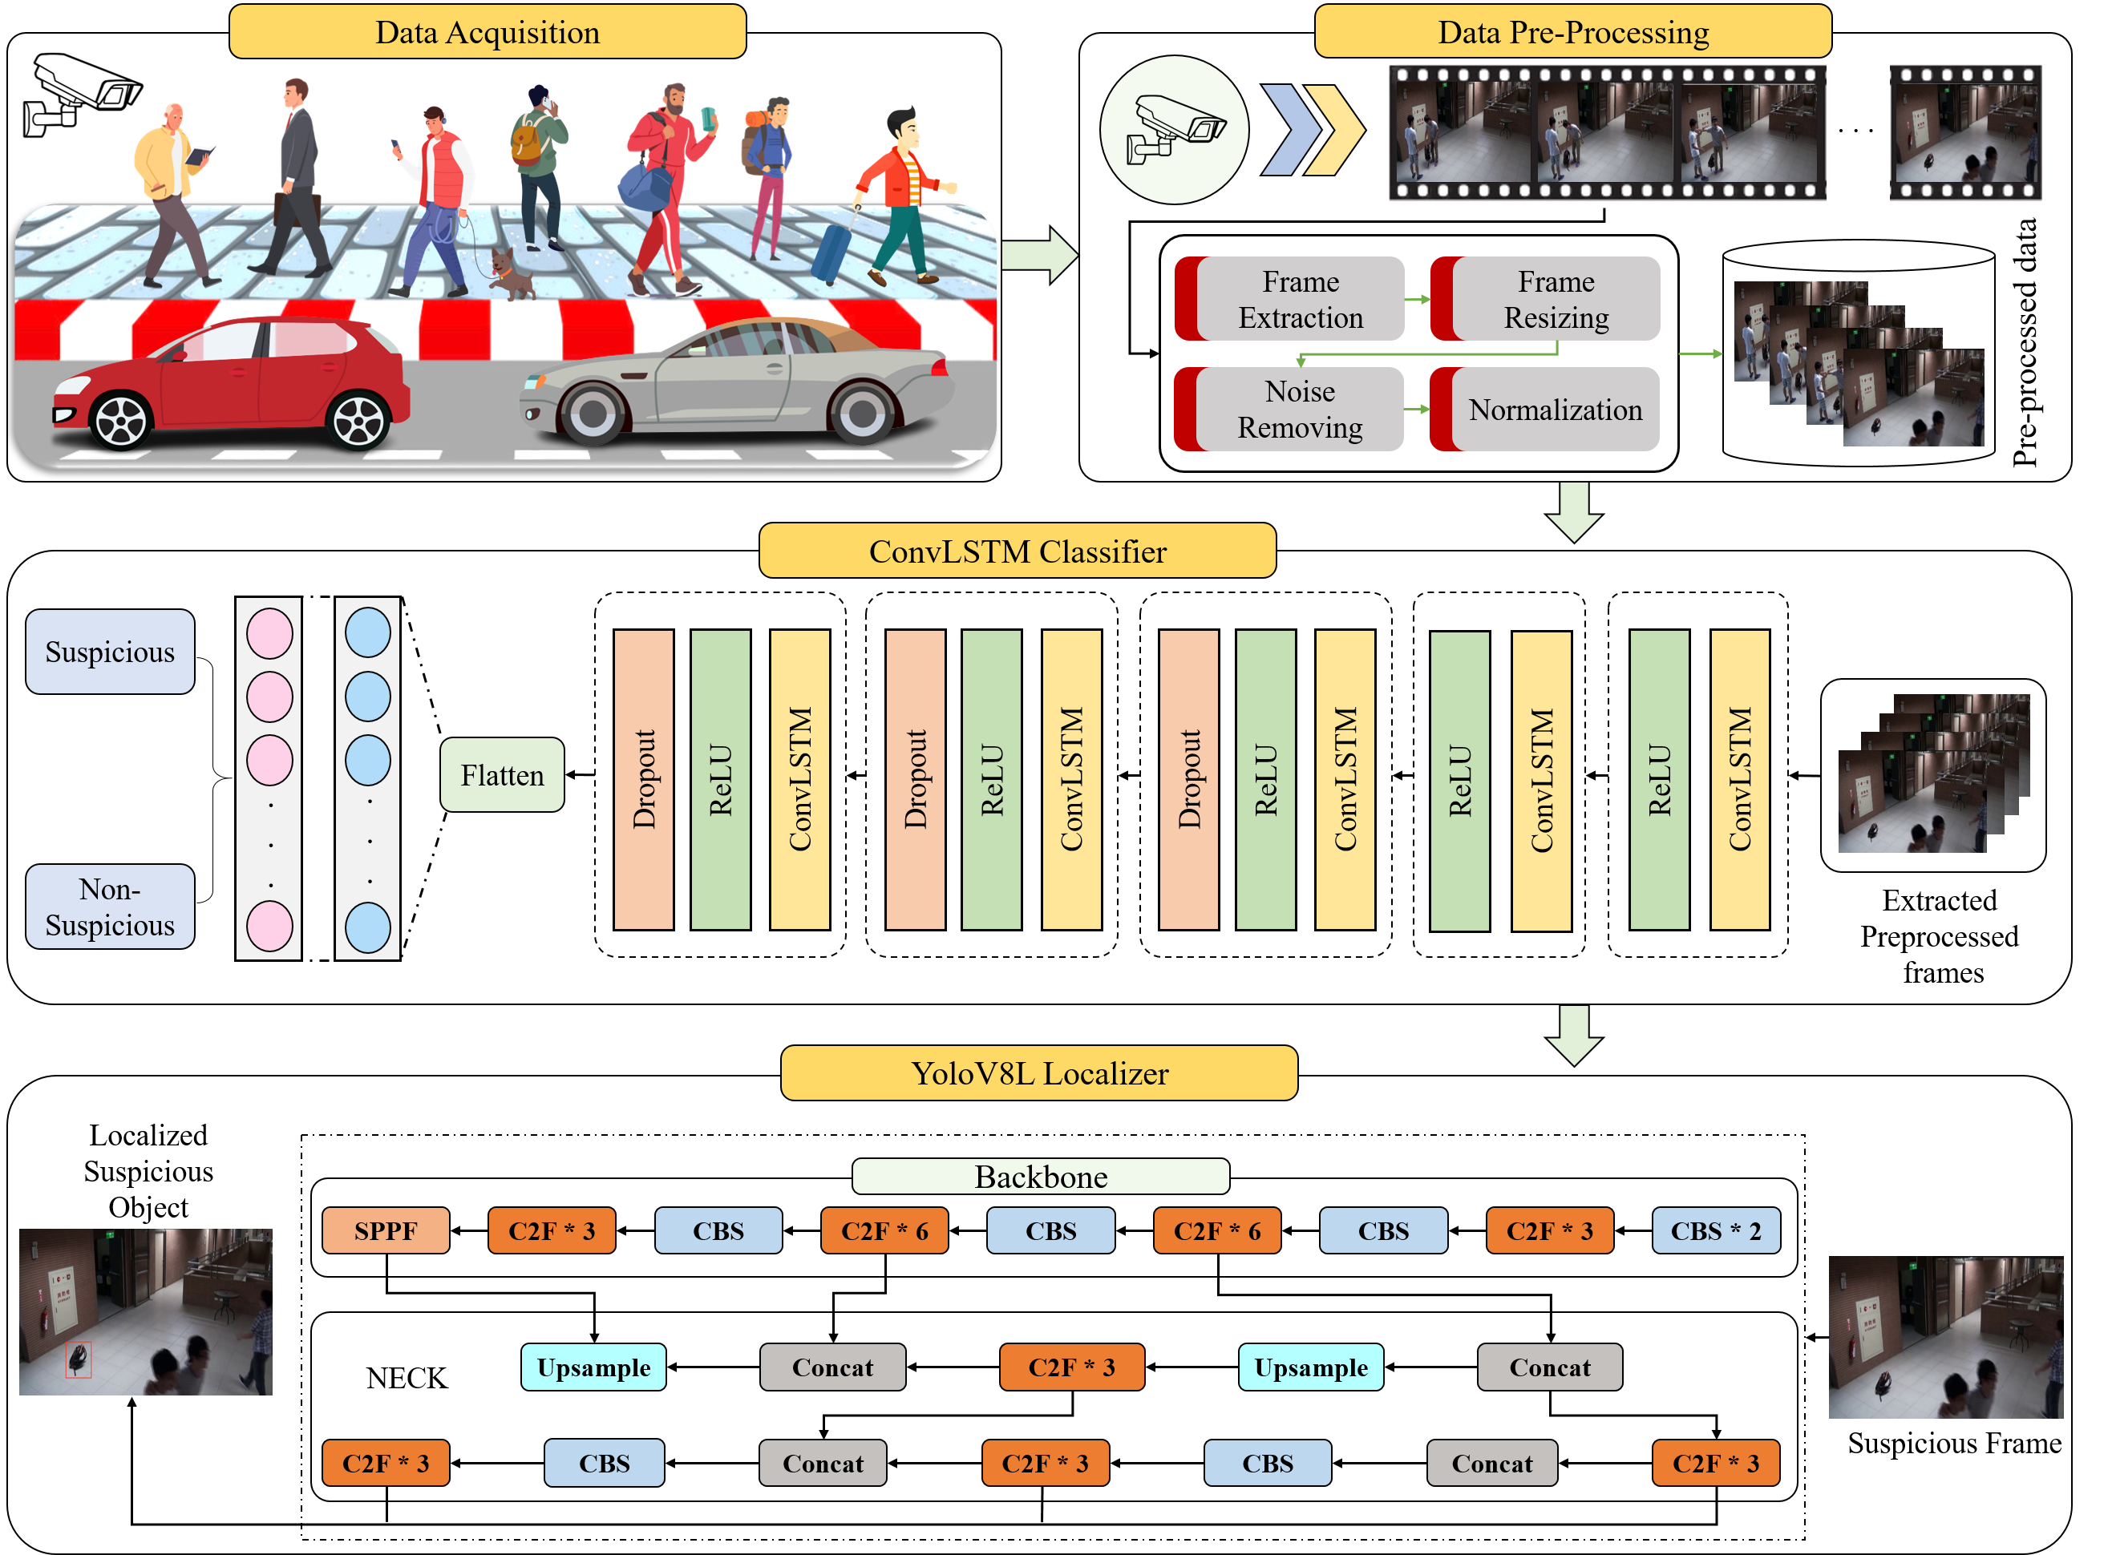
WORK EXPERIENCE
Abandoned Object Detection and Classification

Slide 7
SKILLS & EXPERTISE
Domains:
Computer Vision
Natural Language Processing “NLP”
Blockchain
MLOps “Machine Learning Operation”: Currently Working
Additional Skills:
Programming Languages: Python, JavaScript, Solidity, C++, Matlab
Tools and Frameworks: Tensorflow, PyTorch, MLFlow, DVC ,LangChain, Flask ,Hardhat, Vanilla JavaScript …

Slide 8
INTEREST & FUTURE OBJECTIVES
Exploring New Technologies:
I have a strong passion for exploring new technologies and staying updated with the latest trends in tech word.
My Primary Goals is to Explore new technologies and contributing to ongoing projects and publication.

Slide 9
INTEREST & FUTURE OBJECTIVES

Slide 10
THANK YOU

