Slide 1
컴퓨터공학 석사 학위청구 논문
Representational Power of Graph Neural Networks: A Novel Approach on Time-Series
그래프 신경망의 표현력: 시계열에 대한 새로운 접근
가천대학교 대학원 IT융학대학
지도교수 최 창
석사 과정 Aslan Hacı İsmail

Slide 2
Contents
1
Introduction
2
Related Work
3
Exploring GNNs on Extracting Node Embeddings
4
GNN for ECG Biometric Authentication
5
Experiments & Results
6
Conclusion and Future Direction

Slide 3
01
Introduction
Background
Objectives
Research Content

Slide 4
Introduction
Background
Graph Neural Networks
Graph Data
Visibility Graphs
Electrocardiogram (ECG)

Slide 5
Introduction
Graph Neural Networks
$V_{i}$ : Vertex (or node) attributes
$$U$$
$$E_{13}$$
$$V_{1}$$
$E_{ij}$ : Edge (or link) attributes/ directions
$$V_{3}$$
$$E_{12}$$
$U$: Global (or master node) attributes
$$E_{23}$$
$$E_{14}$$
Vertex (or node) embedding
$$V_{2}$$
$$E_{15}$$
Edge (or link) embedding
$$V_{4}$$
$$E_{45}$$
$$V_{5}$$
Global (or master node) embedding

Slide 6
Introduction
Graph Neural Networks (Cont.)
$$f_{U_{s}}$$
$$U_{n}$$
$$U_{n+1}$$
$$f_{V_{s}}$$
$$V_{n}$$
$$V_{n+1}$$
$$f_{E_{s}}$$
$$E_{n}$$
$$E_{n+1}$$
Graph Independent Layer
Layer N
Layer N+1
update function $f=$
, LSTM, etc.

Slide 7
Introduction
Graph Data
Where to find graphs?
Graphs
are
everywhere
Text as graphs
Images as graphs
Molecules as graphs

Slide 8
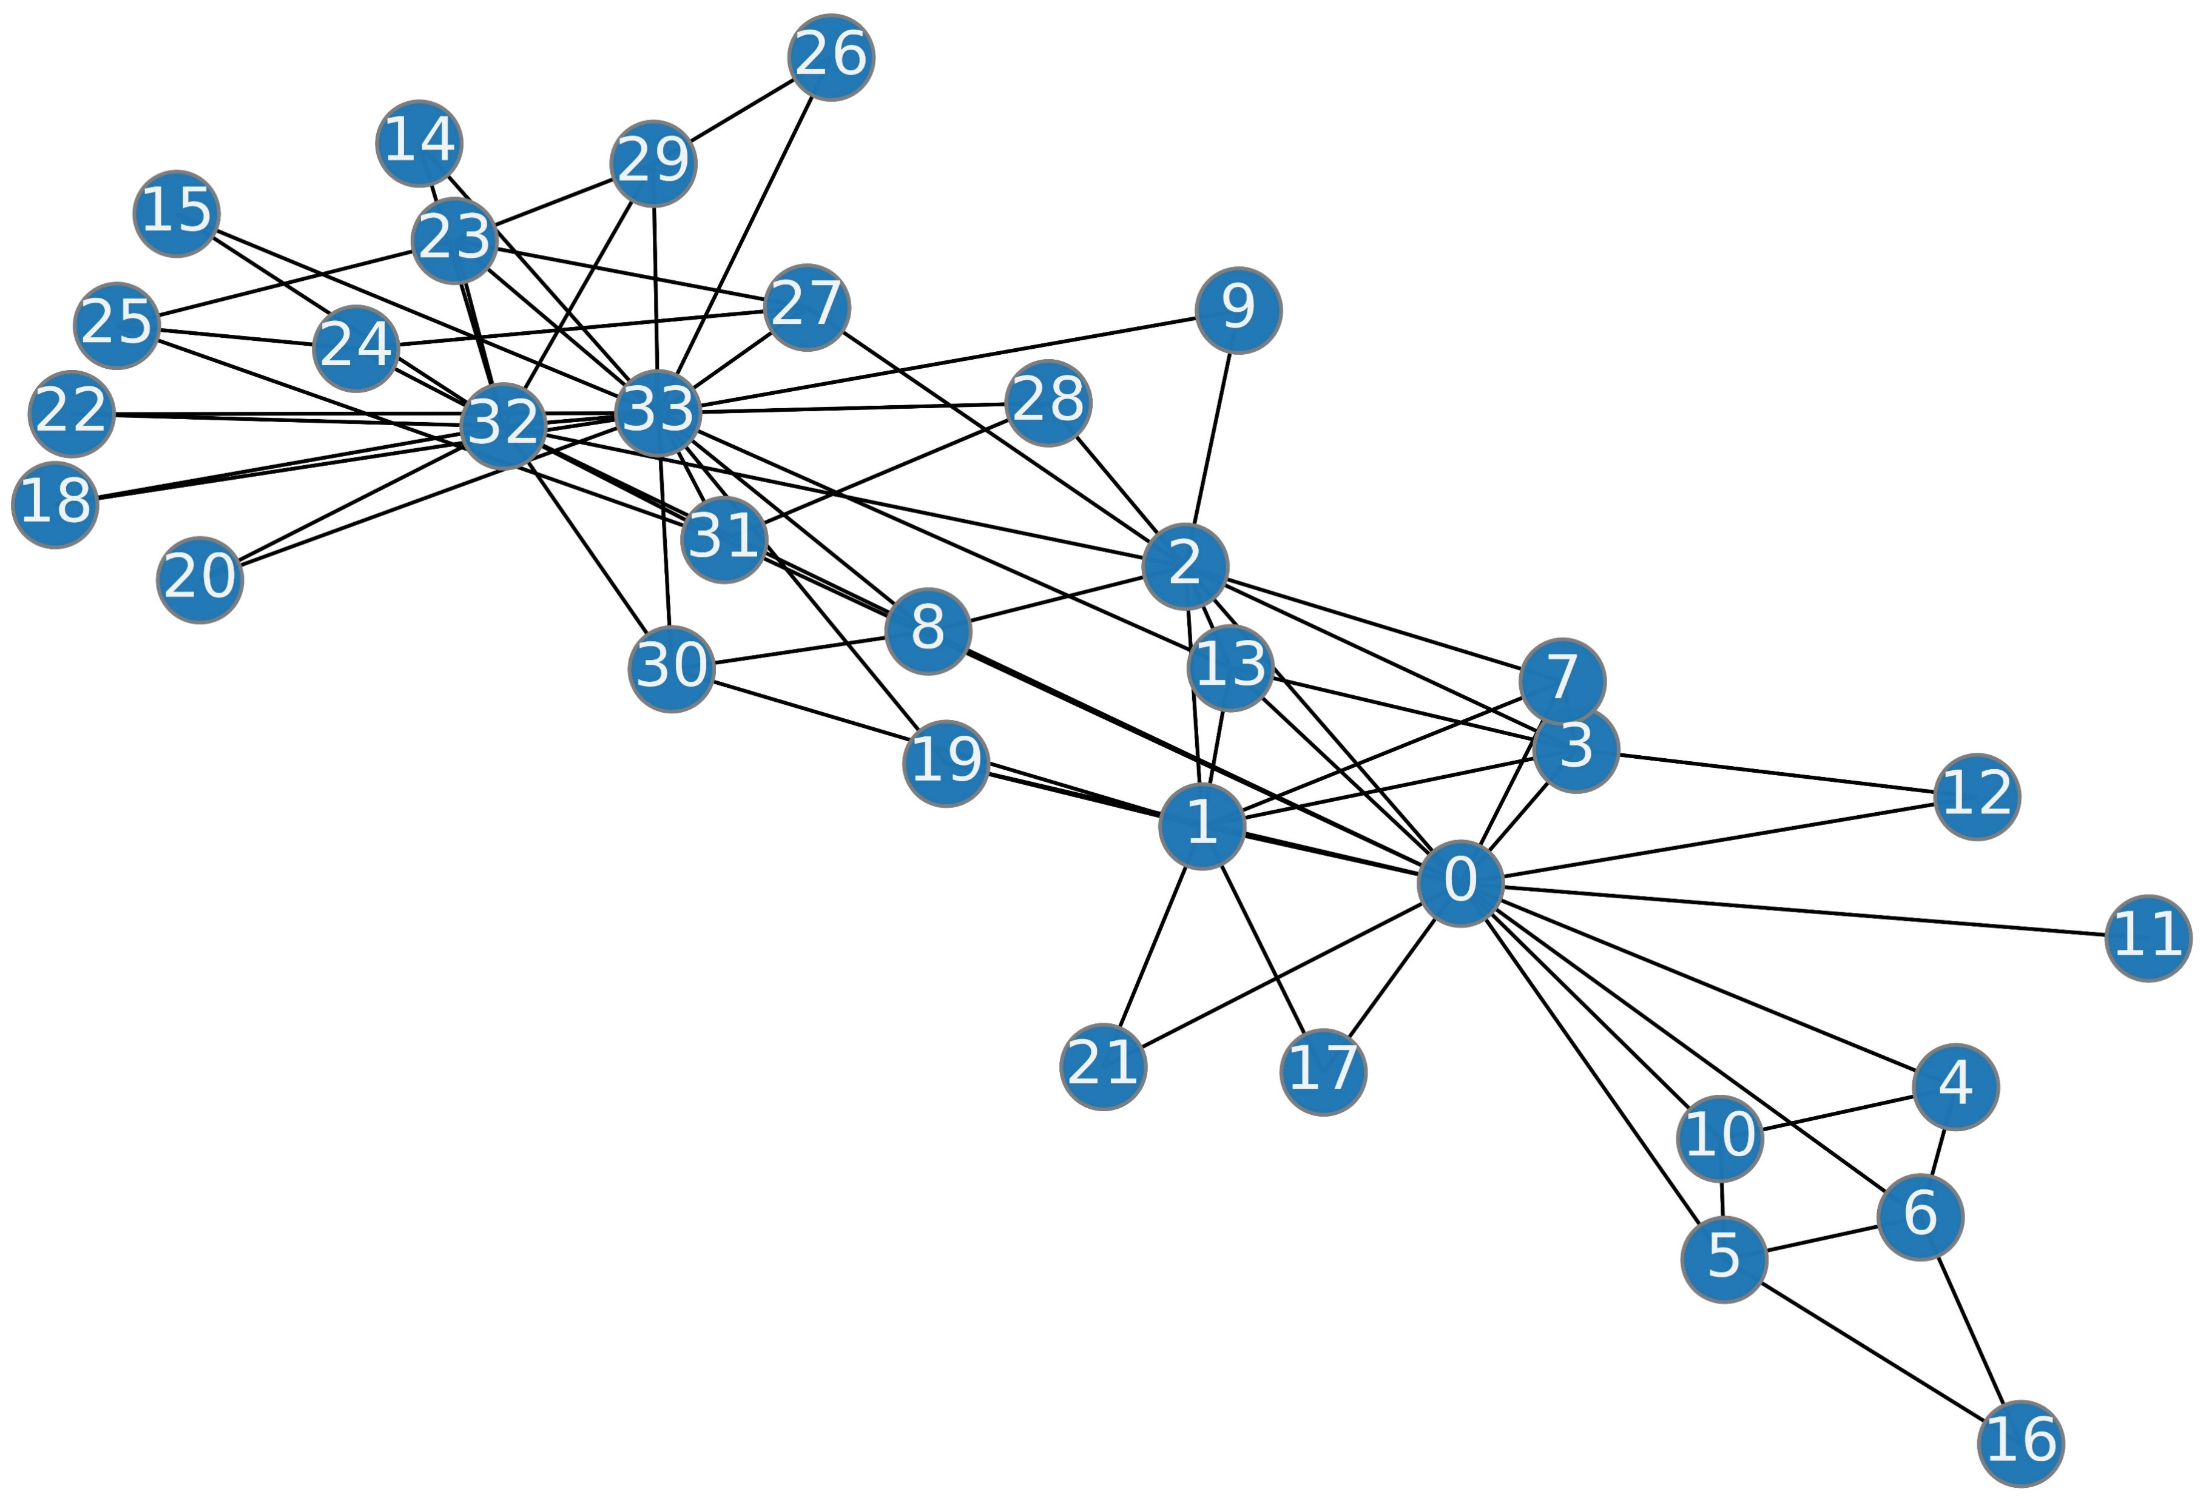
Introduction
Graph Data (Cont.)
Social networks as graphs

Slide 9
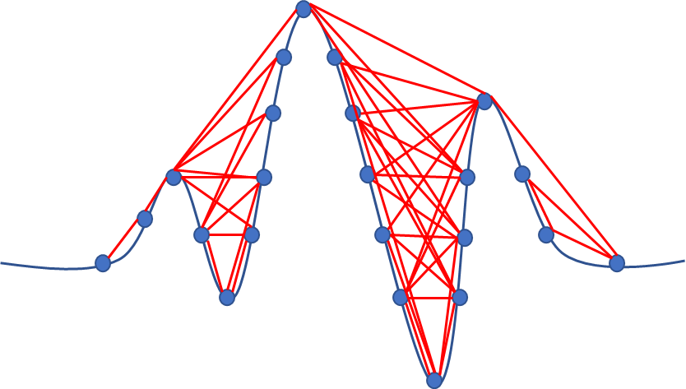
Introduction
Visibility Graphs
What about time-series as graphs?
$$E_{ij}∈E,∃!E_{ij}⟺\frac{X\left[i\right]−X\left[j\right]}{t\left[i\right]−t\left[j\right]}>slope_{max}$$

Slide 10
Introduction
Electrocardiogram (ECG)
Periodical
Characteristic features
Depends on individual’s physiological attributes
Impossible to fake
Crucial to preprocess
Useful even when obtained from 1-lead

Slide 11
Introduction
Objectives
Extract heart pulses from each ECG measurement
Enhance the signal representation with graphs
Explore graph machine learning algorithms
Classify the genuine and impostor

Slide 12
Introduction
Research Content
Benchmarking time-series based models
Proposing the VisGIN Architecture
Exploring Graph Algorithms
ECG Data Preprocessing
Purpose
ECG signals from impostor and genuine signal owners needs to be classified in order to propose an ECG-based biometric authentication scheme.

Slide 13
02
Related Work

Slide 14
Related Work
Study (1)
Study (2)
(2019) User Identification System Using 2D Resized Spectrogram Features of ECG¹
(2022) Personal Identification Using an Ensemble Approach of 1D-LSTM and 2D-CNN with Electrocardiogram Signals²
Datasets are the same (CU-ECG)
ECG transformed to spectogram image
Model : Bi-cubic interpolation
Accuracy : 93%
CU-ECG Dataset
Both 1D signals and its 2D fourier transforms
Model: LSTM & 2D-CNN Ensemble
Accuracy : 98.73% (maximum)
97.67% (without ensemble)
G. -H. Choi, E. -S. Bak and S. -B. Pan, "User Identification System Using 2D Resized Spectrogram Features of ECG," in IEEE Access, vol. 7, pp. 34862-34873, 2019, doi: 10.1109/ACCESS.2019.2902870.
Lee, J.-A.; Kwak, K.-C. Personal Identification Using an Ensemble Approach of 1D-LSTM and 2D-CNN with Electrocardiogram Signals. Appl. Sci. 2022, 12, 2692. https://doi.org/10.3390/app12052692

Slide 15
Related Work
Study (3)
Study (4)
(2020) Toward improving ECG biometric identification using cascaded convolutional neural networks³
(2019) An Enhanced Machine Learning-Based Biometric Authentication System Using RR-Interval Framed Electrocardiograms⁴
Dataset: NSRDB (Only 18 Subjects)
Model : Cascaded CNN with soft-max
Accuracy : 94.3%
Dataset: RRIF ECG
Feature Extraction: Shannon entropy
Model : Decision Tree
Accuracy : 95%
Y. Li, Y. Pang, K. Wang and X. Li, "Toward improving ECG biometric identification using cascaded convolutional neural networks," Neurocomputing, vol. 391, pp. 83--95, 2020.
S. -K. Kim, C. Y. Yeun and P. D. Yoo, "An Enhanced Machine Learning-Based Biometric Authentication System Using RR-Interval Framed Electrocardiograms," in IEEE Access, vol. 7, pp. 168669-168674, 2019, doi: 10.1109/ACCESS.2019.2954576.

Slide 16
03
Exploring GNNs on Extracting Node Embeddings
Compared Models
Datasets

Slide 17
Exploring GNNs on Extracting Node Embeddings
Compared Models
GCN & GAT versus Harmonic Functions
Graph Convolutional Network
Graph Attention Network
$$h_{i}=σ\left(\sum_{j∈V\left(i\right)}{W^{T}}h_{j}\right)$$
$$=\frac{ exp\left(LeakyReLU\left(a\left[W^{T} | h_{i} | W^{T}h_{j}\right]\right)\right)}{\sum_{k∈V\left(i\right)}^{n}{exp\left(LeakyReLU\left(a\left[W^{T} | h_{i} | W^{T}h_{k}\right]\right)\right)}}$$
$$α_{ij}$$
Harmonic Functions
$${h^{′}}_{i}=σ\left(\sum_{j∈V\left(i\right)}^{n}{α_{ij}W^{T}h_{j}}\right)$$
$$h\left(V_{i}\right)=\frac{1}{d_{i}}\sum_{\left(V_{i},V_{j}\right)∈V}{h\left(V_{j}\right)}$$

Slide 18
Exploring GNNs on Extracting Node Embeddings
Datasets
 | Karate | Email | Cora | Pubmed
No. Nodes | 34 | 1.005 | 2.708 | 19.717
No. Edges | 78 | 25.571 | 5.429 | 44.338
No. Clusters | 2 | 42 | 7 | 3
No. Training Nodes | 2 | 804 | 2.166 | 5.000
Average Clustering Coefficient | 0.57 | 0.4 | 0.24 | 0.06
Average Degree | 4.59 | 25.44 | 3.9 | 4.5

Slide 19
04
GNN for ECG Biometric Authentication
Important Metrics in Authentication
Proposed Environment for Biometric Authentication
Data Handling
VisGIN: Visibility Graph Isomorphism Network for ECG Biometric Authentication

Slide 20
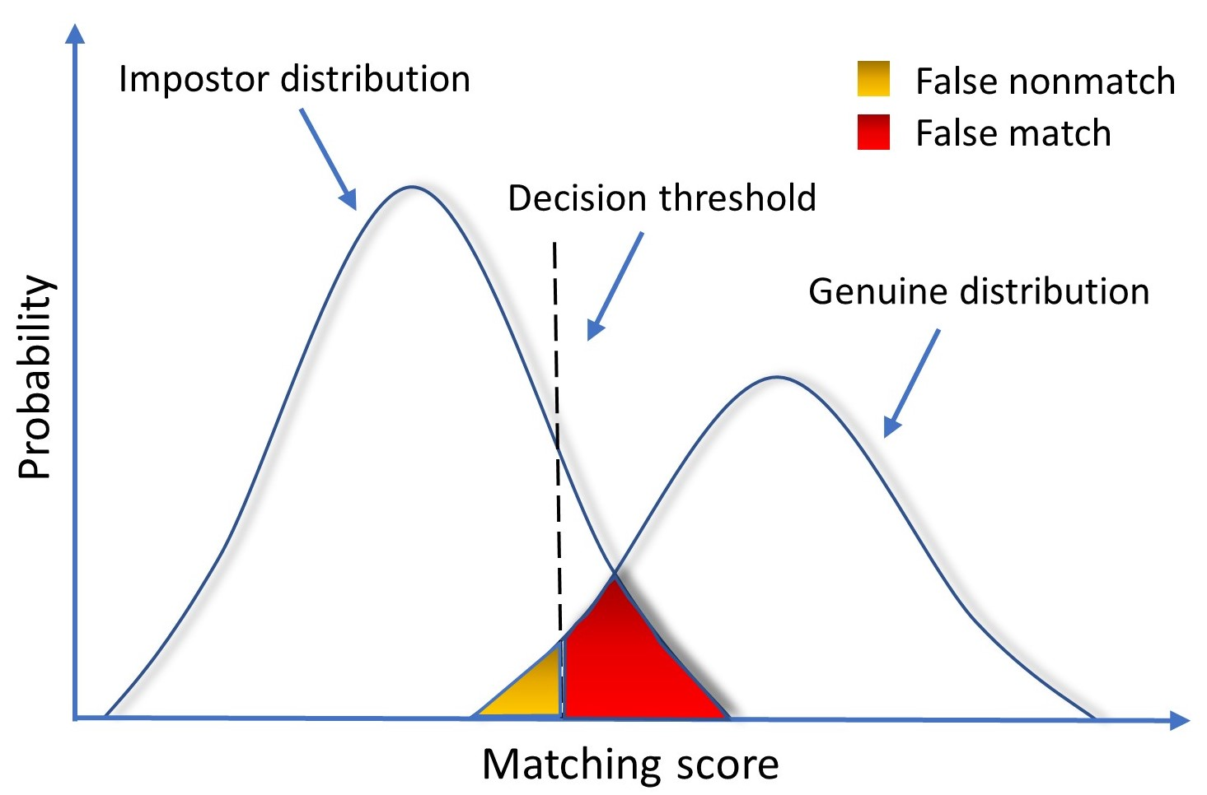
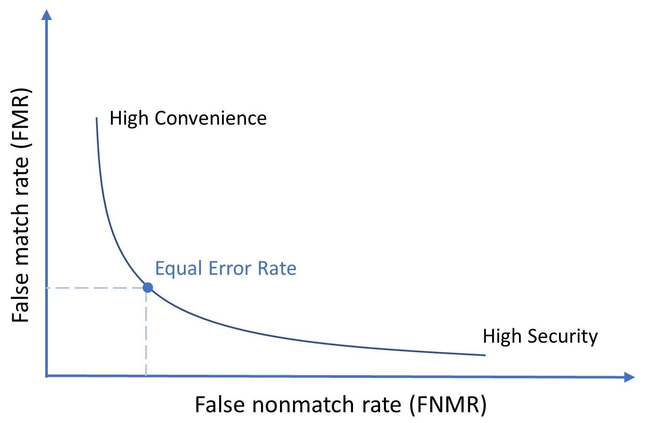
GNN for ECG Biometric Authentication
Important Metrics in Authentication

Slide 21
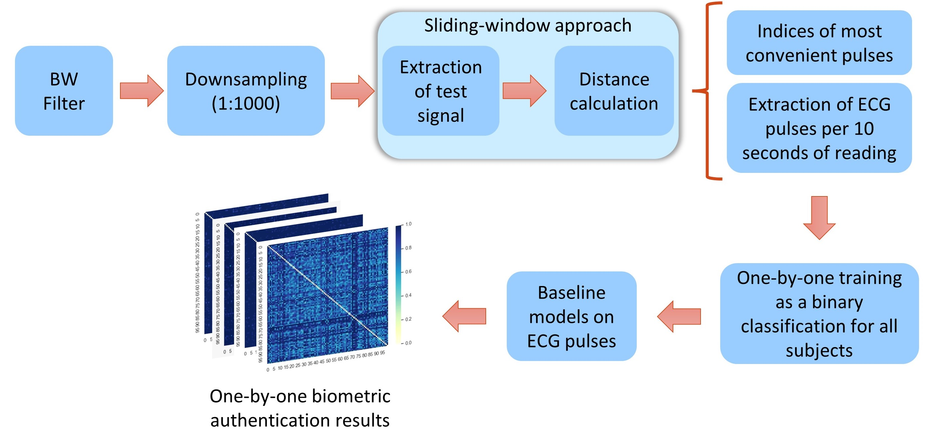
GNN for ECG Biometric Authentication
Proposed Environment for Biometric Authentication

Slide 22
GNN for ECG Biometric Authentication
Data Handling
Which strategy to extract pulses?

Slide 23
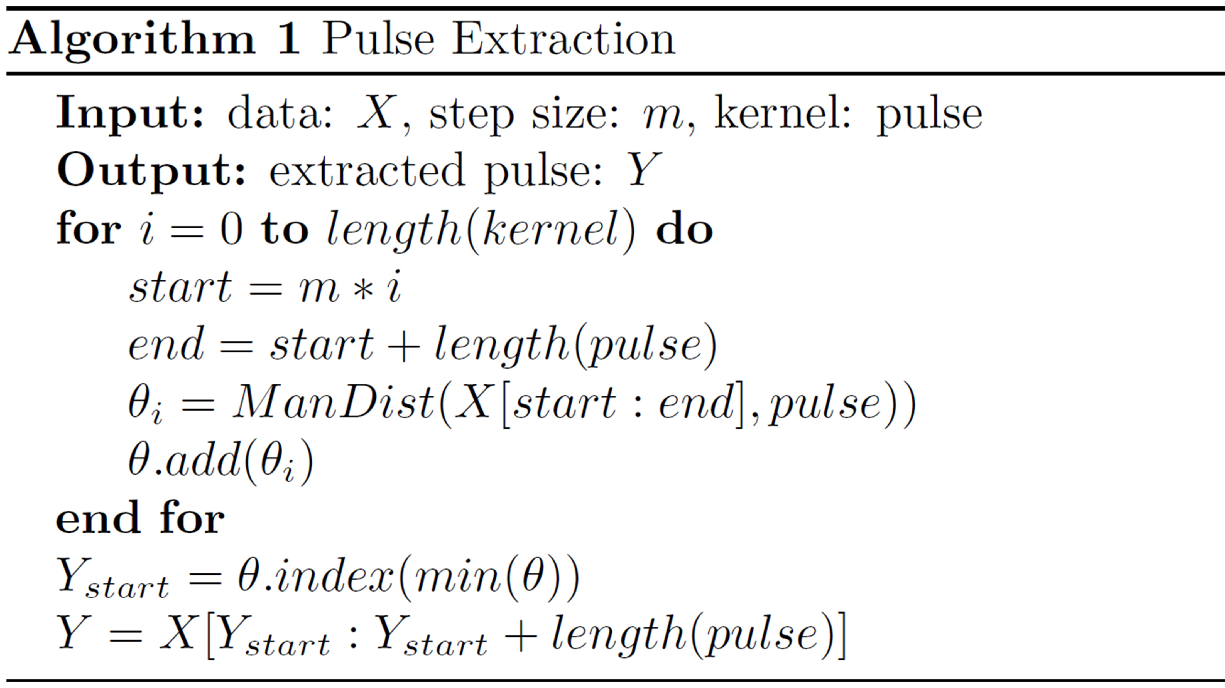
GNN for ECG Biometric Authentication
Data Handling (Cont.)
starting index of the windowed ECG sample
last index of the windowed ECG sample
similarity/distance
append all similarity scores in a list
find the minimum distance/maximum similarity and get the index of it in the list
fetch the most similar pulse from the start index
kernel
Extracted Pulse

Slide 24
GNN for ECG Biometric Authentication
Data Handling (Cont.)
Why not to use R-peak finders?
Because all R-peak finders make our application bound to the accuracy of the R-peak finder algorithm. In other words, R-peak finder algorithms cannot detect R peaks with %100 accuracy.
Hamilton
Engelse and Zeelenberg
Pan and Tompkins
Stationary Wavelet Transform
Two Moving Average
Matcher Filter
WQRS
All these methods are available in py-ecg-detectors package.
However, our application doesn’t need to detect R-peak index for pulse extraction

Slide 25
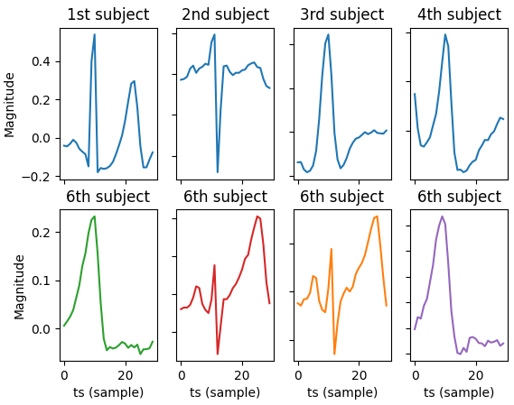
GNN for ECG Biometric Authentication
Data Handling (Cont.)
Extracted pulses after Pan-Tompkins
To check why it is not needed to get R points with R-peak finders, I simulated Pan-Tompkins algorithm.
R-peaks with Pan-Tompkins and windowed 30 samples around R-peak (10 samples before R-peak and 20 samples after R-peak)
Note that all these samples below belongs to 6th subject. However, pan-tompkins did not work out well on these.

Slide 26
GNN for ECG Biometric Authentication
VisGIN: Visibility Graph Isomorphism Network for ECG Biometric Authentication
Graph Isomorphism
A
G
A
H
Two graphs $G$ and $H$ are considered isomorphic $G≅H$ if there exists a structure-preserving bijection $f: N_{G}→N_{H}$, where the vertex function $f$ preserves adjacency.
B
H
G
B
$$\text{≅}$$
C
I
C
J
D
J
I
D

Slide 27
GNN for ECG Biometric Authentication
VisGIN: Visibility Graph Isomorphism Network for ECG Biometric Authentication
Graph Isomorphism Network
$$h_{i}=MLP\left(\left(1+ϵ\right)⋅x_{i}+\sum_{j∈𝒩_{𝒾}}^{N}{h_{i}^{0}}\right)$$
GIN Convolution
Graph-level representation
$$h_{G} = \sum_{i=0}^{N}{h_{i}^{0}} \left| \right| … \left| \right| \sum_{i=0}^{N}{h_{i}^{k}}$$
Commonly used operators include mean ($h_{G}=\sum_{i=0}^{N}{h_{i}/N}$), sum ($h_{G}=\sum_{i=0}^{N}{h_{i}}$), and max ($h_{G}=max_{i=0}^{N}\left(h_{i}\right)$).

Slide 28
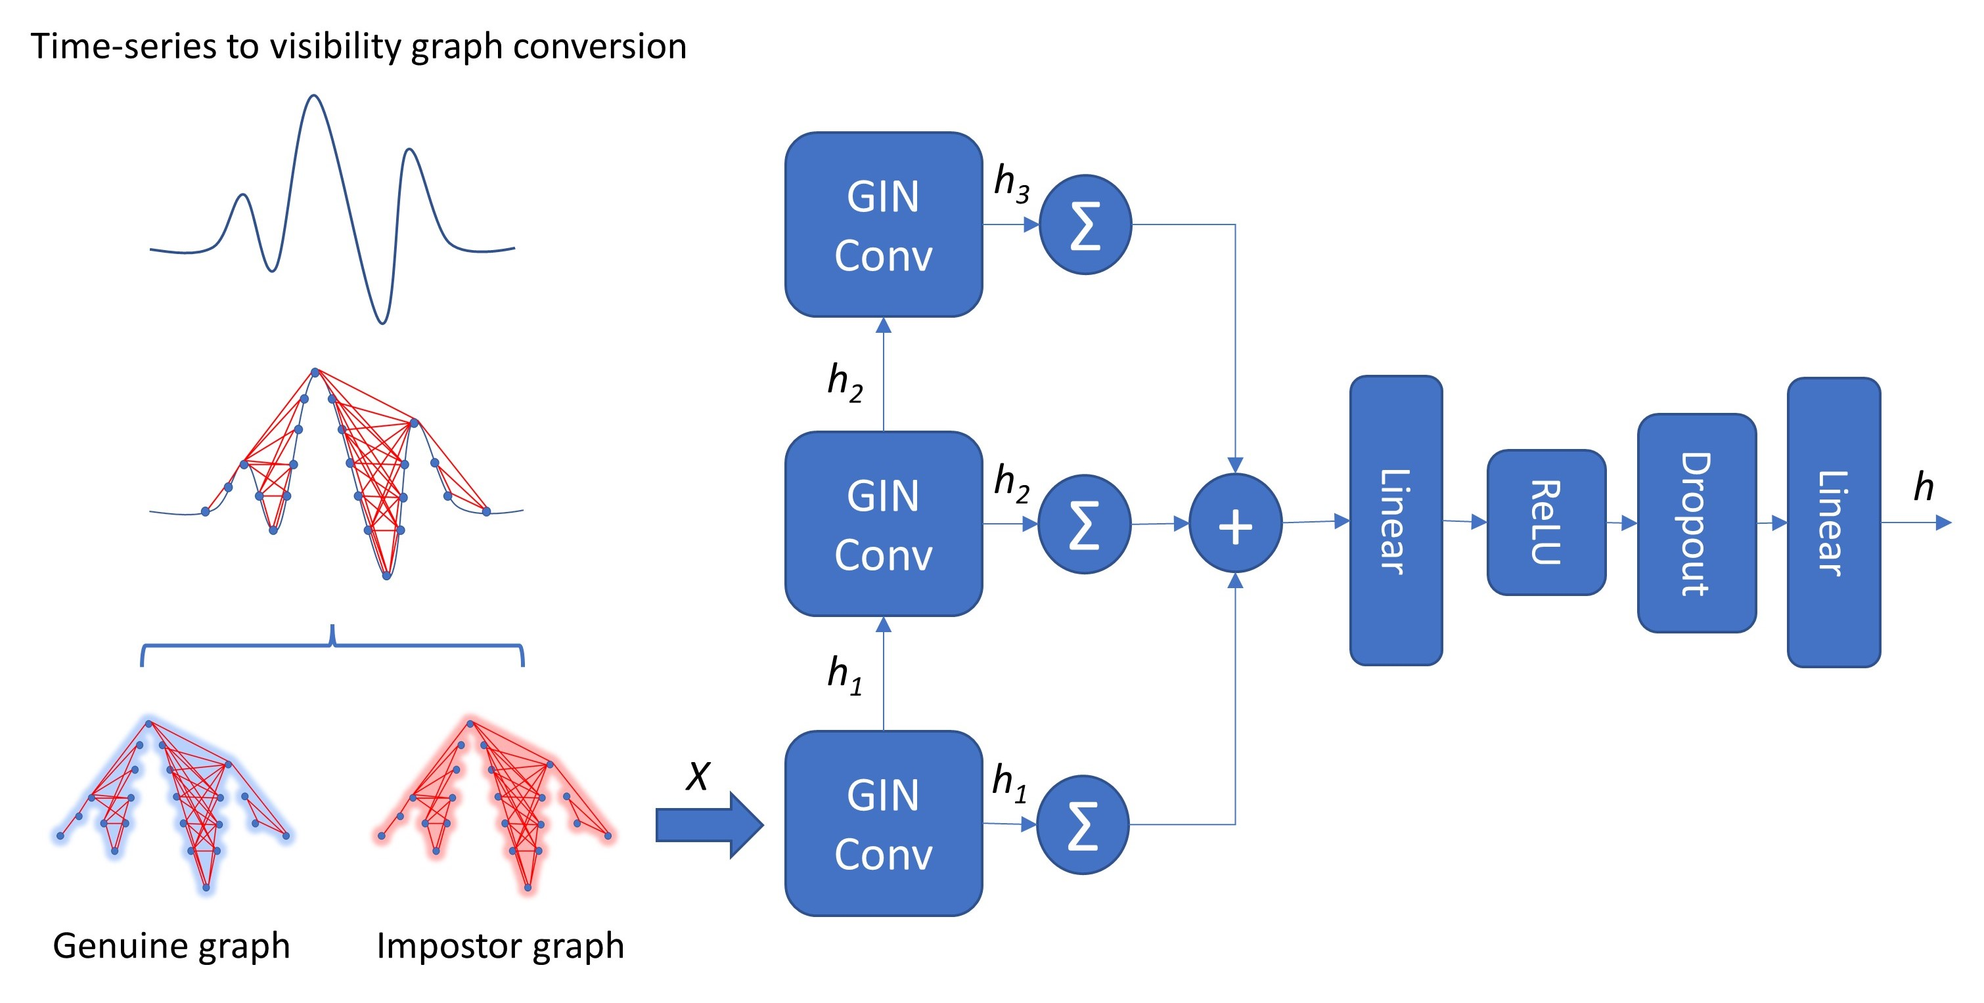
GNN for ECG Biometric Authentication
VisGIN: Visibility Graph Isomorphism Network for ECG Biometric Authentication

Slide 29
05
Experiments and Results
Exploring GNNs on Extracting Node Embeddings
GNN for ECG Biometric Authentication

Slide 30
Experiments & Results
Exploring GNNs on Extracting Node Embeddings
 | GCN | GAT | Harmonic
Karate | 100% | 100% | 100%
Email | 72.1 ± 0.52% | 67.95 ± 0.47% | 70.7 ± 0.68%
Cora | 81.45 ± 0.3% | 83.05 ± 0.29% | 86.35 ± 0.23%
Pubmed | 80.39 ± 0.26% | 80.73 ± 0.24% | 82.35 ± 0.07%
GCN & GAT need to improve on supervised learning settings
When it comes to less homogeneous graphs, GCN is still better

Slide 31
Experiments & Results
GNN for ECG Biometric Authentication
Model | Not Applied (%) | Applied (%)
LSTM | 92.98 ± 10.1% | 94.78 ± 8.2%
MLP | 97.15 ± 4.1% | 98.68 ± 2.8%
TCN | 97.29 ± 4.6% | 98.23 ± 3.6%
mWDN | 98.88 ± 2.4% | 99.03 ± 2.2%
XCM | 99.08 ± 2.2% | 99.04 ± 2.2%
FCN | 99.23 ± 1.9% | 99.26 ± 1.9%
LSTM-FCN | 99.24 ± 1.9% | 99.24 ± 1.9%
MLSTM-FCN | 99.27 ± 1.9% | 99.25 ± 1.9%
InceptionTime | 99.36 ± 1.8% | 99.30 ± 1.9%
VisGIN (Proposed) | 99.54 ± 1.5% | 99.55 ± 1.5%
Effects of baseline correction (wander removal)

Slide 32
Experiments & Results
GNN for ECG Biometric Authentication
 | $$ℳ =1$$ |  |  | $$ℳ =2$$ |  |  | $$ℳ =3$$
Model | ACC $\left(↑\right)$ | FNMR $(↓)$ | FMR $(↓)$ | ACC $(↑)$ | FNMR $(↓)$ | FMR $(↓)$ | ACC $(↑)$ | FNMR ($↓)$ | FMR ($↓)$
LSTM | 92.98 ± 10.1 | 7.28 | 6.75 | 95.0 ± 7.1 | 4.99 | 4.99 | 95.66 ± 6.0 | 4.42 | 4.26
MLP | 97.15 ± 4.1 | 2.81 | 2.89 | 97.86 ± 2.7 | 2.12 | 2.16 | 98.04 ± 2.3 | 1.89 | 2.0
TCN | 97.29 ± 4.6 | 2.79 | 2.61 | 98.4 ± 2.4 | 1.66 | 1.53 | 98.48 ± 2.2 | 1.53 | 1.52
mWDN | 98.88 ± 2.4 | 1.11 | 1.12 | 98.92 ± 1.8 | 1.11 | 1.05 | 98.94 ± 1.5 | 1.06 | 1.05
XCM | 99.08 ± 2.2 | 0.97 | 0.86 | 99.32 ± 1.3 | 0.69 | 0.65 | 99.36 ± 1.1 | 0.66 | 0.61
FCN | 99.23 ± 1.9 | 0.79 | 0.74 | 99.66 ± 0.9 | 0.35 | 0.33 | 99.72 ± 0.7 | 0.28 | 0.29
LSTM-FCN | 99.24 ± 1.9 | 0.79 | 0.73 | 99.67 ± 0.9 | 0.34 | 0.32 | 99.71 ± 0.7 | 0.28 | 0.30
MLSTM-FCN | 99.27 ± 1.9 | 0.73 | 0.74 | 99.63 ± 0.9 | 0.38 | 0.35 | 99.69 ± 0.7 | 0.30 | 0.31
InceptionTime | 99.36 ± 1.8 | 0.59 | 0.69 | 99.44 ± 1.2 | 0.54 | 0.57 | 99.49 ± 0.9 | 0.52 | 0.51
VisGIN | 99.54 ± 1.5 | 0.5 | 0.42 | 99.67 ± 0.9 | 0.34 | 0.31 | 99.76 ± 0.7 | 0.24 | 0.25

Slide 33
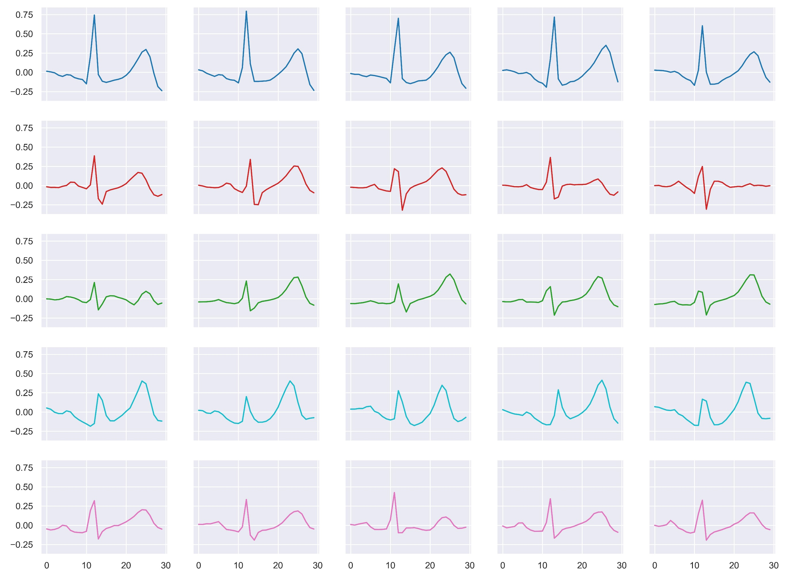
Experiments & Results
GNN for ECG Biometric Authentication
ECG pulse signals of a selection of individuals. X-axis and y-axis denote sample numbers and magnitudes (mV), respectively.

Slide 34
Experiments & Results
GNN for ECG Biometric Authentication
Corresponding visibility graphs of the signals in the previous slide.

Slide 35
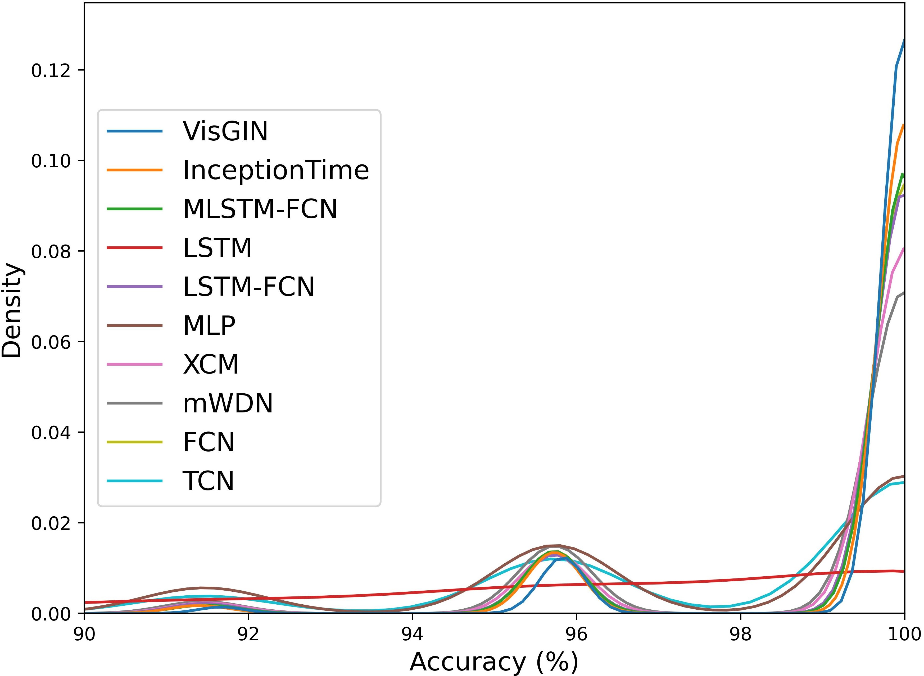
Experiments & Results
GNN for ECG Biometric Authentication
VisGIN is above the other curves
LSTM and TCN have less representative power for this task
Density distribution of binary classification accuracies of impostor-genuine match pairs when $ℳ$=1.

Slide 36
06
Conclusion & Future Direction

Slide 37
Conclusion & Future Direction
Conclusion & Future Direction
Representational boundaries of GNNs against traditional graph machine learning algorithms
Time-series analysis using GNNs
Representing one-dimensional signals with graphs
Characterization of time-series signals for various tasks such as outlier detection, anomaly detection, regression, etc.
Learning new time-series to graph conversions thanks to the universal approximation theorem

Slide 38
Thanks for listening
Your questions are welcomed
발표 경청해 주셔서 감사합니다

