Slide 1
Study Plan
Yasir Muhammad

Slide 2
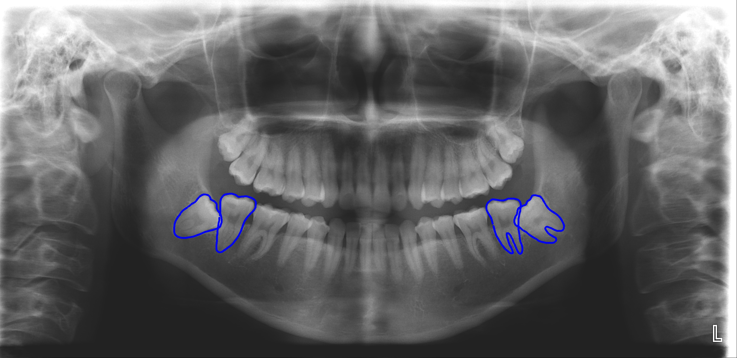
Mandibular third molars extraction difficulty classification
Mandibular second and third molars
#48
#38
#47
#37

Slide 3
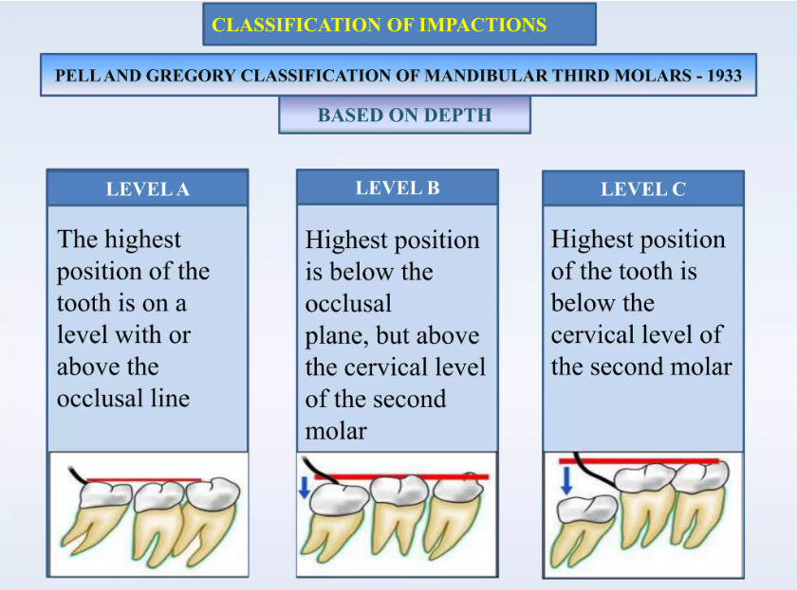
Pell and Gregory Classification
If tooth is classified as “Class A or I”, the extraction difficulty is low.
If tooth is classified as “Class B or II”, the extraction difficulty is moderate.
If tooth is identified as “Class C or III”, the extraction difficulty is high.

Slide 4
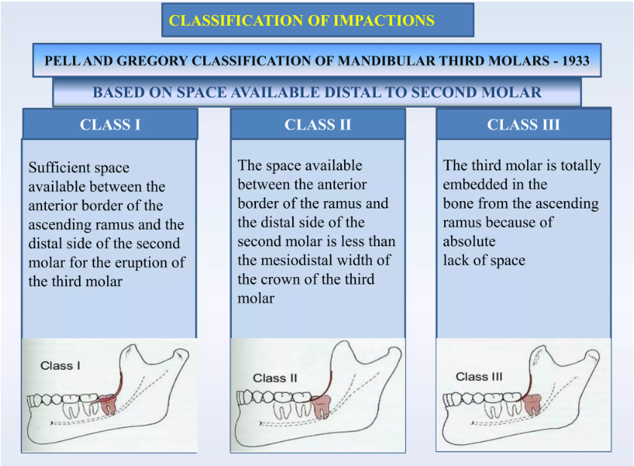
Continue

Slide 5
Dental Panoramic Dataset
Contains 11 Folders, and 5408 images and JSON annotations.
Folder’s name represents a doctor.
Image name represents a patient number.
We have six classes;
“P.A”, “P.I” → Pell and Gregory Class A, Class I,
“P.B”, “P.II” → Pell and Gregory Class B, Class II,
“P.C”, P.III → Pell and Gregory Class C, Class III.
We will classify the difficulty level of mandibular third molars based on the above classes.

Slide 6
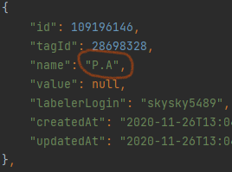
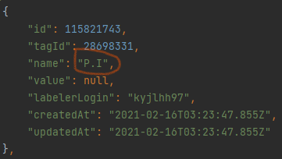
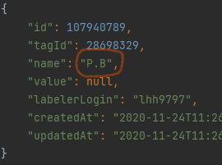
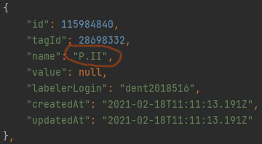
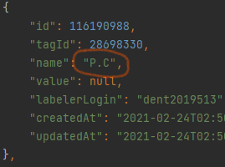
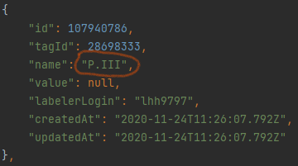
Continue

Slide 7
Detection
We will first do detection to detect the Region of Interest (RoI).
We will try Vision Transformer with YOLO family(ViT-YOLO: Transformer-Based YOLO for Object Detection).

Slide 8
Semantic segmentation
After getting the RoI, we will use segmentation to get mask images of RoI.
We will use Semantic segmentation based on Unet model hybrid with Transformers (For example: TransUNet: Transformers Make Strong Encoders for Medical Image Segmentation).

Slide 9
Classification
Finally, we will classify the 3 classes of the extraction difficulty based on Pell and Gregory classification.
We will use Classification based Ensemble Learning Techniques (For example: An Analysis of Ensemble Learning optimized Medical Image Classification with Deep Convolutional Neural Networks (models: EfficientNetV2, MobileNetV2, DenseNet121))

Slide 10
Conference Paper to Journal
I have started writing of the paper for Journal.
These sections are completed.
Abstract
Introduction
Related works
I will try to complete the rest of the sections.

Slide 11
Survey Paper
We had written a Survey paper type report for reinforcement learning course in previous semester.
I will update that report to a Survey paper.

