Slide 1
Overview of Research Progress
Lab Seminar
Notes:
ID=d924773e-9a16-4d6d-9803-8cb819e99682
Recipe=text_billboard
Type=TextOnly
Variant=0
FamilyID=AccentBoxWalbaum_Zero

Slide 2

Contents
Published Research
  Description of previous publications
Ongoing Research
  Lightweight super-resolution
Future Plan
  Finish writing the paper
  Submit to Journal

Slide 3
Details of Previously Published Research
Title: Improving human parsing with self-correction and instance-aware edge detection (Conference).
Submitted to: Korean Institute of Smart Media (KISM) on 21st April 2023.
Title: An AI-based approach for classification of fouls and no-fouls in soccer games (Conference).
Submitted to: Next-generation Convergence Information Services Society (NCISS) on 7th July 2023.

Slide 4
Lightweight Model for Single Image Super Resolution (SISR)
Ongoing Research
Notes:
ID=d924773e-9a16-4d6d-9803-8cb819e99682
Recipe=text_billboard
Type=TextOnly
Variant=0
FamilyID=AccentBoxWalbaum_Zero

Slide 5
Introduction
CNN achieved great performance in the field of single image super resolution.
However, these models mostly focus on performance and to achieve great performance, these model use very deep networks which require heavy computations.
Therefore, it is difficult to apply these models to edge devices due to their high memory and computational requirements.
Considering this, we propose a lightweight model for single image super resolution that will maintain the performance and reduce the parameters, flops, inference time, and model memory.

Slide 6
Related Works
Residual Feature Distillation Network (RFDN) is a lightweight model which maintained the PSNR and achieved success in terms of reducing the metrics i.e., parameters, flops, memory, and inference time.
They used Residual Feature Distillation Blocks (RFDB) which consists of Shallow Residual Block and Convolution Block.
Inspired by this, Residual Local Feature Network (RLFN) proposed Residual Local Feature Blocks (RLFBs) instead of RFDB, which reduced the inference time specifically, but the accuracy was also dropped.
Therefore, to maintain the PSNR and make the model more lightweight, we modified the original RFDN and RLFN, and proposed Channel Attention, and Depth-wise Separable Convolution blocks.

Slide 7
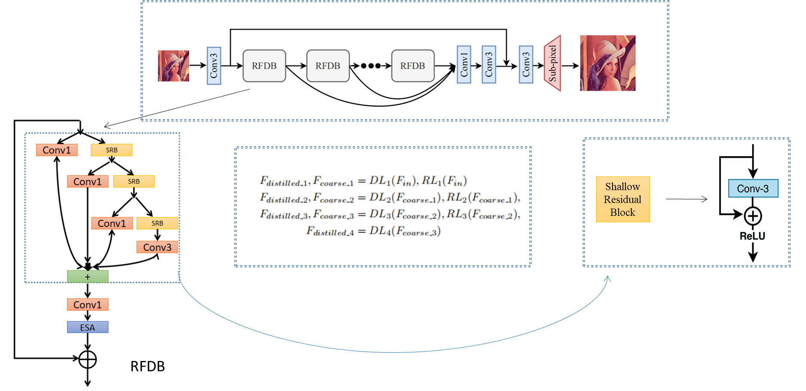
Architecture of RFDN

Slide 8
Contribution
We proposed a modified version of RFDN, and our model has lesser parameters and flops than others.
The RFDB is replaced with DWCAB (DepthWise Channel Attention Block), we use Depthwise separable convolution and channel attention mechanism.
By using the DWCAB, our model reduced the following metrics, and maintained the PSNR to 29.03.
  Number of Flops
  Number of Parameters
  Inference time
  Model memory

Slide 9
Proposed Method
We proposed DepthWise Channel Attention Network (DWCAN) which uses multiple DWCABs.
DWCAB uses depthwise separable convolution and channel attention.
Depthwise separable convolution reduces the parameters, flops while the channel attention improves the accuracy.
Our baseline paper is RFDN, which uses RFDB, so we changed the architecture.
The DWCAB acts as the main block of our model.

Slide 10
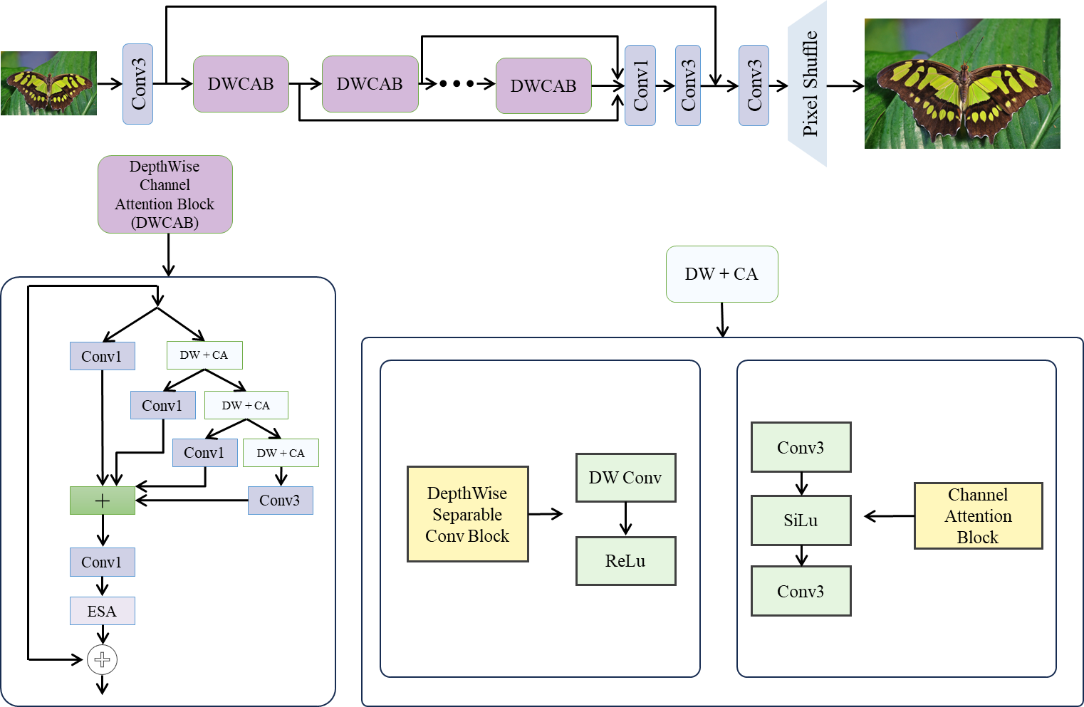
Proposed Architecture

Slide 11
Results

Slide 12
Result Comparison with Baseline Model (Winner of NTIRE and AIM 2020 Challenges) and other Models
Model | RunTime [ms] | Params [M] | PSNR [val] | Flops [G] | Acts [M] | Memory [M]
IMDN | 119.86 | 0.894 | 28.78 | 58.53 | 154.14 | 471.76
RLFN | 72.78 | 0.317 | 28.72 | 19.7 | 80.05 | 377.91
MResNet | 114.45 | 1.51 | 28.70 | 166 | 292 | 546.87
RFDN [baseline] | 112.14 | 0.433 | 29.04 | 27.10 | 112.03 | 788.13
DWCAN [Ours] | 64.42 | 0.416 | 29.03 | 25.42 | 117.27 | 376.07

Slide 13
Future Plans
Experiments are completed.
I have started writing the paper, and these sections are finished;:
  Introduction
  Related works
  Methodology
I will soon complete the rest of the sections and will submit to one of the following journals.
  Information Fusion
  Future Generation Computer Systems
  Complex and Intelligent Systems
  Knowledge-based Systems

