Slide 1
Lab Seminar
Yasir
Notes:
ID=d924773e-9a16-4d6d-9803-8cb819e99682 Recipe=text_billboard Type=TextOnly Variant=0 FamilyID=AccentBoxWalbaum_Zero

Slide 2
Lightweight Model for Single Image Super Resolution (SISR)
CNNs achieved great success in the field of SISR.
When it comes to edge devices, it is not easy to apply these methods due to the requirement of heavy computation.
These devices have low computation powers, and these models are not useful in most cases.
Our aim is to propose a light-weight single image super resolution model for the low-constrained devices.
The focus of our model is to lower the inference time, memory consumption, and number of Floating-point operations per second (FLOPS).

Slide 3
Our Baseline Model
Notes:
ID=d924773e-9a16-4d6d-9803-8cb819e99682 Recipe=text_billboard Type=TextOnly Variant=0 FamilyID=AccentBoxWalbaum_Zero

Slide 4
Residual Feature Distillation Network for Lightweight Image Super-Resolution (RFDN)
RFDN won the first place in the AIM 2020 efficient super-resolution challenge.
They proposed a lightweight and accurate SISR model called residual feature distillation network (RFDN).
The model uses multiple feature distillation connections to learn more discriminative feature representations, using a shallow residual block(SRB) as the main building block of RFDN.
It reduces the number of parameters compared to IMDN and VDSR while maintaining the PSNR value of 29 db.

Slide 5
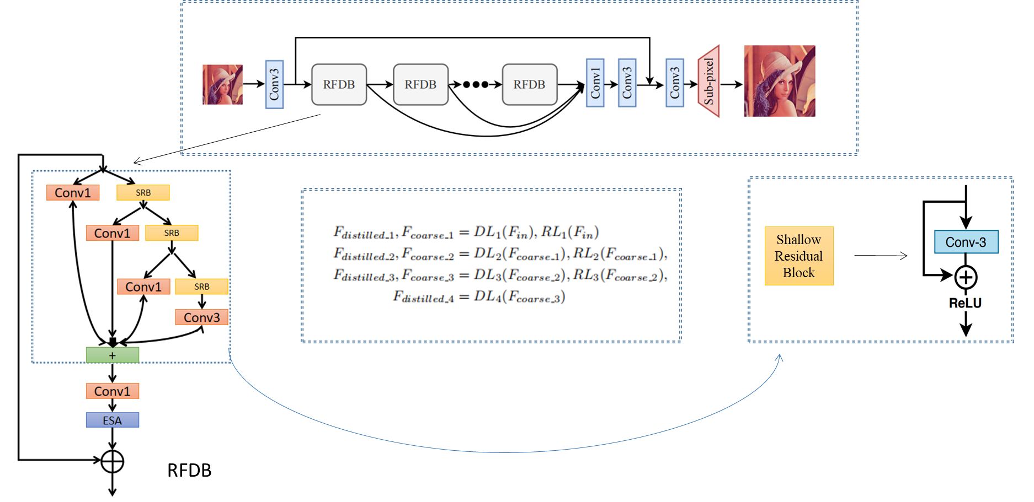
Architecture of RFDN

Slide 6
Contribution
Our goal is to optimize the model for constrained IoT devices by reducing one of or some of the following model metrics while maintaining the same PSNR or with a little sacrifice.
Number of Flops
Number of Parameters
Inference time
Model memory

Slide 7
Result Comparison with Our Baseline Model (Winner of NTIRE and AIM 2020 Challenges)
Model | Runtime[ms] | Params [M] | Val PSNR | Flops[G] | Acts[M] | GPU mem [M]
RFDN | 112.14 | 0.433 | 29.04 | 27.10 | 112.03 | 788.13
Ours | 79.45 | 0.345 | 28.378 | 15.13 | 242.62 | 1006.03

