Slide 1
Lab Seminar
Yasir
Notes:
ID=d924773e-9a16-4d6d-9803-8cb819e99682
Recipe=text_billboard
Type=TextOnly
Variant=0
FamilyID=AccentBoxWalbaum_Zero

Slide 2

Contents
Introduction
Challenges
Baseline Paper
Contribution
Results

Slide 3
Image Super Resolution
Enhancing resolution of low-quality images to produce high-quality images.
Aims to reconstruct missing high-frequency details and restore sharpness and clarity in the upscaled images.
It has various applications:
  Computer Vision
  Medical Imaging
  Surveillance
  Digital Photography
The final goal is to produce high-resolution images that are indistinguishable from original high-resolution images.

Slide 4
Challenges
Deep learning-based models utilize large datasets to learn relation between LR and HR image pairs.
When it comes to edge devices, it is not easy to apply these methods due to the requirement of heavy computation.
These devices have low computation powers, and these models are not useful in most cases.
Our aim is to propose a light-weight single image super resolution model for the low-constrained devices.

Slide 5
Baseline Paper
Notes:
ID=d924773e-9a16-4d6d-9803-8cb819e99682
Recipe=text_billboard
Type=TextOnly
Variant=0
FamilyID=AccentBoxWalbaum_Zero

Slide 6
Residual Feature Distillation Network for Lightweight Image Super-Resolution (RFDN)
RFDN won the first place in the AIM 2020 efficient super-resolution challenge.
They proposed a lightweight and accurate SISR model called residual feature distillation network (RFDN).
The model uses multiple feature distillation connections to learn more discriminative feature representations, using a shallow residual block(SRB) as the main building block of RFDN.
It reduces the number of parameters compared to IMDN and VDSR while maintaining the PSNR value of 29 db.

Slide 7
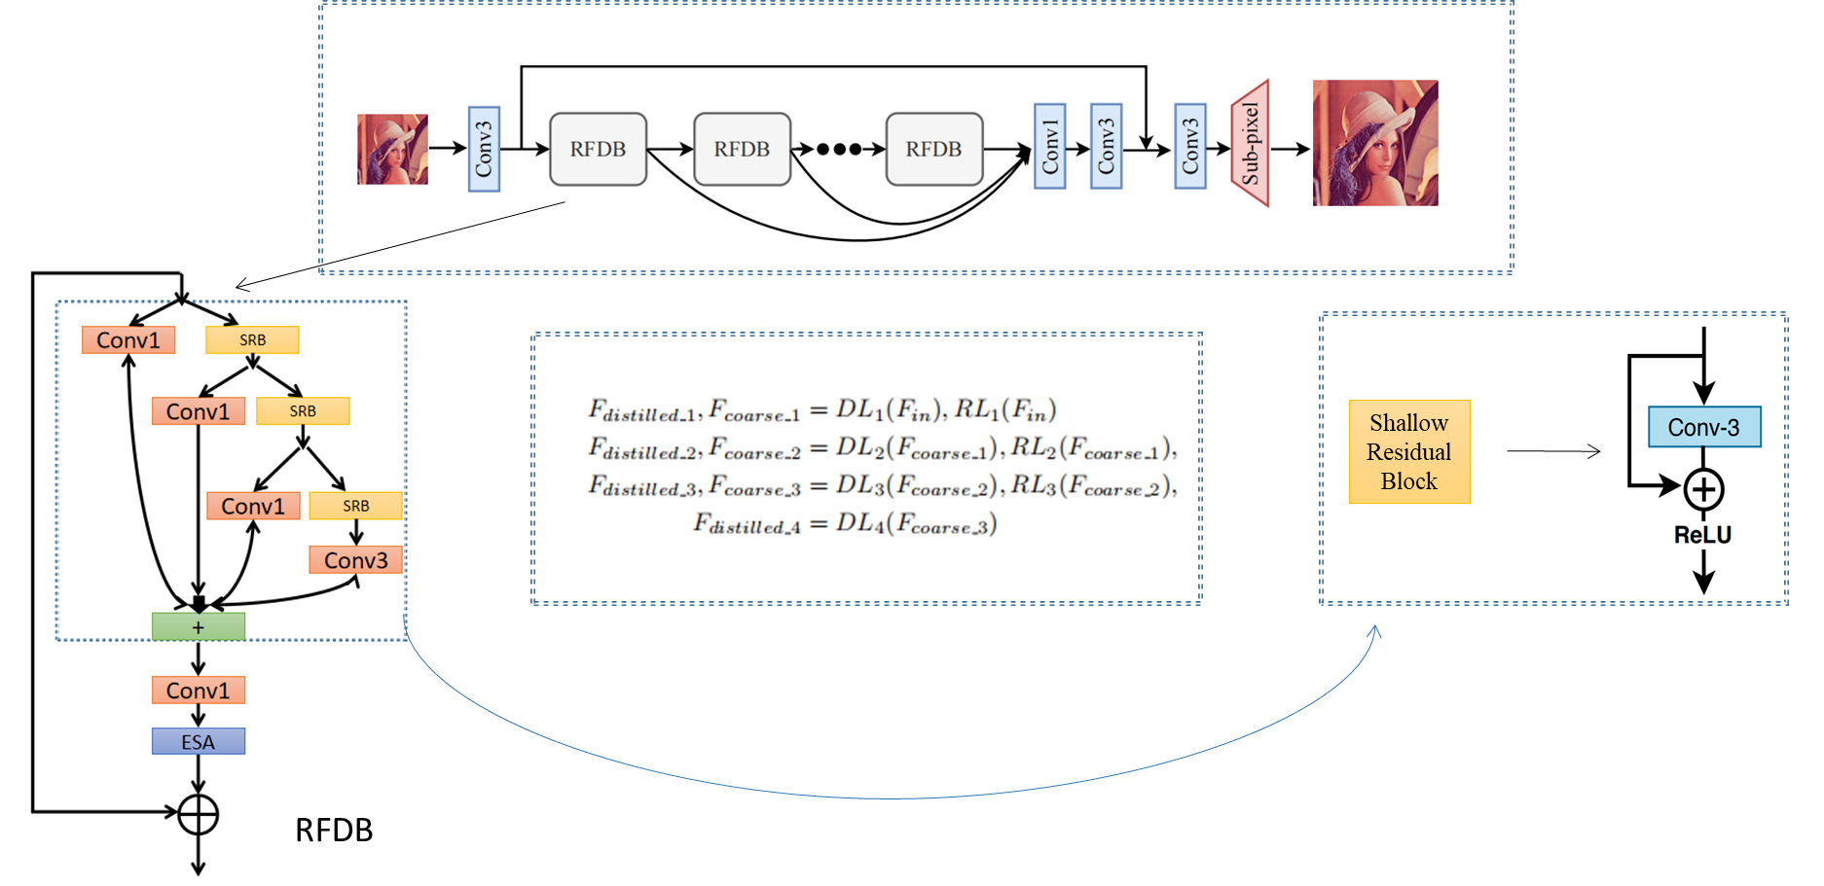
Architecture of RFDN

Slide 8
Contribution
Our goal is to further optimize the model for constrained IoT devices by reducing one of or some of the following model metrics while maintaining the same PSNR or with a little sacrifice.
  Number of Flops
  Number of Parameters
  Inference time
  Model memory

Slide 9
Result Comparison with Baseline Model (Winner of NTIRE and AIM 2020 Challenges)
Previous Comparison
Model | Runtime[ms] | Params [M] | PSNR [test] | Flops[G] | Acts[M] | Mem [M]
RFDN | 112.14 | 0.433 | 29.04 | 27.10 | 112.03 | 788.13
Ours | 79.45 | 0.345 | 28.378 | 15.13 | 242.62 | 1006.03
Current Comparison
Model | Runtime[ms] | Params [M] | PSNR [test] | Flops[G] | Acts[M] | Mem [M]
RFDN | 112.14 | 0.433 | 29.04 | 27.10 | 112.03 | 788.13
Ours | 71.33 | 0.560 | 29.05 | 35.56 | 117.27 | 376.61

