Slide 1


Depthwise Channel Attention Network (DWCAN): An Efficient and Lightweight Model for Single Image Super-Resolution
Muhammad Yasir
Intelligent Information Processing (IIP) Lab
Computer Engineering
Advisor: Prof. Chang Choi
Department of IT Convergence, Gachon University, South Korea
Notes:
ID=d924773e-9a16-4d6d-9803-8cb819e99682
Recipe=text_billboard
Type=TextOnly
Variant=0
FamilyID=AccentBoxWalbaum_Zero

Slide 2

Contents
Introduction
Literature
Baseline
Proposed Method
Contributions
Experiments and Results
Conclusion

Slide 3
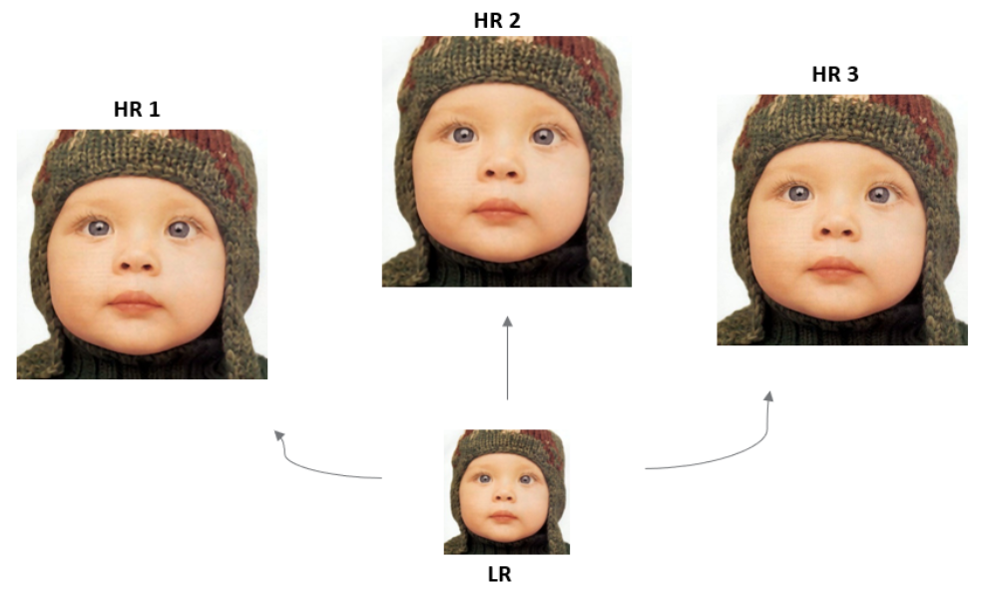
Introduction
Single Image Super-Resolution (SISR):
Generating high-resolution (HR) image with more resolving power using one or more low-resolution (LR) images.
  More resolving power – more details
SISR Approaches
  Interpolation-based
  Learning-based

Slide 4
Introduction Cont’d
Interpolation:
  Transferring image from one resolution to another without changing image quality.
Common Interpolation Techniques:
  Nearest Neighbor
  Bilinear
  Bicubic
Expanded
Original
Interpolated

Slide 5
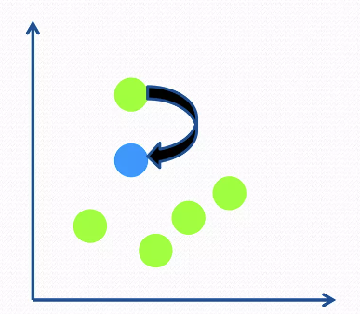
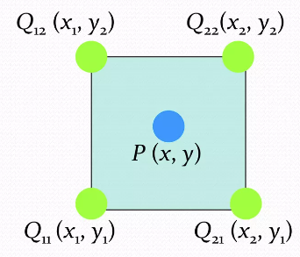
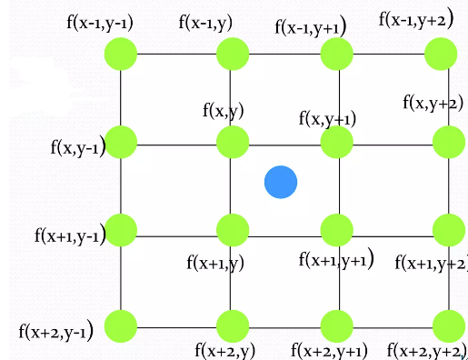
Introduction Cont’d
Nearest Neighbor
  Interpolated pixel is replaced by its nearest pixel
Bilinear
  It takes a weighted average of 4 neighborhood pixels to calculate its final interpolated value
Bicubic
  It takes a weighted average of 16 neighborhood pixels to calculate its final interpolated value
Nearest Neighbor
Bilinear
Bicubic

Slide 6
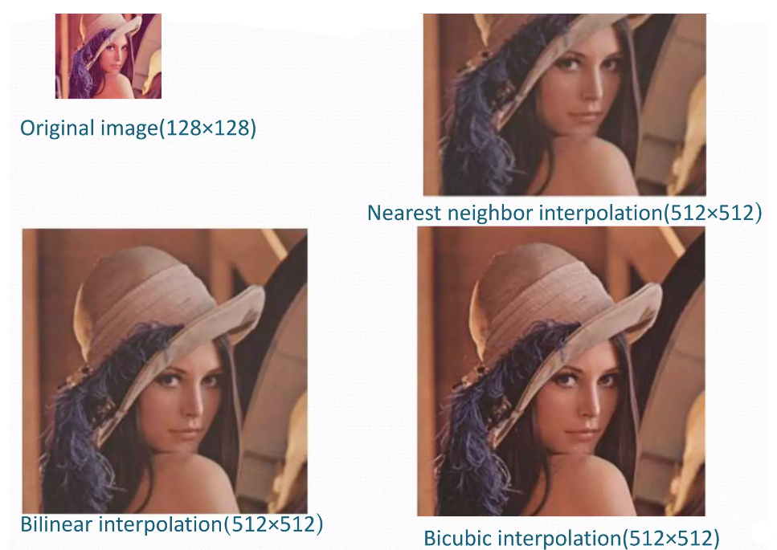
Introduction Cont’d

Slide 7
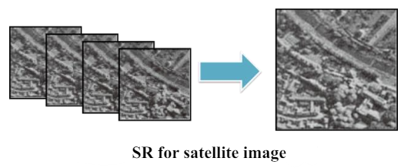
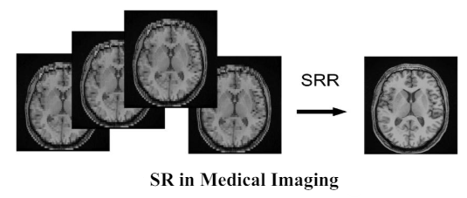
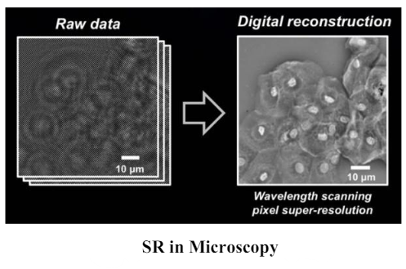
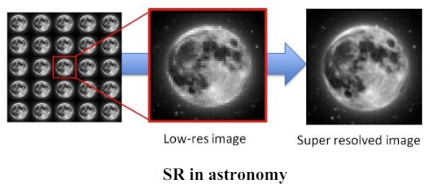
Introduction Cont’d
SR Applications

Slide 8
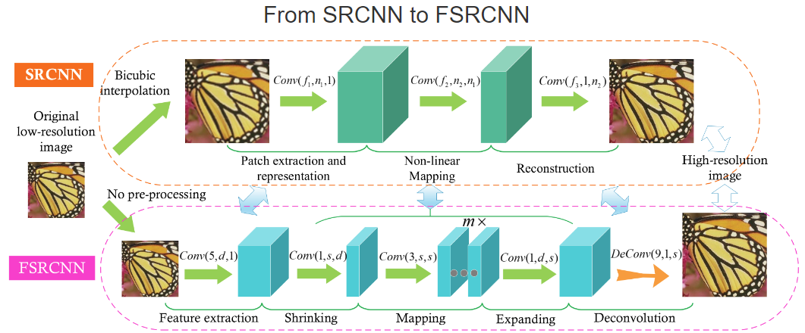
Literature
Deep learning-based SISR have been successful since the development of “Super resolution using Deep Convolutional Neural Networks (SRCNN)”.
SRCNN has three layers, patch extraction, non-linear mapping, and reconstruction.
FSRCNN extended the SRCNN in which, the LR input image is directly fed into the convolution and at the end, a deconvolution is applied to increase the height/width of feature map to get HR.
Framework of SRCNN [1] and FSRCNN [2]
[1]. Dong, Chao, Chen Change Loy, Kaiming He, and Xiaoou Tang. "Image super-resolution using deep convolutional networks." IEEE transactions on pattern analysis and machine intelligence 38, no. 2 (2015): 295-307.
[2]. Dong, Chao, Chen Change Loy, and Xiaoou Tang. "Accelerating the super-resolution convolutional neural network." In Computer Vision–ECCV 2016: 14th European Conference, Amsterdam, The Netherlands, October 11-14, 2016, Proceedings, Part II 14, pp. 391-407. Springer International Publishing, 2016.

Slide 9

Motivation
Although deep learning-based SR have achieved great performance.
However, these models need high computations to be deployed and that make them unsuitable for edge devices.
Therefore, lightweight models, which have low computational complexity, need to be developed.

Slide 10
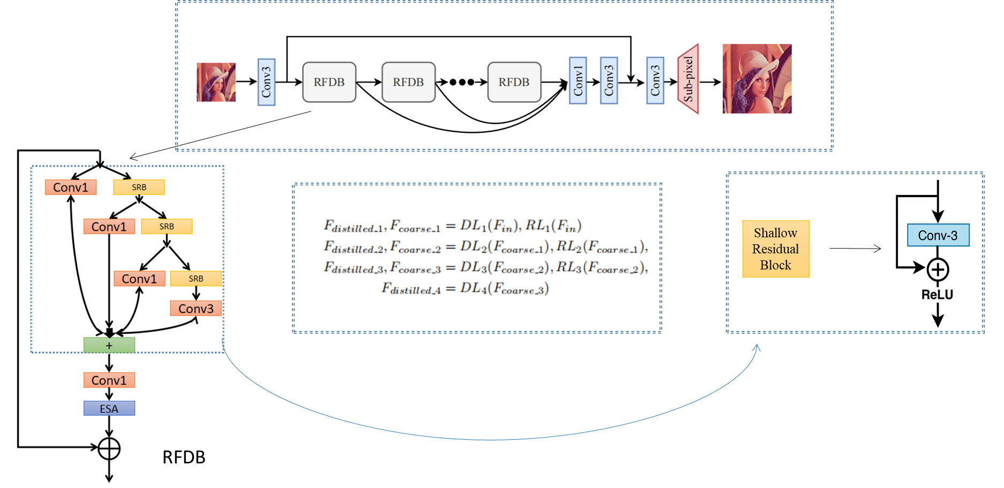
Baseline Model
Residual Feature Distillation Network (RFDN)
RFDN is the winner of AIM2020 and NTIRE2022 SR challenges.
It was proposed to reduce computational complexity while maintaining the PSNR to 29dB.
It has four parts, feature extraction, multiple Residual Feature Distillation Blocks (RFDBs), feature fusion, and reconstruction.
Architecture of RFDN [3]
[3]. Liu, Jie, Jie Tang, and Gangshan Wu. "Residual feature distillation network for lightweight image super-resolution." In Computer Vision–ECCV 2020 Workshops: Glasgow, UK, August 23–28, 2020, Proceedings, Part III 16, pp. 41-55. Springer International Publishing, 2020.

Slide 11
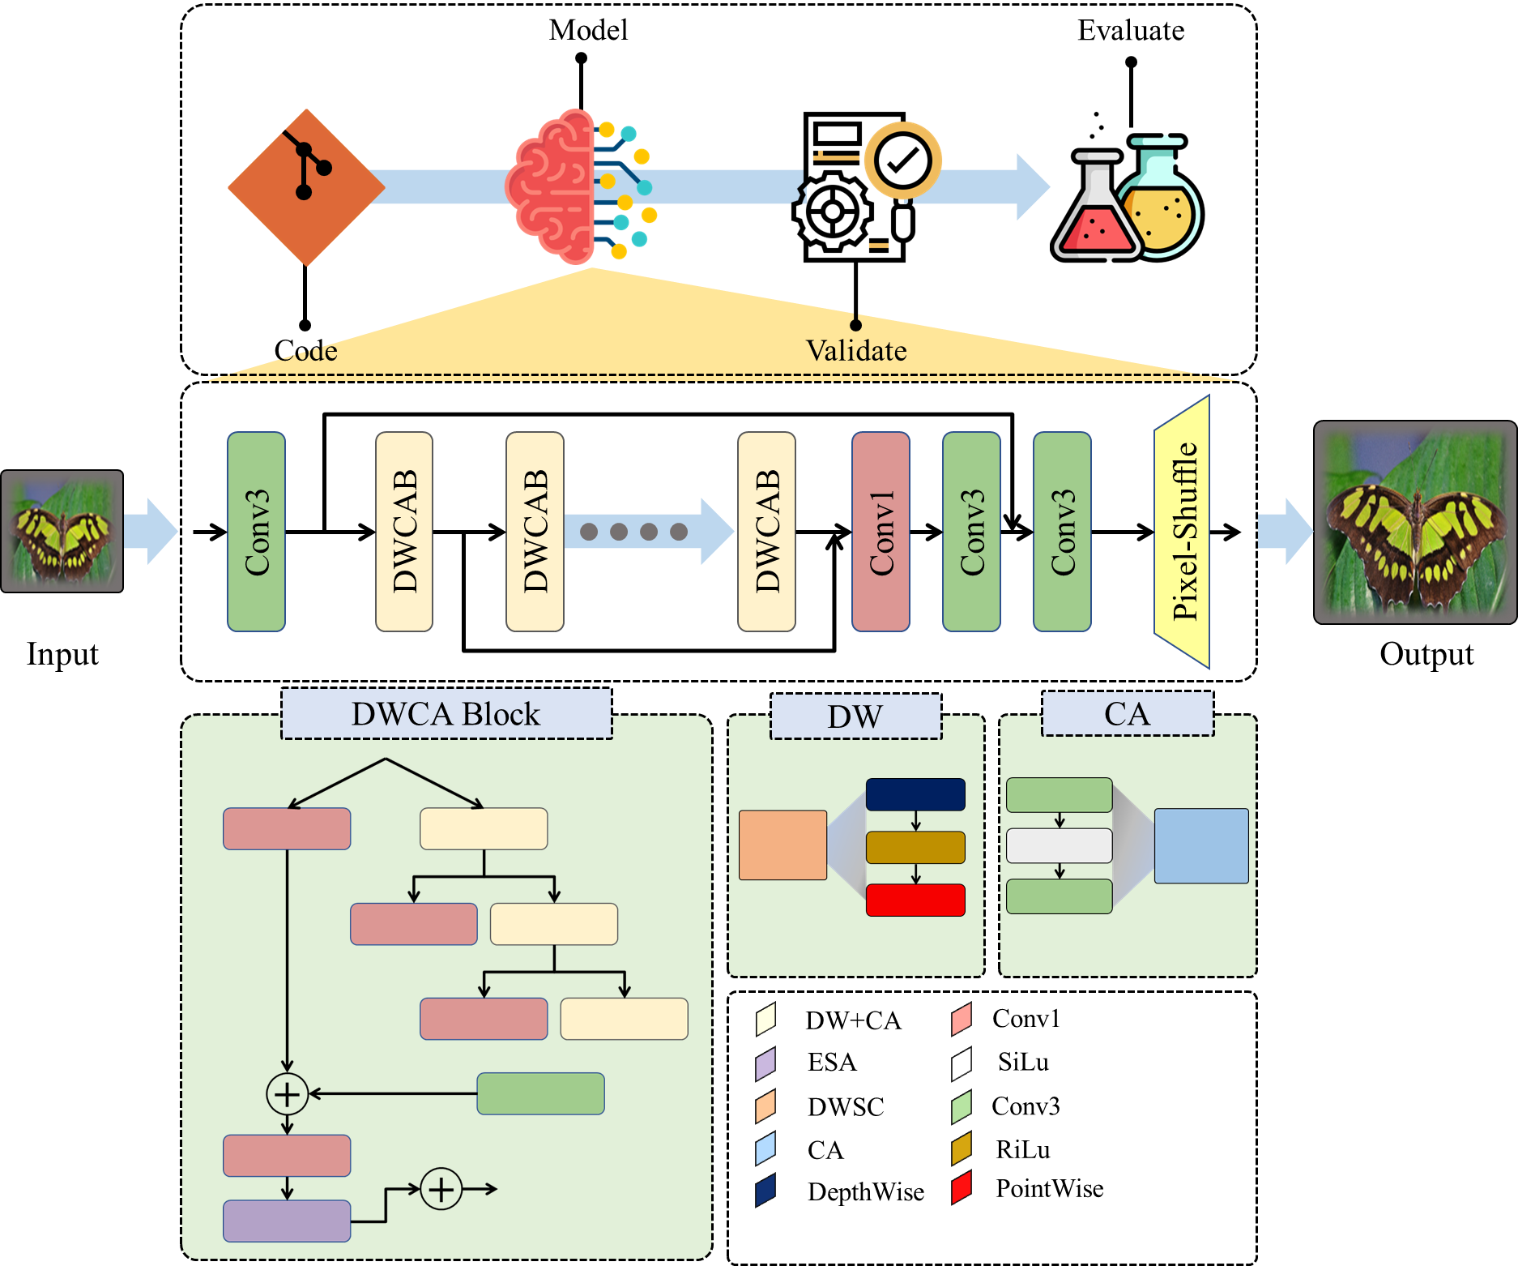
Proposed Method
Depthwise Channel Attention Network (DWCAN)
We propose an efficient and lightweight model for SISR.
We aim to reduce the computational complexity i.e., parameters, flops, inference time, and memory, while maintaining or improving the PSNR to/from 29 dB.
The architecture of our model is a refined version of RFDN, in which we replaced the main RFDB with DWCAB.
Additionally, the Shallow Residual Block is replaced with Depthwise separable convolution and Channel attention.

Slide 12
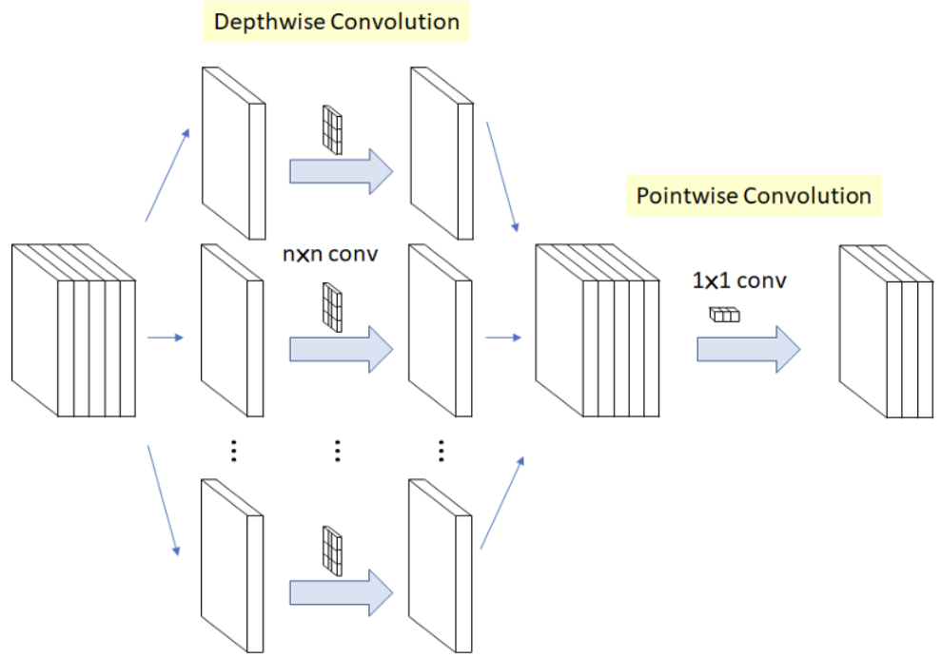
Proposed Method Cont’d
Depthwise Channel Attention Block (DWCAB)
Depthwise Separable Convolution
  Depthwise Convolution:
    Each filter is applied individually on each channel
  Pointwise Convolution:
    As we don’t get the inter-channel information in depthwise convolution, thus, a 1x1 filter is applied n-times to get inter-channel dependency

Slide 13
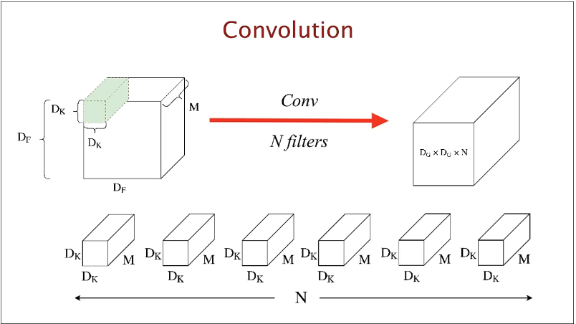
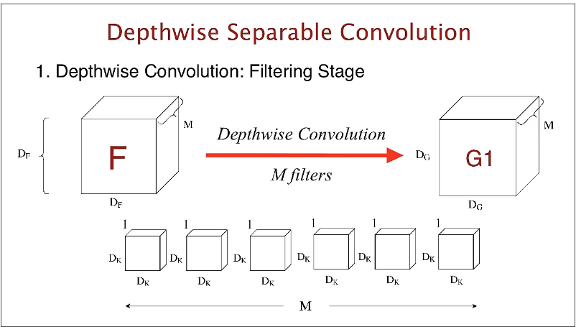
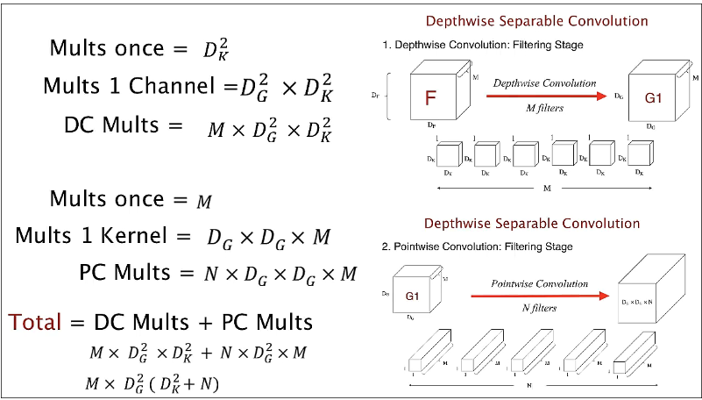
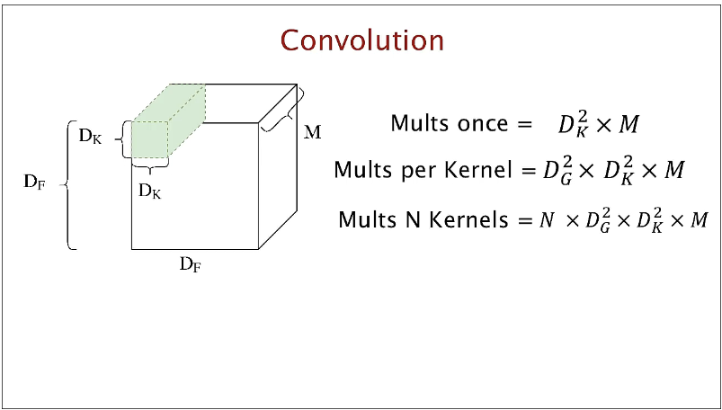
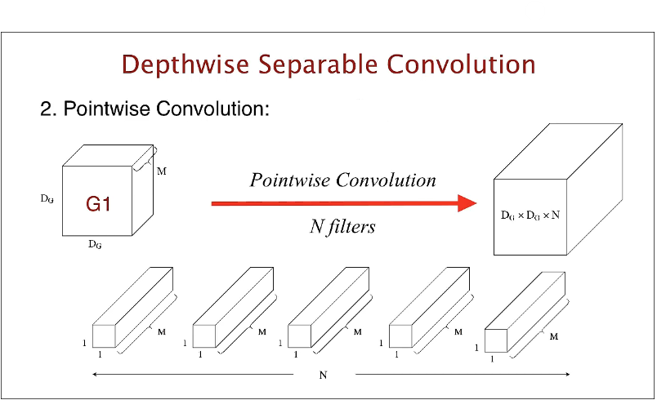
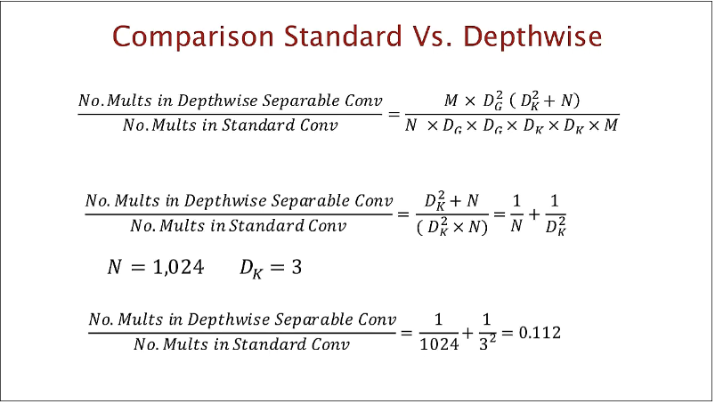
Proposed Method Cont’d
Standard VS Depthwise Separable Convolution

Slide 14
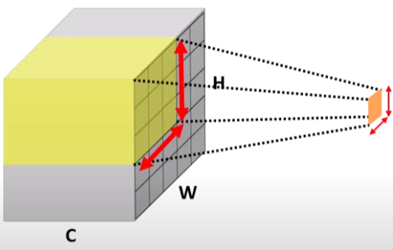
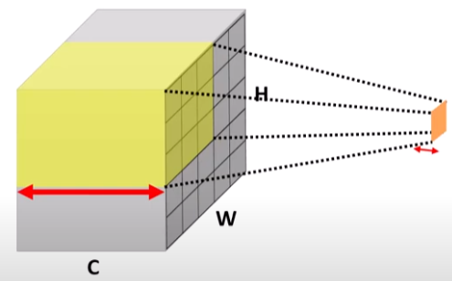
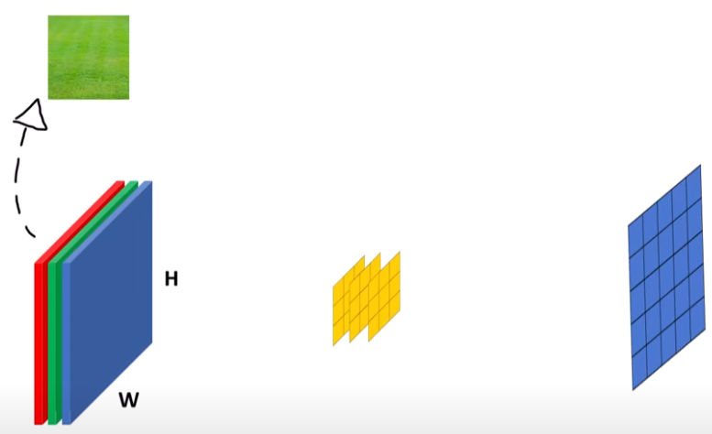
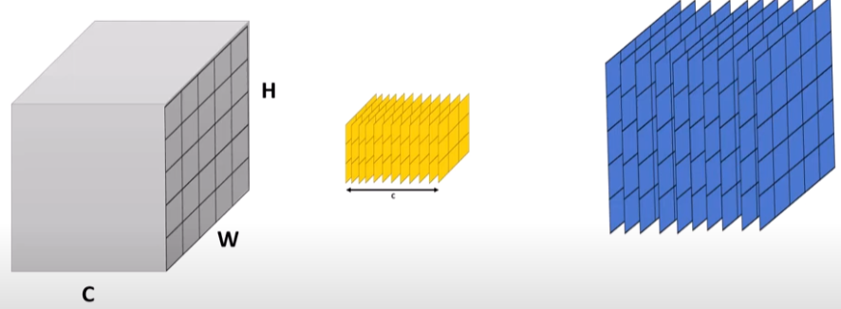

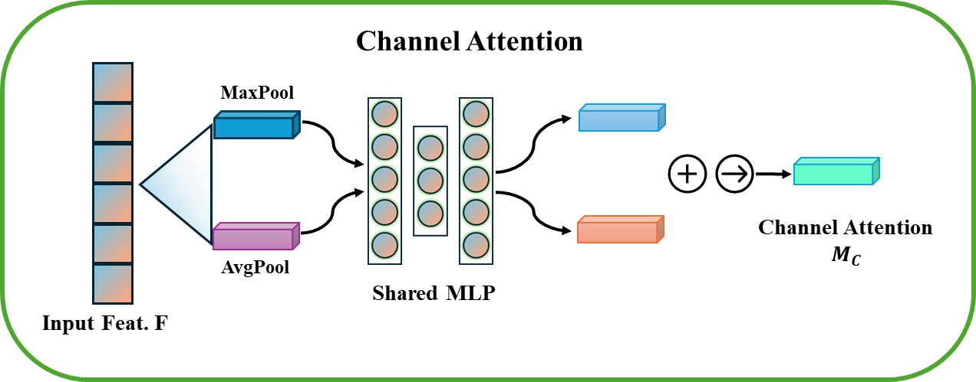
Proposed Method Cont’d
Depthwise Channel Attention Block (DWCAB)
Channel Attention
  When a convolution kernel is applied on input volume, it fuses spatial locations and fuses number of channels, so we get 1 spatial element and 1 channel as output.
  Channel attention focuses on channel to get intermediate feature maps and then it aggregates the feature maps to get the final output.
14

Slide 15
Contributions
Proposed a lightweight depthwise channel attention network for SISR.
Created a custom depthwise channel attention block as the main component of our framework.
Employed depthwise separable convolution and channel attention in DWCAB.
Reduced the computational complexity as compared to SOTA methods.
Enhanced PSNR on DIV2K dataset as compared to baseline and other participants of the AIM 2020 challenge.

Slide 16
Experiments and Results | Datasets
Train Dataset
DIV2K [3]: It contains 1000 diverse 2k resolution images.
Test Datasets
Set5 [4]: Consists of 5 images including bird, baby, butterfly, head, and woman.
Set14 [5]: It has 14 images.
Urban100 [6]: Contains 100 images of urban scenes.
Manga109 [7]: Contains 109 artistic images.
BSD100 [8]: Contains 100 images.

Slide 17
Experiments and Results | Evaluation Metrics
PSNR (Peak Signal-to-Noise Ratio)
  The ratio between the maximum possible value (power) of a signal and the power of distorting noise that affects the quality of its representation.
SSIM (Structural Similarity Index)
  A method of comparing similarity between two images using three factors i.e., luminance, contrast, structure.
f represents the matrix data of our original image
g represents the matrix data of our degraded image in question
m represents the numbers of rows of pixels of the images and i represents the index of that row
n represents the number of columns of pixels of the image and j represents the index of that column
MAX_{f} is the maximum signal value that exists in our original “known to be good” image

Slide 18
Results
Comparison based on computational complexity against participants of the AIM 2020 challenge [9]
Model | PSNR [Val] | Params [M] | Flops [G] | RunTime [MS] | Memory [M] | Acts [M]
AiriA_CG | 29.00 | 0.687 | 44.98 | 122.15 | 501 | 118.49
UESTC-MediaLab | 29.01 | 0.461 | 30.06 | 201 | 448 | 219
MDISL-lab | 29.01 | 0.660 | 42.40 | 213 | 1629 | 149.09
MLVC | 29.00 | 0.441 | 27.11 | 311 | 402 | 212.24
XMUlab | 29.00 | 0.691 | 53.62 | 234 | 1373 | 184.74
RFDN [baseline] | 29.04 | 0.433 | 27.1 | 122.13 | 788.13 | 112.03
DWCAN [ours] | 29.07 | 0.401 | 25.4 | 64.42 | 376.61 | 117

Slide 19
Results Cont’d
Model | Scale | Parameters | Set5 | Set14 | BSDS100 | Urban100 | Manga109
 |  |  | PSNR/SSIM | PSNR/SSIM | PSNR/SSIM | PSNR/SSIM | PSNR/SSIM
SRCNN[1] | X2 | 8K | 36.66/0.9542 | 32.45/0.9067 | 31.36/0.8879 | 29.50/0.8946 | 35.60/0.9663
FSRCNN[2] |  | 13K | 37.00/0.9558 | 32.63/0.9088 | 31.53/0.8920 | 29.88/0.9020 | 36.67/0.9710
DRCN[10] |  | 1774K | 37.63/0.9588 | 33.04/0.9118 | 31.85/0.8942 | 30.75/0.9133 | 37.55/0.9732
VDSR[11] |  | 666K | 37.53/0.9587 | 33.03/0.9124 | 31.90/0.8960 | 30.76/0.9140 | 37.22/0.9750
LapSRN[12] |  | 251K | 37.52/0.9591 | 32.99/0.9124 | 31.80/0.8952 | 30.41/0.9103 | 37.27/0.9740
IDN[13] |  | 553K | 37.83/0.9600 | 33.30/0.9148 | 32.08/0.8985 | 31.27/0.9196 | 38.01/0.9749
DRRN[14] |  | 298K | 37.74/0.9591 | 33.23/0.9136 | 32.05/0.8973 | 31.23/0.9188 | 37.88/0.9749
MemNet[15] |  | 678K | 37.78/0.9597 | 33.28/0.9142 | 32.08/0.8978 | 31.31/0.9195 | 37.72/0.9740
SRMDNF[16] |  | 1511K | 37.79/0.9601 | 33.32/0.9159 | 32.05/0.8985 | 31.33/0.9204 | 38.07/0.9761
CARN[17] |  | 1592K | 37.76/0.9590 | 33.52/0.9166 | 32.09/0.8978 | 31.92/0.9256 | 38.36/0.9765
IMDN[18] |  | 694K | 38.00/0.9605 | 33.63/0.9177 | 32.19/0.8996 | 32.17/0.9283 | 38.88/0.9774
RFDN [3] (baseline) |  | 534K | 38.05/0.9606 | 33.68/0.9184 | 32.16/0.8994 | 32.12/0.9278 | 38.88/0.9773
DWCAN (Ours) |  | 401K | 37.60/0.9598 | 33.33/0.9160 | 32.07/0.8987 | 31.95/0.9267 | 38.09/0.9764
SRCNN[1] | X3 | 8K | 32.75/0.9090 | 29.30/0.8215 | 28.41/0.7863 | 26.24/0.7989 | 30.48/0.9117
FSRCNN[2] |  | 13K | 33.18/0.9140 | 29.37/0.8240 | 28.53/0.7910 | 26.43/0.8080 | 31.10/0.9210
DRCN[10] |  | 1774K | 33.82/0.9226 | 29.76/0.8311 | 28.80/0.7963 | 27.15/0.8276 | 32.24/0.9343
VDSR[11] |  | 666K | 33.66/0.9213 | 29.77/0.8314 | 28.82/0.7976 | 27.14/0.8279 | 32.01/0.9340
LapSRN[12] |  | 251K | 33.81/0.9220 | 29.79/0.8325 | 28.82/0.7980 | 27.07/0.8275 | 32.21/0.9350
IDN[13] |  | 553K | 34.11/0.9253 | 29.99/0.8354 | 28.95/0.8013 | 27.42/0.8359 | 32.71/0.9381
DRRN[14] |  | 298K | 34.03/0.9244 | 29.96/0.8349 | 28.95/0.8004 | 27.53/0.8378 | 32.71/0.9379
MemNet[15] |  | 678K | 34.09/0.9248 | 30.00/0.8350 | 28.96/0.8001 | 27.56/0.8376 | 32.51/0.9369
SRMDNF[16] |  | 1511K | 34.12/0.9254 | 30.04/0.8382 | 28.97/0.8025 | 27.57/0.8398 | 33.00/0.9403
CARN[17] |  | 1592K | 34.29/0.9255 | 30.29/0.8407 | 29.06/0.8034 | 28.06/0.8493 | 33.50/0.9440
IMDN[18] |  | 694K | 34.36/0.9270 | 30.32/0.8417 | 29.09/0.8046 | 28.17/0.8519 | 33.61/0.9445
RFDN [3] (baseline) |  | 534K | 34.41/0.9273 | 30.34/0.8420 | 29.09/0.8050 | 28.21/0.8525 | 33.67/0.9449
DWCAN (Ours) |  | 401K | 34.29/0.9258 | 30.29/0.8410 | 29.00/0.8027 | 28.18/0.8521 | 33.53/0.9443
SRCNN[1] | X4 | 8K | 30.48/0.8626 | 27.50/0.7513 | 26.90/0.7101 | 24.52/0.7221 | 27.58/0.8555
FSRCNN[2] |  | 13K | 30.72/0.8660 | 27.61/0.7550 | 26.98/0.7150 | 24.62/0.7280 | 27.90/0.8610
DRCN[10] |  | 1774K | 31.53/0.8854 | 28.02/0.7670 | 27.23/0.7233 | 25.14/0.7510 | 28.93/0.8854
VDSR[11] |  | 666K | 31.35/0.8838 | 28.01/0.7674 | 27.29/0.7251 | 25.18/0.7524 | 28.83/0.8870
LapSRN[12] |  | 251K | 31.54/0.8852 | 28.09/0.7700 | 27.32/0.7275 | 25.21/0.7562 | 29.09/0.8900
IDN[13] |  | 553K | 31.82/0.8903 | 28.25/0.7730 | 27.41/0.7297 | 25.41/0.7632 | 29.41/0.8942
DRRN[14] |  | 298K | 31.68/0.8888 | 28.21/0.7720 | 27.38/0.7284 | 25.44/0.7638 | 29.45/0.8946
MemNet[15] |  | 678K | 31.74/0.8893 | 28.26/0.7723 | 27.40/0.7281 | 25.50/0.7630 | 29.42/0.8942
SRMDNF[16] |  | 1511K | 31.96/0.8925 | 28.35/0.7787 | 27.49/0.7337 | 25.68/0.7731 | 30.09/0.9024
CARN[17] |  | 1592K | 32.13/0.8937 | 28.60/0.7806 | 27.58/0.7349 | 26.07/0.7837 | 30.47/0.9084
IMDN[18] |  | 694K | 32.21/0.8948 | 28.58/0.7811 | 27.56/0.7353 | 26.04/0.7838 | 30.45/0.9075
RFDN [3] (baseline) |  | 534K | 32.24/0.8952 | 28.61/0.7819 | 27.57/0.7360 | 26.11/0.7858 | 30.58/0.9089
DWCAN (Ours) |  | 401K | 32.20/0.8938 | 28.56/0.2809 | 27.41/0.7339 | 26.06/0.7851 | 30.48/0.9081
Comparison with state-of-the-art models on benchmark datasets
19

Slide 20
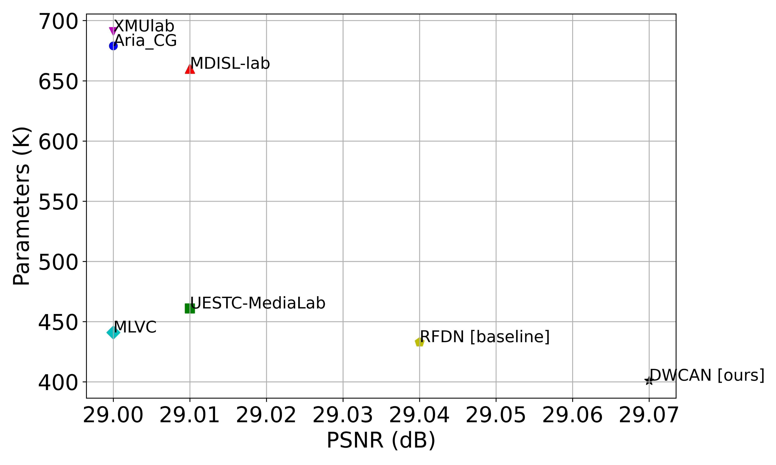
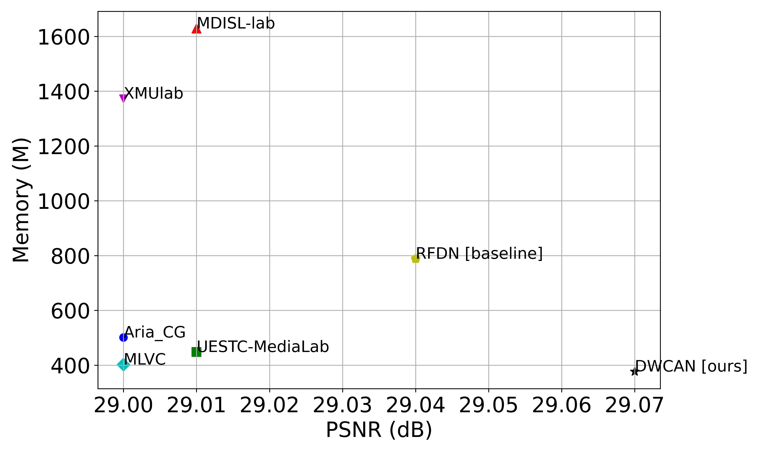
Results Cont’d
Graphical Comparison of Accuracy Metrics
(a). Comparison of model complexity (PSNR, Parameters)
(b). Comparison of model complexity (PSNR, Memory)

Slide 21
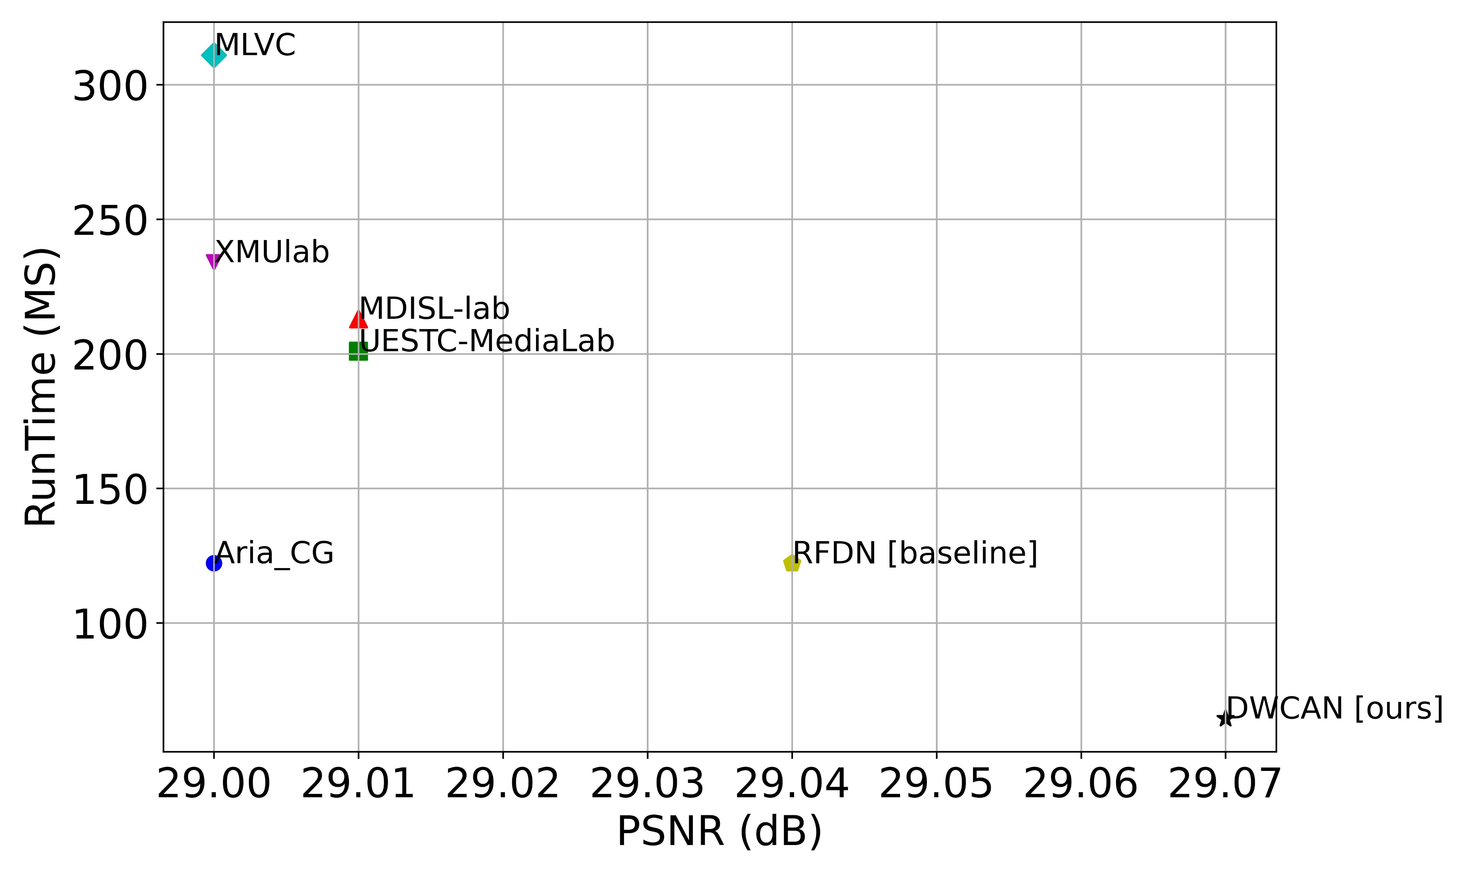
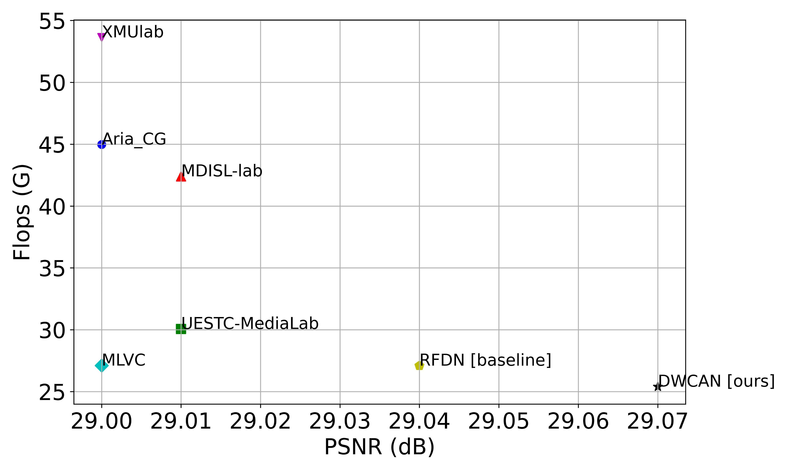
Results Cont’d
Graphical Comparison of Accuracy Metrics
(c). Comparison of model complexity (PSNR, RunTime)
(d). Comparison of model complexity (PSNR, Flops)

Slide 22
Visual Results Comparison

Slide 23
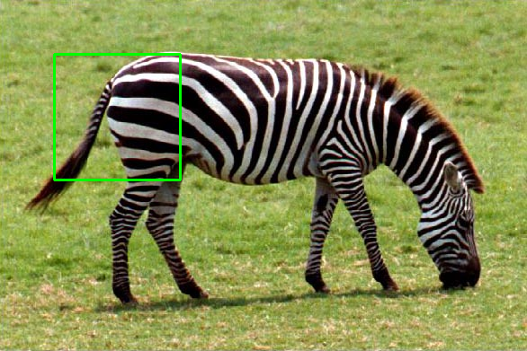
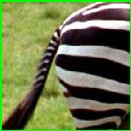



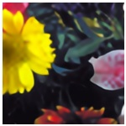


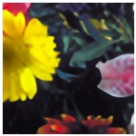

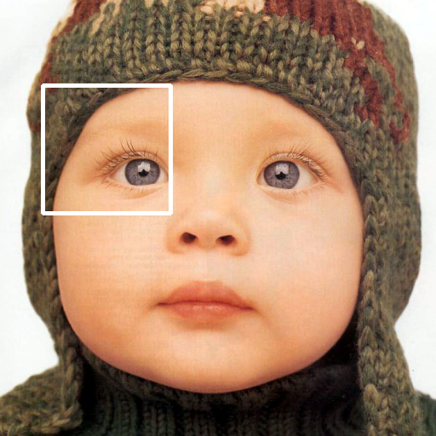
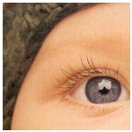

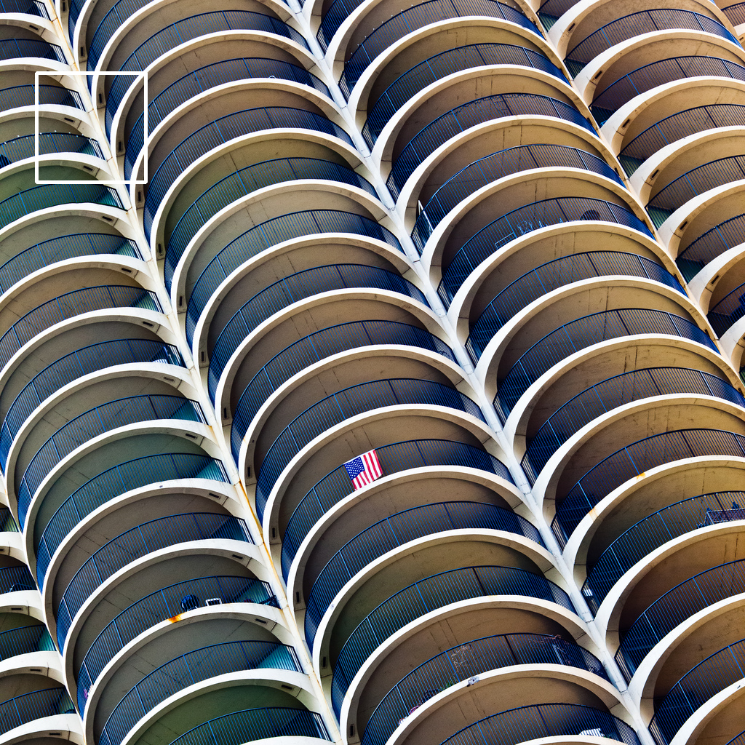
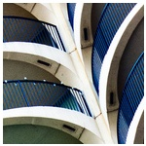




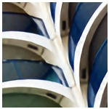
Set14
Set14
GT
IMDN
GT
IMDN
Zebra
RFDN
DWCAN
Flowers
RFDN
DWCAN
Urban100
Set5
GT
IMDN
GT
IMDN
Baby
RFDN
DWCAN
img_100
RFDN
DWCAN

Slide 24
Conclusion
We proposed an efficient and lightweight model known as Depthwise Channel Attention Network (DWCAN) for SISR.
We refined the baseline RFDN architecture and replaced their core block RFDB with our custom block DWCAB. Moreover, the SRB in RFDN is replaced with Depthwise Separable Convolution and Channel Attention block.
We have done qualitative and quantitative comparison with SOTA models, which proved that our model successfully reduced the model complexity in terms of Parameters, FLOPS, Inference Time, and Memory, and improved the PSNR to 29.07dB.

Slide 25
References
Dong, Chao, Chen Change Loy, Kaiming He, and Xiaoou Tang. "Image super-resolution using deep convolutional networks." IEEE transactions on pattern analysis and machine intelligence 38, no. 2 (2015): 295-307.
Dong, Chao, Chen Change Loy, and Xiaoou Tang. "Accelerating the super-resolution convolutional neural network." In Computer Vision–ECCV 2016: 14th European Conference, Amsterdam, The Netherlands, October 11-14, 2016, Proceedings, Part II 14, pp. 391-407. Springer International Publishing, 2016.
Liu, Jie, Jie Tang, and Gangshan Wu. "Residual feature distillation network for lightweight image super-resolution." In Computer Vision–ECCV 2020 Workshops: Glasgow, UK, August 23–28, 2020, Proceedings, Part III 16, pp. 41-55. Springer International Publishing, 2020.
Agustsson, Eirikur, and Radu Timofte. "Ntire 2017 challenge on single image super-resolution: Dataset and study." In Proceedings of the IEEE conference on computer vision and pattern recognition workshops, pp. 126-135. 2017.
Bevilacqua, Marco, Aline Roumy, Christine Guillemot, and Marie Line Alberi-Morel. "Low-complexity single-image super-resolution based on nonnegative neighbor embedding." (2012): 135-1.
Zeyde, Roman, Michael Elad, and Matan Protter. "On single image scale-up using sparse-representations." In Curves and Surfaces: 7th International Conference, Avignon, France, June 24-30, 2010, Revised Selected Papers 7, pp. 711-730. Springer Berlin Heidelberg, 2012.
Huang, Jia-Bin, Abhishek Singh, and Narendra Ahuja. "Single image super-resolution from transformed self-exemplars." In Proceedings of the IEEE conference on computer vision and pattern recognition, pp. 5197-5206. 2015.
Matsui, Yusuke, Kota Ito, Yuji Aramaki, Azuma Fujimoto, Toru Ogawa, Toshihiko Yamasaki, and Kiyoharu Aizawa. "Sketch-based manga retrieval using manga109 dataset." Multimedia tools and applications 76 (2017): 21811-21838.
Timofte, Radu, Vincent De Smet, and Luc Van Gool. "A+: Adjusted anchored neighborhood regression for fast super-resolution." In Computer Vision--ACCV 2014: 12th Asian Conference on Computer Vision, Singapore, Singapore, November 1-5, 2014, Revised Selected Papers, Part IV 12, pp. 111-126. Springer International Publishing, 2015.
Zhang, Kai, Martin Danelljan, Yawei Li, Radu Timofte, Jie Liu, Jie Tang, Gangshan Wu et al. "Aim 2020 challenge on efficient super-resolution: Methods and results." In Computer Vision–ECCV 2020 Workshops: Glasgow, UK, August 23–28, 2020, Proceedings, Part III 16, pp. 5-40. Springer International Publishing, 2020.
Kim, Jiwon, Jung Kwon Lee, and Kyoung Mu Lee. "Deeply-recursive convolutional network for image super-resolution." In Proceedings of the IEEE conference on computer vision and pattern recognition, pp. 1637-1645. 2016.

Slide 26
References
Kim, Jiwon, Jung Kwon Lee, and Kyoung Mu Lee. "Accurate image super-resolution using very deep convolutional networks." In Proceedings of the IEEE conference on computer vision and pattern recognition, pp. 1646-1654. 2016.
Lai, Wei-Sheng, Jia-Bin Huang, Narendra Ahuja, and Ming-Hsuan Yang. "Deep laplacian pyramid networks for fast and accurate super-resolution." In Proceedings of the IEEE conference on computer vision and pattern recognition, pp. 624-632. 2017.
Hui, Zheng, Xiumei Wang, and Xinbo Gao. "Fast and accurate single image super-resolution via information distillation network." In Proceedings of the IEEE conference on computer vision and pattern recognition, pp. 723-731. 2018.
Tai, Ying, Jian Yang, and Xiaoming Liu. "Image super-resolution via deep recursive residual network." In Proceedings of the IEEE conference on computer vision and pattern recognition, pp. 3147-3155. 2017.
Tai, Ying, Jian Yang, Xiaoming Liu, and Chunyan Xu. "Memnet: A persistent memory network for image restoration." In Proceedings of the IEEE international conference on computer vision, pp. 4539-4547. 2017.
Zhang, Kai, Wangmeng Zuo, and Lei Zhang. "Learning a single convolutional super-resolution network for multiple degradations." In Proceedings of the IEEE conference on computer vision and pattern recognition, pp. 3262-3271. 2018.
Ahn, Namhyuk, Byungkon Kang, and Kyung-Ah Sohn. "Fast, accurate, and lightweight super-resolution with cascading residual network." In Proceedings of the European conference on computer vision (ECCV), pp. 252-268. 2018.
Hui, Zheng, Xinbo Gao, Yunchu Yang, and Xiumei Wang. "Lightweight image super-resolution with information multi-distillation network." In Proceedings of the 27th acm international conference on multimedia, pp. 2024-2032. 2019.

Slide 27

Thank You

