Slide 1
Security Verification of Data-efficient Image Transformer Based on Adversarial Attacks
In-pyo Hong
Notes:
Nice to meet you all. I’m Inpyo Hong from Gachon University, South Korea, and I would like to introduce our research on security verification with transformer models on images.
As the title refers, I will be explaining you our study in which we proposed a security verification platform and the flow of the presentation consists of background, method, experiments, and conclusion, respectively.

Slide 2
Introduction
Knowledge distillation in AI has been actively conducted.
Representive Image transformer model of knowledge distillation ➔ DeiT (Data-efficient Image Transformer)
DeiT has not been verified as safe against the AI security threat (especially adversarial attack)
Research Purpose
DeiT’s adversarial attack vulnerability analysis
Notes:
Recently, the technique of "knowledge distillation" has been actively researched in the field of AI.
Among these techniques, DeiT is a representative model whose backbone is a transformer network and is widely used.
However, it can be vulnerable to AI model attacks called adversarial attacks, and its robustness has not been verified, up to our study, to the best of our knowledge.
Therefore, our work aims to analyze the vulnerability of DeiT to adversarial attacks.

Slide 3
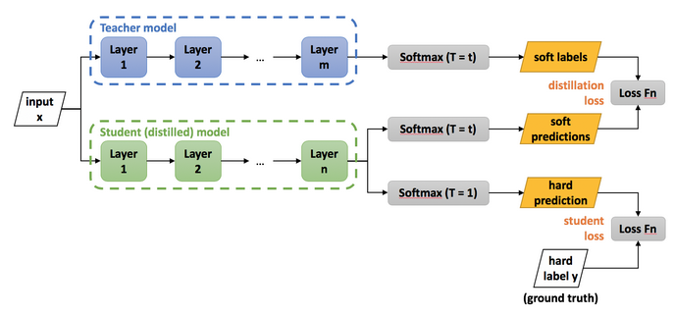
Background #knowledge Distillation
<Fig1> Knowledge Distillation Structure
Concept of knowledge distillation : Using 2 training Models
Purpose of knowledge distillation : Maximizing the performance of the Student Model
Hinton, Geoffrey, Oriol Vinyals, and Jeff Dean. "Distilling the knowledge in a neural network." arXiv preprint arXiv:1503.02531 2.7 (2015).
Notes:
Before introducing our work, I would like to provide some background information.
To briefly explain knowledge distillation, it uses two models for learning: teacher model and student model.
The final model we will use is the student model. Therefore, the purpose of knowledge distillation is to efficiently teach the student model.

Slide 4
Background #knowledge Distillation
①
②
<Fig1> Knowledge Distillation Structure
Learning methods of the Student Model : Twice Training (① ② )
① : Training using the soft labeled output of the teacher model ➔ Learning the weights of the teacher model
② : Basic supervised learning with ground truth
Hinton, Geoffrey, Oriol Vinyals, and Jeff Dean. "Distilling the knowledge in a neural network." arXiv preprint arXiv:1503.02531 2.7 (2015).
Notes:
The student model undergoes two training steps. The first step involves learning from the outputs of the teacher model.
Here, the student model has the advantage of being able to learn features that are difficult to acquire through basic learning.
The second step involves basic supervised learning, which we use to further train the student model.
Together, these two steps are called knowledge distillation, and this process enables the creation of higher performance models.

Slide 5
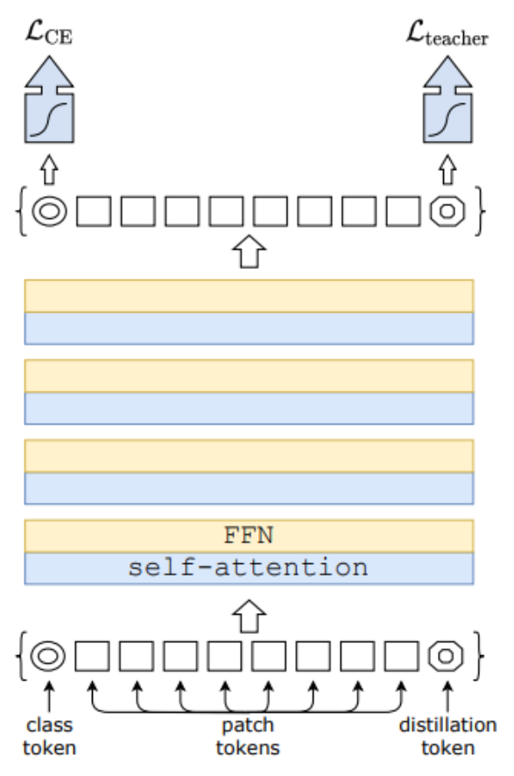
Background #DeiT
<Fig2> DeiT Model Structure
<Fig3> DeiT applied knowledge distillation structure
Touvron, Hugo, et al. "Training data-efficient image transformers & distillation through attention." International Conference on Machine Learning. PMLR, 2021.
Notes:
DeiT is a student model for knowledge distillation based on the Vision Transformer.
Figure 2 on the left shows a customized model that applies ViT to knowledge distillation, and if this model is used for knowledge distillation, it is equivalent to the model shown in Figure 3 on the right.
Through this process, we can apply ViT for the knowledge distillation process. However, this method may be vulnerable to security.

Slide 6
Background #Adversarial Attack
Original Image
Adversarial attack
Adversarial example
Noise
Epsilon
+ 0.15 x
=
“0”
97.2% Confidence (Correct classification)
Perturbation
Predicted = “9”
99.4% Confidence (Misclassification)
<Fig4> Adversarial Attack Example
Notes:
Here I’ll need to discuss adversarial attacks from a security perspective since this is the main topic of our study.
AI models usually use normal images, as shown in the left image of figure 4.
Adversarial attacks induce image classification failures by adding perturbations to normal images, as shown in the middle of Figure 4.
The resulting image with perturbations is called an adversarial example, shown on the right side of Figure 4.

Slide 7
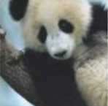
Background #Adversarial Attack
The most dangerous attack in the field of AI security
Typical adversarial attack technique 1) FGSM 2) PGD 3) C&W Attack
DeiT model Attack Inducing 1) Model’s confidence decrease 2) Misclassification
Adversarial Example
+
Original
Image
Perturbation
DeiT
<Fig5> Adversarial Attack Process
Notes:
An adversarial attack aims to disrupt the model's ability to correctly classify an input. The goals of such attacks are typically to reduce model confidence and induce misclassification.
In the field of AI security, adversarial attacks are considered the most dangerous type of attack. The most common attack techniques include FGSM, PGD, and CW.
We used FGSM in the experiment because it is serves as the baseline of many other variations of adversarial attacks.

Slide 8
Method
<Fig6> Experiment Overview
DeiT’s security verification method
Fine-tune of DeiT
Weight extract of fine-tuned DeiT
Generate of FGSM adversarial examples through DeiT weights
Insert of generated adversarial examples into fine-tuned DeiT and performance analysis
Notes:
So, our experiment method follows the process shown in Figure 6.
First, we fine-tuned a pre-trained DeiT model to optimize it for cifar-10.
Second, we extracted the fine-tuned DeiT's weights to perform adversarial attacks.
Next, we generated adversarial examples using FGSM with appropriate perturbation.
Finally, we compared the performance of DeiT on the original dataset and the adversarial examples to validate its effectiveness.

Slide 9
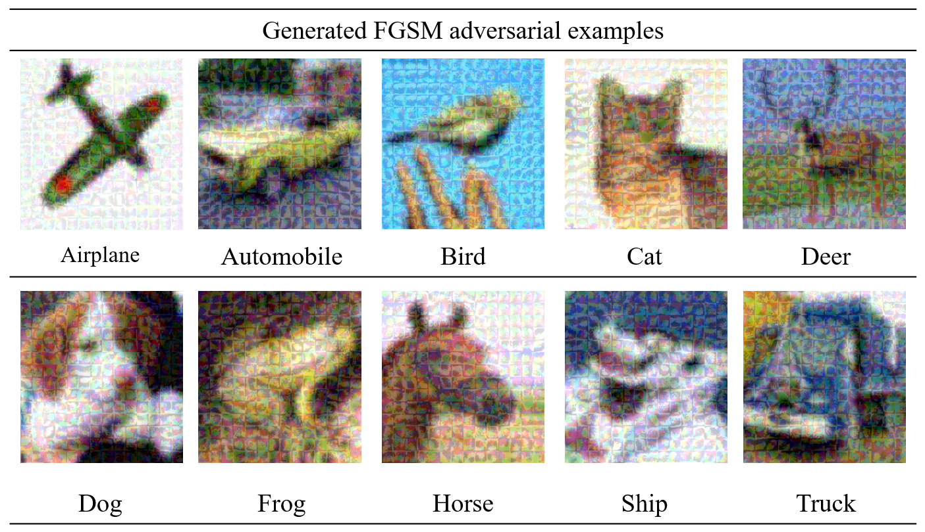
Experiment & Evaluation
Generating adversarial examples through FGSM
<Fig7> Generated FGSM adversarial examples
Generated by FGSM adversarial examples are composed of 100 images per class (A total of 1,000 images)
Notes:
The experiment utilized the cifar-10 dataset and was conducted in a Windows 10 environment.
Figure 7 shows created adversarial examples using FGSM, with 100 images per class and a total of 1,000 images.
These examples exhibit perturbations, which can be adjusted in intensity to make them imperceptible to humans.
Such attacks can be very detrimental to the model's performance.

Slide 10
IIP LAB
Paper Progress
Introduction - Done
Related Work - Done 2-1 Knowledge Distillation and DeiT 2-1-1 DeiT Teacher Model 2-1-2 DeiT Student Model 2-2 Adversarial Attack 2-2-1 FGSM 2-2-2 PGD
Adversarial Attacks - Done 3-1 White Box and Gray Box Attacks 3-1-1 White Box Verification of DeiT 3-1-2 Gray Box Verificaion of DeiT 3-2 Black Box Attack 3-2-1 Black Box Verification of DeiT through Transformer Model Attack 3-2-2 Black Box Verification of DeiT through CNN Model Attack

Slide 11
IIP LAB
Paper Progress
Experiment and Evaluation 4-1 Experimental Results 4-1-1 White Box Attacks of DeiT - Done 4-1-2 Gray Box Attacks of DeiT - Done 4-1-3 Black Box Attacks of DeiT - Writing 4-2 Evaluation – To be updated
Conclusion – To be updated

Slide 12
IIP LAB
Attack Result of DeiT
White Box Attacks
AEs | Target | Attack Method | Un-Attacked Accuracy | Attacked Accuracy | Accuracy Decrease Rate
DeiT | DeiT | FGSM | 0.9399 | 0.1050 | 0.8349
 |  | PGD | 0.9399 | 0.0000 | 0.9399

Slide 13
IIP LAB
Attack Result of DeiT
Gray Box Attack
AEs | Target | Attack Method | Un-Attacked Accuracy | Attacked Accuracy | Accuracy Decrease Rate
RegNetY-160 | RegNetY-160 | FGSM | 0.8666 | 0.0920 | 0.7746
 |  | PGD | 0.8666 | 0.0000 | 0.8666
DeiT | DeiT | FGSM | 0.9399 | 0.4750 | 0.4649
 |  | PGD | 0.9399 | 0.2840 | 0.6559

Slide 14
IIP LAB
Attack Result of DeiT
Black Box Attack (Learning condition equal)
AEs | Target | Optimizer (LR) of AEs | Optimizer (LR) of Target | Attack Method | Un-Attacked Accuracy | Attacked Accuracy | Accuracy Decrease Rate
ViT | ViT | Adam (Step LR. 5e-5) | Adam (Step LR. 5e-5) | FGSM | 0.9765 | 0.2650 | 0.7115
 |  |  |  | PGD | 0.9765 | 0.0000 | 0.9765
ResNet-50 | ResNet-50 |  |  | FGSM | 0.9289 | 0.1580 | 0.7709
 |  |  |  | PGD | 0.9289 | 0.0000 | 0.9289
ViT | DeiT |  |  | FGSM | 0.9399 | 0.2330 | 0.7069
 |  |  |  | PGD | 0.9399 | 0.2210 | 0.7189
ResNet-50 | DeiT |  |  | FGSM | 0.9399 | 0.3560 | 0.5839
 |  |  |  | PGD | 0.9399 | 0.5480 | 0.3919

Slide 15
IIP LAB
Attack Result of DeiT
Black Box Attack (Learning condition not equal)
AEs | Target | Optimizer (LR) of AEs | Optimizer (LR) of Target | Attack Method | Un-Attacked Accuracy | Attacked Accuracy | Accuracy Decrease Rate
ViT | ViT | RMSprop (Step LR, 3e-5) | RMSprop (Step LR, 3e-5) | FGSM | 0.9764 | 0.2650 | 0.7114
 |  |  |  | PGD | 0.9764 | 0.0000 | 0.9764
ResNet-50 | ResNet-50 |  |  | FGSM | 0.9249 | 0.1760 | 0.7489
 |  |  |  | PGD | 0.9249 | 0.0000 | 0.9249
ViT | DeiT | Step LR (3e-5) | Adam (Step LR. 5e-5) | FGSM | 0.9399 | 0.2350 | 0.7049
 |  |  |  | PGD | 0.9399 | 0.2810 | 0.6589
ResNet-50 | DeiT |  |  | FGSM | 0.9399 | 0.4040 | 0.5359
 |  |  |  | PGD | 0.9399 | 0.6100 | 0.3299

Slide 16
Thank you
Inpyo Hong
hip9863@gachon.ac.kr
Dept. of Computer Engineering, Gachon University

