Slide 1
Dual Multi-Head Transpose Attention Network for Enhancing Blind Image Quality Assessment
Master’s Thesis Defense by:
Astha Adhikari
Software Major
School of Computing
astha@gachon.ac.kr
Supervised by:
Sang-Woong Lee
School of Computing

Slide 2
Outline
Introduction:
Problem
Hypothesis
Related Works:
DBCNN, TIQA, MetalIQA, P2P-BM, HyperIQA, TReS
Methodology:
Architecture Overview, Detail Architecture, Dual Attention Block
Contributions
Experiments:
Datasets, Evaluation Metrics, Results, Ablation Study
Conclusion and Future Work

Slide 3
1. Introduction

Slide 4
Image Quality Assessment Applications
Introduction
Image Compression
Medical Imaging
Image Restoration
Security/Surveillance
Fig 1: Compressed Image during transmission [1]
Fig 2: Restored Image from old distorted one [2]
Fig 3: Low- and high-quality MRI [3]
Fig 4: Low- and high-quality Image from surveillance camera. [4]
[1] https://www.lifewire.com/the-effect-of-compression-on-photographs-493726
[2] https://www.dexterscamera.com/photo-restoration-1
[3] https://engineering.nyu.edu/news/diagnostic-companies-triumph-stern-300k-entrepreneurs-challenge
[4] https://icamsecurity.com.au/blogs/news/how-many-mp-does-your-cctv-camera-need

Slide 5
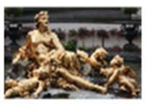
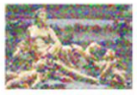
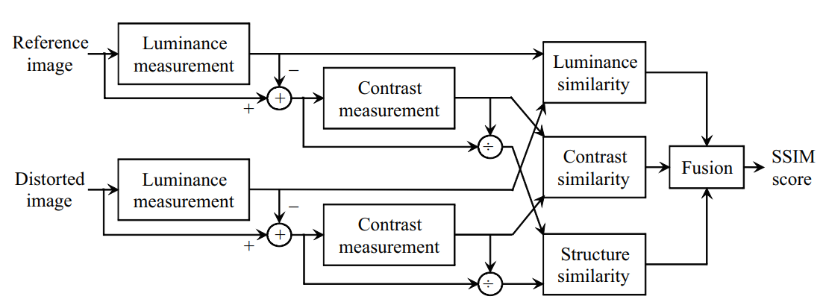
Background
Introduction
Some FR-IQA metrics:
MSE (Mean Square Error)
PSNR (Signal-to-noise ratio)
SSIM (Structural Similarity)
FR-IQA
Reference Image
Distorted Image
IQA
RR-IQA
Some Parameters
Distorted Image
NR-IQA
IQA: Image Quality Assessment
FR-IQA : Full Reference IQA
RR-IQA: Reduced-reference IQA
NR-IQA: No reference IQA
Distorted Image
Fig 5: Different types of IQA (Image Quality Assessment)
Fig 6: Framework of the FR SSIM index

Slide 6
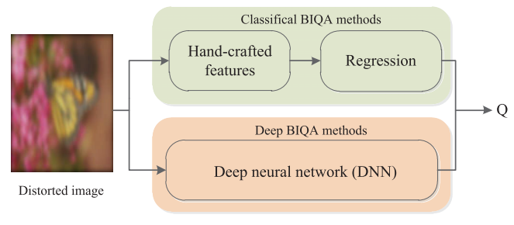
Problem Definition
Introduction
* No reference image available
NR-IQA
Distortion Specific
General Purpose
Specific distortion
Blocking, blurring
Limited Applications
Not limited to specific distortion
Depends on Extracted features
Synthetic Distortion
Authentic Distortion
Simulated from Lab. Exp
Real-life Distortions
Fig 7: Types of Blind IQA
Fig 8: Flowchart of BIQA methods
(I) Real-life image quality application deals with lack of ground truth labels and have authentic distortion which cannot be simulated in laboratory environments.

Slide 7
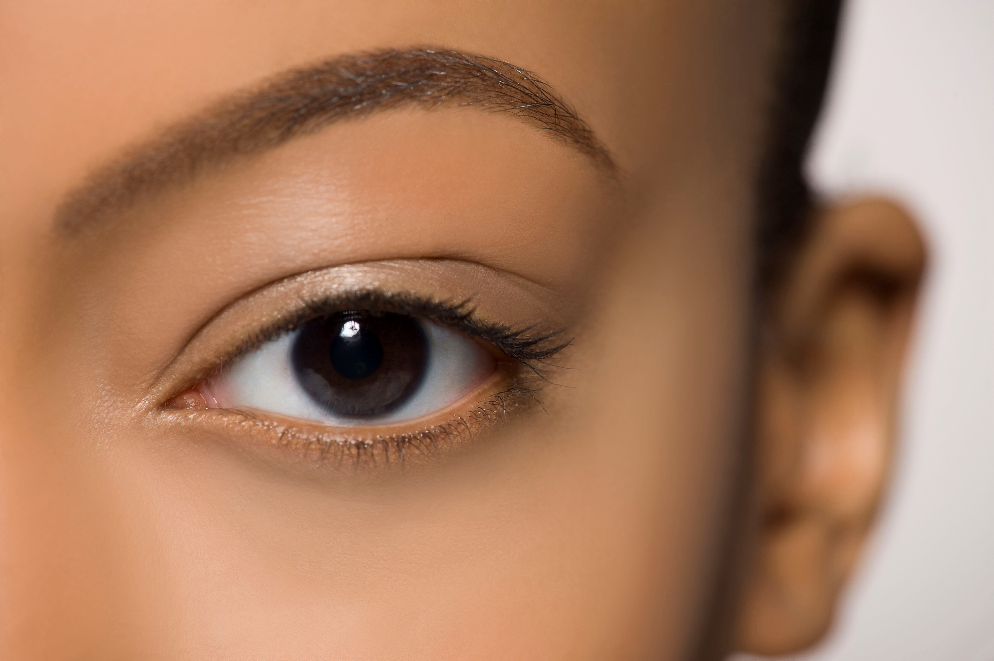
Comparing with Human Perception
Introduction
Label: Good Quality Image
Rich and realistic details
Human Eye
Label: Not Good Quality Image
Distinguish misalignment of degraded and pristine-quality image.
Image
Machine Eye
Restored Image
Fig 9: How human and machine see things differently.
(II) The images from visual devices after task like restoration, compression have noise artifacts which deviate a lot from prior-knowledge learned by network.

Slide 8
Hypothesis
Introduction
Reducing the influence of noise and irrelevant features from the distorted images can help in quality assessment.
Capturing both local and global dependencies in image features is important.
Better Assessment can be obtained by enhancing important features and suppressing irrelevant features.
Contextual information for different types of image and capturing long-range dependency helps to capture relative information helps in better performance.

Slide 9
2. Related Works

Slide 10
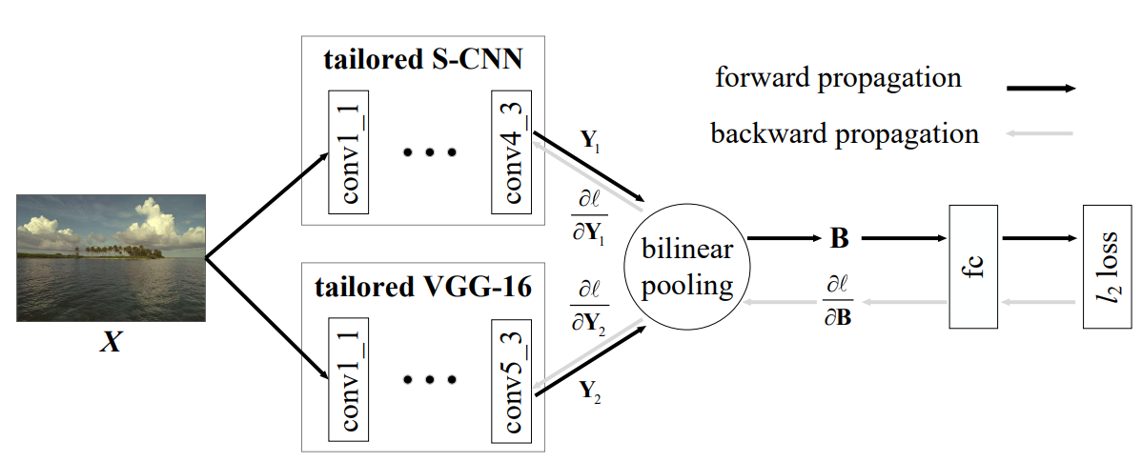
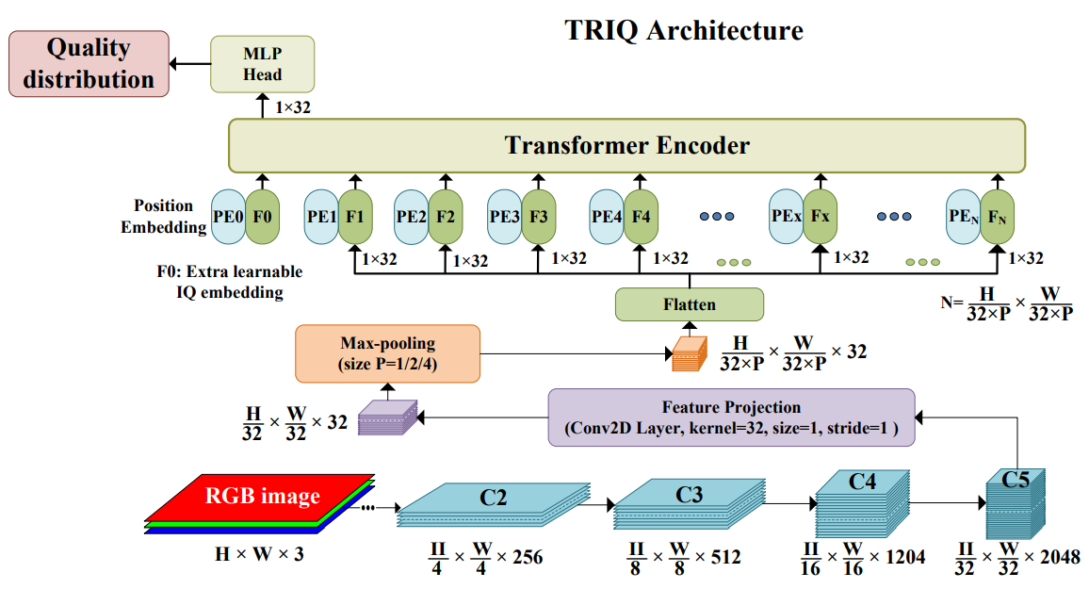
DBCNN
Related Works
TIQA
Fig 10: Overall Architecture of DBCNN [1]
Fig 11: Overall Architecture of TIQA [2]
Main Ideas:
Two CNN for two different distortion scenario:
Synthetic distortion
Authentic Distortion
Bilinearly Unified features
Main Ideas:
Feature map extracted by CNN.
Transformer Encoder on feature map.
Adaptive positional embedding employed.
[1] Weixia Zhang, Kede Ma, Jia Yan, Dexiang Deng, and Zhou Wang. Blind image quality assessment using a deep bilinear convolutional neural network. IEEE Transactions on Circuits and Systems for Video Technology, 2018.
[2] Junyong You and Jari Korhonen. Transformer for image quality assessment. In Proc. of ICIP, 2021.

Slide 11
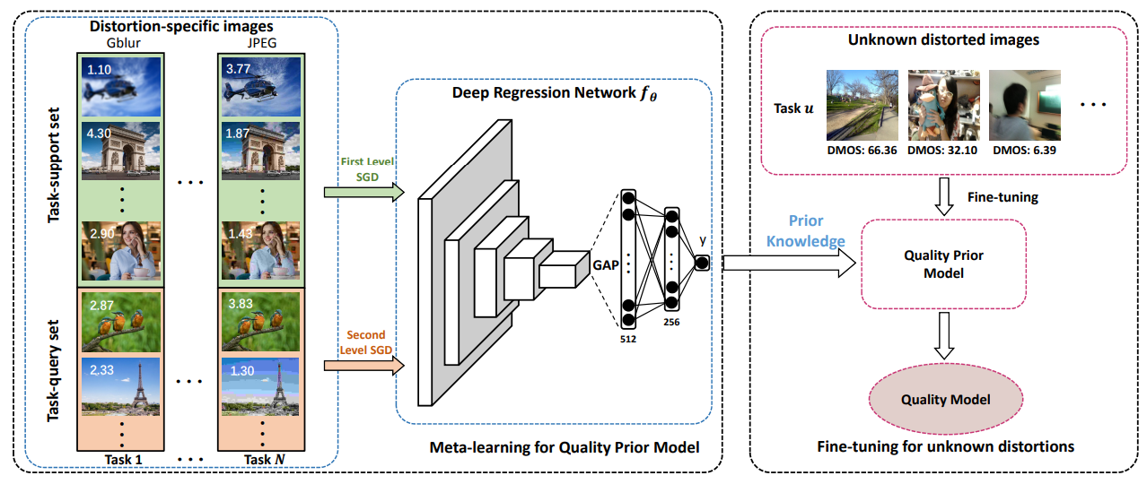
MetalIQA
Related Works
WaDIQaM
Fig 13: Overall Architecture of WaDIQaM [4]
Fig 12: Overall Architecture of MetalIQA [3]
Main Ideas:
Meta-Learning based network.
Learn prior knowledge shared by diverse distortions.
Generalized to authentic distortions.
Main Ideas:
CNN as feature extractor.
Estimate the weighted quality for each patch.
Regression along with pooling layer are used.
[3] Hancheng Zhu, Leida Li, Jinjian Wu, Weisheng Dong, and Guangming Shi. Metaiqa: Deep meta-learning for noreference image quality assessment. In Proc. of CVPR, 2020.
[4] Sebastian Bosse, Dominique Maniry, Klaus-Robert Muller, ¨ Thomas Wiegand, and Wojciech Samek. Deep neural networks for no-reference and full-reference image quality assessment. IEEE Transactions on Image Processing, 2017.

Slide 12
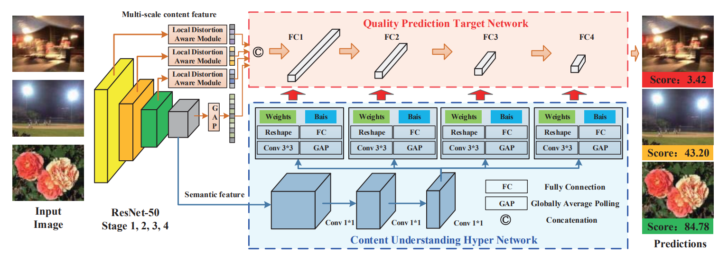
HyperIQA
Related Works
TRES
Fig 15: Overall Architecture of Tres [6]
Fig 14: Overall Architecture of HyperIQA [5]
Main Ideas:
Resnet used as feature extractor.
Hyper network: formulate quality perception rule relative to image content.
Main Ideas:
Resnet for feature Extractor
Self-attention module of Transformer Encoder Layer
Triplet Loss
[5] Shaolin Su, Qingsen Yan, Yu Zhu, Cheng Zhang, Xin Ge, Jinqiu Sun, and Yanning Zhang. Blindly assess image quality in the wild guided by a self-adaptive hyper network. In Proc. of CVPR, 2020.
[6] S Alireza Golestaneh, Saba Dadsetan, and Kris M Kitani. No-reference image quality assessment via transformers, relative ranking, and self-consistency. In Proceedings of the IEEE/CVF Winter Conference on Applications of Computer Vision, 2022.

Slide 13
3. Methodology

Slide 14
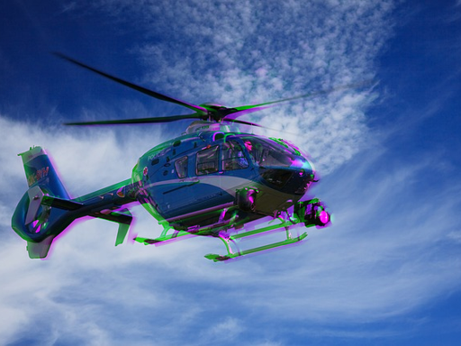
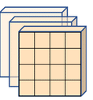
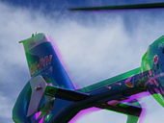
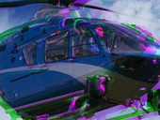
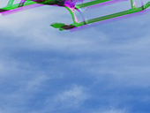
Overview of the Architecture
Methodology
Swin Transformer Block
Image
Pre-trained Vision Transformer (ViT) [Feature Extractor]
Attention Block
Weighted Quality Score
Score: 43.20
Fig 16 : Overall Structure of Proposed Architecture.

Slide 15
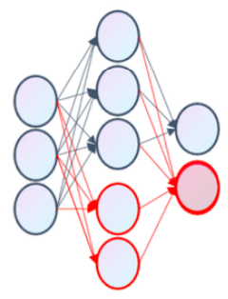
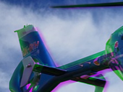
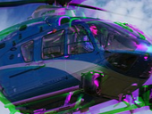
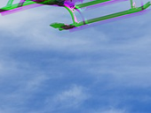
Detail Architecture
Methodology
Attention Map
transpose & reshape
Conv
Attention Block
Layer Feature Map Concat
L1
L2
L3
L4
SWIN
Position Embedding
Pretrained Vision Transformer (VIT)
Score: 43.20
Weighted Quality Score
Fig 17 : Detail Overview of Proposed Architecture.

Slide 16
Attention Block
Methodology
H*W*C
Q
3 × 3 Conv
X
1 × 1
K1
Transposed-Attention Map
Feature Map
C*H*W
K=K1+K2
Norm
Y
Softmax
C*C
C*H*W
K2
H*W*C
3 × 3 Conv
^
1 × 1
X
V
1 × 1
H*W*C
H*W*C
H*W*C
Fig 18 : Multi-Head Dual key Transpose Attention

Slide 17
Swin Block
Methodology
Scale
LN
W-MSA
LN
MLP
LN
SW-MSA
LN
MLP
Fig 19 : Scaled Swin Transformer Block

Slide 18
Contributions
Contributions
Propose a deep learning blind image quality assessment which predicts the quality of image without the reference image irrespective of distortion types.
Multi-Head transpose attention block along with dual key attention for capturing both local and global dependencies in image features.
Contextual information and long-dependencies with the help of Swin Transformer.
Achieve improvements in 4 different datasets relative to state of art models.

Slide 19
4. Experiments

Slide 20
Datasets
Experiments
LIVE [1] : Distorted data with different distortion types.
CSIQ [2]: Original data and six different types of distortions in each.
TID2013 [3]: Dataset of 3000 distorted images.
KADID-10K [4]: Data containing 81 pristine images, each degraded by 25 distortions in 5 levels.
[1]. Hamid R Sheikh, Muhammad F Sabir, and Alan C Bovik. A statistical evaluation of recent full reference image quality assessment algorithms. IEEE Transactions on Image Processing, 2006.
[2]. Eric Cooper Larson and Damon Michael Chandler. Most apparent distortion: full-reference image quality assessment and the role of strategy. Journal of electronic imaging, 2010.
[3]. Nikolay Ponomarenko, Lina Jin, Oleg Ieremeiev, Vladimir Lukin, Karen Egiazarian, Jaakko Astola, Benoit Vozel, Kacem Chehdi, Marco Carli, Federica Battisti, et al. Image database tid2013: Peculiarities, results and perspectives. Signal processing: Image communication, 2015.
[4]. Hanhe Lin, Vlad Hosu, and Dietmar Saupe. Kadid-10k: A large-scale artificially distorted iqa database. In 2019 Eleventh International Conference on Quality of Multimedia Experience, 2019.

Slide 21
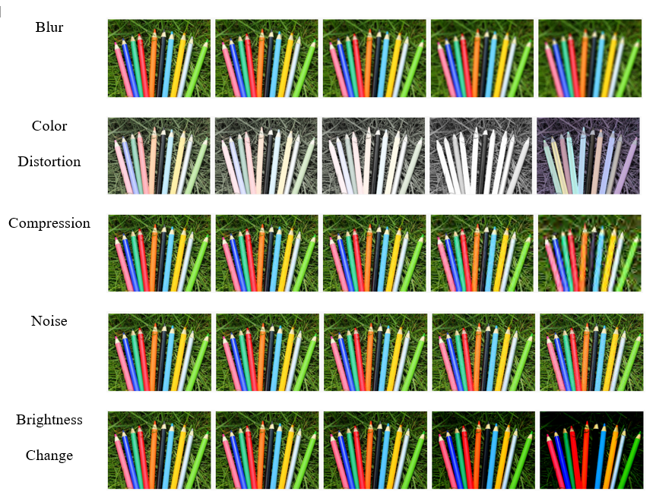
Experiments
Summary of IQA datasets
Table 1: Statistics for IQA datasets.
Dataset | Distorted Images | Types of Distortion
LIVE | 779 | 5
CSIQ | 866 | 6
TID2013 | 3,000 | 24
KADID-10K | 10,125 | 25
Fig 20 : Various types of distortions observed in KADID-10K dataset

Slide 22
PLCC (Pearson’s linear correlation coefficient) [1] $$PLCC=\frac{\sum_{i=1}^{N}{(s_{i}−μ_{s_{i}})({\hat{s}}_{i}−μ_{{\hat{s}}_{i}})}}{\sqrt{\sum_{i=1}^{N}{{(s_{i}−μ_{s_{i}})}^{2}}}\sqrt{\sum_{i=1}^{N}{{({\hat{s}}_{i}−μ_{{\hat{s}}_{i}})}^{2}}}}$$
Experiments
Evaluation Metrics
SROCC (Spearman’s rank order correlation coefficient ) [2]
$SROCC=1−\frac{6\sum_{i=1}^{N}{d_{i}^{2}}}{N(N^{2}−1)}$
$s_{i}$ : ground-truth score
${\hat{s}}_{i}$ : predicted quality score
$μ_{s_{i}}$ : mean of ground truth scores
$μ_{{\hat{s}}_{i}}$ : mean of predicted scores
N : no. of testing images
$d_{i}$ : difference in ground truth and predicted quality scores
[1] Cohen, I., Huang, Y., Chen, J., Benesty, J., Benesty, J., Chen, J., ... & Cohen, I. (2009). Pearson correlation coefficient. Noise reduction in speech processing, 1-4.
[2] Sheskin, D. J. (2007). Spearman’s rank-order correlation coefficient. Handbook of parametric and nonparametric statistical procedures, 1353.

Slide 23
Experiments
Results
Table 2 : Comparative analysis of proposed architecture versus state-of-the-art NR-IQA algorithms on four standard datasets.
 | LIVE |  | CSIQ |  | TID2013 |  | KADID-10K
 | PLCC | SROCC | PLCC | SROCC | PLCC | SROCC | PLCC | SROCC
DIIVINE [5] | 0.908 | 0.892 | 0.776 | 0.804 | 0.567 | 0.643 | 0.435 | 0.413
BRISQUE [6] | 0.944 | 0.929 | 0.748 | 0.812 | 0.571 | 0.626 | 0.567 | 0.528
ILNIQE [7] | 0.906 | 0.902 | 0.865 | 0.822 | 0.648 | 0.521 | 0.558 | 0.528
BIECON [8] | 0.961 | 0.958 | 0.823 | 0.815 | 0.762 | 0.717 | 0.648 | 0.623
MEON [9] | 0.955 | 0.951 | 0.864 | 0.852 | 0.824 | 0.808 | 0.691 | 0.604
WaDIQaM [10] | 0.955 | 0.960 | 0.844 | 0.852 | 0.855 | 0.835 | 0.752 | 0.739
DBCNN [11] | 0.971 | 0.968 | 0.959 | 0.946 | 0.865 | 0.816 | 0.856 | 0.851
TIQA [12] | 0.965 | 0.949 | 0.838 | 0.825 | 0.858 | 0.846 | 0.855 | 0.850
MetaIQA [13] | 0.959 | 0.960 | 0.908 | 0.899 | 0.868 | 0.856 | 0.775 | 0.762
P2P-BM [14] | 0.958 | 0.959 | 0.902 | 0.899 | 0.856 | 0.862 | 0.849 | 0.840
HyperIQA [15] | 0.966 | 0.962 | 0.942 | 0.923 | 0.858 | 0.840 | 0.845 | 0.852
TReS [16] | 0.968 | 0.969 | 0.942 | 0.922 | 0.883 | 0.863 | 0.858 | 0.915
Ours | 0.986 | 0.984 | 0.971 | 0.964 | 0.938 | 0.926 | 0.942 | 0.939

Slide 24
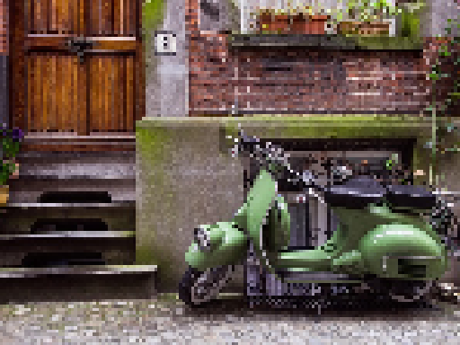
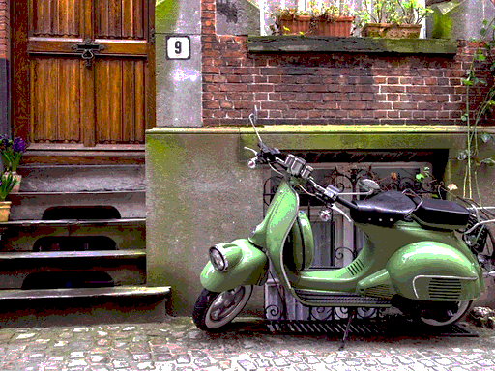
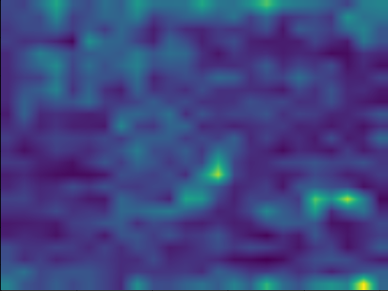
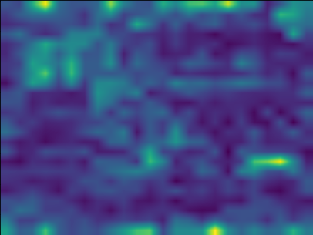
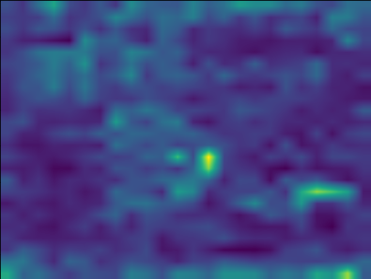
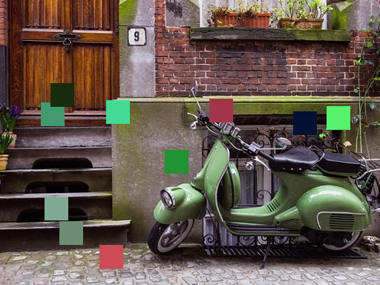
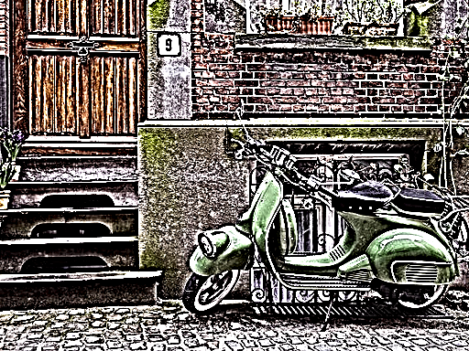
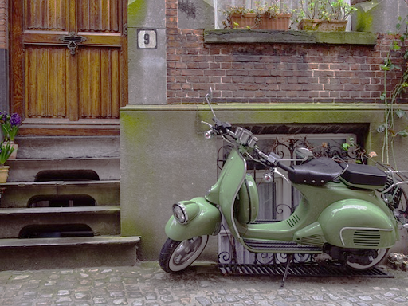
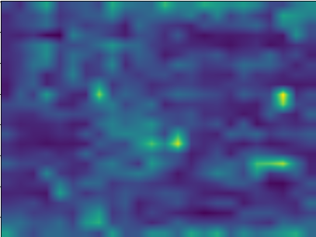
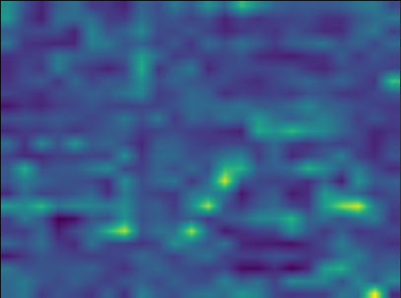
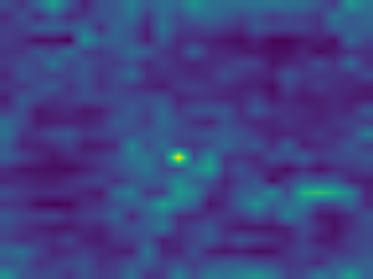
Experiments
Results
Distorted Images
Distorted Image
Attention Map
MOS: 1.33
Predicted: 0.69
MOS: 1.53
Predicted: 0.09
MOS: 1.9
Predicted: 0.61
Distorted Image
Original Image
Attention Map
MOS: 2.13
Predicted: 0.28
MOS: 1.37
Predicted: 0.04
MOS: 3.27
Predicted: 0.65
Fig 21 : Visualization of KADID-10K image

Slide 25
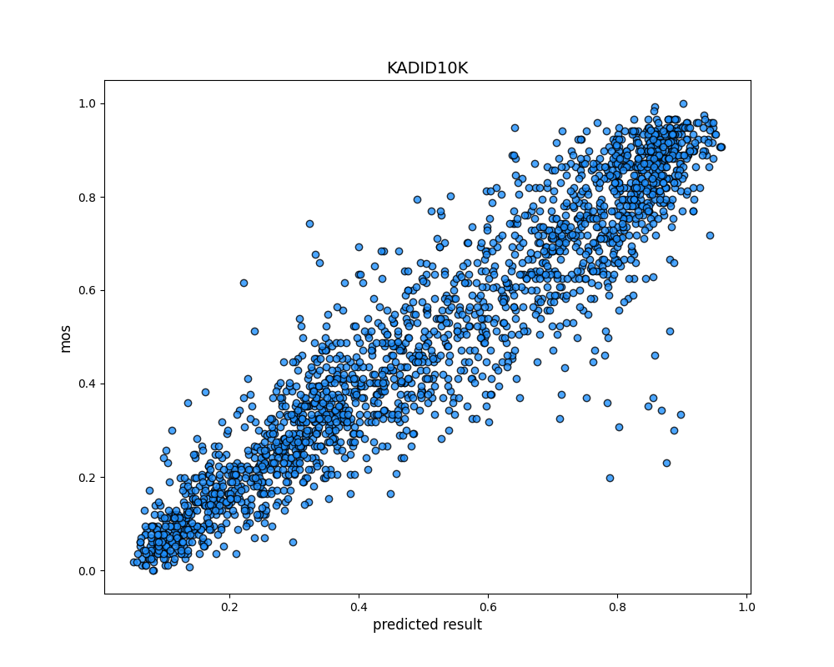
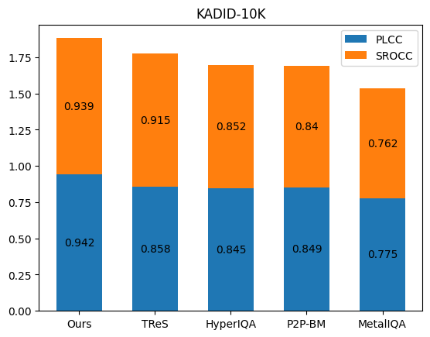
Experiments
Results
Fig 22 : Scatter Plot Visualization of MOS and predicted scores
Fig 23 : Performance Comparison

Slide 26
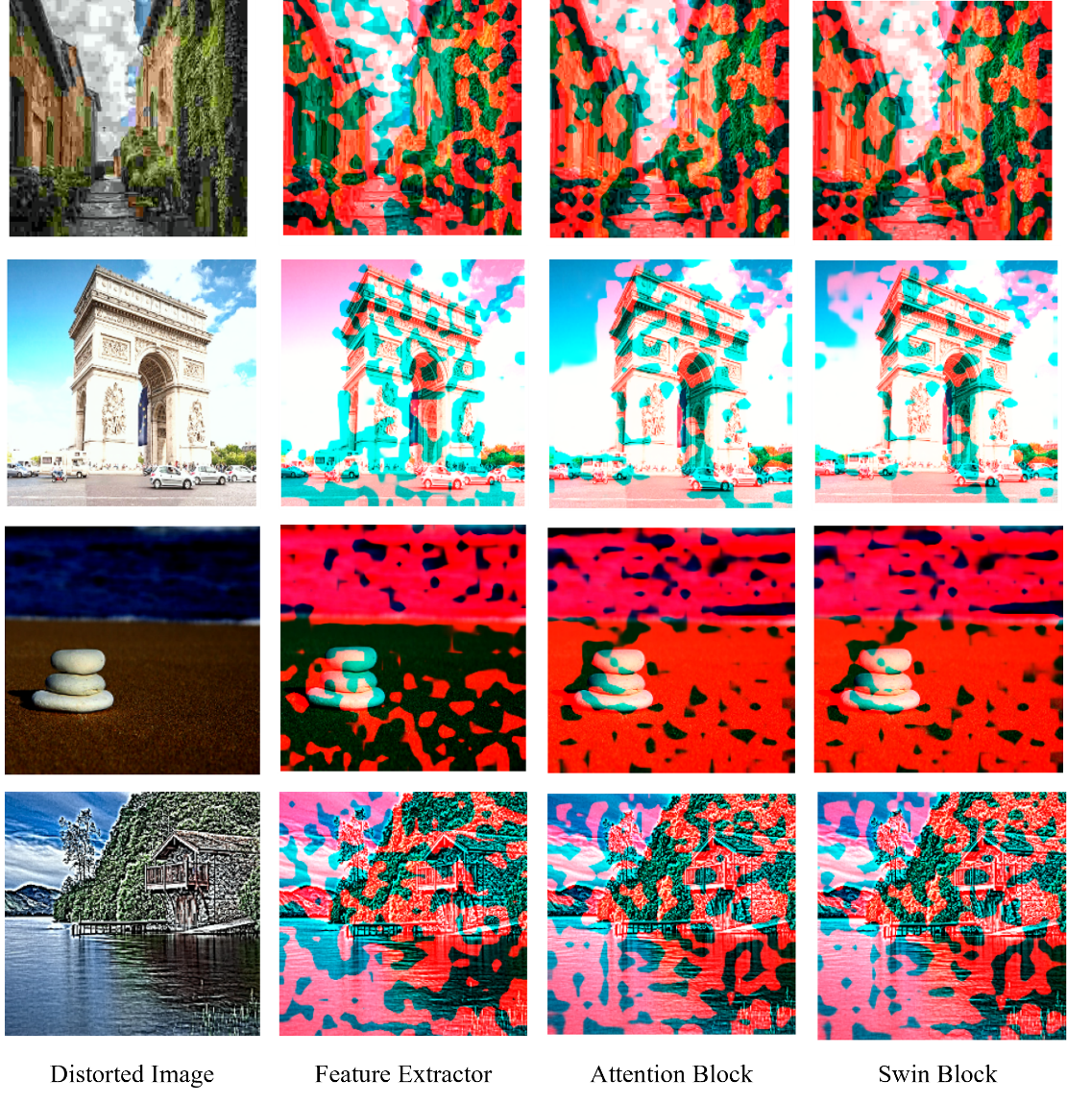
Experiments
Ablation Study
Table 3: Effect of employing different blocks
CSIQ
 | Attention Block | Swin Block | Weighted Block | PLCC | SROCC
1 |  |  |  | 0.854 | 0.802
2 | ✓ |  |  | 0.902 | 0.892
3 |  | ✓ |  | 0.894 | 0.874
4 | ✓ |  | ✓ | 0.934 | 0.903
5 |  | ✓ | ✓ | 0.922 | 0.892
6 | ✓ | ✓ | ✓ | 0.971 | 0.964
KADID-10K
 | Attention Block | Swin Block | Weighted Block | PLCC | SROCC
1 |  |  |  | 0.824 | 0.812
2 | ✓ |  |  | 0.882 | 0.864
3 |  | ✓ |  | 0.874 | 0.852
4 | ✓ |  | ✓ | 0.932 | 0.904
5 |  | ✓ | ✓ | 0.928 | 0.912
6 | ✓ | ✓ | ✓ | 0.942 | 0.939
Fig 24 : Visualization of different overlayed feature maps

Slide 27
Experiments
Ablation Study
Table 4: Performance accuracy obtained by employing various encoders
Backbone | Para | PLCC | SROCC
Resnet50 | 72.98 | 0.923 | 0.902
ViT-B/8 | 135.62 | 0.942 | 0.939
Swin-B/4-7 | 195.32 | 0.902 | 0.875
Table 6: Effects of scaling in Swin Transformer
Scale | PLCC | SROCC
0.1 | 0.942 | 0.939
0.2 | 0.940 | 0.938
0.4 | 0.939 | 0.936
0.8 | 0.938 | 0.935
1.0 | 0.936 | 0.932
Table 5: Impact of single/dual in Linear or multi-head convolution
 | Single Key | Dual Key | PLCC | SROCC
Linear | ✓ |  | 0.904 | 0.892
 |  | ✓ | 0.918 | 0.902
Convolution | ✓ |  | 0.934 | 0.928
 |  | ✓ | 0.942 | 0.939

Slide 28
5. Conclusion

Slide 29
Conclusion and Future Works
Experiments
To accurately measure the image quality without reference image :
Local and global attention should be captured in the image features.
Contextual and long dependency issue should be addressed.
Suggested ‘multi-head transpose attention block with dual key attention’ for better interaction in between spatial and channel features.
State-of-the-art results have been achieved.
Suggested blocks can be modified for other purpose.
Distortion types as in pleasing or unpleasing unreal texture is crucial and needs further progress.

Slide 30
References
https://www.lifewire.com/the-effect-of-compression-on-photographs-493726
https://www.dexterscamera.com/photo-restoration-1
https://engineering.nyu.edu/news/diagnostic-companies-triumph-stern-300k-entrepreneurs-challenge
https://icamsecurity.com.au/blogs/news/how-many-mp-does-your-cctv-camera-need
Michele A Saad, Alan C Bovik, and Christophe Charrier, “Blind image quality assessment: A natural scene statistics approach in the dct domain,” IEEE transactions on Image Processing, vol. 21, no. 8, pp. 3339–3352, 2012.
Anish Mittal, Anush Krishna Moorthy, and Alan Conrad Bovik, “No-reference image quality assessment in the spatial domain,” IEEE Transactions on image processing, vol. 21, no. 12, pp. 4695–4708, 2012.
Lin Zhang, Lei Zhang, and Alan C Bovik, “A feature-enriched completely blind image quality evaluator,” IEEE Transactions on Image Processing, vol. 24, no. 8, pp. 2579–2591, 2015.
Jongyoo Kim and Sanghoon Lee, “Fully deep blind image quality predictor,” IEEE Journal of selected topics in signal processing, vol. 11, no. 1, pp. 206–220, 2016.
Kede Ma, Wentao Liu, Kai Zhang, Zhengfang Duanmu, Zhou Wang, and Wangmeng Zuo, “End-to-end blind image quality assessment using deep neural networks,” IEEE Transactions on Image Processing, vol. 27, no. 3, pp. 1202–1213, 2017.
Sebastian Bosse, Dominique Maniry, Klaus-Robert M ̈uller, Thomas Wiegand, and Wojciech Samek, “Deep neural networks for no-reference and full-reference image quality assessment,” IEEE Transactions on image processing, vol. 27, no. 1, pp. 206–219, 2017.

Slide 31
References
Weixia Zhang, Kede Ma, Jia Yan, Dexiang Deng, and Zhou Wang, “Blind image quality assessment using a deep bilinear convolutional neural network,” IEEE Transactions on Circuits and Systems for Video Technology, vol. 30, no. 1, pp. 36–47, 2018.
Junyong You and Jari Korhonen, “Transformer for image quality assessment,” in 2021 IEEE international conference on image processing (ICIP). IEEE, 2021, pp. 1389–1393.
Hancheng Zhu, Leida Li, Jinjian Wu, Weisheng Dong, and Guangming Shi, “Metaiqa: Deep meta-learning for no-reference image quality assessment,” in Proceedings of the IEEE/CVF Conference on Computer Vision and Pattern Recognition, 2020, pp. 14143–14152.
Zhenqiang Ying, Haoran Niu, Praful Gupta, Dhruv Mahajan, Deepti Ghadiyaram, and Alan Bovik, “From patches to pictures (paq-2-piq): Mapping the perceptual space of picture quality,” in Proceedings of the IEEE/CVF Conference on Computer Vision and Pattern Recognition, 2020, pp. 3575–3585.
Shaolin Su, Qingsen Yan, Yu Zhu, Cheng Zhang, Xin Ge, Jinqiu Sun, and Yanning Zhang, “Blindly assess image quality in the wild guided by a self-adaptive hyper network,” in Proceedings of the IEEE/CVF Conference on Computer Vision and Pattern Recognition, 2020, pp. 3667–3676.
S Alireza Golestaneh, Saba Dadsetan, and Kris M Kitani, “No-reference image quality assessment via transformers, relative ranking, and self-consistency,” in Proceedings of the IEEE/CVF Winter Conference on Applications of Computer Vision, 2022, pp. 1220–1230.
Hamid R Sheikh, Muhammad F Sabir, and Alan C Bovik. A statistical evaluation of recent full reference image quality assessment algorithms. IEEE Transactions on Image Processing, 2006.

Slide 32
References
Eric Cooper Larson and Damon Michael Chandler. Most apparent distortion: full-reference image quality assessment and the role of strategy. Journal of electronic imaging, 2010.
Nikolay Ponomarenko, Lina Jin, Oleg Ieremeiev, Vladimir Lukin, Karen Egiazarian, Jaakko Astola, Benoit Vozel, Kacem Chehdi, Marco Carli, Federica Battisti, et al. Image database tid2013: Peculiarities, results and perspectives. Signal processing: Image communication, 2015.
Hanhe Lin, Vlad Hosu, and Dietmar Saupe. Kadid-10k: A large-scale artificially distorted iqa database. In 2019 Eleventh International Conference on Quality of Multimedia Experience, 2019.
Cohen, I., Huang, Y., Chen, J., Benesty, J., Benesty, J., Chen, J., ... & Cohen, I. (2009). Pearson correlation coefficient. Noise reduction in speech processing, 1-4.
Sheskin, D. J. (2007). Spearman’s rank-order correlation coefficient. Handbook of parametric and nonparametric statistical procedures, 1353.

Slide 33
Thank You!

