Slide 1
ECG Research
Ziyang
gongzy0123@163.com
04/26

Slide 2
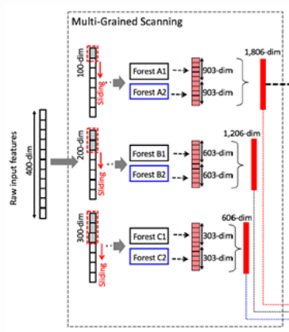
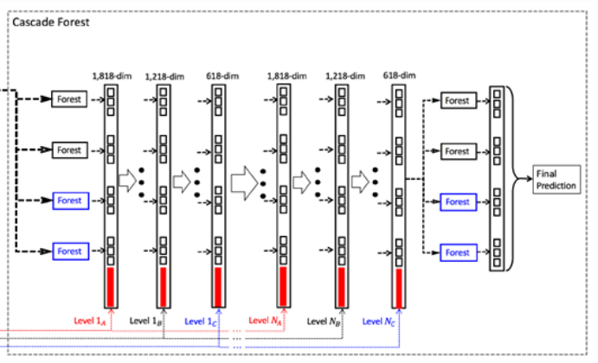
GcForest(multi-Grained Cascade Forest): A Decision Tree Ensemble Method
The design of gcForest comes from DNN and ensemble learning:
# From DNN -> Multi-Grained Scanning：
Layer-by-layer processing
in-model feature transformation
sufficient model complexity
# From ensemble learning -> Cascade Forest：
data sample
input features
learning parameters
Output Representation
Enhanced Diversity

Slide 3
Gcforest combined with ECG:
# advantage:
The ECG signal is a time series, and the sliding window is used to ensure its sequence information and improve the effectiveness of feature extraction. At the same time, two methods of complete random forest and random forest are adopted to ensure the richness and effectiveness of features.
# disadvantage:
very few references
[1] Xiong, Peng, et al. "Multi-grained cascade forest model for automatic CAD characterization on ECG segments." Displays 70 (2021): 102070.
The model is not complex enough

Slide 4
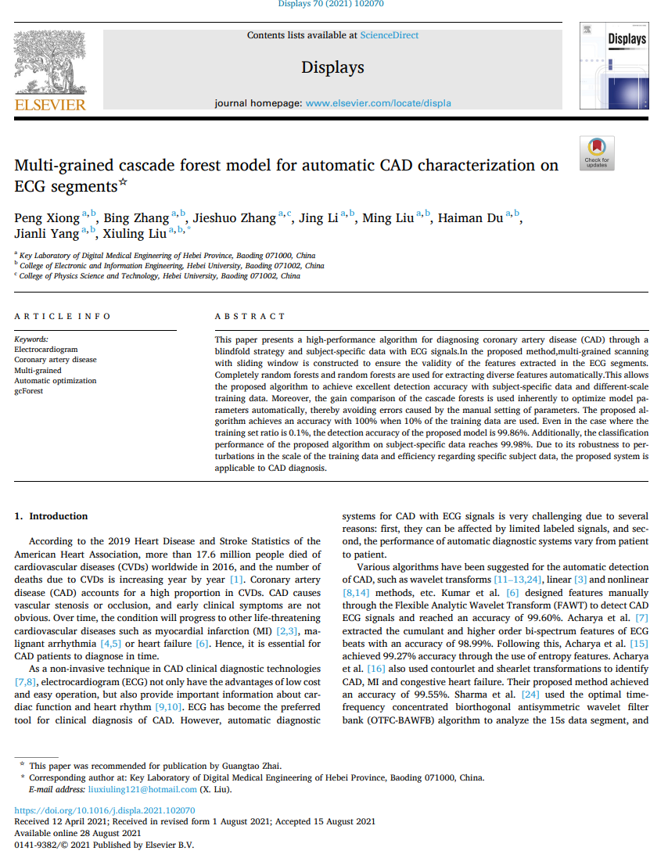
Related:
# Paper: Multi-grained cascade forest model for automatic CAD characterization on ECG segments
# Journal: displays
# From: Key Laboratory of Digital Medical Engineering of Hebei Province, China
# The classification performance about CAD:
# paper references [1]
Technique | Data | Task | Input | Special | Acc(%)
gcforest | Fantasia database the St Petersburg Institute of Cardiology Technics 12- lead arrhythmia database | coronary heart disease (abnormal heart rhythm) | signal | no peak detection good robustness | 99.98

Slide 5
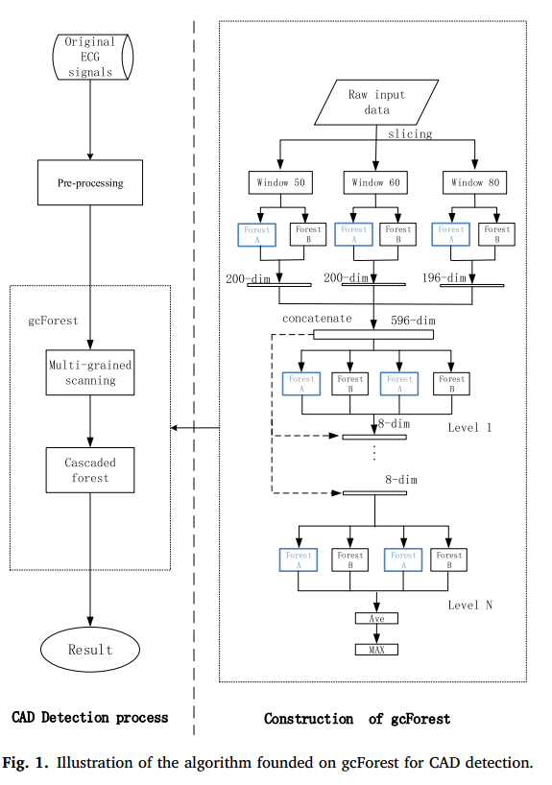
# paper references [1]
CAD automatic detection model:
# Construction of multi-grained scanning:
In order to realize the automatic extraction of effective features and improve the robustness of the algorithm to the amount of training data, a sliding window is used to perform multi-grained scanning on the input data.
# Construction of cascade forests:
In order to reduce the impact of data segments with insignificant features in the intercepted ECG signals on the diagnosis results, and further improve the effectiveness of the features, this algorithm employs cascade forests to classify the features that were automatically obtained from the multi-grained scanning part.

Slide 6
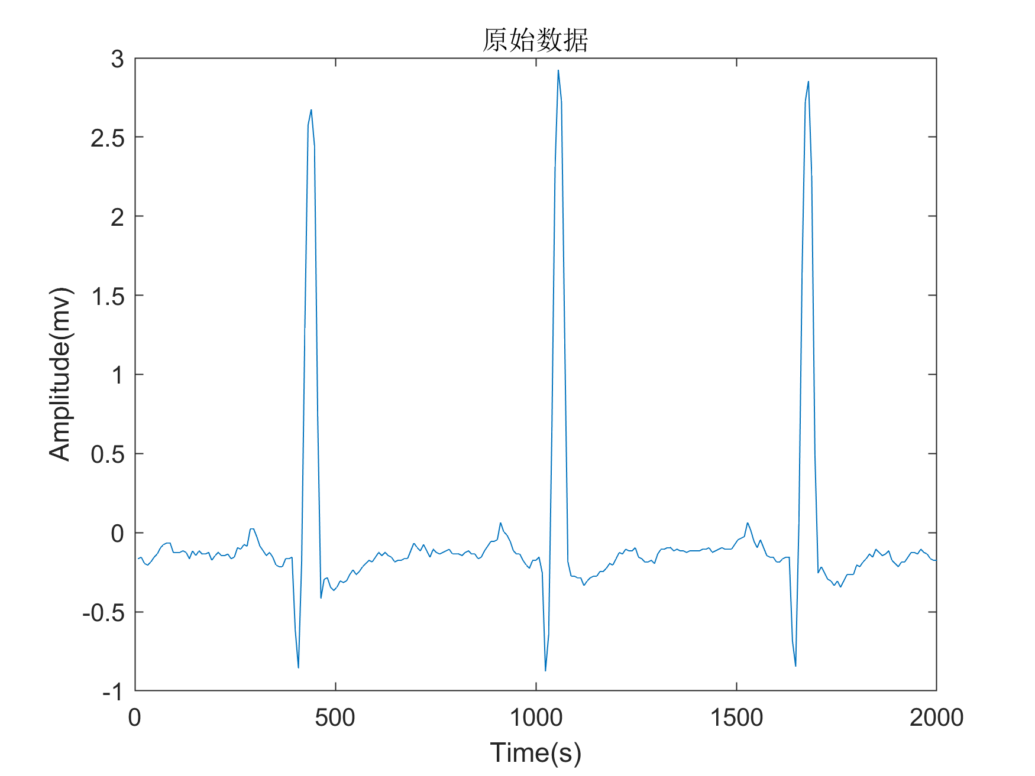
data preprocessing
Now my research:
# data preprocessing
wavelet transform
median filter
# heartbeat segmentation
fiducial-based segmentation
non-fiducial-based segmentation
non-fiducial-based segmentation
& 50%overlap
# gcforest model testing
Wavelet denoising
Removing the baseline migration
heartbeat segmentation
fiducial-based segmentation | R point detection, 100 left, 150 right
non-fiducial-based segmentation | 1s data
 | 2s data
 | 3s data
non-fiducial-based segmentation + 50%overlap | 1s data +overlap 50%
 | 2s data +overlap 50%
 | 3s data +overlap 50%

Slide 7
Gcforest model testing result：
model | database | input | process |  |  | identity accuracy
gcforest | MIT-BIH | signal | denoise | fiducial-based segmentation | fiducial-based segmentation | 0.9342
 |  |  |  | non-fiducial-based segmentation | 1s data | 0.9574
 |  |  |  |  | 2s data | 0.9710
 |  |  |  |  | 3s data | 0.9545
 |  |  |  | non-fiducial-based segmentation + 50%overlap | 1s data +overlap 50% | 0.9496
 |  |  |  |  | 2s data +overlap 50% | 0.9562
 |  |  |  |  | 3s data +overlap 50% | 0.9425

Slide 8
Next :
#Try another dataset to test the accuracy
ECG-ID
#Compare with other models
BiLSTM

